Slide 1
Alaska Forest Resources & Practices act (frpa)
OVERVIEW

Slide 2
FRPA Focus
FRPA (AS 41.17)
Governs how commercial timber harvesting, reforestation, and timber access occur on state, private, and municipal land.
Establishes the Division of Forestry and Board of Forestry
Establishes the State Forest system

Slide 3
Board of Forestry
Representatives
Commercial fishing
Environmental
Mining
Recreation
ANCSA corporation,
Forest industry
Professional forester
Professional fish/wildlife biologist.
Alaska State Forester
Responsibilities:
Provide input on FRPA regulations
Provide a forum to discuss and resolve forest practices issues and forest management issues
Survey research needs and promote needed research
Coordinate FRPA compliance and effectiveness monitoring
Report to the Governor on FRPA effectiveness and needs after reviewing annual reports from DNR, DEC, and ADF&G;
Identify candidates for state forester
Notes:
The State Forester is the non-voting chair of the board
Staff support: DNR Division of Forestry;
DEC Division of Water and ADF&G Division of Habitat provide technical staffing and information as needed.

Slide 4
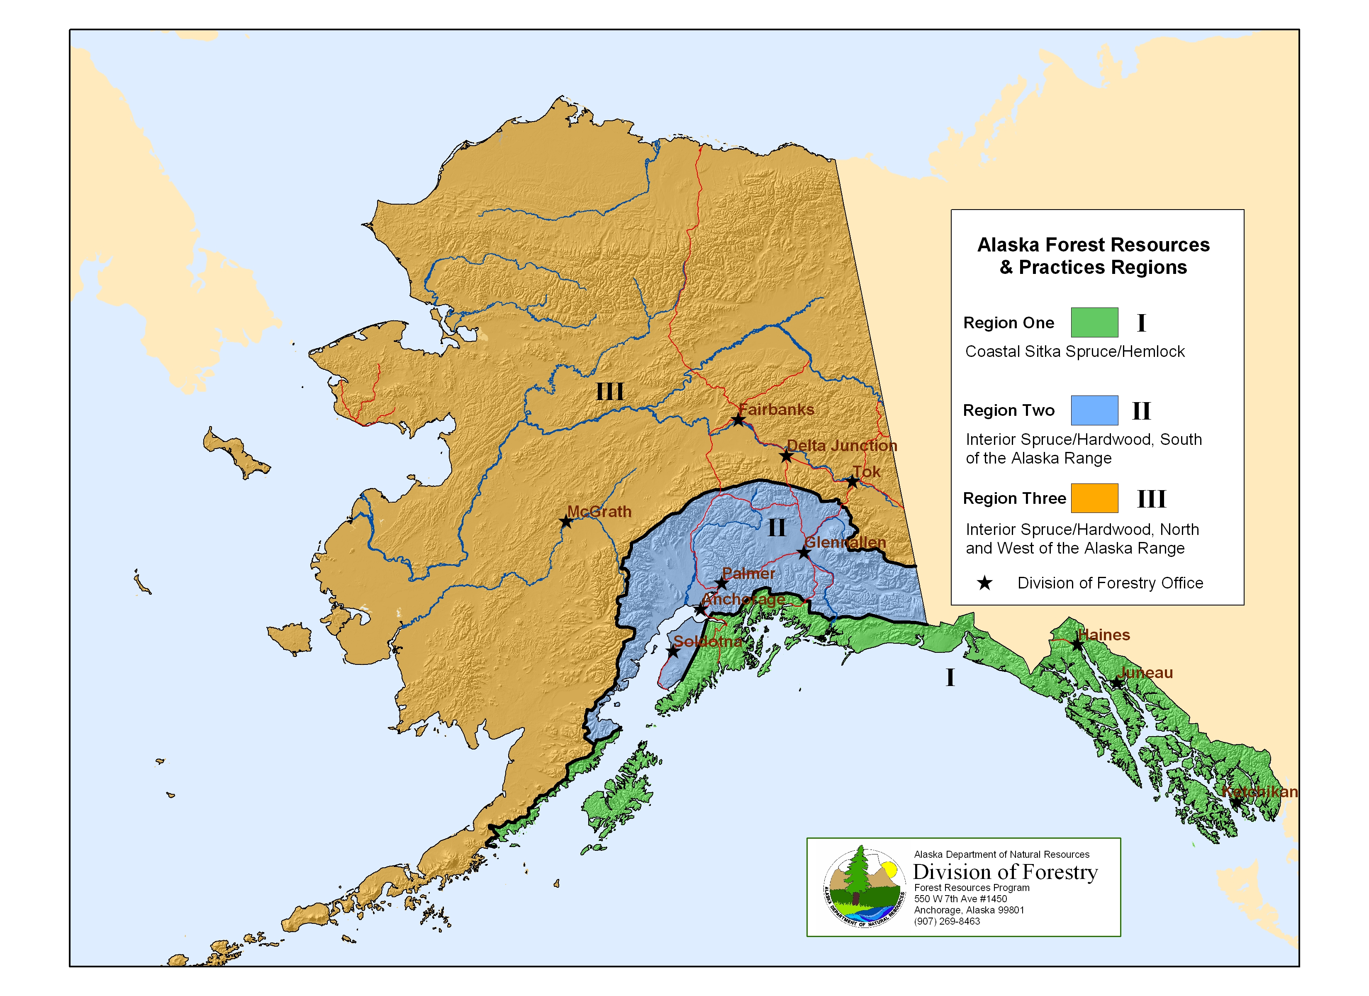
Regions
BMPs are tailored to the forest types, climate, and topography of each region
Notes:
Region I = coastal forest, Sitka spruce/hemlock dominated
Region II = boreal forest, white spruce/black spruce/birch/cottonwood/aspen south of the Alaska Range
Region III = boreal forest, white spruce/black spruce/birch/cottonwood/aspen north of the Alaska Range

Slide 5
Applicability
Commercial forest operations
Region I: >10 acres
Region II: >40 acres
Region III: >40 acres for forest landowners that own more than 160 acres in total.
All commercial harvest operations that encompass or border surface waters or a riparian area, regardless of size.
Notes:
FRPA does not apply to Native allotments
Except for the DPO, FRPA does not apply if a landowner notifies DOF of their intent to convert forest land to another use after harvest. Notification is required.
No DPO is required for platted land or land with a building permit.
Failure to convert on land that doesn’t have a plat approval or building permit within 5 years triggers the requirement for reforestation.

Slide 6
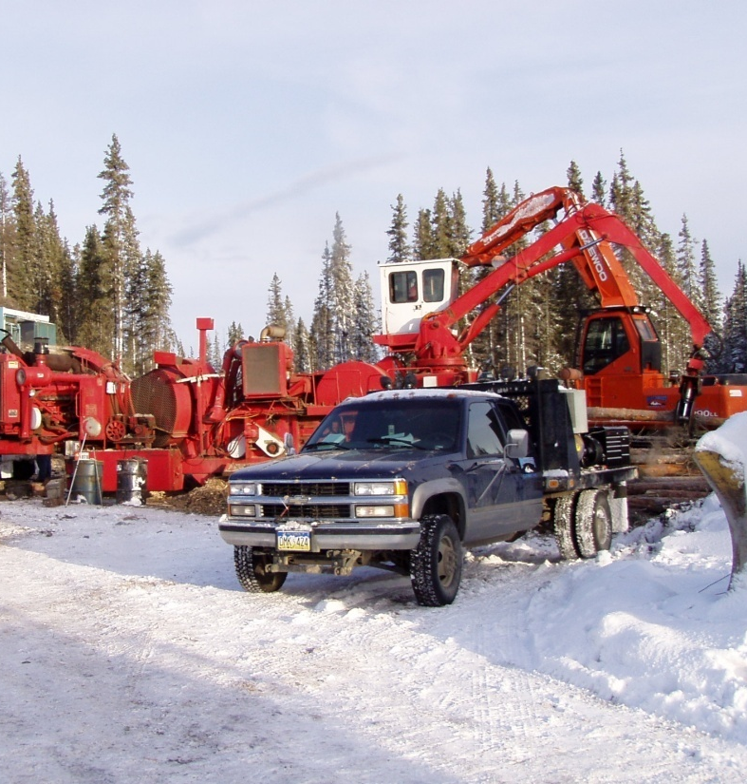
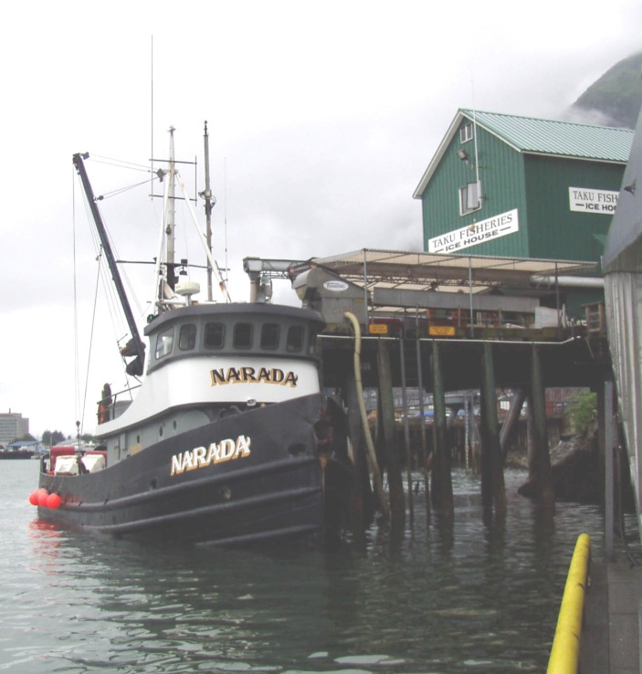
Intent
Balance economic concerns for the timber industry with water quality and habitat protection needs.
Protect fish habitat and water quality
Ensure prompt reforestation
Support economic activities derived from forest resources
Provide certainty and credibility for landowners, operators, and the public.

Slide 7
History
Adopted 1978.
Revised 1990 to
Address riparian management on private land,
Enhance notification procedures for timber operations,
Reorganize the Board of Forestry, and
Establish enforcement procedures.
Amended to
Update stream classification system,
Update riparian management standards, and
Establish state forest system.
Notes:
Amendments:
Stream classification and riparian management standard updates for Region I (1999), Region III (2003), and Region II (2006)
State Forest system established (1983); Tanana Valley State Forest established (1983) and expanded (2008)
Southeast State Forest established (2010) and expanded (2011)

Slide 8
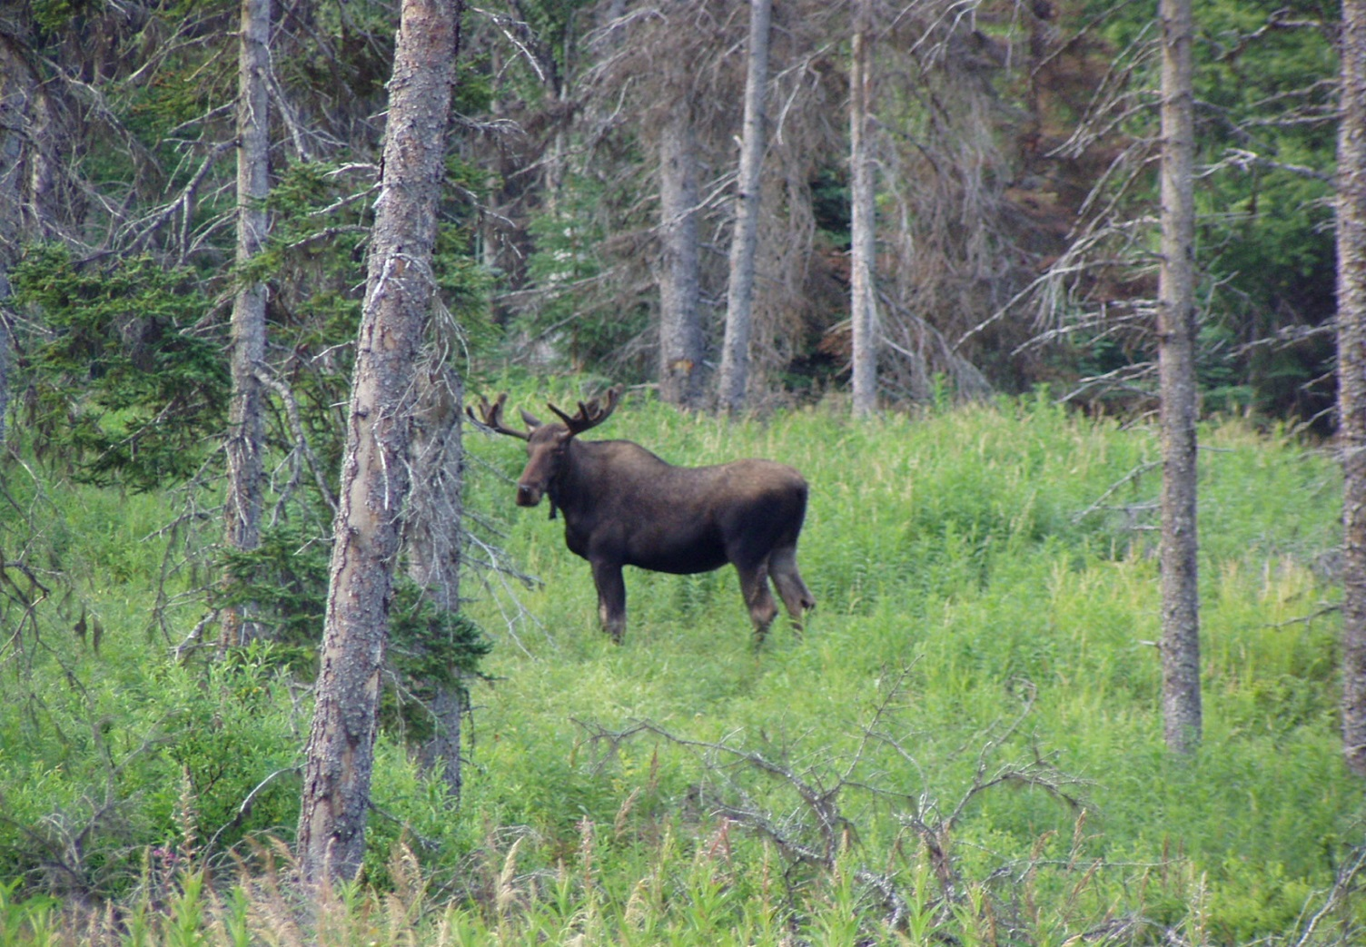
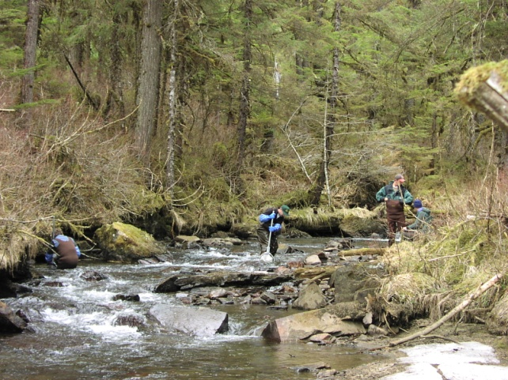
Key provisions – Coordination
1-stop shopping for forest operation compliance with state and federal clean water standards.
DNR is the lead agency for FRPA implementation
DNR must give due deference to DEC for water quality decisions. DOF must give due deference to ADF&G for fish habitat issues on private land, and for fish and wildlife habitat on public land.
Notes:
Due deference is that deference that is appropriate in the context of the agency’s area of expertise, area of responsibility, all the evidence available to support a factual assertion.

Slide 9
Key provisions - DPOs
Detailed Plan of Operations required prior to operations on non-state land.
DNR, DEC, and ADF&G review DPOs for consistency with FRPA and its regulations
Agencies can require site inspection and check stream classification
This is not a permit process; timber operations can proceed if the agencies do not respond within the set time frame.
Notes:
30 day review period
On state land, Forest Land Use Plans (FLUPs) include the same information required in DPOs

Slide 10
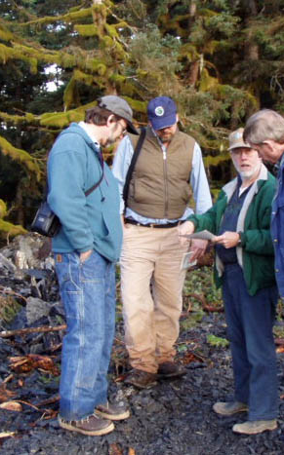
Key provisions – Inspections
DNR may inspect and forest land and activities in conjunction to ensure compliance with FRPA and its regulations.
DEC & ADF&G have the same authority to enforce their own laws and regulations on forest land.
DNR, DEC, and ADF&G coordinate inspections.
Inspections are routinely conducted, and may occur before, during, and after operations.
Compliance monitoring score sheets are part of inspections.
Notes:
From 208-2017, DOF conducted between 142 and 278 FRPA inspections each year, depending on levels of activity, risk of adverse effects, and available staffing
ADF&G accompanies DOF on many inspections, and sometimes conducts stream classification inspections on their own.
DEC will participate in inspections on request when there are specific water quality concerns.

Slide 11
Key provisions – Riparian areas
No-cut buffers on all anadromous waters
Partial harvest areas
Provision for variations to harvest valuable trees within buffers when it can be done without harming fish habitat or water quality; subject to agency approval.
Special management zones
Slope stability standards
Best management practices
Notes:
Partial harvest on Type I-C and I-D tributaries to anadromous waters

Slide 12
Riparian areas are protected from significant adverse effects of commercial timber harvest activities on all land ownerships. Buffers and special management zones vary by landowner, with the most stringent standards on state land.
Notes:
Buffers are wider on state and other public land in Regions I and III.
Special management zones apply to state land in Regions I and II for fish & wildlife habitat; and to state and other public land in Region II for stream temperature

Slide 13
Key provisions – Reforestation
Prompt reforestation unless the land will be converted to another use
Exemption for harvest areas significantly composed of dead or dying trees
Design forest operations to reduce likelihood of forest insect infestations or disease infections; DOF may act to address problems on forest land.
Notes:
Reforestation required within 5 years in Region I; 7 years in Region II-III unless extended in areas where natural regeneration is likely to succeed
Exemptions for dead & dying trees are subject to agency approval

Slide 14
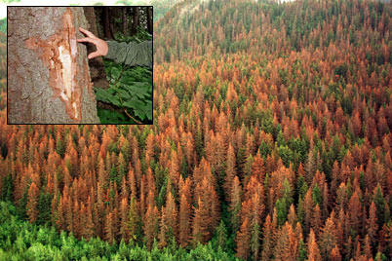
Key provisions – Forest health
Design forest operations to reduce likelihood of forest insect infestations or disease infections
DOF may act to address problems on forest land.

Slide 15
Key provisions – Enforcement
DOF has authority to enforce the Act through
directives,
Notices of violation,
stop work orders, and
civil fines.
Notes:
Since 1991: 52 directives, 38 Notices of Violation, 8 stop work orders and prosecuted one criminal case that resulted in a fine and jail time for intentional cutting in a buffer.
DOF has assessed 30 fines totaling over $155,000 ($26,000 suspended).

Slide 16
Regulations (11 AAC 95)
Adopted 1981.
Amended to
Implement the Act revisions (1993, 1999, 2004, 2007)
Strengthen mass wasting prevention (2013)
Update reforestation standards (2017)
Alaska’s best management practices (BMPs) are regulatory
Notes:
Alaska is one of 13 states to have their BMPs in regulation – we have a strong forest practices act
First regulations 1981; major revision to implement the revised Act 1993; revised following stream classification and riparian standard updates (Region I 1993), (Region III 2004), (Region II 2007)
Mass wasting amendments 2013

Slide 17
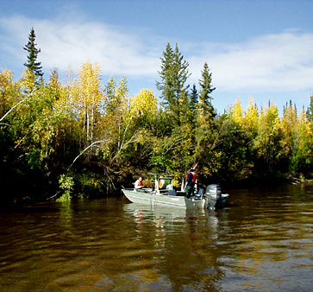
BMPs
Waterbody classification
Based on
region
stream characteristics
fish species
landowner
Notes:
Examples:
Width, gradient, and substrate
Anadromous v. high-value resident v. non-fish
Glacial v. clearwater
Incised v. non-bedrock controlled

Slide 18
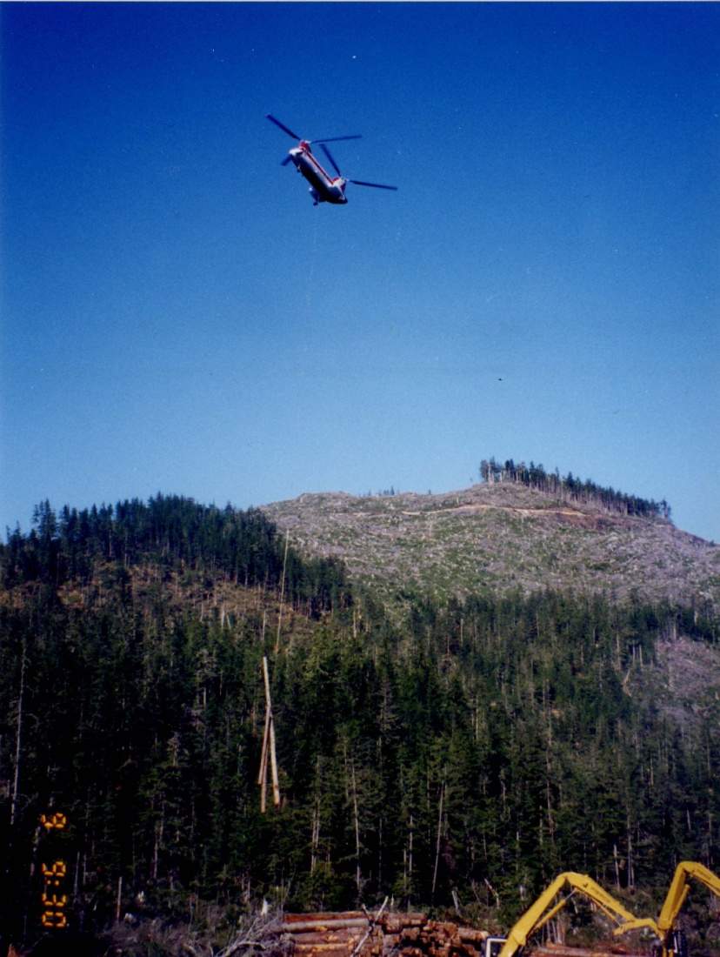
BMPs
Timber harvesting
Unit design
Yarding
Slash management
Mass wasting prevention

Slide 19
BMPs
Roads
construction,
maintenance, and
closure
Bridges and culverts
Winter roads

Slide 20
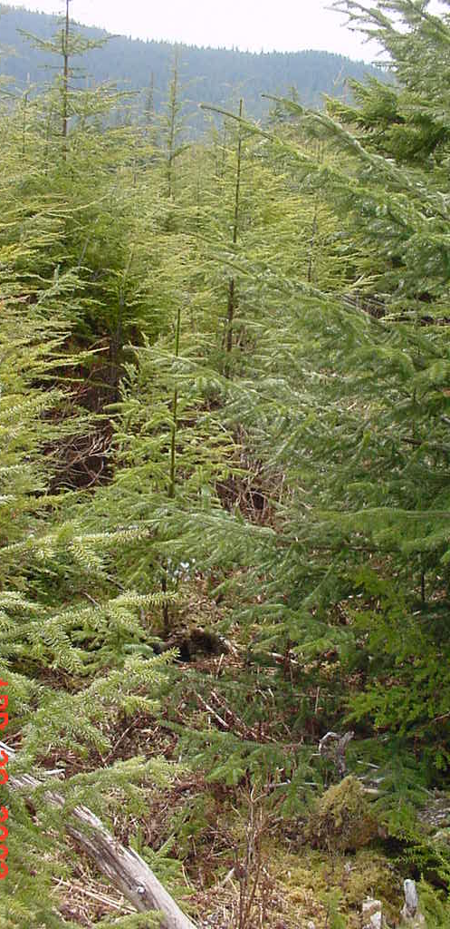
BMPs
Reforestation
Site preparation
Invasive species
Insect infestation and disease prevention

Slide 21
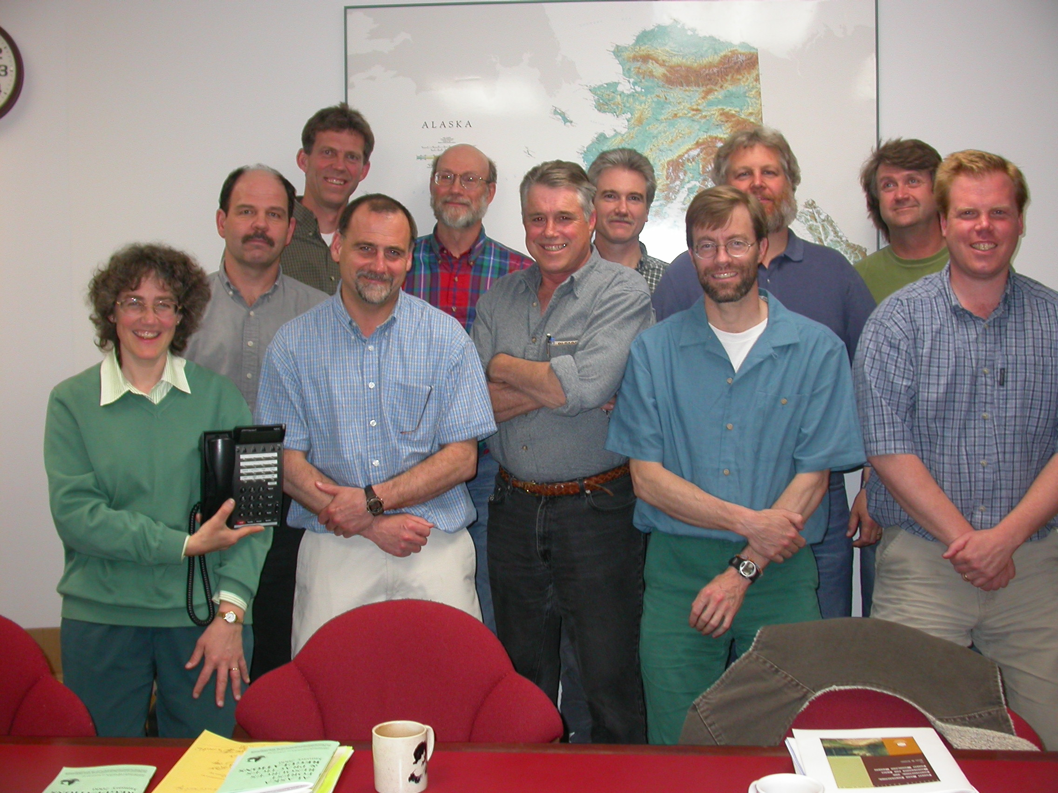
How is FRPA updated?
Region II Riparian Standards Science & Technical Committee

Slide 22
Issue raised by agency or public
Science & Tech Committee
Compile & synthesize info
Review standards
Recommend changes
ID research needs
BOF charge
Implementation Group
Review recommendations
Advise on practical implementation and consider economics
Draft statute/regulation changes
Prioritize research needs
BOF review
BOF review
Implementation actions
Notes:
All meetings are public; public mailing list for all minutes and recommendations; BOF meetings are public hearings

Slide 23
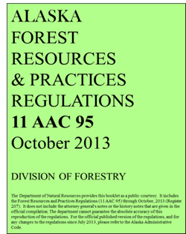
Implementation actions
Statutory amendments
Regulatory amendments
Implementation fieldbook
DPOs and Forest Land Use Plans
Training
Research
Monitoring
ALASKA
FOREST RESOURCES
& PRACTICES
ACT: AS 41.17
Reprinted May, 2013
DIVISION OF FORESTRY
DEPARTMENT OF NATURAL RESOURCES
Please note:
This booklet is a work in progress. If you have any questions about sections in the booklet, please contact rick rogers, division of forestry:
Phone: 907-269-8473; email: r Rick will find answers to your questions, and keep a list of edits and clarifications that need to made in the future. By contacting him with questions, future revisions will make this booklet a more useful document. Thanks!!
Implementing
Best Management Practices
for Timber Harvest
Operations
June 2011
DIVISION OF FORESTRY
DEPARTMENT OF NATURAL RESOURCES
Please note:
This booklet is a work in progress. If you have any questions about sections in the booklet, please contact rick rogers, division of forestry:
Phone: 907-269-8473; email: r Rick will find answers to your questions, and keep a list of edits and clarifications that need to made in the future. By contacting him with questions, future revisions will make this booklet a more useful document. Thanks!!
STATE OF ALASKA
DEPARTMENT OF NATURAL RESOURCES
DIVISION OF FORESTRY
NOTICE OF OPERATIONS
DETAILED PLAN OF OPERATIONS SUMMARY
xxxxxxxxxxxx_______________________________________________________________________________________________________________
Mmmmmmm______________________________________________________________________________________________________________________________________________________________________________
XXXXXXXXXXX_______________________________________________ xxxxxx_______________________________________________________bbbbbbbb___________________________________________________________________________________________________________________qqqqqqqqqqqqqqq____________________________________________________________________________________________________________wwwww_______________________________________________________________________________________________________________________________________________________________________________________________________________________________________________
State of Alaska
Department of Natural Resources
Division of Forestry
Region III – Delta
Forest Land Use Plan
Mississippi Fire Salvage #1
NC-1510-D
February 24, 2014

