Slide 1
Political Preview Election Implications & Legislative Forecast
Leadership Summit
November 15, 2018
Miles Baker
Assoc VP, Government Relations

Slide 2
Year Around Advocacy
Legislative session demands a more focused and coordinated engagement
Public Interests
Opportunities to influence the public agenda exist 365 days/year
Public Policy Agenda
Peers
Legislature
Business Owners
Elders
Military
UA Legislative Agenda
Communities of Interest
Outreach & Communications
BOR
Students
Parents
SW
Citizens
Directors
Staff
Faculty
Spheres of Influence
UAF
UAA
UAS
Alumni
Regents
Community Leaders
University Affiliated Interests
Labor

Slide 3
National Election Results
Huge voter turnout; 49% of voting eligible population
3 states had double-digit % increases compared to prior 10 mid-term average (1982-2014)
Alaska - 41% with 237,000 of 572,000 registered Alaskans voting
Split verdict – House & Senate swung away from each other; unusual for a midterm cycle
Democrats likely up 38 seats in House, 6 still undecided
Republican 1 seat net gain in Senate (Florida & Mississippi remain)
Many new faces - nearly quarter of Congress leaving
104 House members won’t return in January
Younger, more diverse, and more female
Historic year for women – 256 candidates; 114 won (45%)
Largest incoming class of women ever

Slide 4
National Takeaways
Rough 2 years of divided government ahead…..
……polarization likely to increase, making collaboration and compromise more difficult…..
Senate
More conservative bias
McConnell to be longest-serving Republic Leader
Schumer remains top Democrat
Senate: negotiator role between Democrat House and White House
House
Democrats 52% majority
Narrow margin = work challenges
Pelosi likely Speaker, no credible alternative
Resolution to University's Land Grant Deficit more uncertain

Slide 5
Alaska Statewide Results
Congressman Young reelected to 24th term - longest-serving member of Congress
9 points over challenger Alyse Galvin
Senator Murkowski moves to 9th in seniority in the Senate Majority
Mike Dunleavy Governor-Elect
8 points over Begich (52% to 44%)
Governor Walker pulled ~ 2% not enough to make a difference
Dunleavy campaign platform
Restore Law & Order
Cut the Budget
Protect the Dividend
Resource Development

Slide 6
What Did Election Tell Us?
The majority of Alaskans want smaller budgets and bigger dividends
Huge philosophical shift from where we were just last year
Significantly more conservative Administration and Legislature
3-year legislative battle culminated in an agreement to use Earnings Reserve to support state spending – imperiled?
Investment in education was not significant part of public dialogue

Slide 7
What Did Election Tell Us?
Restore Law and Order
First priority of government is public safety
Spending increases most likely to be in those areas
Cut the Budget
Alaska’s fiscal problems are driven by large state budgets
Shrink government to a sustainable level ~ $4billion annually
$700 million below this year
$900 million below projections for next year
Balancing shouldn’t require new taxes or lower dividends
Protect the Dividend
Belongs to the public, not the government
Return to statutory “full” dividend formula
Constitutionalize dividend payout formula
Annually inflation proof the fund
Repay previously shorted dividend amounts from prior 3 years ~ $2.2 - $2.4 billion cost

Slide 8
31st Alaska Legislature
Dunleavy – 1st educator and 2nd UA alum to be Governor (after Jay Hammond)
4 new Senators – but 2 are moving from House
12 new Representatives – but 1 returning
8 new women - 24 total (40%)
30 have attended UA (50%)
14 former UA employees
44 Bachelors/17 Masters/6 Advanced
1 Student Regent 1982-84 Rep Sara Hannan Juneau

Slide 9
Commitment Continuum
Ignorance
Awareness
Interest
Experience
Participation
Ownership
For long-term success we must ……..
….move Legislators from Awareness to Ownership
They need opportunities to Experience and Participate….
…….in our activities and events
Familiarization = Appreciation = Success

Slide 10
Current Senate Organization
14 - Republicans
5 - Democrats
1 - Democrat
Senator Hoffman caucusing with Republicans
15 Member Majority

Slide 11
Senate Election Results
6 - Democrats
1 - Undecided
13 - Republicans
SD A
SD 1 Kelly/Kawasaki Race Undecided

Slide 12
Existing House Organization
Bi-Partisan Majority
Republican Minority
3 - Republicans
18 - Republicans
2 - Independents
17 - Democrats
22 Member Majority

Slide 13
House Election Results
16 - Democrats
1 - Independent
22 - Republicans
HD 1
HD 1- Fairbanks Undecided

Slide 14
LeBon Organization
Bi-Partisan Minority
Republican Majority
2 - Republicans
21 - Republicans
1 - Independent
16 - Democrats
HD 1
21 Member Majority

Slide 15
Dodge Organization
2 - Republicans
20 - Republicans
1 - Independent
17 - Democrats
HD 1
20/20 Split House

Slide 16
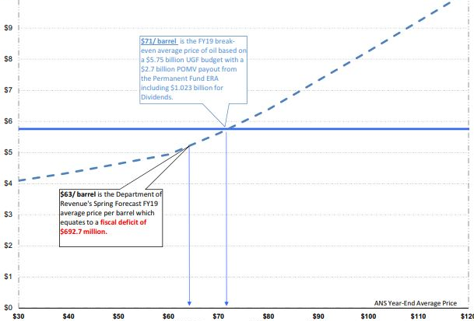
Alaska’s Fiscal Situation
$71/barrel – FY19 break-even oil price based on $5.75 Billion budget, $2.7 Billion ERA payout w/$1.02 billion for dividends
$76/barrel – FY19 YTD average price
Unrestricted General Funds ($ Billions)
$63/barrel – DOR’s Spring Forecast equates to FY19 deficit of $700 million
Source: Legislative Finance Division

Slide 17
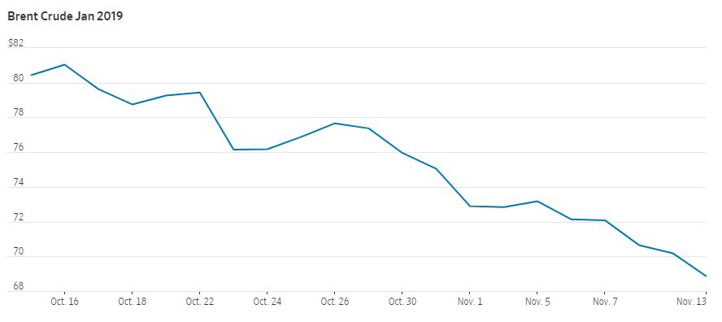
Alaska’s Fiscal Situation
Oil benchmarks have fallen more than 20% since peaking at 4-yr highs in early October
Tuesday marked record 12 consecutive days decline
Fears of over supply and weakening demand
Source: Wall Street Journal
Oil Price & Production Heavily Influence Available State Revenue

Slide 18
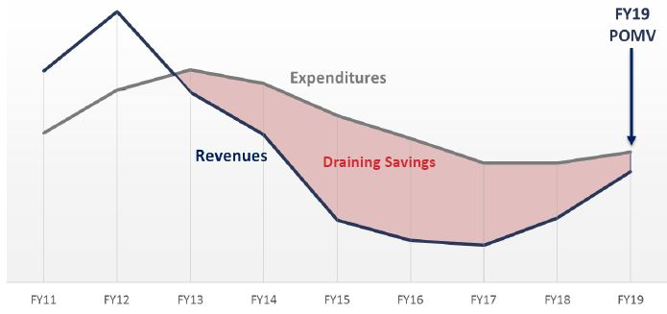
Alaska’s Fiscal Situation
State Revenue vs Expenditures
Excluding Permanent Fund Dividends
Source: Alaska Dept. of Revenue
Permanent Fund Earnings Reserve Critical to Narrowing Deficit

Slide 19
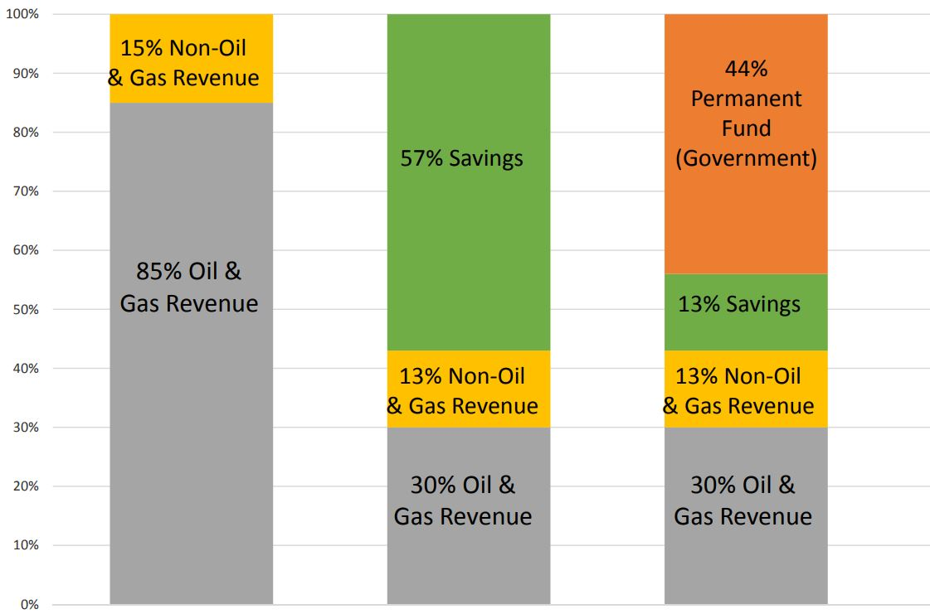
Alaska’s Revenue Mix
Historical
Last Several Years
FY19
Deficit/
Savings Draw
$690 million revenue short fall in FY19
$2.72 Billion generated by Permanent Fund Earnings Reserve draw
$2.34 Billion in Oil, Gas and other Revenue
Permanent Fund Earnings
POMV Payout
Alaska State Budget Revenue Sources (%)
Non-Oil & Gas
Oil & Gas Revenue
Oil & Gas
Source: Alaska OMB/Legislative Finance Division

Slide 20
Alaska’s Spending vs Revenue
$7
It’s a math problem
The state still has a sizable budget deficit
If we reverse course and pay bigger dividends without any offsetting revenue…..
….only place to go is the spending side
Large GF budgets, like UA will get additional scrutiny
$5.75
$5.06
$6
PFD
$1.02
Deficit
$0.69
$5
All Other Agencies
$1.15
Perm Fund
ERA
Payout
$2.72
$4
Budget in $billions
UA $0.33
$3
Statewide
$0.80
$2
H&SS
$1.14
Oil & Other Revenue
$2.34
$1
K-12
$1.32
$0
FY19
Budget
FY19
Revenue

Slide 21
University’s Budget in Context
University is 3rd largest GF budget
$200 million needed in FY20 to replace one-time money and to maintain same level of state services
Without PF Earnings Reserve payout, deficit would have been $1.7 billion higher than current $692 million

Slide 22
University Budget by Funding Source
Legislature doesn’t appropriate to UA by academic programs, campuses, services, etc.
Mental Health Trust, CIP, Inter-Agency Receipts
FY18 Actuals
Pro:
Single appropriation – one check
Spending priorities set by Regents
Con:
Advocating for specific priorities difficult
Inability to quantify immediate impacts of proposed reductions

Slide 23
2019 Legislative Agenda
Education of New Legislators & Staff
Creating Hearing Opportunities
FY20 Operating Increment - $31.5 M ($327 to $358.5)
FY20 Capital & Deferred Maintenance - $57 M
US Array ($5 M) & Digital Fabrication Labs ($2 M)
Deferred Maintenance - $50 M
University Land Grant initative
Alaska College of Education w/SB 241 Report
Expansion of Dual Enrollment Programs

Slide 24
Challenges
Working budget increments in a cut or sustain environment
Finding the cuts necessary to bring spending in-line with campaign expectations will be difficult
Large UGF recipients like UA will be logical place to look
Spending priorities are likely to be crime related – troopers, prosecutors, etc.
Raising above the PFD and Constitutional battles
Amending the Constitution, by design, is very difficult to do
Public expectations may be out of line with Legislature’s ability to deliver on those promises
The conversation/debate will occupy an enormous amount of time; allowing time for little else

Slide 25
Conclusions
Opportunity for a reset, with many new faces and a fresh new legislature
Legislature with many connections to you and our organization
New Administration with an interest in moving our state forward – we are here to engage and to help

