Slide 1
The University of Alaska:
Leading the Way to
Alaska’s Future
Leadership Forum
Fairbanks, Alaska
November 15, 2018

Slide 2
Overview
Why we are here
The big picture
Near term

Slide 3
Why we are here

Slide 4
Our Mission
UA serves the needs of Alaska through world class research, hundreds of academic degree and certificate programs, and community service on our 3 universities and 12 community campuses and through dozens of on-line programs and courses.

Slide 5
Needs of the State
Health care costs #1 in the US
Economic development #42 in New Economy Index in US
Jobs #1 in unemployment in US
Job growth #50 in US
Culture of education #50 in post-secondary participation in US
Teachers 67% hired each year from “outside” Alaska
Climate change 2x world average
Crime #1 concern of Alaskans
Energy costs #6 in US

Slide 6
Meeting the Needs of the State
We will, through our research, educational programs, and community service:
Bring down health care costs
Stimulate economic development
Prepare Alaskans for Alaska’s jobs
Contribute to Alaska’s job growth
Build a culture of education
Prepare Alaska’s teachers
Understand climate change and mitigate its impacts on our communities
Bring down the crime rate
Reduce energy costs

Slide 7
We are here to lead UA forward in service to our state
You will:
Be part of the world’s debut of our 2040 vision
Learn about our 2020 plans, initiatives, budget
Hear our election round-up and, because you will need it this year, craft your elevator speech
Discuss our “culture of respect” and what it means to you
Get up to speed on our philanthropic campaign and your key role in it
So that Alaska, with increased education attainment across the board, will:
grow its own skilled workforce
create valuable knowledge to solve real problems and turn them into opportunities,
develop and diversify our economy, charting our own course toward a stronger and more sustainable way of life

Slide 8
The Big Picture

Slide 9
Unrestricted General Funds History
(in millions of $)

Slide 10
UA Employee Headcount Reduction
Headcount Change Fall 2014-2018 (FY15-FY19) | SW ⁽²⁾ | UAA ⁽⁴⁾ | UAF | UAS | Total | % of Total
Regular | -68 | -176 | -337 | -42 | -623 | -14%
Officers/Sr. Administrators ⁽³⁾ | -5 | -8 | -9 | 0 | -22 | -11%
Faculty | 0 | -74 | -126 | -5 | -205 | -15%
Staff | -64 | -94 | -202 | -37 | -396 | -14%
Temporary | -26 | -217 | -316 | -101 | -660 | -17%
Adjunct Faculty | -6 | -101 | -36 | -55 | -198 | -17%
Staff | -10 | -57 | -56 | -22 | -145 | -18%
Students | -10 | -59 | -224 | -24 | -317 | -16%
Total Headcount Reduction | -94 | -393 | -653 | -143 | -1,283 | -15%
1. Employees with active assignments as of Oct 1st of each year. 2. Includes: 33 regular and 3 temporary positions transferred from SW to UAF for the K-12, OIT, and MAPTS program; and 30 regular and 4 temporary positions in UA's Enterprise Entities RDU. 3. Includes Academic Leaders (12 month regular faculty ecls FR). 4. Includes 145 positions transferred from UAF to UAA in FY15.

Slide 11
FY18 Operating Budget
Revenues and Expenditures

Slide 12
Operating Budget Revenue by Source
FY14-FY19 Projection

Slide 13
Facilities & Infrastructure (Fall 2017)
Number of facilities | 424
Total gross square footage | 8.2 million
Average age of facilities | 33 years
Value (adjusted for inflation) | $4 billion
Annual maintenance budget ($40M on-going operating funds + $5M one-time capital funds) | $45 million
Annual maintenance long-term target (on-going operating funds) | $60 million
Deferred maintenance/renewal & repurposing backlog | $1.1 billion
DM/R&R backlog pay-down request (one-time capital funds) | $50 million
DM/R&R backlog per sq ft | $129/sf

Slide 14
Capital Appropriation DM/R&R History
Unrestricted General Funds (in millions of $)

Slide 15
UA Student Full-time Equivalent (FTE) Enrollment

Slide 16
UA Research Expenditures
~
Methodology: Measured as the total of expenditures in the Research NCHEMS functional classification category, from any fund source.

Slide 17
Strategic Pathways
OUR MISSION |  | “The University of Alaska inspires learning, and advances and disseminates knowledge through teaching, research, and public service, emphasizing the North and its diverse peoples." (Regents' Policy 01.01.01)
OBJECTIVE |  | Maximize value to Alaska through excellent, accessible, and cost effective higher education funded by diverse and growing revenue sources
CORE PRINCIPLES |  | Focus, Access, Diversity, Excellence, Consistency, Fiscal Sustainability
STRATEGY |  | Prepare, Restructure, Implement, Refine
WHO WE ARE |  | UA ANCHORAGE Comprehensive metropolitan university in Alaska’s economic hub, with primary focus on workforce development through its several regional community campuses | UA FAIRBANKS Research university renowned for leadership in Arctic and the North, with additional focus on workforce development and community and rural education |  | UA SOUTHEAST Comprehensive regional university focused on interdisciplinary & marine-oriented programs, teacher education, e-Learning, and workforce development
CAMPUS LEAD FOR THE STATE* | Research | Social and economic sciences, health policy | Arctic science and policy, physical, biological, and social sciences, engineering and applied energy |  | Interdisciplinary / environmental
 | Teaching | Health professions Business and public policy Economics Logistics Project Management | Physical, natural, and related sciences Arctic / Northern Studies Rural development / tribal management Doctoral education Mine training Fisheries and ocean sciences |  | Marine–oriented programs (including joint programs with UAF) Teacher education (administration) Interdisciplinary degrees/ degree completion Emphasis on regional workforce priorities, e.g., mine training
 | Outreach | Aligned with Research and Teaching Focus
COURSES / PROGRAMS AVAILABLE ACROSS THE UNIVERSITY SYSTEM |  | Common General Education Requirements Liberal Arts and Humanities Social Sciences & Natural Sciences Nursing Engineering Distance Education / E-Learning Career and Technical Education |  | Alaska Native Studies Teacher Education Management Mine training Wide choice of non-major courses Dual credit with K-12 Developmental Education
* Research, teaching, and outreach at campuses other than the “lead” campus that are of high quality, cost effective, and core to mission, will continue to be provided.
Notes:
UA has always been dedicated to finding ways to perform our mission more cost effectively. Strategic Pathways (SP) is the framework, approved by the Board of Regents in 2016, we are currently using to improve our ability to meet the state’s large unmet needs for higher education while fiscal resources are being reduced. It is based on the fact that each of our universities has unique strengths in meeting the state’s needs and the reality that each campus cannot be everything to everyone. The Strategic Pathways process is reviewing all of UA’s major academic programs and administrative services to create a more sustainable university and to diversify our revenue sources.

Slide 18
Goals & Measures 2017-2025
(Tentative, subject to BOR approval)
 | 2017 Baseline | 2018 Observed | 2019 Target | 2020 Target | Change 2019-2020 | 2025 Goal
1. Contribute to Alaska’s economic development
Increase STEM graduates | 1,628 | 1,691 | 1,776 | 1,875 | +99 (6%) | 2,460
Increase # invention disclosures | 17 | 34 | 23 | 25 | +2 (9%) | 34
2. Provide Alaska’s skilled workforce
Increase % of educators hired | 30% | 33% | 37% | 43% | +6% (16%) | 90%
Double number of health program completions | 874 | 939 | 986 | 1,086 | +100 (10%) | 1,760
3. Grow our world class research
Lead the world in Arctic related research | 1 | 1 | 1 | 1 |  | 1
Increase research expenditures ⁽¹⁾ | $159.4m | $150.7m | $157.4m | $168.3m | +$10.9m (7%) | $235m
4. Increase degree attainment
Fiscal Year Student Full Time Equivalent (FTE) | 18,492 | 17,555 | 18,433 | 19,825 | +1,392 (8%) | 28,526
Increase completions | 4,594 | 4,554 | 4,781 | 5,442 | +661 (14%) | 10,400
5. Operate more cost effectively
Decrease total cost of education (indirect and direct) per completer | $107.3 | $108.4 | $103.0 | $93.9 | -$9.1 (-9%) | $59.0
Increase annual completions per Full Time Equivalent (FTE) | 23/100 | 23/100 | 24/100 | 26/100 | +1.6 (6%) | 35/100
Note: Information is reviewed annually as part of the President’s performance compensation (quantitative performance goals) 1. FY18 observed research expenditures has been revised to reflect final data ($149.9m to $150.7m)

Slide 19
2040 – BOR Strategies
We will grow UA in its service and leadership for Alaska by:
Taking care of the basics Campus safety and respect Competitive and fair compensation Facility maintenance Efficiency / Productivity | Growing our own Construction and vocational Teachers and health care professionals Engineers Researchers Student recruitment, retention, and completion
Leveraging partnerships K-12 (dual enrollment, teachers, leaders) Industry / Employers (ANCSA corporations, tribes, health care, resource development, gas line, maritime, military) Local, state, and federal agencies International universities and NGOs | Building on our competitive advantages Energy Climate change Indigenous studies On-line courses / programs in areas of excellence (e.g., Arctic studies, project management/logistics, Indigenous studies, Homeland Security, OneHealth)
Leading innovation and creativity Commercialization of UA research Creating new technologies, solutions to problems Integrating traditional and new knowledge | Taking the long view Foster long term strategic planning Focus on quality Invest in leadership

Slide 20
2040 - World Building
We will grow UA in its service and leadership for Alaska by:
Creating a vision for UA 2040 based on World Building survey research, asking what’s important? what’s difficult? what are the “must haves”? what are the barriers to these must haves? what are our challenges? how about our strengths? what are the metaphors and the visions for the university we all want? community research and provocations, asking “what if, why not?”
Developing an interactive website that reflects the vision includes creative new programs invokes the power of narrative, of characters we want to create uses state of the art design invites interest, exploration and perhaps even partnership and support
Tracing back from 2040 to today asking ourselves, what must we do today to realize the vision? what can we put in our FY2020 budget that gets us started?

Slide 21
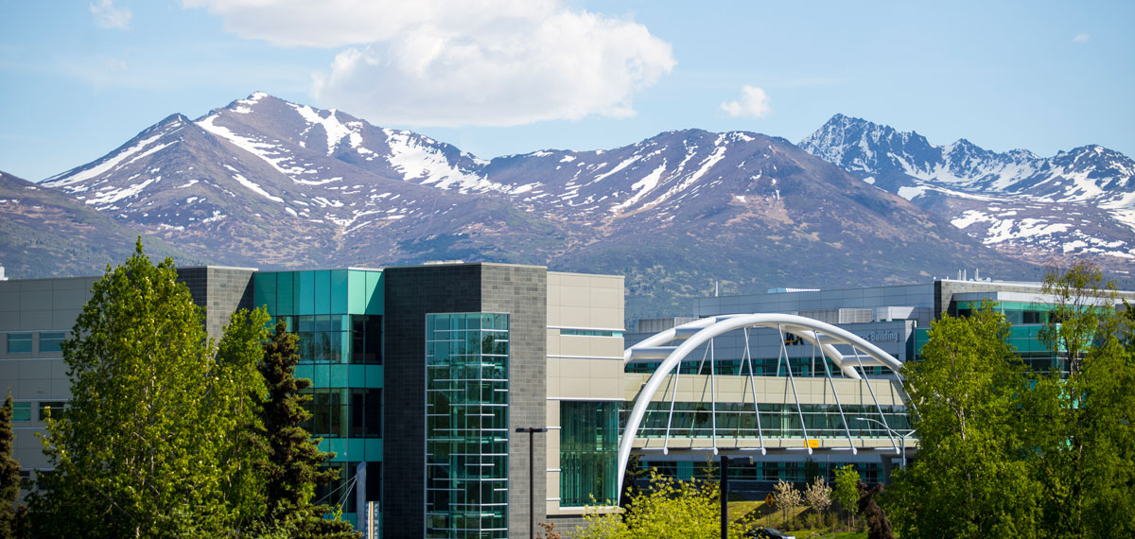
Stakeholder Interests from World Build Surveys
A cross-section of 132 stakeholders were surveyed about an initiative in which higher education helps to build the Alaska of the future. The survey had four components:
1. A summary of “must haves” and the barriers to achieving them
2. Provocations: Importance – Difficulty = Gap
3. Challenges and Strengths
4. Metaphors and Vision

Slide 22
“Must Haves”
Barriers
Source: UofA Fairbanks and Alaska DNR

Slide 23
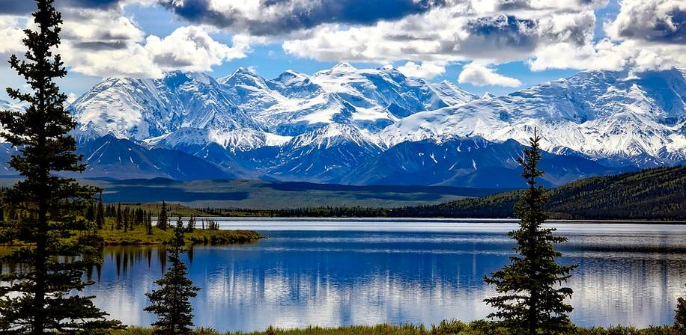
Responses to Future Provocations
More Important / Less Difficult
What if higher education was able to help Alaska move beyond the boom/bust economic cycles? Gap: .94 - .20 = .74
What if every student coming from K-12 schools was effectively prepared for higher education in Alaska? Gap: .90 - .19 = .71
What if every student graduating from higher education in Alaska was able to successfully transition from college to career in Alaska? Gap: .88 - .28 = .60
What if all relevant stakeholders were fully engaged in a state-wide initiative to build the future of higher education in Alaska? Gap: .88 - .28 = .60
What if the business and industry leaders in Alaska saw higher education as the go-to institution for workforce development and leading-edge research? Gap: .92 - .15 = .57
Source: Pixibay

Slide 24
Responses to Future Provocations
More Important / Less Difficult
Provocations, in order by size of gap – Largest
What if every K-12 student in Alaska thought of themselves as continuing onto higher education? Gap: .77 - .23 = .54
What if there were U of A initiatives in every community in Alaska to develop K12 pathways from middle school to Higher Education? Gap: .85-.26= .59
What if U of A became a pioneer in harnessing a blend of indigenous, new and emerging technologies to help Alaska move beyond the boom/bust economic cycles? Gap: .85-.28= .57
What if global business and industry leaders saw the University of Alaska as their partner for tech innovation and cutting-edge research? Gap: .81-.26= .55
What if a One Health Initiative (health of animals, people, and the environment) led to a fundamental rethinking of health and health care in society? Gap: .80-.26= .54
What if the business and industry leaders in Alaska saw higher education as the go-to institution for workforce development? Gap: .90-.42= .48
Source: Pixibay

Slide 25
Responses to Future Provocations
Less Important / More Difficult
Provocations, in order by size of gap -- Smaller
What if higher education in Alaska was transforming learning across the Arctic? Gap: .80 - .30 = .50
What if indigenous traditions of self-sufficiency, innovation, and hard work were combined with access to new technology in ways that enabled people to make what they need locally and to advance the frontiers of new technology in ways relevant to Alaska? Gap: .78 - .31 = .47
What if every generation of students coming out of higher education was deeply committed to be an effective steward of the arctic environment? Gap: .75 - .33 = .42
What if leaders in all professions across Alaska ascribed their success to higher education in Alaska? Gap: .70 - .29 = .41
Source: Pixibay

Slide 26
Responses to Future Provocations
Less Important / More Difficult
Supplemental Provocations, in order by size of gap -- Smaller
What if U of A had a program that incentivized the choice of teaching as a career, increasing the number of Alaskan teachers in the K-12 System? Gap: .81-.42= .39
What if the U of A's new Microsystems and Microgrids Institute attracted people from around the world to Alaska to study new models for rural energy and self-sufficiency? Gap: .79-.43= .36
What if the U of A led a consortium of universities and indigenous organizations in all Arctic Council nations to form an integrated Arctic higher education network to guide the future of the region? Gap: .66-.34= .32
What if Alaska attracted students to U of A by highlighting its magnificence of place as well as its specialized geo-political issues like climate change and trade relations? Gap: .73-.54= .19
Source: Pixibay

Slide 27
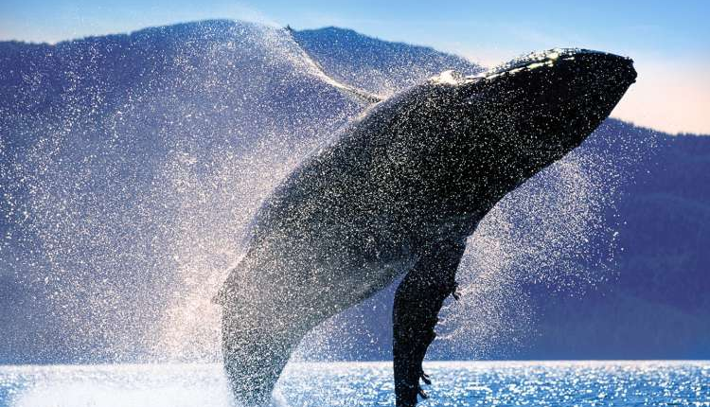
Top three high-level challenges that you believe are most worrisome, needing immediate attention for an initiative in which higher education helps to build the Alaska of the Future.
Strategy
Building a shared vision
Sharing a sense of urgency
Creating value
Mitigating risk
Ensuring effective leadership
Process
Supporting problem-solving in decisions
Fostering inclusivity in decision making
Ensuring effective conflict resolution
Providing timely feedback
Ensuring effective communication
Ensuring effective learning and education
Structure
Specifying roles/responsibilities
Making metrics visible
Providing effective incentives
Ensuring transparent information
Maintaining dependable funding
Culture
Reinforcing shared values
Transforming underlying assumptions
Ensuring effective cooperation
Ensuring constructive competition
Sustaining trust
Being open to change
Appreciating shared and separate interests
Technology
Addressing disruptive technology changes
Addressing incremental technology changes
Using shared technology standards
Developing an effective technology architecture
#2 – 30.9%
#3 – 28.7%
#1 – 42.6%
Source: HollandAmerica

Slide 28
Please select the top three general organizational strengths that an initiative in which higher education helps to build the Alaska of the Future can depend on now.
Strategy
Building a shared vision
Sharing a sense of urgency
Creating value
Mitigating risk
Ensuring effective leadership
Process
Supporting problem-solving in decisions
Fostering inclusivity in decision making
Ensuring effective conflict resolution
Providing timely feedback
Ensuring effective communication
Ensuring effective learning and education
Structure
Specifying roles/responsibilities
Making metrics visible
Providing effective incentives
Ensuring transparent information
Maintaining dependable funding
Culture
Reinforcing shared values
Transforming underlying assumptions
Ensuring effective cooperation
Ensuring constructive competition
Sustaining trust
Being open to change
Appreciating shared and separate interests
Technology
Addressing disruptive technology changes
Addressing incremental technology changes
Using shared technology standards
Developing an effective technology architecture
#3 – 20.8%
#1 – 37.7%
#2 – 23.8%
Source: HollandAmerica

Slide 29
Vision Phrase or Metaphor
Long-Term Success Statement
Source: HollandAmerica

Slide 30
World building UA 2040

Slide 31
How do we begin now to build that UA?

Slide 32
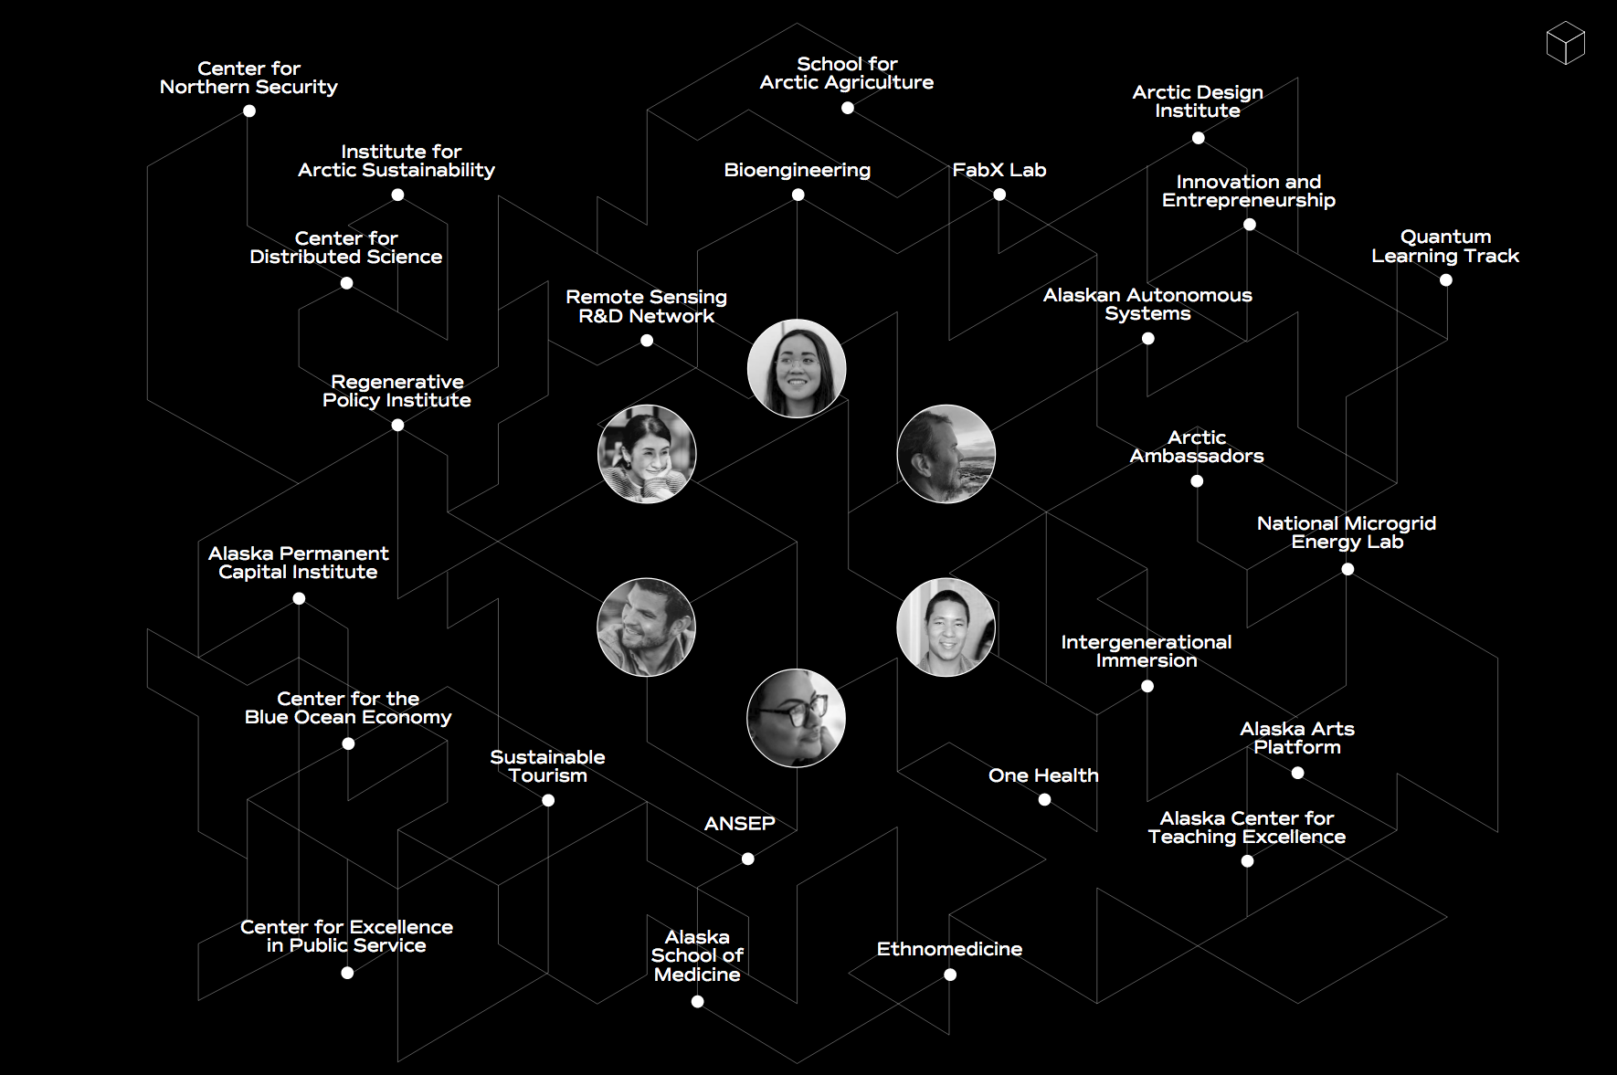
Programs slide/photo

Slide 33
FY20 Operating Budget Request

Slide 34
FY20 Operating Budget Request
Request Summary
Compensation
Title IX / Culture of Respect
Continuing Operating Costs
Strategic Investments

Slide 35
FY20 Operating Budget Request – Summary
(in millions of $)
 | State | Non-State | Total
Compensation ⁽¹⁾ | $7.2 | $4.8 | $12.0
Operating Cost Increases
Title IX Enhancements (Culture of Respect) | $1.8 |  | $1.8
Facilities Maintenance & Utility Cost Increases | $11.1 |  | $11.1
Technology (hardware/software, licensing, subscriptions) | $1.0 |  | $1.0
Other Operating Cost Increases | $.4 |  | $.4
Subtotal Operating Cost Increases | $14.3 | $0.0 | $14.3
Strategic Investments by Goal
Contribute to Alaska’s Economic Development | $.6 |  | $.6
Provide a Skilled Alaskan Workforce | $3.1 |  | $3.1
Grow Our World Class Research | $1.1 |  | $1.1
Increase Educational & Degree Attainment | $5.2 |  | $5.2
Subtotal Strategic Investments | $10.0 | $0.0 | $10.0
Budget Adjustments ⁽²⁾ | $0.0 | -$6.9 | -$6.9
FY20 Operating Budget Change | $31.5 | -$2.1 | $29.4
1. Estimates based on total compensation review 2. Includes a $7.6M reduction of excess budget authority to better align with estimated expenditures.

Slide 36
Compensation
Charge
Guiding Principles
Findings to Date
Our Plan
Estimated Cost and Three-year Plan
Timeline
For More Information

Slide 37
Charge
At the direction of President Johnsen, UA Human Resources is leading a total compensation review to better understand our market competitiveness for salary and benefits to optimize internal equity, retention and recruitment.
We are reviewing the following components of our compensation plan related to market:
Faculty salaries
Staff salaries
Executive (officers and senior administrators) salaries
Benefits
In addition, we are reviewing internal pay equity.

Slide 38
Guiding Principles
The compensation system will uphold the university’s role in the state as a leading employer. As an employer, the university strives to be:
  Competitive: Offering market-driven salary and benefits programs
  Consistent: Providing a dependable framework for compensating employees in a fair and equitable manner
  Creative: Within the confines of its budget, offering a flexible suite of benefits to support employee engagement and productivity
  Collaborative: Working with our employees to ensure our compensation and benefit programs meet their needs and interests

Slide 39
Findings to Date
Pay equity analysis
  A high level review shows that, on average, pay inequities based on factors such as gender and ethnicity are less at UA than those found across higher education, and gender pay inequities are less than found across Alaska
  A detailed review of a limited number of positions is continuing
  Market salary analysis
  “Market” as used in this review is defined as ± 10% of the median of salary survey data for a job. This is a standard benchmark in compensation analysis
  While, on average, faculty and staff salaries are within that + 10% band around the market median, a number of employee salaries are below market
  Executive salaries are, on average, below market
  In addition to market, the review is considering the effects of inflation on our salaries
  The detailed market analysis is continuing
Benefits analysis
  UA Pension is not competitive with university peers and the State
Bottom Line
  In addition to any pay equity adjustments, approximately 3% of payroll will be needed to address recurring market and inflation impact

Slide 40
Our Plan
Seek funding and compensate for any salary inequities (pay equity) as soon as analysis is complete and funding identified (FY2019 and FY2020)
Include funding for market, inflation, and benefit adjustments in FY2020 operating budget. Subject to funding, we plan:
  Salary increases to be made over several years, to bring employee salaries to market
  Annual increases of 1% each for the next several years, to help offset effects of inflation
  Annual increases in the salary cap of our pension benefit over several years, so our pension program is more competitive

Slide 41
Estimated Cost and Three-year Plan ($)
 |  | Pay Equity ⁽¹⁾ | Market ⁽²⁾ | Inflation 1%/year ⁽³⁾ | Pension ⁽⁴⁾ | Benefits ⁽⁵⁾ | Total
Cost | Faculty | 310,000 | 4,667,000 | 3,337,300 | 1,705,000 | 2,415,300 | 12,434,600
 | Staff | 1,251,000 | 3,506,000 | 4,604,200 | 3,465,000 | 3,833,400 | 16,659,600
 | Executives | 140,000 | 510,000 | 467,500 | 330,000 | 312,900 | 1,760,400
 | TOTAL | 1,701,000 | 8,683,000 | 8,409,000 | 5,500,000 | 6,561,600 | 30,854,600
 | FY19 ⁽¹⁾ (Supplemental) | TBD
Three-year Plan | FY20 (Operating) | 1,701,000 | 2,894,333 | 2,775,200 | 2,000,000 | 2,605,000 | 11,975,533
 | GF | 1,020,600 | 1,736,600 | 1,665,100 | 1,200,000 | 1,563,000 | 7,185,300
 | NGF | 680,400 | 1,157,733 | 1,110,100 | 800,000 | 1,042,000 | 4,790,233
 | FY21 (Operating) | 0 | 2,894,333 | 2,802,900 | 1,900,000 | 1,973,300 | 9,570,533
 | FY22 (Operating) | 0 | 2,894,334 | 2,830,900 | 1,600,000 | 1,983,300 | 9,308,534
 | Notes: 1. Pay equity amounts represent our best current costs estimates; these will be refined and likely be less as further analysis is completed. A supplemental will be requested for any retroactive pay equity adjustments. 2. Market amounts represent our best current costs estimates. “Market” is defined as + 10% of the market median for a job. The cost estimate for staff could be higher dependent on a new staff salary structure currently being considered. Any additional costs will be deferred to FY21 and beyond. 3. 1% for salary increases for all regular benefit eligible employees to help offset inflation effects. 4. Increase salary cap from $42,000 to $50,000 (in FY20) for pension contribution factor (7.65%). (IRS and State of Alaska SBS cap will be at $132,900) 5. Estimated employee benefit cost increases that result from salary increases.

Slide 42
Timeline
 | Summer 2018 | Fall 2018 | Winter 2019 | Spring 2019 | Summer 2019
 | Communications Webinar (Fall 2018) Worksite meetings (TBD) Regular updates to employees & to FAQs
Board of Regents
Governance / Unions
Faculty salary analysis
Staff salary analysis
Executive salary analysis
Initial cost estimation
Final costing
Legislature
Pay equity implementation
Market, inflation, and pension implementation*
* Subject to funding.

Slide 43
For More Information
FAQs (periodically updated):
https://alaska.edu/classification/compensation-review/
Board of Regents, September 2018 presentation:
Link: Total Compensation Review Sept. 14, 2018

Slide 44
FY20 Request – Title IX / culture of respect $1.8M
Build Staff capacity across the university to:
  Grow a culture that values respect, service, safety, and compliance
  Provide compassionate, prompt and effective responses to an increasing number of reports
  Provide proactive supervisory coaching and behavioral interventions
  Analyze data and develop appropriate tools to measure organizational culture
  Design training and program strategies to address areas needing improvement

Slide 45
FY20 Request – Continuing operating costs $12.5M
Facilities Maintenance ($9.8M) and Utility Cost Increase ($1.3M)
Annual upkeep necessary to slow accumulation of deferred maintenance backlog and reduce risk of localized mission failure. Utility cost increases for electricity, natural gas rate increases; coal transport and ash disposal. ($11.1M)
Technology (hardware/software, licensing, subscriptions)
Systemwide technology reinvestment for maintenance, licensing renewals, subscriptions for online scientific, academic, other educational and research data. ($1.0M)
Campus safety positions and insurance premiums. ($.4M)

Slide 46
FY20 Request – Focus Areas $10.0M
Economic Development
Grow Our Own Workforce
Research
Recruit and Retain
Operate More Cost Effectively

Slide 47
Economic Development $.6M
Increase interest in STEM programs
Develop industry partnerships
Increase capacity for invention disclosures and licenses

Slide 48
Grow Our Own Workforce $3.1M
Educators for Alaska’s schools
  More teachers for rural schools
  Pipeline of new teachers
  Increased partnerships with K-12
  More Special Education graduates
Healthcare workforce in Alaska
  Expand nursing and other high demand health profession programs
  Provide educational pathways for high demand health care fields
  Increasing capacity for allied health & para-medicine programs
Trained workforce
  Providing accelerated education programs
  Providing regional training programs

Slide 49
Research $1.1M
Increase competitiveness (funding, faculty, and students)
Expand capacity to support growth in research activities
Leverage grant opportunities
Support state policies and initiatives

Slide 50
Recruit and Retain $5.2M
Broader financial aid advising
Comprehensive counseling and academic advising
Strengthen partnerships with K-12 (dual enrollment)
Articulation agreements with other colleges and universities
Improve program delivery options (on-line, modernized)
Expand course offerings aligned with workforce demand
Rural student support
Enhanced marketing

Slide 51
Operate More Cost Effectively
Diversifying revenue sources (e.g. philanthropy and P3)
Process improvement and automation
Project management
Systemwide training
Optimizing facility footprint
Productivity

Slide 52
Goals & Measures 2017-2025
(Tentative, subject to BOR approval)
 | 2017 Baseline | 2018 Observed | 2019 Target | 2020 Target | Change 2019-2020 | 2025 Goal
1. Contribute to Alaska’s economic development
Increase STEM graduates | 1,628 | 1,691 | 1,776 | 1,875 | +99 (6%) | 2,460
Increase # invention disclosures | 17 | 34 | 23 | 25 | +2 (9%) | 34
2. Provide Alaska’s skilled workforce
Increase % of educators hired | 30% | 33% | 37% | 43% | +6% (16%) | 90%
Double number of health program completions | 874 | 939 | 986 | 1,086 | +100 (10%) | 1,760
3. Grow our world class research
Lead the world in Arctic related research | 1 | 1 | 1 | 1 |  | 1
Increase research expenditures ⁽¹⁾ | $159.4m | $150.7m | $157.4m | $168.3m | +$10.9m (7%) | $235m
4. Increase degree attainment
Fiscal Year Student Full Time Equivalent (FTE) | 18,492 | 17,555 | 18,433 | 19,825 | +1,392 (8%) | 28,526
Increase completions | 4,594 | 4,554 | 4,781 | 5,442 | +661 (14%) | 10,400
5. Operate more cost effectively
Decrease total cost of education (indirect and direct) per completer | $107.3 | $108.4 | $103.0 | $93.9 | -$9.1 (-9%) | $59.0
Increase annual completions per Full Time Equivalent (FTE) | 23/100 | 23/100 | 24/100 | 26/100 | +1.6 (6%) | 35/100
Note: Information is reviewed annually as part of the President’s performance compensation (quantitative performance goals) 1. FY18 observed research expenditures has been revised to reflect final data ($149.9m to $150.7m)

Slide 53
FY20 Capital Budget Priorities
(in millions of $)
 | State | Non-State | Total
Facilities Deferred Maintenance/ Renewal & Repurposing | 50.0 |  | 50.0
UAF Sustaining USArray Capabilities in Alaska | 5.0 | 19.0 | 24.0
UA Digital Fabrication Laboratories | 2.0 |  | 2.0
Total | $57.0 | $19.0 | $76.0

Slide 54
Next Steps

Slide 55
Next Steps
November 2018
General Election day, Nov. 6th
Transmit board approved budget request to Governor
Continue discussions with legislators
Internal organization and external advocacy
December 2018
Governor’s term of office begins, Dec. 3rd
By Dec. 15th, Operating, capital and mental health budget bills are released, posted to OMB website, and transmitted to Legislative Finance
January/February 2019
Public opinion survey
By Jan. 4th, departments submit supplemental funding requests to OMB; bill is introduced Jan. 29th
By Jan. 9th, departments submit budget bill amendment requests to OMB; amendments are due to the Legislature Feb. 13th
Legislative Session begins, Jan. 15th
Board of Regents meeting, Jan. 2019 TBD

