Slide 1
University of Alaska
Open Enrollment: 2024-2025 Benefits
Notes:
Hello Everyone. Thank you for joining us today, and welcome to the University of Alaska Open Enrollment Presentation! We hope this session is informative. Please place all of your questions in the chat or hold any questions until the end of this presentation.

Slide 2
Table of Contents
Enrollment: Important Dates
How can TouchCare Help
Medical
Preventive Care
UA Wellness
Pharmacy
Dental
Vision
Ancillary
Other Important Benefits
Important Reminders
Notes:
These are a few of the topics that we will be discussing today. We will review how to enroll in your benefits this year, Touchcare’s service and how our team can assist you during open enrollment and throughout your plan year, the medical plans offered by The University of Alaska for the 2023-2024 plan year, preventive care reminders, pharmacy benefits, dental, vision and ancillary benefits and how to schedule an open enrollment consultation with TouchCare, should you need additional 1:1 assistance selecting a new plan. Let’s get started!

Slide 3
1
Enrollment
Notes:
So let’s get started by discussing some important considerations for this enrollment period.

Slide 4
WHAT: This is your annual opportunity to make changes to your benefits
WHEN: April 15th to May 3th, 2024
The choices you make will remain in effect until June 30, 2025 unless you experience a Qualifying Life Event (QLE).
HOW: Visit https://www.alaska.edu/benefits
Open Enrollment: Introduction
Notes:
What is Open Enrollment? This is the time of year where you can make changes to your benefits without experiencing a qualifying life event or a “QLE”. We will discuss QLE’s in a moment.
When is the active Open Enrollment period for the Univerisity of Alaska? Open enrollment began on April 17th and will end on May 5th, 2023. The plans you select during Open Enrollment become effective on July 1, 2023 and will end on June 30, 2024.
How do you enroll? The link to enroll is listed on the home page of the benefits site. You simply click on the link to the form on the Open Enrollment announcement banner and (from there) you can make your enrollment selections for the plan year.

Slide 5
What to Do:
This Open Enrollment, employees only need to submit a form if they are making changes to their plan and/or dependents, or if they are wanting to enroll in an FSA for July 1, 2024 through June 30, 2025.
Visit the link provided on the previous slide and on the U of A benefits website: https://www.alaska.edu/benefits
If you are waiving coverage, please be prepared to provide your current plan information.
Regardless of waiving medical, please be prepared to provide beneficiary information for your life insurance coverage that is given to you at no cost by the University.
Notes:
Unlike last year’s passive Open Enrollment, this year is an ACTIVE enrollment year. What is an active open enrollment? It is a period when all benefits eligible employees HAVE to complete the enrollment process in order to enroll in their benefits for 2023-2024 through the University of Alaska. Even if you are waiving medical coverage, you will still need to provide beneficiary information for your life insurance coverage, provide medical waiver information, and / or select any additional benefits (beyond medical) that you might be interested in enrolling in this plan year.
Last year’s passive enrollment automatically placed you in your previous year’s plan. During an active open enrollment period that will not happen if you do not select a plan or provide a waiver due to coverage elsewhere. If you do not complete the enrollment process during the active OE period, you will automatically be defaulted into the Basic Health, Basic Dental and vision plans.
Remember to be prepared when you start the enrollment process. Please have any dependent information and beneficiary information ready, as this will be necessary to input at the time of enrollment.

Slide 6
What is a QLE?
What are some examples of QLEs?
Marriage
Divorce
Birth of a child
Losing coverage as a child dependent under plan (i.e., turn 26)
Loss of coverage under spouse’s group plan
Medicare eligibility
Status change from temporary to benefit eligible
Open Enrollment is your only opportunity to make changes to your benefits, unless you experience a Qualifying Life Event (QLE) during the year.
If you experience a Qualifying Life Event, you have 30 days from the QLE date to make benefit changes.
Specific to University of Alaska, employees who experience the adoption of a dependent, the birth of a child, or a custody placement arrangement have 60 days to make changes to their benefits.
Notes:
What is a QLE? Open Enrollment is the time of year you can make changes to your benefits - unless you experience a Qualifying Life Event. If you experience a Qualifying Life Event - such as some of the examples (listed here) - Marriage, Divorce, Medicare Eligibility, etc - you will have 30 days from the QLE date to make changes to your benefits.
Specific to the University of Alaska, benefits eligible employees who experience the adoption or birth of a child, or a custody placement arrangement will have an additional 30 day grace period to make changes to their benefits. In these three instances, changes must be made within 60 days of these qualifying life events.
What if you experience a QLE and miss the defined enrollment period? - If you miss the allowed time to adjust or select your benefits you will not be able to change or select benefits until the active open enrollment period around the same time next year. Your plan will then go into effect on the University of Alaska’

Slide 7
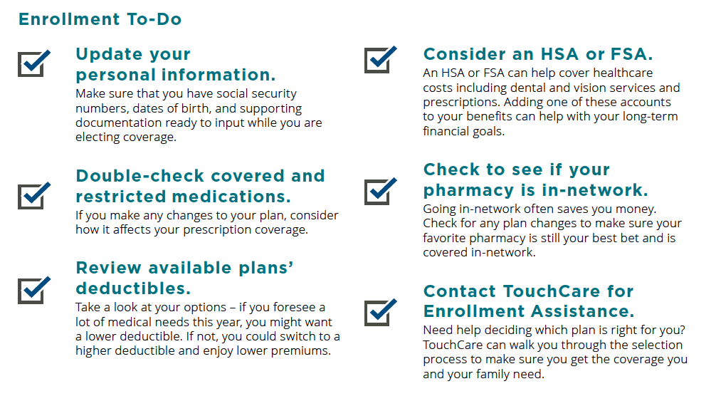
Preparing for Open Enrollment
Notes:
How do I prepare for Open Enrollment? - Read check points on slide

Slide 8
2
TouchCare
Notes:
TouchCare has been mentioned a few times, so let’s discuss this free benefit offered to you and your dependents through the University - and how TouchCare can assist you during Open Enrollment and throughout your plan year.

Slide 9
What is TouchCare?
EXPERT ASSISTANTS
Expert assistance from industry experts
Our Health Assistants are experienced, expert assistants proficient in navigating the constantly evolving health care system. Caring, friendly and ready to support members with their healthcare.
PRIVACY IS OUR POLICY
We take your privacy extremely seriously
Your interactions with TouchCare are 100% confidential. TouchCare is HIPAA compliant and abides by strict security and confidentiality standards that ensure member information is never shared.
100% FREE TO USE
All our vital services, totally free for members.
Unlimited access, unlimited questions, unlimited quality for all team members. TouchCare is completely free to all members. We use clear and simple language to make sure the member experience is easy and stress-free.
Notes:
Present per usual

Slide 10
How do we help?
Cost Estimates
We help employees to get costs for services in their area and compare with other facilities nearby.
Billing & Claims Assistance
Received an EOB that you think is incorrect, but don’t want to deal with it? TouchCare has you covered.
Finding, Choosing, & Scheduling
We find quality doctors with all the specifications requested by employees
Benefit Questions
TouchCare helps employees navigate all of their work-sponsored benefits as well as any available ancillary options.
Notes:
Present per usual - but add OE consultations.

Slide 11
Why ask TouchCare for help?
Notes:
Present per usual

Slide 12
How to get in touch
APP
PORTAL
PHONE
EMAIL
Download our App on your iOS or Android device. Access all of our concierge services from your pocket!
Open a case, exchange messages, or upload plan documents to portal via www.touchcare.com.
Email: assist@touchcare.com and a Health Assistant will reply as soon as they’re available.
Call: 866-486-8242, available 8AM – 9PM (EST) , Monday through Friday.
Notes:
Present Per usual

Slide 13
3
Medical
Notes:
Now that we have covered how to ask questions and receive assistance, if needed - let’s review the medical plans that are being offered again this year.

Slide 14
Important terms to know
Term:
Definition:
Example:
Premium | The amount you pay towards your company medical plan. | You pay $ XX dollars per month to have you and your dependents enrolled in the company medical plan.
Deductible | The amount you pay for care before the insurance carrier begins to pay its share. Once you have met this, the carrier starts to pay its allotted share. | If you have a $1,000 deductible, you are required to pay all expenses out of your pocket until you reach $1,000. From here, either copays or coinsurance will apply.
Coinsurance | A percentage of cost you pay that generally follows after you have met your deductible. | Once you have paid $1,000 worth of medical charges, your coinsurance level is 20%. You would be responsible for 20% of all charges (Carrier will pay the other 80%). NOTE: 80/20 is for in-network, while OON split is 60/40)
Copay | A fixed amount you pay for a medical service. Your insurance carrier will pay the difference in cost. | You pay $20 every time you visit the doctor’s office, regardless of the reason for visit.
Out of Pocket Maximum | The total amount you would ever have to pay into your medical plan. You would have to pay out your deductible, coinsurance and copay responsibilities, before the insurance carrier covers you 100%. | If you are hospitalized for 2 weeks and your expenses go beyond $5,000 after insurance is applied, you will only be responsible to pay up to $5,000 and then you are covered completely.
In-Network | Your doctor has a contracted rate set up with your insurance carrier. This is extremely important when selecting which doctor to go to, as the out of network costs are almost always more expensive. | Your doctor has a contract with an insurance carrier and clarifies that they are a participating provider with XX carrier.
Notes:
But before we do….. Fun fact: 92% of health insurance consumers cannot properly define the 6 terms within their plan listed here… So let’s review before we dive into the plan details….. <Review terms>
A “premium” is the amount that you pay for your benefits during your plan year. This amount is taken out of your paycheck to cover the employee cost for the plans you select for you and your dependents. Premiums are not included in the “maximum out of pocket” - which we will discuss shortly.
A deductible is the amount you are responsible for before your insurance company will start to pay for any services you receive.
After you have met your deductible, Co-Insurance will begin covering a portion of the cost for your services. Typically this is represented as the percentage insurance companies will pay versus the percentage you are responsible for. For example: 80 / 20 coinsurance means: your insurance company will cover 80% of the cost of services billed and you will be responsible for 20% of the cost of in network services billed (again) after you have met your deductible.
Copays are defined amounts listed in your plan that you would pay, while your insurance company covers the remainder. For the University of Alaska, you will see that copays are represented in your pharmacy program for two of the plans that are offered.
Maximum out of Pocket equals the total amount you will pay for in network services before your insurance company covers 100% of your cost. This includes the amount you have paid toward your deductible, coinsurance or any copays. The key here is “in network”. Out of network costs do not apply toward your maximum out of pocket - so please keep this in mind.
“In Network” has been mentioned many times. What does this mean? When a provider is in network, they have formed a contract with an insurance company for any services covered under your plan, at a contracted rate. The provider is not allowed to bill more than has been contracted for the visit, test, or service. When a provider is NOT in the insurance network, this contract does not exist. When out of network, even if insurance covers a portion based upon what is “reasonable or customary” the provider can still balance bill the remainder of what they charge for the test, visit or service. This amount will not be covered, and you will be responsible for the balance bill. This is why it is extremely important to remain in network. Again - please contact TouchCare when you need a provider, test, or procedure. We will ensure you are remaining in network and seeing the lowest cost, highest quality providers or facilities to meet your or your dependent’s needs.

Slide 15
Medical Benefits Overview
Medical benefits are provided through Premera Blue Cross Blue Shield of Alaska.
Choose the plan that works best for your lifestyle - ask TouchCare for help!
Consider the physician networks, premiums
and out-of-pocket costs for each plan. Keep in mind your choice is effective for the entire Plan Year, unless you have a qualifying life event.
Notes:
As you are aware, your Medical benefits are provided through Premera Blue Cross Blue Shield of Alaska.
Remember - please stay in network, and always look at your maximum exposure by viewing the maximum out of pocket listed in each plan.

Slide 16
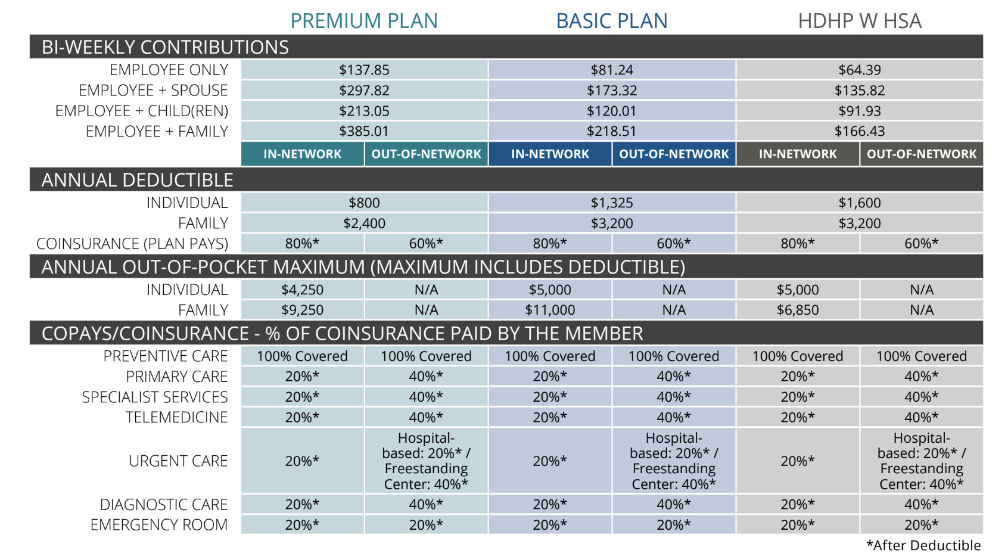
Medical Plan Comparison Details
Notes:
There are three medical plans that are being offered this year. A ”premium” , “Basic” and an ”HDHP with an HSA”…. As you can see on this slide, there are differences with each of these plans - but it is important to mention that all of these plans cover preventative screenings 100%. Although we will discuss preventive care later in this presentation, you are always welcome to contact TouchCare to gain a better understanding of what services are covered as preventative visits or screenings. The primary differences with each of these plans align with the annual deductibles and the annual maximum out of pocket amounts. As you can see, the annual deductibles increase from the Premium plan to the Basic plan. The deductible for the HDHP is the highest, as represented in the name of the plan. As you can also also see, the monthly out of pocket cost for each of the plans is different. Please remember to consider the difference you might pay in premium (your monthly cost to secure one of these three plans) verses what you might pay toward your deductible.
One additional area to consider is the annual out of pocket maximum amount listed under each plan. The maximum out of pocket is the total amount you would pay (not including your premium) for all in network expenses. This includes all money you have paid toward your deductible and any coinsurance you have paid within your plan year. After you meet the maximum out of pocket, you will no longer pay coinsurance for in network services. They will then be covered at 100%. Remember: deductibles and maximum out pocket amounts reset each year.
Here are a few additional considerations you might want to make while you are making your plan decision:
Does anyone on my plan see a specialist regularly, or do they have a chronic illness?
What medications do you or your dependents take?
If you have a spouse or a domestic partner, how do their plans compare and would it be beneficial to stay on their plan vs a plan offered through the University?
Would you benefit from the pretax advantages of an HDHP with an HSA?
If you are confused or if you need assistance making a decision, please contact TouchCare. You can schedule a 1:1 consultation with a specialist who can help you. Don’t forget to include a dependent in your consultation if they help manage manage the healthcare needs in your home.

Slide 17
Callouts: Premium and Basic Plans
For the Premium and Basic plans, the individual deductible amount must be met by each member enrolled under your medical coverage.
If you have several covered dependents, all charges used to apply toward a “per individual” deductible amount will also be applied toward the “per family” deductible amount.
When the family deductible amount is reached, no further individual deductibles will have to be met for the remainder of the plan year.
No member may contribute more than the individual deductible amount to the “per family” deductible amount. The same typically applies for the out-of-pocket max.
Notes:
Read slide

Slide 18
Callouts HDHP w HSA Plan
For the HDHP, each covered individual is not required to meet the individual deductible.
The HDHP has an aggregate deductible meaning the family deductible amount will include all combined eligible expenses that you and your covered dependents incur.
The family deductible amount may be satisfied by one member or a combination of two or more members covered under your medical plan. The same typically applies for the out-of-pocket maximum.
Notes:
Read the slide

Slide 19
What is a Self-Funded Plan?
Our medical, dental, vision and prescription plans are
self-funded, which means that the university bears the financial risk of the plan.
Rather than paying insurance premiums to an insurance carrier as with fully insured plans, the university pays fixed costs for using the insurance carrier’s network of physicians and variable costs for the members’ claims. Self-insured plans allow for more control and freedom in plan design.
This is one reason why it is important for you, as members, to be good healthcare consumers and always consider ways to leverage care responsibly.
Together, the university and employees share the cost for healthcare.
Notes:
The University of Alaska is a self funded or “self insured” plan. This means that the University of Alaska pays all of the “claims” issued by providers, directly. Please understand the importance of that statement.
Your employer is invested in your wellness for a variety of reasons. 1. They want to promote a healthy lifestyle for your personal benefit. 2. If you remain healthy, there are fewer claims that they will have to pay, resulting in lower increases for the total population year over year.
Imagine if everyone in the organization used healthcare carelessly. What if you all went to the ER for a basic headcold, or you all went to the most expensive MRI facilities unnecessarily? This would increase the cost for the total population, because the insurance company would recognize the group isn’t using their coverage wisely.
The University of Alaska has invested in you by offering strong benefits, a robust wellness program and resources (like TouchCare and your EAP program) to help you manage your healthcare in the most efficient way possible. Please do your part be being a good consumer and leveraging free resources that have been provided to you and your dependents.

Slide 20
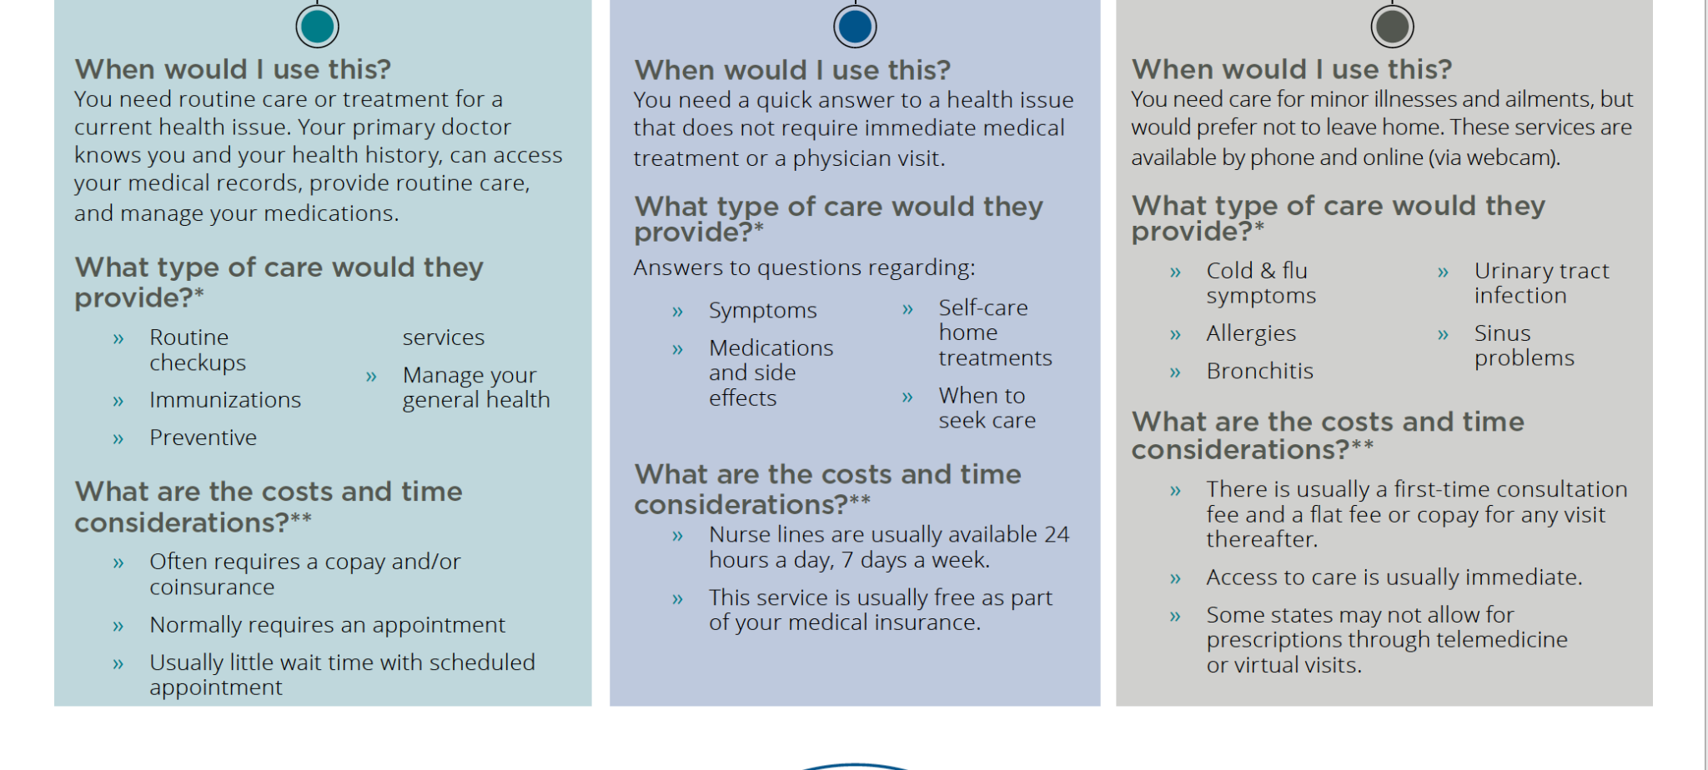
Where to Go for Care (non urgent)
Primary Care
Nurse Line
Telemedicine
Notes:
Where should you go for care? Oftentimes high claims and expenses can be avoided by using additional resources that are available within your plan, within your organization or even independently….. It is extremely important that each member develops a relationship with a primary care physician. If you do not have a PCP, please contact TouchCare. They can help you find one. PCP’s can help you stay healthy by providing routine checkups and screenings. These relationships are vital for your well being.
If you are sick and your PCP is not available, you also have access to virtual medical options. Rather than running to the Urgent Care center or the ER and spending more than you should for non urgent or non life threatening situations you should always contact telehealth providers for assistance. Let’s talk about some of those options and how you can access them….

Slide 21
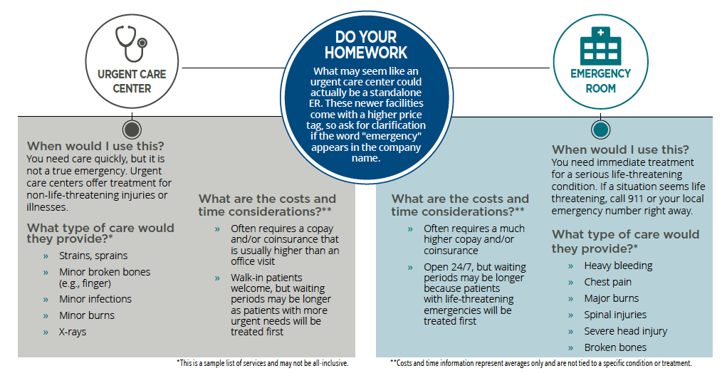
Where to Go for Care (urgent)
Notes:
Although Urgent Care does cost less than the ER - we do encourage you to evaluate if either are truly necessary and when one might be more appropriate than the other. ER’s should be leveraged for extremely serious injuries or life threatening health matters only. Urgent Care has become so convenient for some, individuals have replaced their PCP relationships with this access. Please avoid this behavior. Urgent Care centers and Emergency Rooms should not be used for the common cold or any of the areas detailed in the previous slides. The cost of healthcare somewhat relies on smart consumerism. Use healthcare appropriately to avoid wasteful spending. With so many other resources, both Urgent Care and the ER should be a last resort when caring for your family.

Slide 22
What are My Virtual Care Options?
Doctor On Demand — video-based care from a doctor, 24/7. Get started with Doctor On Demand:
https://patient.doctorondemand.com.
Telehealth services offered through your in-network provider’s office.
24-Hour NurseLine — Call the number on the back of your member ID card.
CirrusMD allows you to securely chat with a dedicated doctor within 60 seconds. Download the app on your mobile device and register today.
Talkspace for mental health needs.
Boulder Care for substance use disorder treatment.
Brightline offers virtual behavioral health care for children and families
Physical therapy for joint and muscle health, is now available virtually through Omada. Log in to Premera MyCare to connect with in-network providers.
Notes:
Doctors on Demand is accessible via the link provided in this presentation. Doctor on demand provides access to physicians 24 / 7. Additionally, access to care through a 24 hour nurse line can be found on the back of your insurance ID card.
Oftentimes, PCP’s and other providers might offer telehealth services as well. A very small silver lining from Covid was the increase in virtual patient communication. Many providers were force to adjust and have adopted the ability to connect with their patients in different ways. Check with your provider to see if they provide virtual access for treatment.
There are many virtual options available for almost any type of care you might need. A few are listed here and will be sent in a list of resources following this presentation.

Slide 23
4
Preventive
Care
Notes:
When we were discussing your medical plans, we mentioned that preventive care is covered at 100% under your health plans. So let’s talk about preventive care…

Slide 24
Preventive Care
Preventive care helps detect or prevent serious diseases and medical problems before they can become major. Annual check-ups, immunizations, and flu shots, as well as certain tests and screenings, are some examples of preventive care. Most health plans are required by law to cover eligible preventive care services at 100%.
Examples:
- Annual Check-ups
- Flu Shot
- Mammogram
- Colonoscopy
- Vaccinations
- Diabetes testing
- Cancer screening
- Well-baby/well-child visits
- Much more….
Notes:
The key to good health is prevention. All University of Alaska employees are encouraged to remain healthy by leveraging a variety of wellness benefits that are offered at no charge to you. It is important to schedule your and your dependent’s annual physicals and age appropriate screenings with a primary care physician each year. Preventive care is covered 100% by all three health plans that are offered. A few preventive services that are covered (depending on your age) are listed in this slide, but there are actually many, many more! If you have a question about coverage or if you need assistance, please contact TouchCare. Remember – some of these services are not covered as preventive if they are scheduled due to a diagnostic concern. For instance: If you find a lump in your breast and your provider sends you for a mammogram, the mammogram will then be considered “diagnostic” verses “preventive”. At that time, the service will be subject to your deductible and coinsurance. Please schedule all preventive services proactively to remain healthy and to receive the preventive coverage of 100%.

Slide 25
5
UA Wellness
Notes:
Now that you have an understanding of preventative services and coverage, let’s discuss the wellness plan offered through the University….

Slide 26
UA Wellness
The Wellness Program is available to employees on a UA Choice Medical Plan. The Wellness Program encourages healthy behaviors through a point-based system that allows employees and their spouses to qualify for a $600 health care rebate each.
*** Dependent Children are not eligible for a rebate.
To be eligible for the rebate, you must:
Be currently employed by the
university at the time of the rebate
2. Be enrolled in a UA Choice Medical Plan at the time of the rebate
Eligibility:
The University of Alaska is offering all employees and spouses/financially interdependent partners (FIPs) enrolled in the UA Choice Medical Plan the opportunity to earn a rebate of up to $600 (each) on their health care contributions.
Notes:
Read slide

Slide 27
UA Wellness – More Information
If you qualify for the rebate, it is applied as a discount toward the next plan year's UA Choice Plan. This means the rebate that was earned in the previous plan year will be applied to the next plan year. This is why you must be a current employee and be enrolled in a UA Choice Plan in order to receive the rebate.
How to Earn Points:
Ordering Biometric Home Test Kits
2024 Wellness Challenges: accessible for registration through Prevention Cloud
More Information: https://alaska.edu/hr/benefits/health/wellness.php
Program Details:
To meet the program requirements, employees and spouses/FIPs must complete various activities with different point values. Once you complete an activity, you will be awarded the point total for that activity. In order to be eligible for the wellness rebate, employees and spouses/FIPs must accumulate a total of 7 points by the June 30 deadline.

Slide 28
6
Pharmacy
Notes:
Let’s discuss Pharmacy benefits, your specific plans - and how pharmaceutical coverage typically works.

Slide 29
Pharmacy Benefits Overview
Pharmacy benefits are provided through Premera Blue Cross Blue Shield of Alaska.
Information on your benefits coverage and a list of network pharmacies is available online at www.premera.com or by calling the Customer Care number on your ID Card or reaching out to TouchCare.
Your cost is determined by the tier assigned to the prescription drug product. Products are assigned as Generic Preventive, Preferred Generic, Preferred Brand Name, Specialty Drugs, and Non-Preferred.
Notes:
Read slide

Slide 30
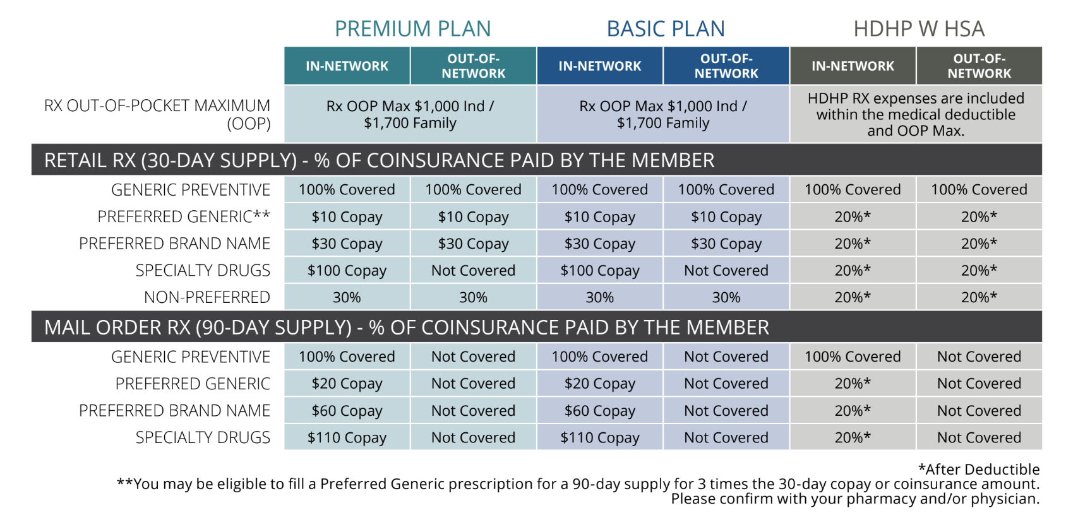
Pharmacy Plan Comparison Details
Notes:
As you can see, with both the Premium and the Basic plan, there is a copay model associated with pharmacy. Generic Preventive prescriptions are covered at 100% on all three plans. Prescriptions are priced based upon the “tier” of the medication. If you would like to understand more about the tier of a medication you or one of your dependents are currently taking, please contact TouchCare. Our team can assess your current medication and help determine if lower cost options might be available for you and which ”tier” your medication would fall under. Additionally – it is always important to discuss generic options with your physician or pharmacist. Please remember – you are the consumer and you have a right to ask questions!

Slide 31
Callouts: Preventative Meds and Generics
Preventative Medicines: Most are covered at no cost to you on all plans.
For a list of current preventive medications, please refer to the PV Core Plus drug list available through Premera’s website (https://www.premera.com/documents/052924.pdf).
This drug list applies to all three UA Choice Plans.
For more information on alternatives for non-preferred or excluded drugs, please visit Premera’s website at www.premera.com.
Generic Drugs: Brand-name drugs with the exact same dosage, intended use, side effects, route of administration, risks, safety and strength.
Because they are the same medicine, generic drugs are just as effective as brand-name drugs and undergo the same rigid FDA standards.
But on average, a generic version costs 80% to 85% less than the brand-name equivalent.
Notes:
Lets talk a bit more about the different levels of medication and what that means for you. Starting with Preventative medication and generic brands. <Read Slide>

Slide 32
Callouts: Speciality Meds and SaveonSP
Speciality Medications: Patients with complex chronic medical conditions need care management. Premera’s Specialty Pharmacy is a program that provides a full complement of specialized drugs and services.
If you are taking medications for a complex chronic medical condition, contact Accredo, an Express Scripts Specialty Pharmacy at 877-244-2995
Certain Specialty Drugs are $100 for up to a 30-day supply only from specialty pharmacy Accredo (Premium and Basic)
Visit here for more information or Call TouchCare at 866-486-8242
SaveonSP: The University of Alaska is collaborating with Express-Scripts’ program, SaveonSP, to help you save. Contact SaveonSP directly at 800-683-1074 to find out if your current medication is eligible. Participation is voluntary.
If you participate, your copay will be covered (thus no out-of-pocket costs to you!)
Notes:
<Read Slide>

Slide 33
7
Dental
Notes:
Moving on - to Dental benefits!

Slide 34
Only 60% of adults have been to the dentist in the past year.
If you use a dentist who doesn’t participate in your plan’s network, your out-of-pocket costs will be higher, and you are subject to any charges beyond the Reasonable and Customary (R&C). To find a network dentist, visit Premera Blue Cross at www.premera.com.
Notes:
This is an alarming statistic. Dental health plays a significant role in the overall health of an individual. If you are one of the individuals in the 60% stated above, please reach out to TouchCare. We will find an in network dentist who is accepting new patients so you can begin your dental hygene health journey!

Slide 35
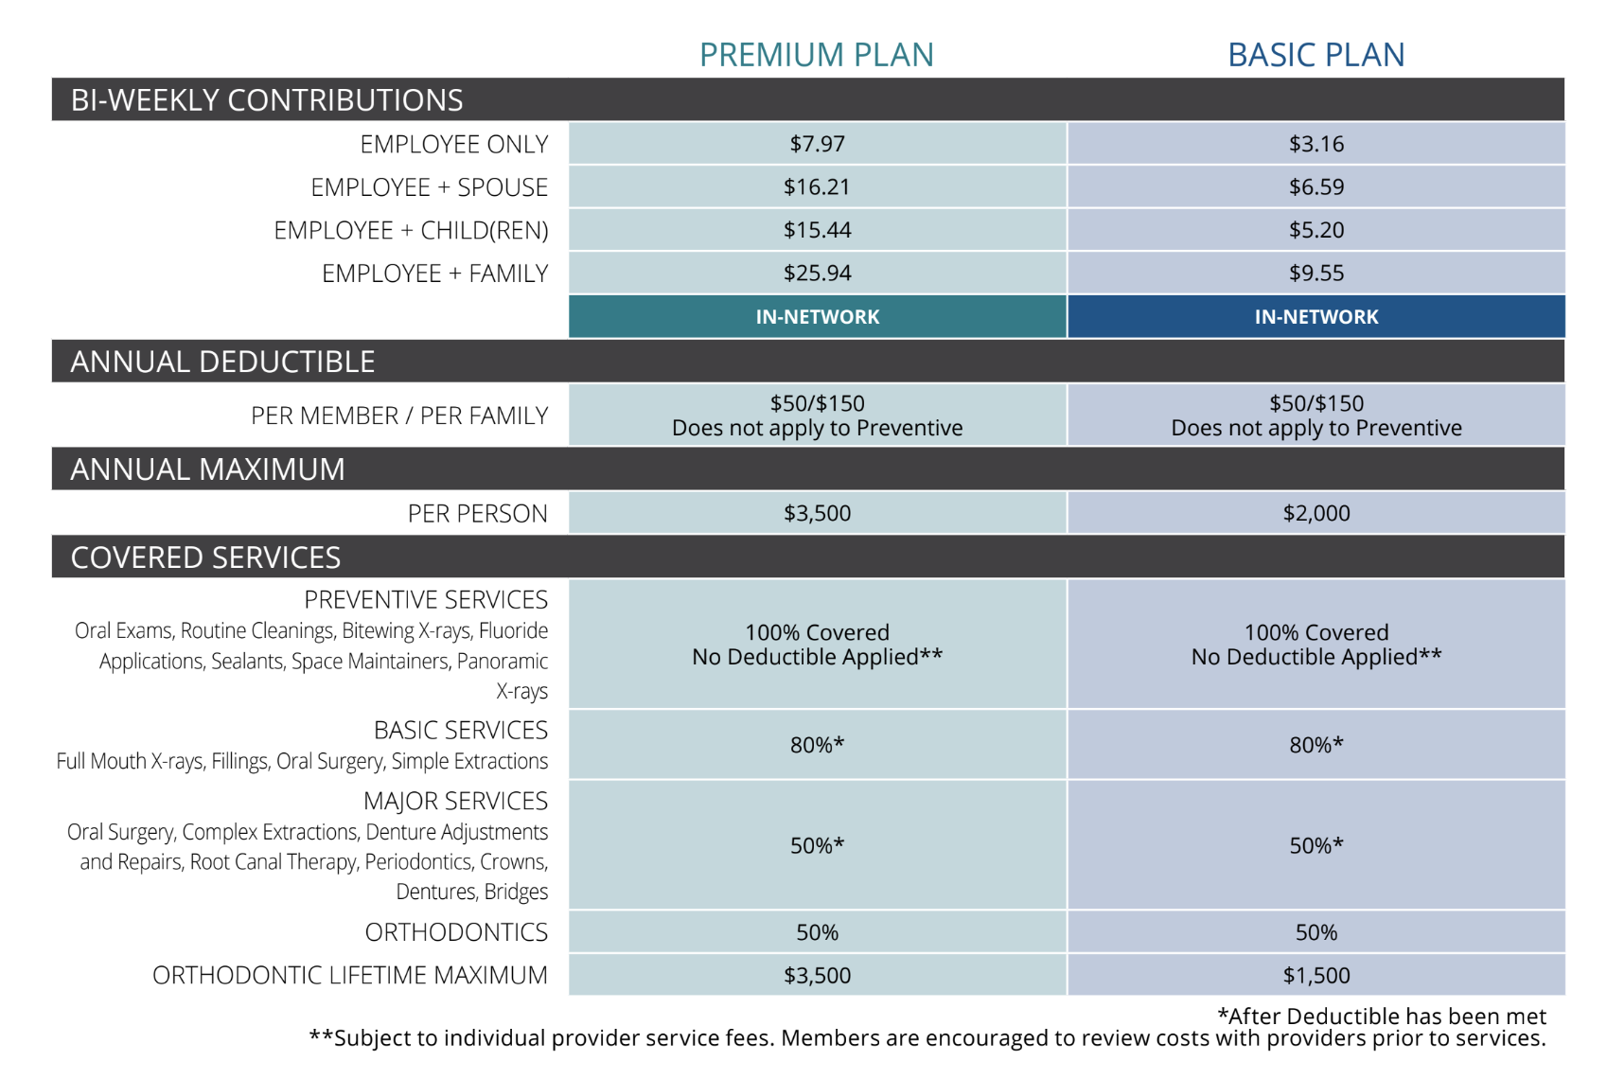
Dental Plan Comparison Details
Notes:
There are two Dental plans offered through U of A. One important call out is that both plans have orthodontia coverage - at different amounts. For those of you who might need braces in your family, please consider this when you are selecting your dental plan.
Also important to remember: Dental insurance maximum benefits work differently than your medical maximum out of pocket that we discussed. The annual maximum with dental plans means, this is the maximum amount your benefit will cover. Once your plan has paid the maximum, you will be responsible for the in network, contracted rate that your dentist charges.
Don’t forget: if you decide to participate in the FSA or the HSA plans, any out of pocket dental expenses for you or your tax dependents can be paid for via these funds.
As a final reminder - some dental procedures could be covered under your medical plan. Please contact TouchCare if you have any questions.

Slide 36
8
Vision
Notes:
Let’s move on to your vision plan…

Slide 37
More than 150M Americans use corrective eyewear to compensate for refractive errors.
Don’t wear glasses? Even you shouldn’t skip an annual eye exam! University of Alaska provides you and your family access to quality vision care with a comprehensive vision benefit through VSP.
Notes:
Read slide

Slide 38
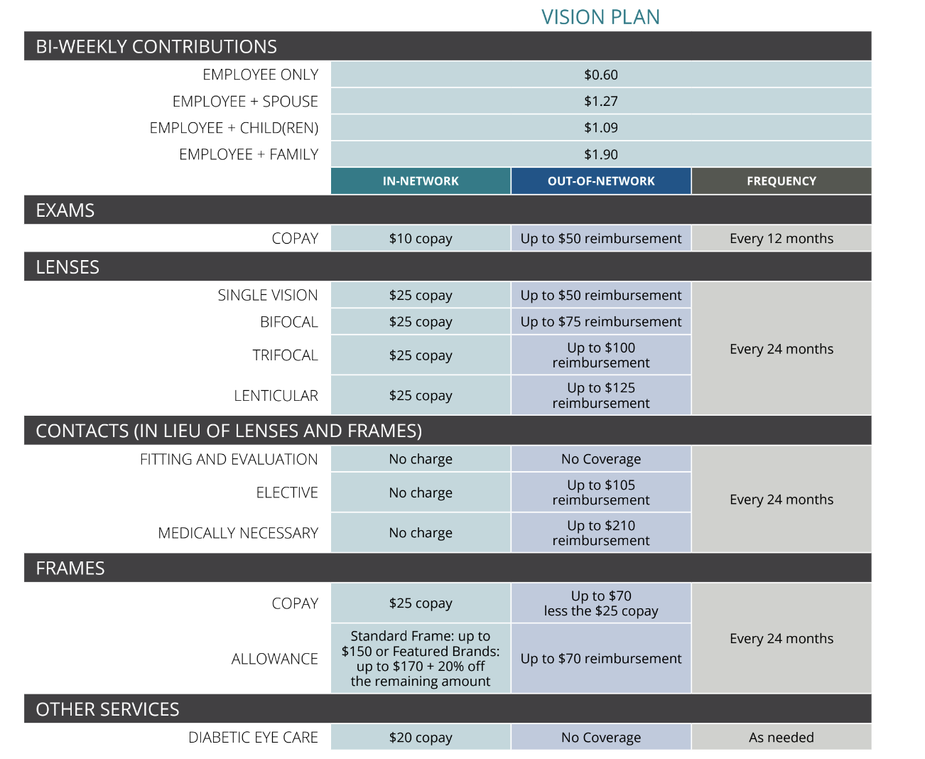
Vision Plan Comparison Details
Notes:
The University of Alaska offers vision coverage through VSP. Please contact TouchCare if you need assistance locating an in network provider. This particular plan does provide both in and out of network coverage, but it is always best to stay in network when possible. Like dental, Out of pocket expenses for vision can be covered using your FSA or HSA card – including prescription glasses, prescription sunglasses, or contacts.

Slide 39
9
Ancillary
Notes:
Finally, let’s discuss the ancillary benefits that are offered this year.

Slide 40
What is a HSA?
Your HSA is a personal bank account that you own and administer.
You decide how much you contribute, when to use the money for medical services or supplies and when to reimburse yourself.
You can save and roll over unused HSA funds to the next year or let funds accumulate year over year to use for eligible expenses in retirement.
Use your Bank of America Benefit Solutions debit card to pay for qualified medical expenses. Contributions are made through payroll deductions on a pre-tax basis.
REMINDER: HSA aligns with the CALENDAR year (Jan 1 – Dec 31). HSA can be adjusted ANYTIME throughout the year. No enrollment period is necessary
A Health Savings Account (HSA) is a personal healthcare bank account used to pay for
qualified medical expenses. HSA contributions and withdrawals for qualified healthcare expenses are tax free.
You must be enrolled in UA’s HDHP or a qualifying plan to participate.
Notes:
Read HSA

Slide 41
Important HSA Tips:
You Are Eligible to Contribute to an HSA if:
A Health Savings Account can be use for qualified expenses for you, your spouse or tax dependents even if they are NOT on your plan!
You must be enrolled in the HDHP to maintain an HSA
If you are switching from an FSA to an HSA, you cannot have any balance in your FSA after 6/30/24. If there is even $1.00 in your FSA on 7/1/24, you will not be able to contribute money to your HSA account until 1/1/25.
You are enrolled in an HSA eligible plan and NOT otherwise covered by a non-eligible plan (this includes spouse coverage, Medicare and TRICARE.
You are NOT covered by your Spouse’s non-HDHP
You were NOT previously contributing to an FSA or will not carry an FSA balance after 6/30/23
Your spouse does NOT have a healthcare FSA or an HRA (Health Reimbursement Amount).
You are NOT eligible to be claimed as a dependent on someone else’s tax return.
You are NOT enrolled in Medicare or TRICARE
You are NOT received Department of Veterans Affairs medical benefits in the past 90 days for non-service-related care. (Service-related care will not be taken into consideration.)
Notes:
Read HSA

Slide 42
It’s up to you how much you contribute.
HSA funds are your funds. You do not lose them, regardless of employment!
Notes:
Read

Slide 43
What is a FSA?
A Flexible Spending Account (FSA) is a special tax-free account you put money into to pay for certain out-of-pocket expenses. Unlike the HSA, you may enroll in an FSA regardless of if you choose a UA Choice plan or not.
Funds in your Healthcare FSA can be used for qualified medical expenses (deductibles, copays, coinsurance, menstrual products, PPE, over-the-counter medications, etc.) with pre-tax dollars.
Funds in your Dependent Care FSA can be used for qualified expenses for care for elderly or child dependents.
Funds in your Limited Purpose FSA can be used for qualified dental and vision expenses only. You must be enrolled in the UA HSA to qualify for the LP FSA.
Notes:
READ

Slide 44
Your Health Care FSA can be used for medical services including chiropractic care, acupuncture, glasses, orthodontia, and more…
Notes:
Read

Slide 45
FSA vs HSA
Plan Feature | HC FSA | DC FSA | LP FSA | HSA
Who can enroll? | Any benefit-eligible employee regardless of plan election or opt out status | Any benefit-eligible employee regardless of plan election or opt out status | Benefit-eligible employees who are contributing to a UA HSA only | Any benefit-eligible employee who is enrolled in the HDHP or other qualifying plan
Annual Limit | $3,200 | $5,000 | $3,200 | $4,150
Who contributes and how? | Employee thru payroll deduction | Employee thru payroll deduction | Employee thru payroll deduction | Employee thru payroll deduction
New bank account? | No | No | No | Yes
Will the money “go away” at the end of the year? | Yes | Yes | Yes | No
Can you use money that is not yet in the account? | Yes | No | Yes | No
Portable when you leave? | No | No | No | Yes
Notes:
Review slide but call out:
Although the full amount you select for your MEDICAL FSA is available immediately, this is not the case with the dependent care FSA. Funds can only be used if they have been deducted from your paycheck for the dependent care FSA. If you have any questions, please contact TouchCare.

Slide 46
What is an EAP?
The university’s Employee Assistance Program is a FREE benefit through Vivacity/ComPsych
You have 24-hour access to helpful resources by phone
The EAP benefit includes eight visits with a licensed professional.
You may access information, benefits, educational materials and more either by phone at 800-851-1714 or online at www.compsych.com
EAPs deliver a comprehensive, global approach to addressing employee problems so that organizations stay ahead of workforce issues.
The EAP benefit includes eight visits per issue with a licensed mental health professional. All services provided are confidential and will not be shared with University of Alaska.
Notes:
Review the slide and then say:
The EAP provided to you through The University of Alaska also provides access to LegalConnect. This service includes a free 30 minute consultation and a professional service fee reduction for matters such as: divorce, adoption, family law, wills, trusts and more.
Financial Connect is another resource that provides 24/7 access to resources for retirement planning, taxes, relocation, mortgages, insurance, budgeting, debt, bankruptcy and more.
FamilySource provides 24/7 access to resources such as child and elder care, hiring movers, home repair contractors, planning events – or even finding pet care.
Guidance Resources Online is a way to access tools, podcasts, on-demand trainings – and more. You can also “ask an expert” to receive personal responses to questions you might have.
Well-being and lifestyle coaching is a telephonic or video support tool you can use for individual well being or to help you reach personal goals.
And Finally:
Take the Highroad: If you are an avid cab, Uber or Lyft user you can receive up to $45.00 reimbursement for these services one time per person per year.
A few other examples of why you might leverage your EAP are:
Work / life balance challenges, relationship challenges, managing change, financial difficulties, parenting frustrations or simple, daily stress.

Slide 47
Survivor Benefits: Employee
Notes:
Last year, The University of Alaska offered $50,000 as a basic life insurance benefit. Great news! This year – your employer has increased life insurance coverage to $100,000! If you are a full time employee, you automatically receive Basic Life Insurance even if you elect to waive other coverage. This is offered to you at no cost, paid 100% by your employer. Please note: there is an IRS tax implication for life insurance plans in excess of $50,000.00. We encourage you to speak with your accountant or an attorney to establish your will or trust. Don’t forget – you have access to your free EAP if you do not have a will.
Additionally, beyond the $100,000 provided through your employer, you an also purchase supplemental coverage for yourself with a maximum benefit of $600,000.00 This means, through the University of Alaska, you could establish $700,000.00 of life insurance coverage for yourself. Evidence of insurability is required when you are electing over $200,000 of supplemental coverage. If you are over the age of 65, Evidence of Insurability is required if you are electing over $100,000.00
In addition to yourself, you can also elect to purchase up to $150,000 of voluntary term coverage for your spouse. You can elect up to $50.000.00 without having to answer medical history questions.
Coverage is also available for your children for a flat amount of $10,000.00 per dependent.
Please remember: Even if you are not enrolling in any other plans, basic employee life insurance is provided to you automatically, however you will need to include beneficiary information. You will not be able to select life insurance coverage without this beneficiary information. So your beneficiary information is needed even if you are only selecting the insurance offered to you (for free) through The University.

Slide 48
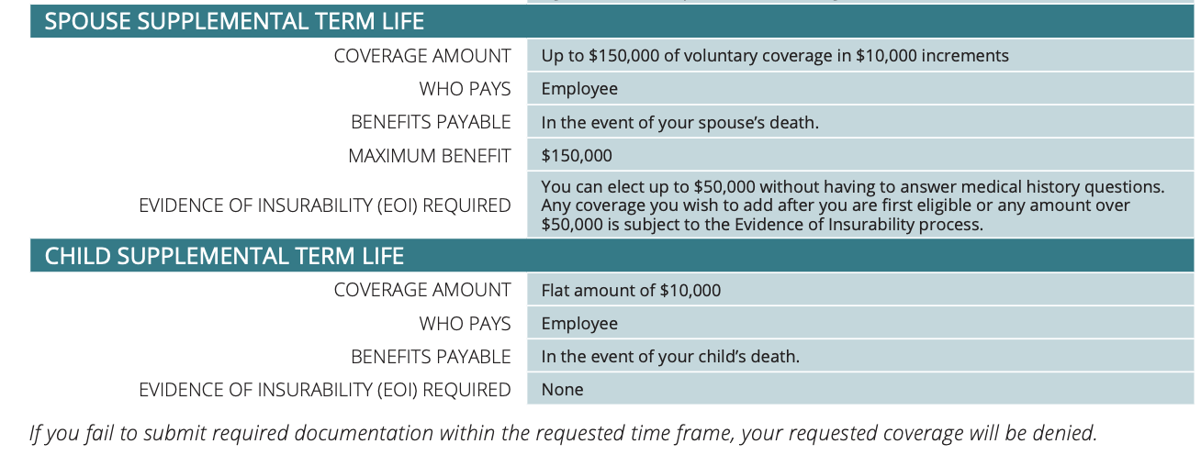
Survivor Benefits: Dependents

Slide 49
Survivor Benefits: AD&D
Notes:
Review the slide

Slide 50
10
Other Important Benefits
Notes:
So far, we have discussed many of the benefits that are top of mind to most individuals. Now, let’s discuss additional benefits that are offered through the University.

Slide 51
Additional Benefits: STD, LTD and Premera
Short Term Disability (No Cost):
Weekly Maximum Benefit: $800.00
Maximum Benefit Period: 11 Weeks
Long Term Disability (No Cost):
Monthly Maximum Benefit: $3,000.00
Maximum Benefit Period: Payments will last for as long as you are disabled or until you reach your Social Security normal retirement age, whichever is sooner.
Livongo Diabetes & Hypertension Management (No Cost):
For employees and covered dependents who are enrolled in a UA Choice Health plan. Support and medical supplies for diabetes, diabetes prevention, hypertension and weight loss.
BestBeginnings (No Cost):
Giving families the best possible start with a comprehensive maternity program. From pregnancy to delivery, postpartum and newborn care, BestBeginnings provides information and support throughout your journey.
Notes:
Review the slide

Slide 52
Additional Benefits: Premera
Prenatal Care:
Helpful information about pregnancy and proper prenatal care is available by calling the 24-hour nurse line at 1-800-841-8343.
TalkSpace:
With TalkSpace, you can easily connect to therapists and psychiatrists by video, phone call, and text for about the same cost as an in-person visit. Please sign up via the dedicated TalkSpace website through Premera by visiting: www.premera.com/visitor/mentalhealth.
Brightline:
Brightline provides confidential video visits with licensed clinicians for your children and resources or skills that provide assistance to parents and caregivers. Chat with a coach or schedule a video visit by visiting: www.hellobrightline.com/premera?referrer=access.
Substance Use Disorders
Premera offers BoulderCare for opioid use disorders and addiction treatment. These services are offered virtually for easy access. Visit: start.boulder.care.
Notes:
Review the slide

Slide 53
Additional Voluntary Benefits…. Visit: alaskaedu.corestream.com
Accident:
This benefit, available through The Hartford, provides benefits for you and your covered family members if you have expenses related to an accident that occurs outside of work. If you have active children – please consider this benefit!
Critical Illness:
Coverage through The Hartford pays a lump-sum benefit of either $15,000 or $30,000 if you are diagnosed with a covered disease or condition. You can use this money for whatever you like!
Hospital Indemnity:
The Hartford pays cash benefits directly to you if you have a covered stay in a hospital or ICU. You can use funds to cover any expenses or personal needs.
Identity Theft:
Access to identity theft protection is available through Allstate ID. Millions of transactions are monitored every second, alerting you to suspicious activity by text, phone or email.
Prepaid Legal:
LegalShield offers you and your family low-cost access to attorneys for a wide variety of personal legal services.
ASPCA Pet Insurance: SEE LINK
Save up to 10% on ASPCA Pet Health Insurance. You can use any vet, specialist, or emergency clinic!
www.aspcapetinsurance.com/UniversityofAlaska
Priority Code: EBUniversityofAlaska
Notes:
Review the slide

Slide 54
11
Important Reminders

Slide 55
Open Enrollment officially begins on April 15, 2024 and ends on May 3, 2024.
Your new plan selection will become active on July 1, 2024 and will be active until June 30, 2025.
If you are selecting to participate in the HDHP with the HSA, you need to exhaust all Health Care FSA funds no later than June 30, 2024.
You cannot make plan changes after your open enrollment (OE) period ends unless you experience a Qualified Life Event (QLE). If you miss OE an do not have a QLE, you will need to wait until OE next year to make changes.
Remember to have all of your beneficiary and dependent information available at the time of Open Enrollment.
HSA accounts are based on the CALENDAR YEAR. FSA accounts are based on the PLAN YEAR.
If you need additional assistance with plan selections or if you have questions, please schedule a One-to-One consultation with TouchCare by visiting: www.touchcare.com/openenrollment
Notes:
Read Slide

Slide 56
Thank You

