Slide 1
Welcomes University of Alaska
to
Absence Management Training

Slide 2
Who is Unum and what is their role?
Leave Overviews
- FMLA - AFLA
- Short-term Disability (STD) / Long-term Disability (LTD) Overview
Intake Process
How the Continuous Leave Process works
How the Intermittent Leave Process works
How the Disability Plans work
Return to work
Responsibilities and Communications
Questions
Agenda

Slide 3
Absence Management Process

Slide 4
Who is Unum and what is their role?
Unum acts as a third party administrator for the University of Alaska’s Federal and State leave protections, STD, and LTD.
Unum will gather all of the necessary information and documentation to determine eligibility for each leave or claim type.
Unum will track all entitlement/time that is taken for all leaves and claims.
Unum will administer all appropriate communications to both you and UA.

Slide 5
Leave Overviews

Slide 6
The Family Medical Leave Act (FML) is a federal entitlement that gives eligible employees up to 12 weeks of leave. You may miss work due to:
FMLA Refresher –
What is it?
Your own serious health condition
A family member’s serious health condition
The birth, adoption, or foster care placement of a child
A qualifying exigency leave for a family member in the military
A military caregiver leave for a servicemember
*26 weeks of leave available for military caregiver

Slide 7
AFLA Refresher –
What is it?
The Alaska Family Leave Act (AFLA) provides eligible employees up to 18 weeks of leave in 24 months for:
Your own serious health condition
The serious health condition of a child, parent, parent-in-law or spouse.
Alaska FLA provides eligible employees up to 18 weeks of leave in 12 months for:
The birth, adoption, or foster care placement of a child

Slide 8
Who is eligible for FMLA and AFLA?
To be eligible for Federal FML, an employee must:
Have 12 months of service
Have worked 1,250 hours in the last 12 months prior to the request
To be eligible for Alaska FLA, an employee must:
Be scheduled to work full time for six months prior to the request, or
Be scheduled to work part time for 12 months prior to the request

Slide 9
Who is eligible for FMLA and AFLA?
Eligible for both FMLA and AFLA? Remember, leaves run concurrently if you are eligible for both Federal and state leaves.
Eligibility for other state leave laws may apply, depending on your work location, if outside of Alaska. Please contact Unum at 866-779-1054 to discuss your specific leave options.

Slide 10
STD and LTD –
What is it?
STD and LTD is partial income replacement for time off due to disability.
Short Term Disability (STD) Plan Design
Weekly 60% benefit to a maximum of $800
11 weeks maximum duration
14 day Elimination Period (must be disabled for this duration prior to being eligible for benefits)
University of Alaska paid benefit
May be offset by other sources of income
Long Term Disability (LTD) Plan Design
Monthly 60% benefit to a maximum of $3000
Maximum duration Normal SS Retirement Age (if under age 62 at time of disability)
90 day Elimination Period (must be disabled for this duration prior to being eligible for benefits)
University of Alaska paid benefit
May be offset by other sources of income
*Both benefits are considered taxable income

Slide 11
STD and LTD –
Who is eligible?
To be eligible for disability (STD and LTD):
you must be a benefit eligible employee working in the United States
you must be working at least 20 hours per week
University of Alaska pays the cost for this insurance coverage

Slide 12
Intake
Process

Slide 13
Intake process –
How to submit a leave request
So you need a leave. What do you need to do?
You don’t need to know what type of event, Unum will complete the set up of leave and disability files as appropriate based on the answers you give to the intake questions regarding your event.
You can submit your new event online, via our mobile app, or via phone
Your supervisor or an authorized individual may request a new event on your behalf by contacting HR at: ua-benefits@alaska.edu.
Regardless of how you reach out to Unum, we will walk you through a detailed Q&A in order to:
Validate your identity
Gather the information needed to set up their expert resources for successful decision-making
Answer any questions you may have
Provide you with next steps
You will also be given the opportunity to sign an authorization electronically or verbally depending on your submission type.

Slide 14
Integrated Claim and Leave Experience
ONE Specialist manages the claim and leave
Your employee submits ONE claim and/or leave for all products online, via mobile app, telephone or fax…
and completes an authorization using secure voice authorization, or via mobile app/online
Claim/leave assignment is completed and Eligibility Notification is sent within 2 business days.
Employers receive notifications in Claim & Leave InSight
One Specialist manages the claim and leave, so you have only one point of contact
Proactive outreach to clinical/ vocational staff to assess for intervention
Clinical & Vocational professionals continuously assess for return to work opportunities
You can check the status, update and upload information via the web or with our mobile app
UA can also check status, update and upload information on Claim & Leave InSight
Seamless transition to Long Term Disability / Life Waiver of Premium 30 days before the end of the STD maximum duration; Social Security advocacy begins
Claim Decision – STD claim and leave are approved and monitored for duration; employer and the employee are notified
SSDI advocacy with 95% of referred Unum applicants awarded SSDI²
Helping members achieve recovery and better health
For FMLA only and/or if the STD claim is not approved, the specialist opens communication with the employee. If certification is incomplete, we help gather information and provide an extension
If leave is approved or denied, we notify the employee and employer contacts.
The specialist confirms return to work with the employee 5-7 days before their original return to work date; confirms return with employer and advises on any next steps
14

Slide 15
Intake process –
What happens next?
Within 2 business days of a new leave/claim request, Unum will send you a written or electronic packet containing:
Notice of eligibility status for applicable coverages (e.g. FMLA, state leave, or STD coverage)
Request for medical information
Authorization form
FMLA Rights & Responsibilities, if eligible:
o Conditions of leave and employee
obligations
If you do not receive your packet by the third business day please contact Unum directly.
Unum will contact you in writing if additional information is needed and also by phone if you are not eligible and/or do not qualify.

Slide 16
Intake process –
What is the timeline for
a decision?
Certification is due 18 days from its request date
INITIAL NOTICE
Reminder is sent to the employee if certification not yet received
DAY 10
Closure notice is sent to employee if certification is not submitted
DAY 19
You are given the opportunity – at least 10 calendar days – to remedy any deficiencies if an incomplete or insufficient certification is submitted.
Within 2 business days of receiving a complete certification an approval or denial decision will be made.

Slide 17
Intake process –
Documentation
Complete documentation must support the need for leave due to a serious health condition as defined by the FMLA/state leave law
Integrated Event (Leave and STD are applicable) - definition of disability must also be met for purposes of STD benefits
Serious health condition - certification required
Baby bonding – certification not required
*A note about Pregnancy Related leaves and baby bonding time:
Pregnancy can be approved for basic recovery and prenatal care if no certification is received.
Standard pregnancy/prenatal care is defined as 6 weeks of post-partum recovery from the date of delivery and standard prenatal treatment.

Slide 18
How the Continuous Leave Process Works

Slide 19
Continuous Leave Process – When you are on FML
How you report your leave to UA
Time sheets will need to be completed through UAOnline using sick leave (EC 550) for any time you are absent from work due to your FML event.
How you report your leave to Unum
Due to the nature of continuous FML, an employee will not need to submit time to Unum unless:
There has been a change in status (i.e. moving to
intermittent FML time)
There has been a change in the return to work date
When an extension of leave is needed
Please contact Unum as soon as it is known that there is a change in status or schedule for your FML event.
Intermittent FML will be covered in the next section.

Slide 20
Continuous Leave Process – When you are on STD
How you report your leave to UA
Time sheets will need to be completed through UAOnline using STD (EC 622) for any time you are absent from work due to your STD event. This is an unpaid leave code as payment while you are on STD comes from Unum, not UA.
How you report your leave to Unum
When you call, file online, or go through the mobile app, we will determine if an STD claim needs to be marked up using the answers to your intake questions and this will be created after intake with your leave request.
Intermittent STD is described in the next section.

Slide 21
Continuous Leave Process – When you are on LTD
How you report your leave to UA
Please reach out to benefits at ua-benefits@alaska.edu if you are approved for LTD. Time sheets will not be completed during the time you are out continuously.
How you report your leave to Unum
When you near the end of your STD maximum duration of 11 weeks, your specialist will confirm if you are returning to work or require an additional extension. If an extension is needed, Unum will automatically set up the LTD claim approximately 30 days prior to the maximum duration of your STD benefits. You will then receive a letter and a phone call from your new LTD specialist.
Intermittent LTD is described in the next section.

Slide 22
How the Intermittent Leave Process Works

Slide 23
In order to manage intermittent leaves effectively, Unum carefully reviews medical certifications submitted to determine:
Certifying intermittent FML
The medical necessity for intermittent leave
The probable frequency of
episodes, if known
The estimated treatment schedule, if known
Please refer to the Important Information Document for additional detail on Continuous, Intermittent and Reduced Leave schedules. This document will be attached to the initial communication packet that you receive from Unum.

Slide 24
Intermittent Leave Process – When you are on FML
How you report your leave to UA
Time sheets will need to be completed through UAOnline using sick leave (EC 550) for any time you are absent from work due to your FML event.
How you report your leave to Unum We recommend using the mobile app or online system however you can also call in your missed time. Please report this time as soon as possible so that your entitlement can be reflected accurately.

Slide 25
Reporting Intermittent Time
The employee can report time to
Unum three different ways:
When reporting intermittent time, we
will request the following information:
Reason for the absence
Start/end time of absence
Duration of lunch (if within the absence timeframe)
If for treatment, healthcare provider
name and appointment time
Mobile App
Web Services
Telephonic

Slide 26
Intermittent Leave Process –
When you are on FML
ABSENCE REPORTING
Each absence reason is evaluated to ensure:
It is consistent with the leave reason
The frequency/duration is supported
There is no pattern of absence
The notice requirement is met
ENTITLEMENT DEDUCTION
Absences are entered to-the-minute to ensure:
Entitlement is accurate
Leave time replenishes correctly
RECERTIFICATION
For ongoing conditions, Unum requests certification
every 6 months to ensure:
The employee still needs intermittent leave
The estimated frequency/duration is still current
Exception: Conditions causing long-term or permanent incapacity (e.g. Alzheimer’s, terminal disease) will be recertified annually.

Slide 27
Monitoring Absence Frequency and Duration
Monitoring treatments and episode frequency
Absences are monitored to determine if a significant change in circumstances has occurred, justifying a need for recertification. A review by medical staff is triggered when an employee’s absences differ from the certification as follows:
Employee exceeds the healthcare provider’s
estimate on 3 or more occasions
Unknown frequency and duration
Healthcare providers are clearly directed to provide specific frequency/duration information
“Unknown” may be acceptable. If the healthcare provider is unable to predict how often an employee may need leave, Unum will allow 3 full or partial absences in a calendar month before reviewing for a significant change in circumstances.

Slide 28
Intermittent Leave Process – When you are on STD
How you report your leave to UA
Time sheets will need to be completed through UAOnline using STD (EC 622) for any time you are absent from work due to your STD event. This is an unpaid leave code as payment while you are on STD comes from Unum, not UA.
How you report your leave to Unum
Your reported time off will be captured in both your Leave and STD claim. You can report this time online, mobile or by calling. You will be required to report your part time earnings to your specialist and provide them with copies of your pay stubs.

Slide 29
Intermittent Leave Process – When you are on LTD
How you report your leave to UA
Please reach out to benefits at ua-benefits@alaska.edu if you are approved for LTD. When you are out intermittently, a schedule may need to be discussed to ensure your time sheets are generated properly.
How you report your leave to Unum
You will need to provide a copy of your part time pay stubs each month prior to your benefits being released.

Slide 30
How the Disability Plans Work

Slide 31
How the Disability Plans Work
STD and LTD are partial income replacement plans for time off due to a disability. Both are UA paid benefits provided to all qualifying benefit-eligible employees.
STD and LTD are taxable funds and payments are received directly from Unum.
Short Term Disability (STD) Plan Design
Weekly 60% benefit to a maximum of $800
11 weeks maximum duration
14 day Elimination Period (must be disabled for this duration prior to being eligible for benefits)
May be offset by other sources of income
Long Term Disability (LTD) Plan Design
Monthly 60% benefit to a maximum of $3000
Maximum duration Normal SS Retirement Age (if under age 62 at time of disability)
90 day Elimination Period (must be disabled for this duration prior to being eligible for benefits)
May be offset by other sources of income

Slide 32
Return to Work

Slide 33
Return to Work
Employees need to inform Unum of the following
Changes in estimated return to work dates as soon as possible/known
Confirmation of return to work date 5-7 days prior to returning
Unum takes the following actions
Calls/texts (if enrolled) the employee to verify return to work plans, as needed
Emails the employer if the estimated return to work date has changed
Confirms actual return to work date with employer via email

Slide 34
Responsibilities and Communications

Slide 35
Communication – between Unum and Employees
Notices
Initial eligibility and coverage status, designation decisions, ongoing date and status updates, etc.
Notices are sent to employee’s mailing address unless digitally enrolled into paperless correspondence
Employees can access digital services to:
Review notices
Submit information: updated dates, contact info, etc.
Report intermittent absences
Review STD or LTD pay information

Slide 36
Communication – between Unum, HR and your supervisor
Your supervisor receives an email at the following points:
New Leave Request
Projected Return to Work Update
Leave Status and/or date changes
Intermittent Hours Reported
Exhaustion Notification
Eligibility Information Needed (HR)
Return to Work Confirmation Needed

Slide 37
Employee Responsibilities
1
2
Contact Unum immediately to report leaves or disability claims
Notify manager/ supervisor of absence request
3
4
5
Supply requested documentation to Unum within specified timeframes
Provide Unum with signed copies of relevant authorization to release information
Notify Unum and manager/ supervisor of any changes in return to work status or date

Slide 38
HR Responsibilities
1
2
Provide employee with absence brochure as requested
Be sure all family and medical leaves are reported to Unum promptly
3
Facilitate an ongoing dialogue with Unum regarding status determinations, problem or suspect leaves, and other extenuating circumstances
4
Facilitate appropriate disciplinary or employment action based on the absence information on Daily and Weekly reports
If for any reason you have not reported a leave to Unum, then your manager/supervisor should do so in order to facilitate compliance.

Slide 39
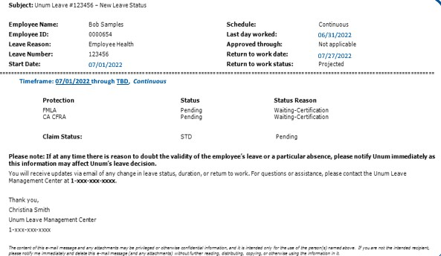
Sample of New Event Status Notification
Top fields Identifying information and leave
dates
Body
Detailed status of FMLA/state leave and disability (if applicable)
Status: pending, approved, denied
Status reason: waiting certification, short term disability decision, etc.
Multiple time frames may be represented
Contact information

Slide 40
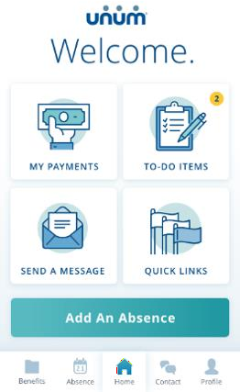
Easy Self Serve Tools Keep You Up to Date
Mobile app & employee desktop portal
Lets you easily:
Submit a leave
View status and updates
Provide authorizations
View letters
View outstanding information
Submit outstanding information
Send message to
specialist
Smart dashboard: Shows most commonly used items for easy access
Absence history: Comprehensive view of absence details, with available time and prior absences in both calendar and list views

Slide 41
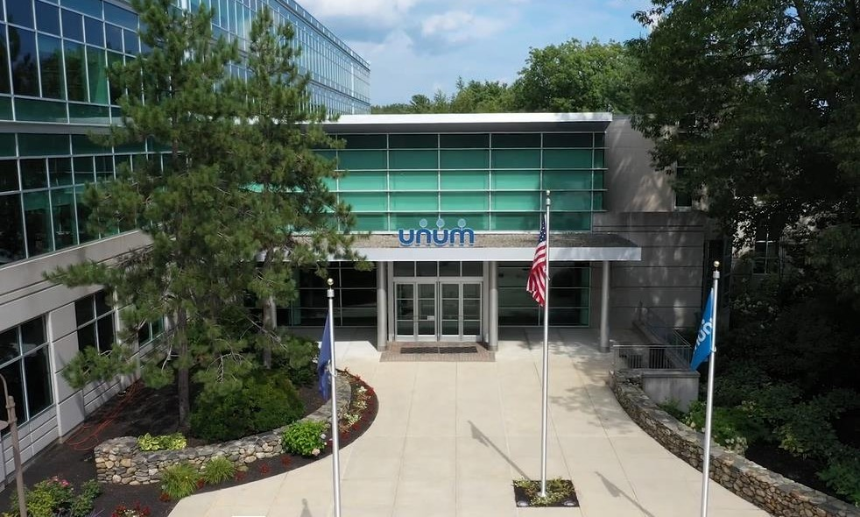
THANK YOU!
Insurance products are underwritten by the subsidiaries of Unum Group. © 2022 Unum Group. All rights reserved. Unum is a registered trademark and marketing brand of Unum group and its insuring subsidiaries.
ADR-1270356

