Slide 1
Annual Financial Report for Fiscal Year 2014
Presentation to: The Board of Regents
Ashok K. Roy, Ph.D., CIA, CBA, CFSA
Vice President for Finance & Administration/ CFO
December 12, 2014

Slide 2
Financial Highlights
FY2014 marked a year of stability, strength, and progress for the University of Alaska System.
The University’s financial assets were $1.9 Billion
with net position of $1.6 Billion.
Net position increased 13%, or $ 187.3 M
(FY13-14).
State support very robust – 47.3% of revenues.
Tuition & Fees – 15.3% of revenues.

Slide 3
The University’s college savings plans continue to be ranked among the top performing plans in the nation. (The T. Rowe Price College Savings Plan is one of four college savings plans in the nation awarded a “Gold” rating by Morningstar for 2014).
Portfolio managed on June 30, 2014
= $6.5 Billion.

Slide 4
Revenues & Expenses (operating & non-operating*) were $848.7 M and $847.8 M, respectively.
*not including Capital Appropriation ($186.3 M).
Total Operating expenses grew only 1.6%.
Operating funds were invested ( $144.2 M) for necessary liquidity, security, reasonable returns
UA’s Endowment balance = $146.2 M.
Investment return on our Consolidated Endowment Fund =12.5%.

Slide 5
Total Debt outstanding = $181.6 M.
Annual Debt Service = $17.3M (modest).
Annual Debt Service ratio = 2.8% of unrestricted revenues.
Maintained high Credit Ratings from both Standard & Poor (AA-) and Moody’s Investor Services (Aa2).
Total Budget = $914.2 M (FY13 – FY14).

Slide 6
4 Successful External Audits
Received “unmodified” opinion , the most favorable, from external/ independent auditors (Moss Adams LLP).
Received “unmodified” opinion from Pricewaterhouse Coopers, LLP. for the “Education Trust of Alaska”.

Slide 7
No exceptions/deficiencies noted in rigorous 7 month audit of F & A cost rates by Defense Contract Audit Agency.
(These rates are used on Federal grants/contracts for recovering indirect/overhead costs).
Received from Moss Adams “Single Audit” reports on federal awards in accordance with Government Auditing Standards and OMB Circular A-133.

Slide 8
Bottom-line:
We are pleased to report that the University of Alaska System continues to be financially healthy.

Slide 9
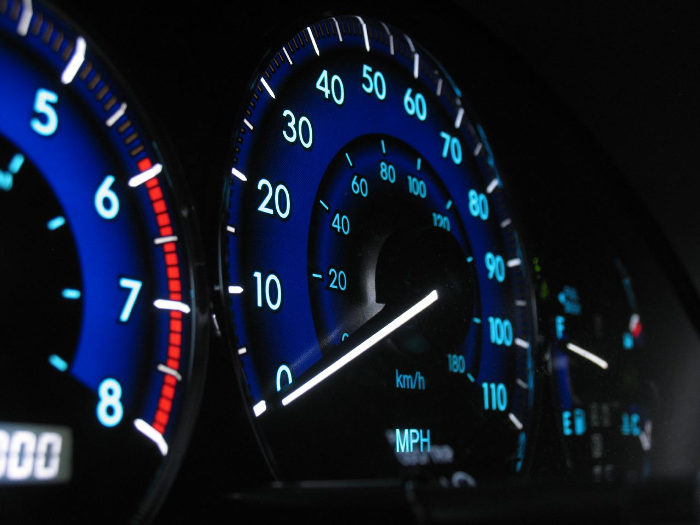
Graphical Presentation of Data

Slide 10
Condensed Statements of Net Position
Net Position | 2014 | 2013
Assets:
Current Assets | $ 171,236 | $ 143,039
Other noncurrent assets | 317,348 | 337,569
Capital assets, net of depreciation | 1,447,301 | 1,280,298
Total assets | 1,935,885 | 1,760,906
Liabilities:
Current liabilities | 117,980 | 120,515
Noncurrent liabilities | 186,679 | 196,427
Total liabilities | 304,659 | 316,942
Net position:
Net investment in capital assets | 1,255,355 | 1,076,861
Restricted – expendable | 69,987 | 78,443
Restricted – nonexpendable | 130,853 | 131,365
Unrestricted | 175,031 | 157,295
Total net position | $ 1,631,226 | $ 1,443,964
($ in Thousands)

Slide 11
Revenues/Expenses | 2014 | 2013
Revenues:
State Operating Appropriations | $ 385,887 | $ 371,051
Capital Appropriations & Grants | 186,331 | 191,809
Student Tuition and Fees, net | 125,104 | 127,055
Federal Grants and Contracts | 148,339 | 156,247
State, Local and Private Grants | 73,934 | 77,801
Auxiliary Enterprises | 37,717 | 40,008
Endowment Income | 19,065 | 18,992
Other | 25,780 | 32,226
Total Revenues | 1,002,157 | 1,015,189
Expenses:
Student and Academic | 365,749 | 363,074
Research | 129,842 | 132,905
Public Service | 45,361 | 41,360
Operations and Maintenance | 68,918 | 63,364
Institutional Support | 95,793 | 96,072
Auxiliary Enterprises | 35,714 | 35,276
Depreciation | 66,618 | 63,403
Other Expenses | 6,630 | 9,529
Total Expenses | 814,895 | 804,983
Increase in Net Position | $ 187,262 | $ 210,206
($ in Thousands)

Slide 12
Revenue Mix

Slide 13
Expenditure Mix by
Natural Classification

Slide 14
Expenditure Mix by Function

Slide 18
Operating Cash & Investments ($144M)

Slide 19
Financial Metrics

Slide 20
Viability Ratio

Slide 21
Return on Net Position Ratio

Slide 22
Primary Reserve Ratio

Slide 23
Composite Financial Index (CFI) (1 of 2)
Norm/Average= 3 (see red line)

Slide 24
Composite Financial Index (CFI) (2 of 2)

