Slide 1
Science Olympiad 2024 Alaska Coaches Meeting
December 15, 2023
Dan Nichols – National Program Director
DNichols@soinc.org

Slide 2
Introduction
Dan Nichols – National Program Director
Student competitor in high school
27 years as HS Biology Teacher
25 years as Head Coach –Whiting High School, IN
Tournament Director for 20+ tournaments
Indiana Science Olympiad board (2 terms as State Director)
National Event Supervisor
National Inquiry Committee Chair

Slide 3
Today’s Objectives
General Coaching Tips
Discuss Alaska Events
Questions

Slide 4
General Coaching Tips

Slide 5
The Most Important Thing to Do
Understand the Rules for your Event
Read & reread to find key information
Key information differs by event type
Use the key information to prepare for your event.
(This should be stressed with your students as well)

Slide 6
Coaching Tips
Practice, Practice, Practice
Create useful resource sheets for events that allow them.
Practice with your students under timed conditions as the tournament gets closer.
Use available resources to help prepare your students
Kahoot
Quizlet
Quizizz
EdPuzzle
YouTube
Google

Slide 7
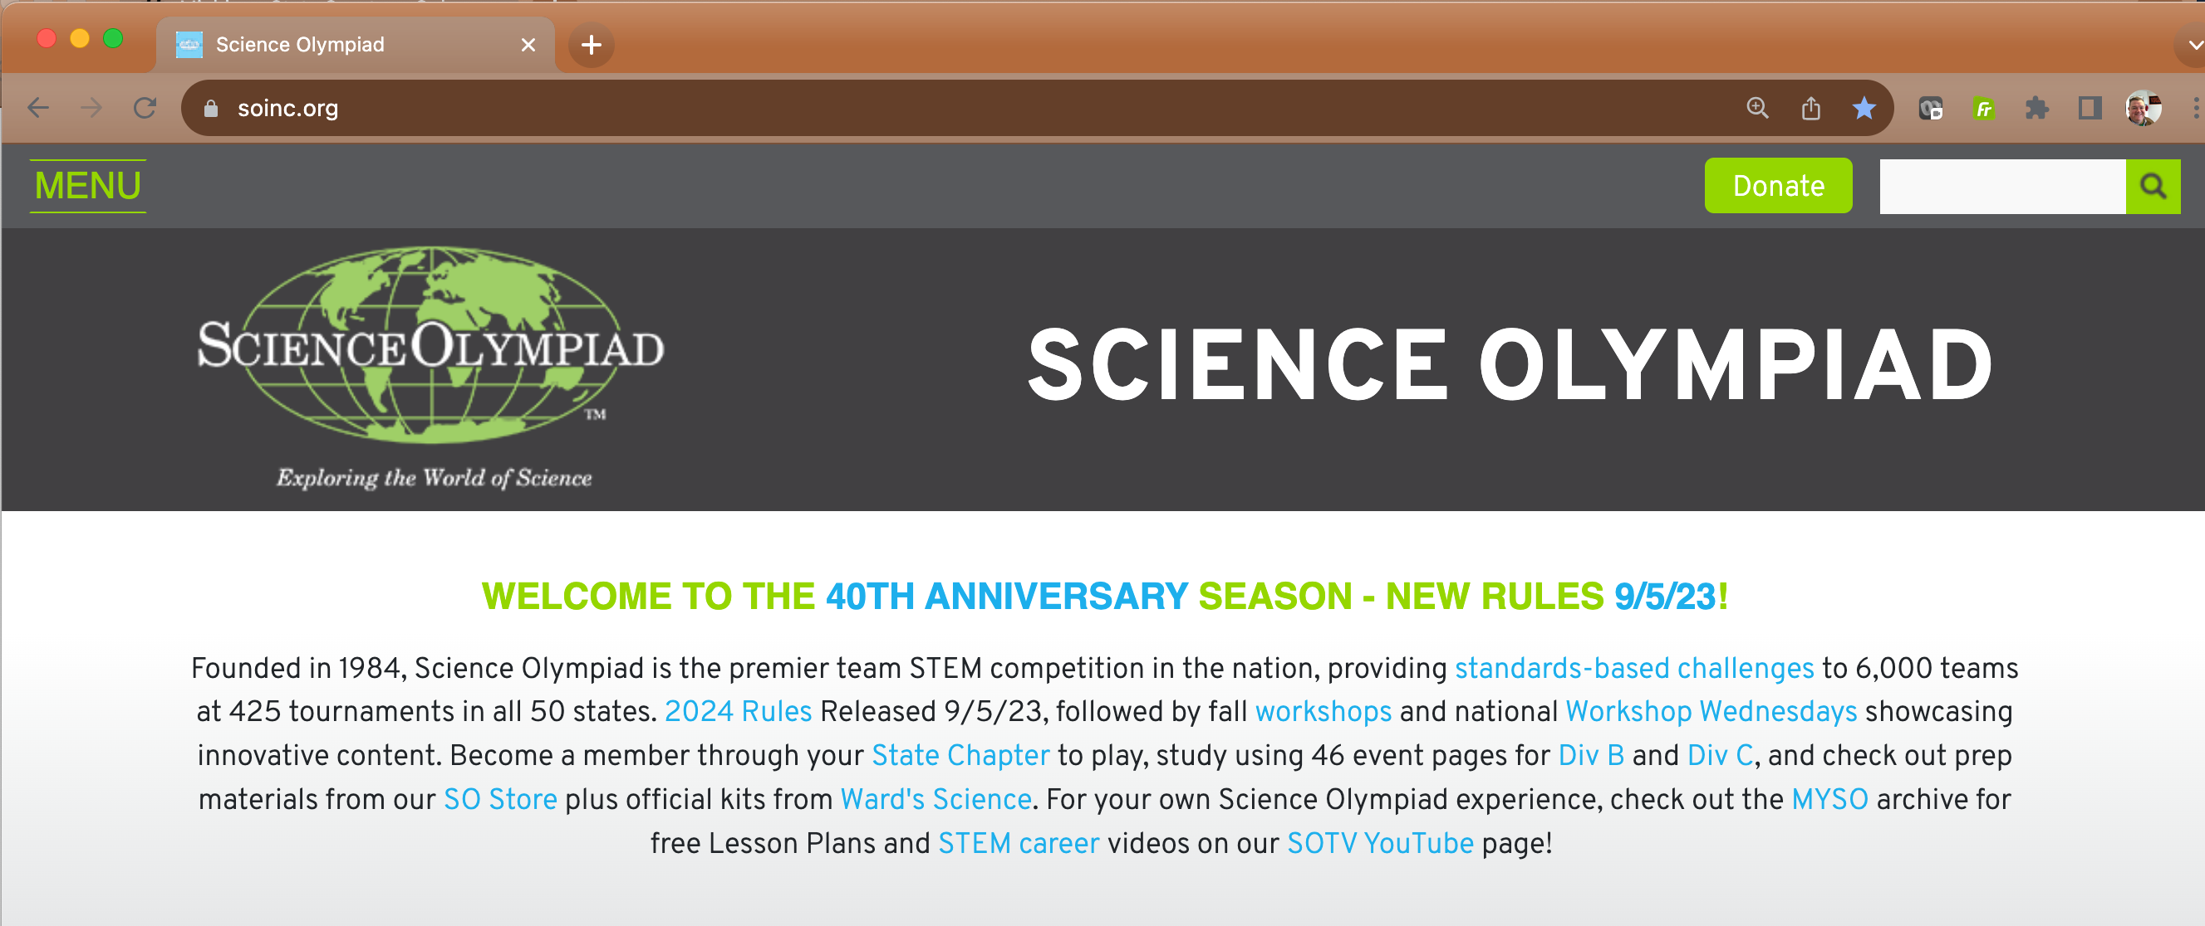
Science Olympiad Resources
Science Olympiad website (soinc.org)
Divisions B
Event Pages
FAQs & Rules Clarifications
Logistics Manual, Score Sheets, & Checklists
Other State Websites
Resources posted
North Carolina
Virginia
Notes:
Mention more samples as the season progresses

Slide 8
Science Olympiad TV
youtube.com/user/ScienceOlympiadTV
Event Videos
Tower Construction & Testing
Flight
US Forest Service Webinar
Wind Power
Workshop Videos

Slide 9
Other Science Olympiad Resources
Partner Sites
NASA – Universe of Learning
NOAA
CDC
NFFS
USDA – US Forest Service
SciOly – Student Forum & Wiki (scioly.org)
Khan Academy (khanacademy.org)
Annenberg Learner (learner.org)
Keep in mind that some aren’t necessarily Science Olympiad official

Slide 10
Alaska Event Questions

Slide 11
Alaska Life Science Events
Ecology – Tundra, Taiga and Deciduous Forest focus
Agricultural Science – Mariculture Focus – primarily Kelp and Oyster farming Only doing part A of the event (test portion)
Disease Detectives – Scientific study of disease, injury, health and disability in populations
Anatomy and Physiology – Cardiovascular, Lymphatic and Excretory systems

Slide 12
Alaska Chemistry & Physics Events
Can’t Judge a Powder – Students will collect observations from one testing on substance. They will then tell the observation that has the answer to questions about the substance.
Lab equipment, Goggles and Aprons will be provided at the tournament.
Air Trajectory – Students will design, construct and test a device capable of launching projectiles at a target

Slide 13
Alaska Inquiry Events
Experimental Design – students will design, conduct and report the findings of an experiment conducted on site
Codebusters – students will decode encrypted messages
https://toebes.com/codebusters/
Write It, Do It – One student writes a description of how to build an object, the second student uses the description and unassembled parts to create a replica of the object

Slide 14
Alaska Earth/Space Science Events
Meteorology – focus on Severe weather and Storms
Dynamic Planet – Understanding large scale processes effecting the structure of the earth’s crust
Reach for the Stars – Formation and early-stage evolution of stars
Fossils – identify and classify fossils and demonstrate knowledge of ancient life

Slide 15
Alaska Technology Events
Flight – design, construct and test a rubber powered air craft
Roller Coaster – design, construct and test a gravity powered Roller Coaster track
Tower – design and construct a Tower with the highest structural efficiency
Wheeled Vehicle – design, build and test a vehicle powered by a non-metallic elastic material

Slide 16
Mariculture Resources
-Field Guide to Seaweeds of Alaska
-Kelp Hatchery Manual
-NOAA Aquaculture and Education Materials Website
-ADF&G Aquatic Farming Website
-Aquatic Farming Operations Map
-Alaska Mariculture Research and Training Center
-Alaska Sea Grant Aquaculture Website
-Horn Point Oyster Hatchery
-Alutiiq Pride Marine Institute HAB manual
-Lowman et al. 2021 Nutritional Quality of Giant Kelp declines due to warming ocean temps
-Mattner et al. 2013

Slide 17
Bonuses
Air Trajectory Device Build Instructions
Tower materials
Tower Plans
Tower clinic presentation
Tower rules graphic

Slide 18
Useful Links
https://www.soinc.org/events/2024-division-b-events
https://scioly.org/wiki/index.php/Main_Page
https://ncscienceolympiad.ncsu.edu/resources/
https://www.virginiaso.org/events-bc
https://toebes.com/codebusters/
Event Logistics Resource

Slide 19
Questions?

