Slide 1
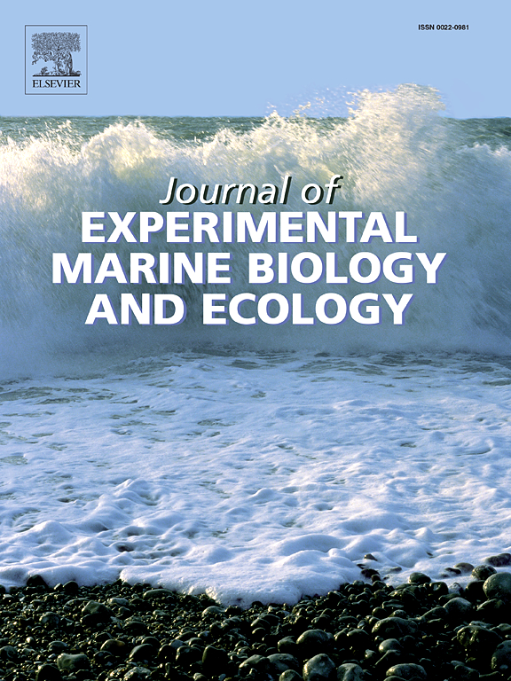
How to Get Published!
Will White
^{Oregon State University}
Stephanie Kamel
University of North Carolina Wilmington
Peter Petraitis
^{University of Pennsylvania}
14 Sept 2023
Notes:
funding from OPC…

Slide 2
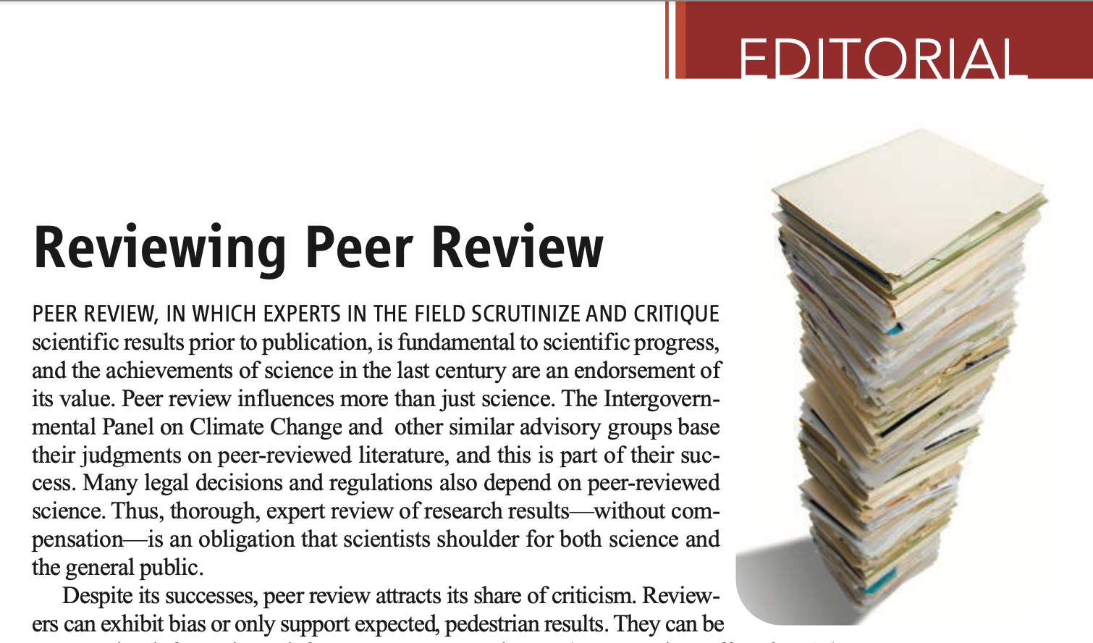
Why do we publish…and why peer review?
Tell the world about your science!
Objectively critique work and ensure best practices
Quality assurance for the reader & public
Career advancement – for you and others
Imperfect! But the best system we have…
Science (2008)

Slide 3
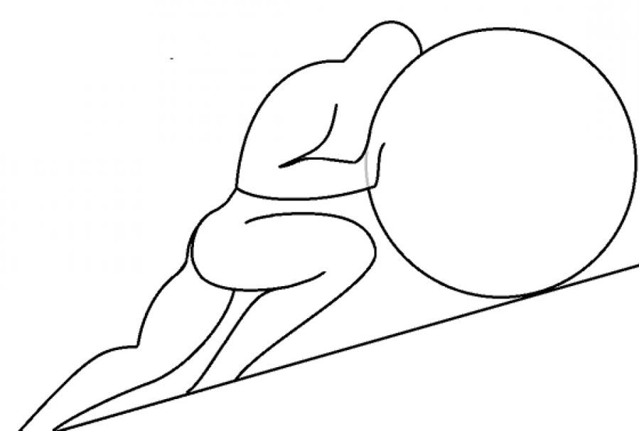
The Publication Process
Invite reviewers
(slooooow)
Wait for reviews
(slooooow)
Editor decision
Accept!
Submit to journal
Reject
Desk reject
Revise/resubmit
Major revisions
Minor revisions
Publicize!!
Revise/resubmit
Published!
Page Proofs

Slide 4
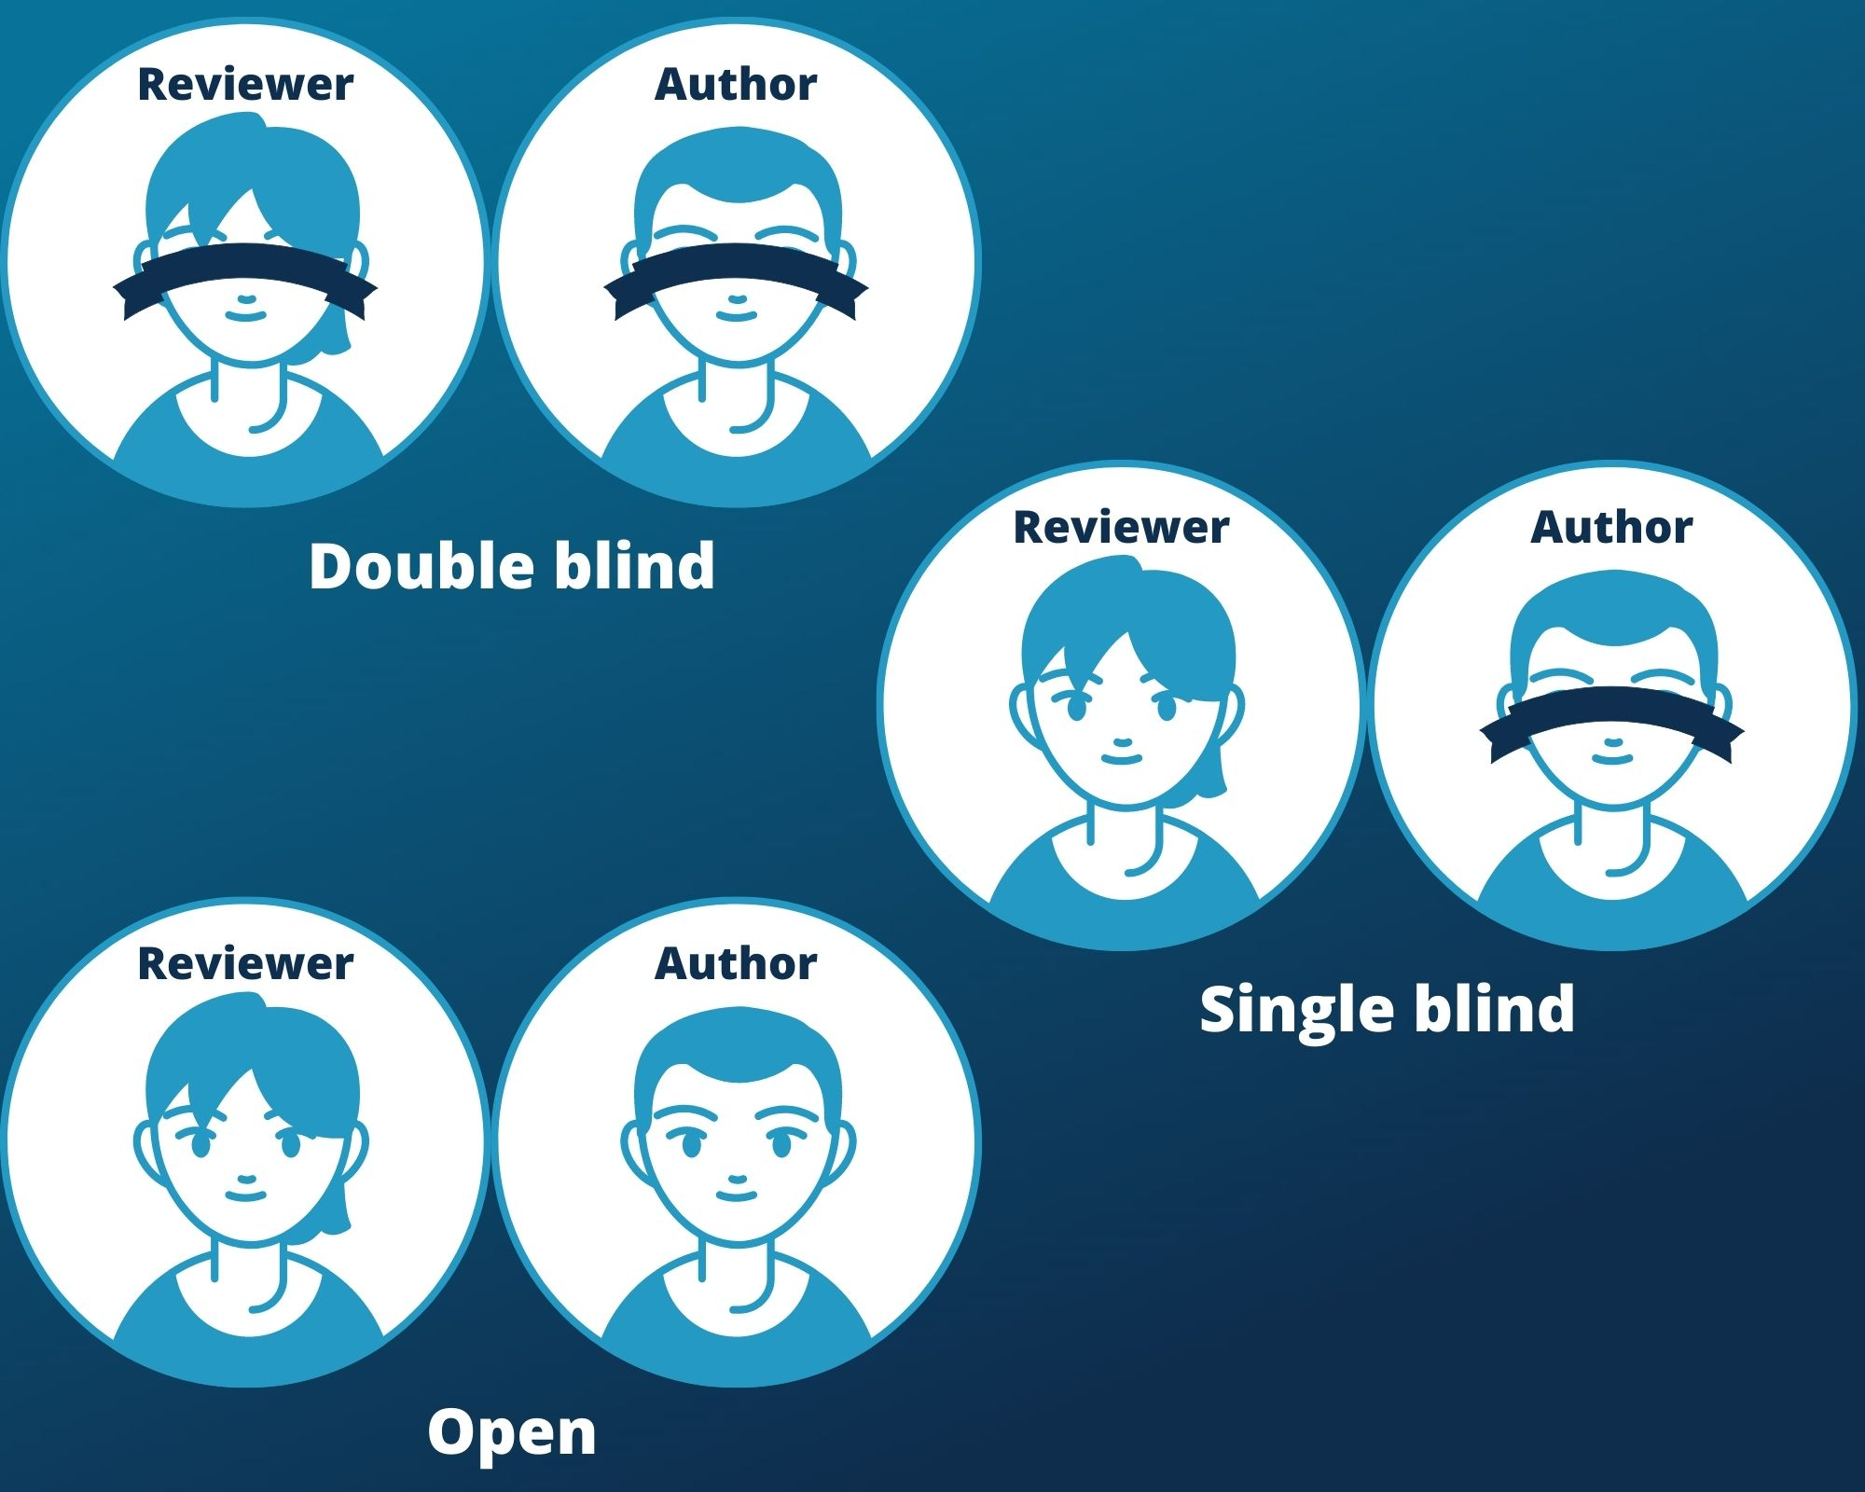
Peer Review Models
Single Blind
Double Blind
Open/Unblind
fourwaves.com

Slide 5
Publication Models
Subscription-based (free to publish/pay to access)
Page charges (pay to publish/pay to access)
Open Access (pay to publish/free to access)
OA optional journals (e.g., JEMBE)
‘Impact free’ (e.g., PeerJ, PLoS ONE)
Predatory (e.g., MDPI)

Slide 6
How to Find the Right Journal?
Impact Factor?
Journal impact ≠ paper impact
Broad vs. subfield
Who’s the audience?
Journal scope
Journal webpage
Look at recent issues
Look at the papers you are citing
Things not to care about:
Journal statistics on turnaround time
Things to care about:
Where are your colleagues publishing?
Past experiences with the editors

Slide 7
How Do I Get My Paper Noticed?
Right audience?
Question → Answer
Tell a story … and what it means beyond your study site
Clear take home message

Slide 8
Getting Ready for Submission
• Check journal’s style guide + recent papers
Use a reference manager!
Many journals don’t fuss about formatting in the first round
• Use page numbers and continuous line numbers
PLEASE suggest reviewers
Pointing out conflicts of interest is OK … within reason
The Cover Letter
Not super important! Many editors ignore it
Quick statement of impact & journal fit, NOT another abstract

Slide 9
Responding to Reviews
Make it EASY for the editor and reviewers
Point by point responses
Ask peers & mentors for examples and advice
Paste in revised passages, don’t just point to line numbers
OK to disagree, but be respectful and justify yourself
Sometimes reviews ask the impossible! Explain why it is so
Thank your reviewers!
OK to ask for extra time
OK to ask the editor to resolve conflicting advice

Slide 10
Diversity, Equity, Inclusion in Publishing
Lots of opportunities for bias!
Things that journals can do or do better
Diversify editorial board and reviewer pool
Filter reviewer comments to remove bias or unprofessional language
Arbitrate disputes and conflicts of interest
Things that authors can do to minimize risk
Initialize first names
Suggest reviewers
Networking (conferences, social media)

Slide 11
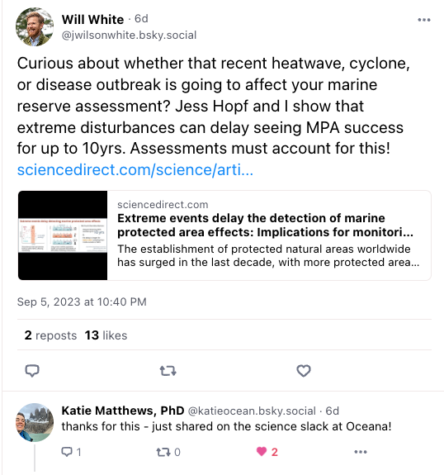
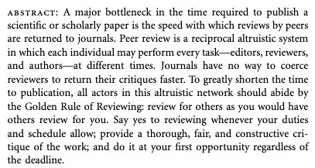
So, You’ve Published
Publicize your paper! Press releases
Agree to review! Don’t be a freeloader
Am Nat (2009)

Slide 12
Questions?
will.white@oregonstate.edu
https://blogs.oregonstate.edu/whitelab/
@j_wilson_white
@jwilsonwhite.bsky.social
kamels@uncw.edu
thekamellab.com
ppetrait@sas.upenn.edu
https://www.bio.upenn.edu/people/peter-petraitis

Slide 14
Comparing Journal Scopes
JEMBE
(experimental marine ecology)
Marine Biology
(could include descriptive studies)
Restoration Ecology
(applied restoration science)
vs.
Transactions of the American Fisheries Society
(applied fisheries)
Theoretical Ecology
(modeling and theory)

Slide 15
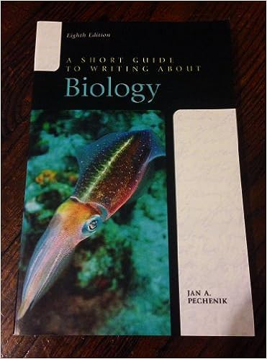
Preparing your Manuscript
• Scientific writing courses/seminars
Be kind
Make it easy for editor/reviewers
Authorship & author contributions
Acknowledgements are free! Be kind & don’t forget reviewers
Write so that any journal reader could figure it out
(PNAS -> Ecology -> JEMBE)
Introduction: End with question/goal
Methods: How did you answer that question?
Results: What is the answer to the question?
Discussion: What does the answer mean in context?

Slide 16
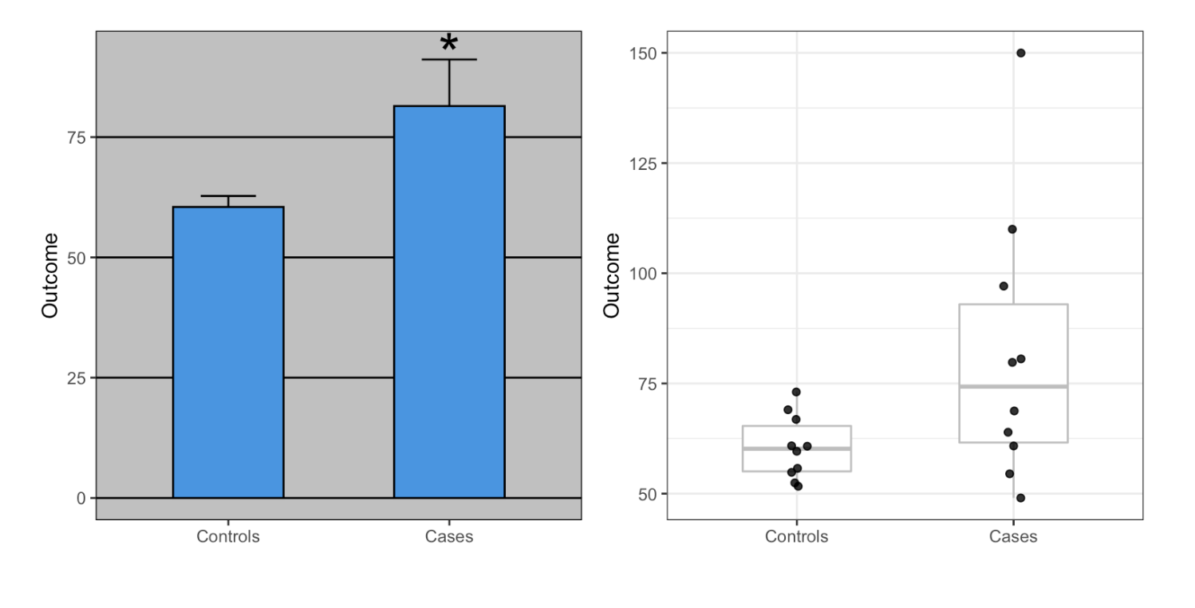
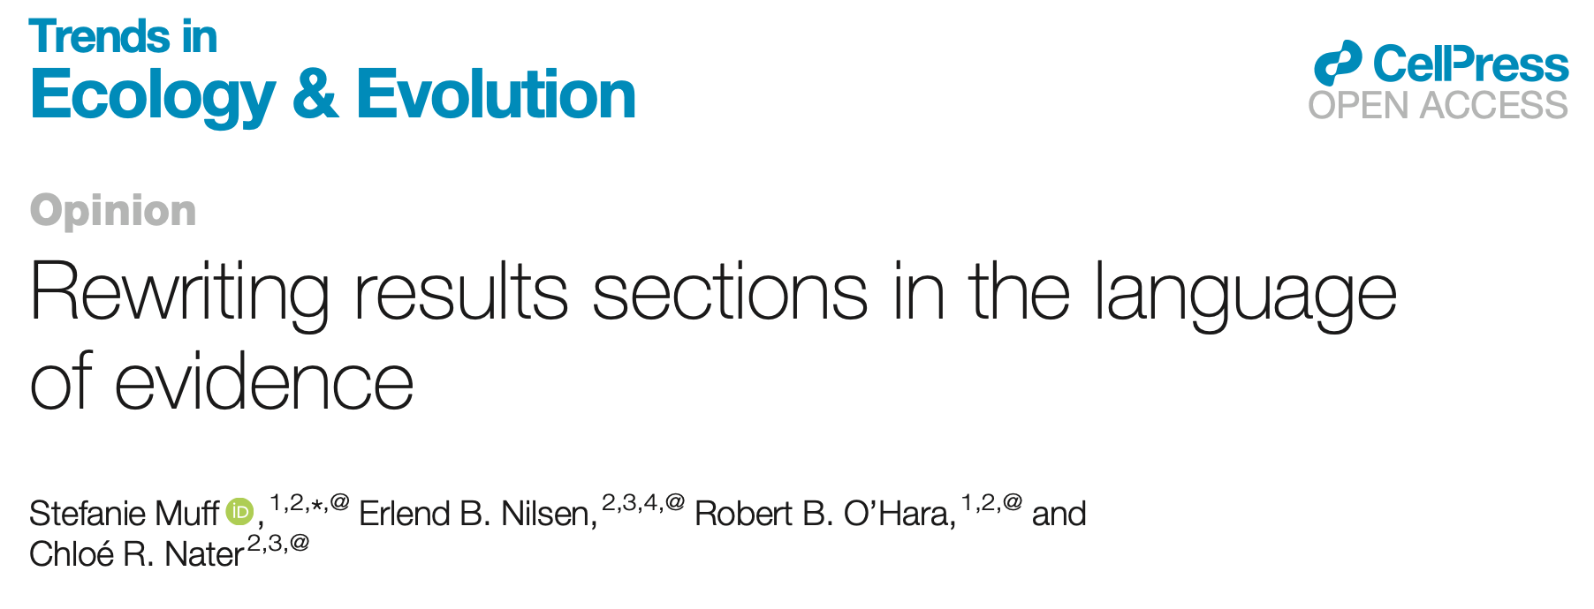
Preparing your Manuscript
Tips – Methods
Replicable
Avoid recursive chain of citations of previous papers’ methods
Statistics: Cite R packages, explain the options you used
Publish code & data – GitHub, Dryad, etc
Tips – Results
Report full statistics – not just p-values
Avoid p-value cutoff thresholds. Use language of evidence
Show the data! Not just summary statistics or best fit lines
Use accessible color palettes (e.g., viridis; https://venngage.com/blog/accessible-colors/)
TREE (2022) 37: 203

