Slide 1

e-Learning
University of Alaska
Board of Regents Meeting
December 6-7, 2012
1

Slide 2
Addressed in this e-Learning report
All campuses are engaged
Significant growth in course and program offerings
Modest growth in student enrollment
Competition is stiff
Improvement in student access
Improvement in ability to summarize data
Effective areas and challenging areas
What others are doing that we are not
Future directions

Slide 3
All Campuses Are Engaged
Notes:
The graph above provides a snapshot of the proportion of student credit hours delivered by e-Learning or by traditional classroom methods in fall 2011, by each academic organization in the university system. It is important to note that standard reporting figures do not yet reflect the recent elevation of the UAF Center for e-Learning and Distance Education (EDE) to report directly to the Chancellor, therefore EDE activity appears under the Rural College statewide academic and administrative unit of the UAF College of Rural and Community Development (CRCD).
Courses
--UAF Rural College accounted for more than 20 percent of all e-Learning courses offered.
--Kenai Peninsula delivered about 11 percent of all e-Learning courses in fall 2011.
Of the three MAUs, UAF offered the most (44 percent) e-Learning courses.
Students
--UAA students comprised about half of all UA e-Learners
--UAF students one-third
--UAS students about 20 percent. More than 5 percent of all fall 2011 students took at least one course from a second MAU in addition to enrolling at their program MAU.

Slide 4
Defining e-Learning
e-Learning is planned learning that predominantly occurs in situations where a student is not required to be in a predetermined location.
Delivery may be by video conference, audio conference, correspondence, tele-courses, satellite telecasts, via the Internet, CD-ROM, and/or video/audio tape.
A course may be delivered entirely via e-Learning or by a hybrid of e-Learning and on-campus methods.

Slide 5
267 Programs Available more than 50% by e-Learning
Notes:
UA institutions offer 267 distinct degree, certificate and endorsement programs that can be completed at least 50 percent via e-Learning.

Slide 6
132 Programs Available 100% by e-Learning
Notes:
Of these, nearly half (132 programs) are available completely via e-Learning.
A full list of available programs is provided in the report on page 48

Slide 7
New e-Learning Programs in FY12 and FY13
MAU Degree Major Type
UAA AAS Outdoor Leadership 50+%
UAF BA Film 50+%
UAS MAT Special Education 50+%
UAS BA Special Education 100%
UAS OE/Cert Medical Office Supp. 50+%
UAS BLA AK Native Lang & Studies 50+%

Slide 8
e-Learning Courses
More than 1,400 distinct e-Learning courses were taught in FY12, a 34 percent increase over the number in FY08.
318 new courses were offered for the first time via e-Learning in FY12.

Slide 9
Students making use of e-Learning
Notes:
While in-state competition from other institutions has grown, e-Learning participation at the University of Alaska has also increased as a result of efforts to increase capacity to serve students via e-Learning. About 34 percent of all University of Alaska students took at least one e-Learning course in FY12, compared to 29 percent in FY08. Over this same period, the total proportion of student credit hours delivered by e-Learning rose from 16 to 20 percent, and the total number of course sections delivered by e-Learning grew by 15 percent.
Compared to the University of Alaska’s total student body, a similar proportion of e-Learning students self-identified as Alaska Native (about 15 percent).
Women made up 65 percent of e-Learning students and 59 percent of all enrolled students in FY12.
Somewhat surprisingly, e-Learning students tend to be a little older, with those 25 years of age or older making up 62 percent of e-Learning students and 51 percent of all students in FY12.

Slide 10
Students making use of e-Learning
Notes:
A greater proportion of FY12 e-Learning students were seeking a degree, certificate or credential than the total student population, about 80 percent versus 70 percent, respectively. Conversely, 20 percent of e-Learners were non-degree seeking, compared to 30 percent of all students. For students seeking a degree, proportionally more juniors and seniors took e-Learning courses, making up one-third of all e-Learners and about a quarter of students on the whole. This implies that upper division students are using e-Learning to achieve attainment. Graduate students and underclassmen made up similar proportions of e-Learning, and total student enrollment. Among first-time, full-time degree seeking freshmen starting in fall 2005, those who enrolled in e-Learning courses graduated at a slightly higher rate (32.9 percent) six years later than those who did not (28.9 percent) in FY11.

Slide 11
Competition
The Alaska Commission on Postsecondary Education reports that 260 institutions are delivering courses in Alaska in direct competition with UA.
Massively Open Online Courses (MOOCs) are a developing threat and opportunity

Slide 12
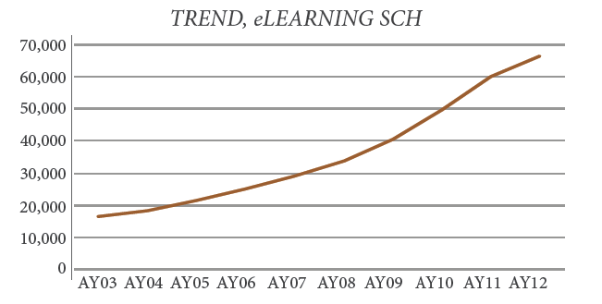
UAA Highlights
Notes:
Note: This graph is from UAA report, which uses broader internal UAA definition so shows more SCH than other standard published figures for UAA e-Learning.
Kenai Peninsula College - largest increase and largest producer of eLearning credit hours.
Kodiak College – grew e-Learning SCH significantly and is now the second largest producer of eLearning credit hours online SCH among UAA’s community campuses.
The College of Arts and Sciences grew SCH by 7.5% over AY11
In AY12 UAA presented 1,335 courses with online content, with the majority (90%) requiring no location based delivery.

Slide 13
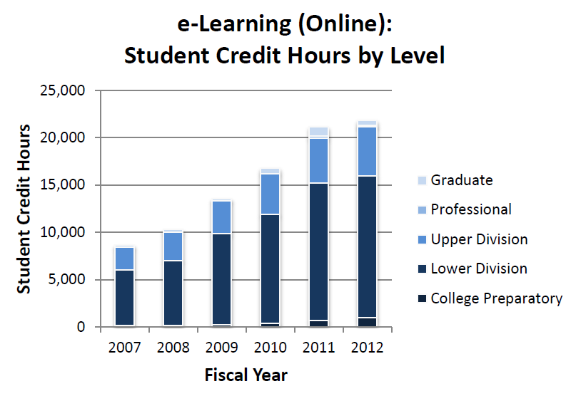
UAF Highlights
Notes:
E-learning SCH delivered increased 14% from FY07 to FY 12.
About 20% of all student credit hours in lower and upper division courses are delivered by distance, and the fraction has been increasing, reflecting UAF’s efforts to increase the number of programs available via e-learning.
UAF eLearning and Distance Education offers 24 open online courses, with more being added each semester (http://idesign.uaf.edu/courses/opencourses/). These open courses increase access to knowledge and allow students to preview course materials before they enroll.

Slide 14
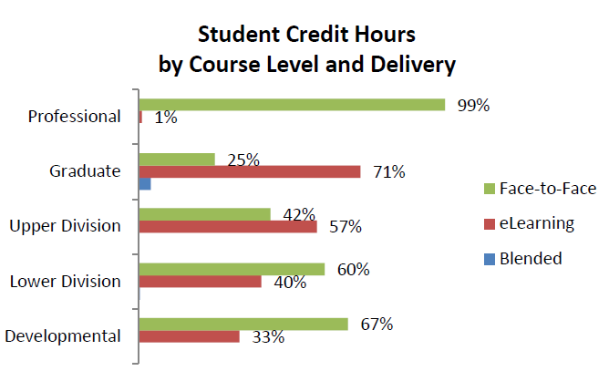
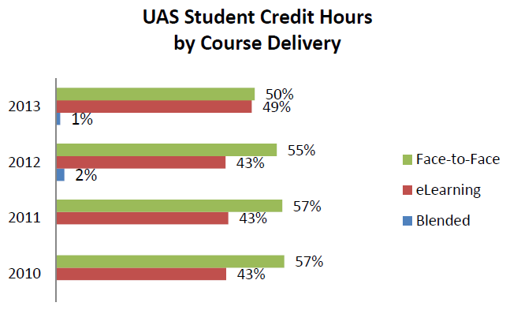
UAS Highlights
Notes:
Dana would like to use the SCH graph on page 32
Of the 543 endorsements, certificates and degrees awarded in AY12, 262 were in eLearning programs, 177 were in blended programs, and 104 were in face-to-face programs.
Of the 1,272 students who have earned an endorsement, certificate or degree at UAS since academic year 2010, 2% (n=30) have done so entirely via eLearning, and 14% took only face-to-face courses.
32 percent of graduates have earned their awards by taking more than half of their credits via eLearning.

Slide 15
What other institutions are doing that we are not?
Collaborating with private companies
Centralizing on-line courses and programs in a distinct stand alone institution
Collaborating with providers of Massively Open Online Courses (MOOCs)
Awards for faculty excellence in e-learning instruction
Notes:
Coursera has 33 university partners, including Duke, California Institute of Technology, and the University of Illinois at Urbana-Champaign. The University of California at Berkeley and the University of Texas system are partnering with edX, a nonprofit organization run out of M.I.T. and Harvard. The third major provider of MOOCs is Udacity, a for-profit institution with no university affiliation.

Slide 16
Challenge areas for e-Learning
Rural areas with limited bandwidth
Labs and courses requiring specialized equipment, e.g., welding, wet labs
Oral communication
Some upper division coursework, e.g., advanced calculus
Creating a quality community of learners requires a different approach than in person
Notes:
Distance Labs and specialized equipment courses – lower division chemistry sends out a lab kit to distance students. This subject has received considerable recent attention from the Faculty Alliance. Expanding lab based science courses and other programs requiring specialized equipment e.g. welding, airframe and powerplant, and culinary arts, to e-Learning remains a tough challenge and this currently limits full-program offerings.
Oral communication - can it be taught via e-Learning, even by audio or two-way
video, because of the lack of an audience in the same room and the impact that
has on the speaker? There are MAU philosophical differences on the subject.
Upper division coursework – Advanced Calculus and abstract algebra are upper division courses in mathematics
That require substantial mentoring and discussion to achieve learning outcomes and
have relatively low demand. Faculty in such areas are reluctant to pursue e-
Learning offerings. This reluctance makes some entire programs unavailable by
distance.
Creating a quality community of learners - online requires different approaches
than learning in the classroom in-person. Faculty development in this area is vital
because students learn a great deal through interactions with other students.

Slide 17
Especially effective e-Learning subject areas within UA
Lower Division Courses
  E.g., math, English, Humanities, and Social Sciences
A few entire colleges/schools
  E.g., Health, Education, and Management
Many specific programs
  E.g., Computer Information Systems and Rural Development
Notes:
Refer to report pages….

Slide 18
Where is e-Learning going?
Nowhere without requisite bandwidth!
Greater integration within and across MAUs
Greater collaboration for efficiency and expanded offerings
Make more full programs available
Continue/expand faculty development and support
Keep up with change and communicate improving capability to faculty, students
Notes:
We noted that the MAU reports need more standardization – the Statewide Academic Council will create a common reporting format with standardized data definitions for future reports.

Slide 19
e-Learning Strategic Direction Questions
Why does UA have relatively few full programs available online via e-learning?
What are the most significant barriers inhibiting the further development of and student satisfaction with e-Learning within UA?
Why do Alaska students enroll in e-learning courses offered by other institutions?
Are free courses impacting student enrollment and if so, how?
How can UA improve faculty development opportunities to expand e-learning program offerings?
How can UA promote a balanced program of blended and hybrid instruction, in addition to e-learning?

Slide 20
Successes
Increased course offerings
Increased programs available
A single sign-on, system wide
Standardization of course coding to improve information summaries
On going experimentation with open courses and MOOCs

