Slide 1
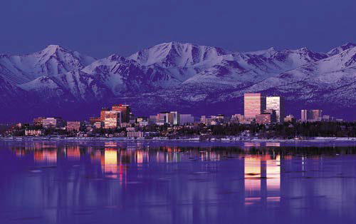
Presentation to the University of Alaska Board of Regents
UAA innovation and research commercialization
New pathways for growth
June 8
2012
DR. HELENA S. WISNIEWSKI
VICE PROVOST FOR RESEARCH
DEAN OF THE GRADUATE SCHOOL

Slide 2
Creating a climate of innovation
The Hallmark of the US is - Creative Genius and Innovation.
In the past century, universities developed ideas that became products that underwrote corporate giants including: Boeing, Ford, Google and Intel.
Unfortunately, today the US is in danger of losing its pre-eminence in science and technology (National Science Board May 2010).
Therefore, in the 21st Century, Universities will need to play even a more important role to keep US dominance in science, engineering and in particular – innovation.

Slide 3
Creating a climate of innovation
Today we will provide:
An overview of innovation at UAA, and
A presentation of several notable products recently developed by faculty and students.
These will highlight invention, entrepreneurship and research at UAA.

Slide 4
Creating a climate of innovation

Slide 5
Creating a climate of innovation
Incentives for faculty and students.
An infrastructure.
Advances in Research that can result in Disruptive Technology.
Quality patent portfolio.

Slide 6
Creating Incentives for
a Climate of Innovation
Innovate Awards – established in December 2011 – internal seed money for research and invention.
Since January 2012 already achieving successes – 3 invention disclosures; Scholar in Residence; received external funding from NIH.
Patent Wall of Fame – established in December 2011.
First inductees December 2011.
Other incentives considering - $500 patent filing; $1,000 for patent awarded.

Slide 7
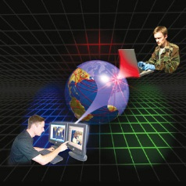
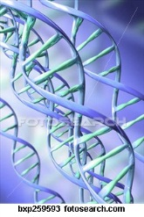
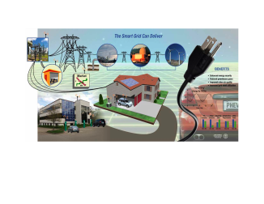
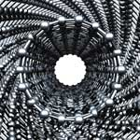
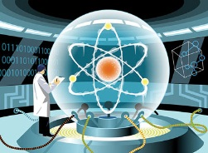
Key Sustainable Research & Technology Trends in the 21st Century
Climate Change – Innovative Technology Approaches to deal with Climate Change and Arctic Awareness
Cyber Security
Biomedical Sciences
Health Sciences
Emergent Energy Systems
Augmented Reality
Cloud Computing
Smart Grids
Nano materials
New Ways of Energy Storage
Quantum Computers

Slide 8
Current Areas of Strength at UAA
ARTS
SCIENCES
International and native arts and music
Visual and performing arts
Music therapy
Music education
Learning technologies
Arctic Ecology/Physiology
Biomedical
Cyber Security
Mineral Resources/ Biogeochemistry
Resilience and Adaptive Mgmt
HUMANITIES
Ethics
Multimedia composition
Alaskan narratives
International/intercultural
discourse
SOCIAL SCIENCES
ENGINEERING
Behavioral health (CBHRS)
Alaska Native cultures
Rural mental health
Economic research (largely through ISER)
Adaptation to climate change (RAM)
Biomedical engineering
Coastal engineering
Transportation engineering
Earthquake engineering
Emergent Alternative Energy –
generation and application
Cyber Security
BUSINESS/PUBLIC POLICY
HEALTH
Social and Economic Research (ISER)
Economics Laboratory
Behavioral Research and Services (BHRS)
Circumpolar Health Studies (ICHS)
Justice Center
Effects of climate change on health
Biomedical
Domestic violence and sexual assault
Drug and alcohol abuse
Maternal and child health and welfare

Slide 9
capabilities aligned with sustainable technology trends.
· Biomedical Sciences and Health Sciences
College of Arts and Sciences (CAS), College of Health (COH), School of Engineering (SOE), College of Business and Public Policy (CBPP), already investing in these areas.
· Emergent Energy Systems
SOE, CAS, already investing in these areas.
· Innovative Technology/Approaches for dealing with Climate Change
CAS, COH, SOE, CBPP, and their associated institutes, already investing in these areas.
· Cyber Security - network security, authentication, physical, cyber.
SOE, CAS, CBPP already investing in these areas.

Slide 10
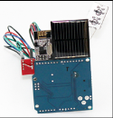
IP activity
Invention Disclosures and Patent Applications since January 2012 total 13, including students.
Inventor | Invention | Status | License
Kenrick Mock (Math and Computer Science, CAS) Bogdan Hoanca (Computer Information Systems, CBPP) | Methods and Systems for Multiple Factor Authentication Using Gaze Tracking and Iris Scanning: | July 26, 2011 –US patent # 7,986,816
Dr. Anthony Paris and Engr students Brian Glasheen, Gan Wu, and Jacob Thompson | Spinal Rod Bender | Patent pending | Under discussion
Dr. Gary Rice | Student Success Model | Patent Pending (Provisional) | Yes
Dr. John Lund and Dr. Todd Peterson | Ultra Long Life Energy Source | Patent Pending (Provisional)

Slide 11
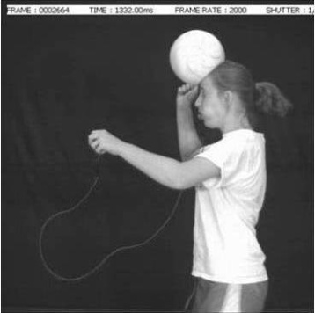
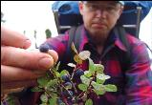
IP activity
Inventor | Invention | Status | License
Drs. Anthony Paris, John Lund, Jennifer Brock | Wireless Head Impact Mouth-guard | Invention Disclosure Submitting Provisional
Dr. Anthony Paris and Engr students Doug Franklin, Kelvin Goode and Orest Harkacz Jr. | Ultrasonic Gum Tissue Sounder | Invention Disclosure to be submitted
Dr. Colin McGill Chemistry | Pharmacological Treatment for Neurodegenerative Diseases | Invention Disclosure Submitting provisional patent
Dr. Joey Yang Civil Engineering | Self-Heating Concrete | Invention Disclosure submitted

Slide 12
IP activity
Inventor | Invention | Status | License
Tim Menard (Engr Student) with Professors John Lund and Jeff Miller | Helped develop FreeSim traffic pattern software (testing snowplows) | Submitted invention disclosure
Dr. Frank Moore Computer Science & Engineering | Improving Compressed Images via Evolutionary Computation | Submitting Invention Disclosure
Alexandra West, Engineering student | Hydro-powered Fish Carcass Grinder | Submitted invention disclosure; developing provisional patent
Dr. LeeAnn Munk, Geology | Isotope Methods for Exploring and Mining copper | Submitted invention disclosure

Slide 13
IP activity
Inventor | Invention | Status | License
Eric Pederson, Pat Borjon, and Mike B. Smith, Enrollment Services | Student management software (two separate programs) | Submitting Invention Disclosures
Dr. Paul Johnson and Dr. Jonathan Alevy, Economics | Economics Laboratory educational game software | Submitting Invention Disclosure
Dr. Kyle Hampton, Economics | Economics Laboratory educational game software | Submitting Invention Disclosure

Slide 14
Ergonomic Rod Bender for Spinal Surgery
Approximately 500,000 Americans undergo spinal surgery each year to correct spinal instability.
Surgeons insert a metal rod that is bent to the curvature of the spine and attached to the vertebra to correct deformity.
UAA Professor Paris and senior engineering design students developed a one-handed device to bend this rod during surgery.
This device minimizes operating time and reduces patient trauma by allowing the surgeon to ensure the correct bend of the rod without assistance and without leaving the patient.
Patent Pending.
Level 5 Partners LLC – licensing under discussion.

Slide 15
Student Success Model
Dr. Gary Rice developed a new model for university assessment of student success.
This model takes into account factors previously ignored, for example, socio-economic factors, for a more precise evaluation of student performance.
A successful nationwide beta test at universities and community colleges led to requests for licensing of this model, which are being executed.
Status: Licensing agreements in place - Received first signed agreement and payment. Potential first year revenue: $130,000 to $260,000.
Patent Pending.

Slide 16
Concussion Impact and Monitoring
Traumatic Head injuries are a foremost concern in athletes, since research suggests that even blows that are not severe enough to cause unconsciousness can be harmful when their effects are cumulatively considered.
Also of concern to the military.
Professors Paris, Brock and Lund developed an instrumented mouth-guard with custom wireless capabilities that measures acceleration of the skull upon impact and effects of such blows.
It provides coaches and physicians accurate and quick assessments when athletes experience head injuries.
Additional assessments include biometrics such as: measuring heart rate to further evaluate performance, and identify high risk athletes.
Provisional patent
Under development.
Funded by an Innovate Award.

Slide 17
ultra long life energy source
UAA Professors Lund and Peterson developed an ultra long lifespan wireless sensor device for remote monitoring and asset management, for surveillance and security.
Unique features:
No Batteries -Solar energy harvesting circuit eliminates use of batteries through new ultra-capacitor.
Lifespan 50-100 years vs 5-10 years for a battery.
Each device receives, transmits and stores data from every other node in the system. A single device can provide information about all the other devices.
If one node in the system is connected to a power grid, or UAV, it can report the entire network’s data over a cellular network for monitoring hundreds of miles away. Can use UAVs to deploy to remote areas.
Patent Pending.
Interest from US Govt.
Innovate Award.

Slide 18
leveraging the arctic Pharmacological Treatment for Neurodegenerative Diseases
The Alaskan blueberry contains compounds that improve memory, providing promise as a therapeutic in neurodegenerative diseases (Alzheimer’s and Parkinson’s), and improves insulin sensitivity (diabetes).
UAA Chemistry Professor Colin McGill isolating the specific mechanisms responsible for the blueberry’s neuro-protective effects.
Pharmaceuticals resulting in treatment strategies.
Funded by an Innovate award.
Patent pending.

Slide 19
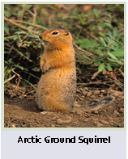
Leveraging the Arctic for innovation Understanding Obesity Using the Arctic Ground Squirrel
Arctic ground squirrels provide a non-traditional model to study a variety of human diseases because of their extreme physiology (hibernation).
They may unlock secrets between gut microbial community and diseases such as obesity.
This is the focus of biology Professor Khrystyne Duddleston’s work.
Uses genetic sequencing of gut microbial communities to uncover changes in community structure during pre-hibernation fattening.
The results have implication in human obesity and may lead to treatment strategies.
Additional applications include inducing hibernation in humans.
Funding from NIH, and received an Innovate Award.

Slide 20
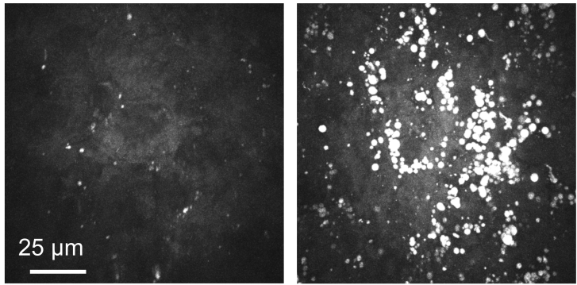
therapeutic targets to help alleviate the liver dysfunction due to non-alcoholic fatty liver disease
Non-alcoholic fatty liver disease is growing worldwide and is a leading cause of death in persons with type II Diabetes.
Understanding the mechanisms of fatty liver disease development and the molecular response to copper deficiency that influence diseases is the focus of this work by biology Professor Jason Burkhead.
He will collaborate with the Liver Disease and Hepatitis Program at the Alaska Native Tribal Health Consortium to assess the possibility of copper deficiency in Alaska native patients.
His work may lead to therapeutic targets to help alleviate the liver dysfunction.

Slide 21
Research for future Innovation in Therapeutic treatments
Connection between Neural crest function and symptoms of Williams Syndrome – can lead to therapeutic targets for dealing with symptoms of Williams Syndrome. Williams Syndrome is a genetic condition present at birth and caused by missing genes. UAA biology Professor Dr. Jocelyn Krebs is the first to show a specific neural crest defect caused by loss of a gene deleted in Williams Syndrome.
Possible therapeutic interventions for oral cancer related to chewing tobacco.
Determining genetic mechanisms that control development of skeletal muscle cells - can provide a better understanding of diseases affecting muscle development and nerve muscle interactions – neuro-myopathy –diseases such as MS.
Possible therapeutic targets to help alleviate the liver dysfunction caused by non-alcoholic fatty liver disease.
Possible pharmaceuticals resulting in treatment strategies for memory loss - Alzheimer’s and Parkinson’s disease - from Alaskan blueberry.

Slide 22
Improving Compressed Images via Evolutionary Computation
Image compression techniques are an important interest both to government agencies as well as commercial entities.
By compressing data, you can send and store high volumes more quickly and less expensively. However, can you reconstruct the data so that the image is recognizable and enough information is presented?
Computer Science Professor Frank Moore developed an evolutionary algorithm that will outperform current wavelet methods by automatically learning to compensate for detrimental effects by reducing distortion in the particular reconstructed image.
His current customer is NASA.
Additional applications include medical imaging where costs are increasing at an annual rate of 50%, so decreases in storage and transmission requirements have the potential to save millions of dollars.
Funding: NASA EPSCoR, and Innovate Award.

Slide 23
Cyber Security — Ultra Secure Computer Logon
National and global concerns over security in cyberspace are increasing.
To address this concern, Professors Kenrick Mock (Mathematical/Computer Sciences, College of Arts and Sciences) and Bogdan Hoanca (Computer Information Systems, College of Business and Public Policy) developed an ultra secure computer log-on system.
This system is a multiple factor authentication approach combining gaze tracking and iris scanning.
It avoids problems many current methods have: being spoofed by pictures or fake models of an eye; accounts for error in recognizing the password symbols; avoids problems inherent with traditional passwords.
United States Patent 7,986,816.

Slide 24
Eye tracking/gazing for learning tools
In addition to cyber security, gaze tracking can be used to create learning tools.
The system is currently being used by the UAA Music Department to analyze eye movement while students are reading or performing a piece of music from score at the piano.
It will assist students in becoming more aware of their eye fixation patterns and suggest alternative or improved techniques.
A system to help children learn to read is under development.

Slide 25
summary
This presentation has provided you with an overview of some of the research that is either ready for commercialization or has the potential for it.
There is a sense of excitement and momentum at UAA.
Research and IP activity is on the rise.
We are developing technology that will have an impact on solving problems of importance to the community, the state, and the nation.
Developing technology that is commercializable and can contribute to providing a revenue stream for the university, retain students after graduation, attract faculty and students, and can contribute to economic development.

