Slide 1
Health Programs Update
Board of Regents Meeting
June 2012

Slide 2
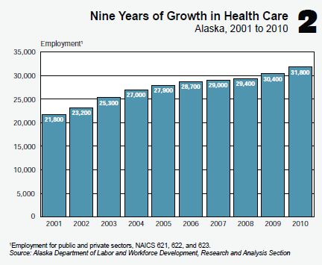
Environmental Scan
Current situation
  Critical and growing industry with ongoing shortages
  Retirements looming – providers, faculty
  State demographics - aging population -> more care needs
  National recession easing -> recruitment success will likely wane

Slide 3
Health Care Industry

Slide 4
Job Locations

Slide 5
Preparing Health Care Workers

Slide 6

The Picture of Health Workforce
Many types of data are available – occupation projections, vacancies, industry and student data – but the picture is incomplete
Working with partners to develop a more comprehensive and integrated set of data to allow for better prediction of critical needs
Program needs assessments
Deep dive studies
  Physical Therapy
  Nursing
Occupational taxonomy/crosswalk
Improved vacancy study design

Slide 7
External Partners
Alaska Health Workforce Coalition
  A public-private partnership created to develop, implement, and support a statewide approach to ensure a robust workforce to address Alaska’s growing health care needs
    Alaska Health Workforce Plan
    Action Agenda 2012-2015
Alaska Health Reform
  The goal of this group is to provide factual research, data and analysis regarding the state of health care in Alaska
Health Care Action Coalition – Commonwealth North
  This group meets periodically to track the activities and issues affecting major health care policy in Alaska and keeps the CWN Board apprised of new developments and the need for additional studies, recommendations, or other involvement by CWN to support the implementation of good public policy
Associations, organizations, agencies, others

Slide 8
University of Alaska Health Students
91% increase in UA health
majors in a decade

Slide 9
University of Alaska Health Programs
More than 80 programs state wide:
  Nursing
  Medicine/primary care (physician, nurse practitioner, physician assistant)
  Public health and wellness (nutrition, dietetics, fitness leadership)
  Therapies (occupational therapy, speech/language pathology)
  Allied health (radiography and ultrasound, medical laboratory, dental hygiene and assisting, medical assisting, pharmacy)
  Behavioral health (social work, human services, psychology)
  Direct services (nursing assistant, personal care assistant, disabilities services)
  Emergency services/paramedic
  Health information management/technology
  Medical office/billing and coding
About 50 programs are offered via eLearning or blended instruction
Alaska Native/American Indian Students FY2009-2011
  Health Majors –15.4% (average 396 per year)
  Health Degrees/Certificates Awarded – 14.6% (average 112 per year)

Slide 10
Program Initiatives
Physical Therapy – in-Alaska program partnership
Physical Therapy Assistant program
Nurse Practitioner and Nurse Educator program expansions/ doctorate in nursing practice (DNP)
Pharmacy – in-Alaska program partnership
Health Information Technology career pathway
Wellness occupations/Health Coaching/Care Management
BSHS tracks development (health education/promotion, management/supervision, pre-professional preparation, environmental health)
  WWAMI second year – need may be eliminated by new curriculum structure being proposed
Ongoing support for Alaska AHEC System
Alaska Health Workforce Coalition priorities
  Work with secondary schools/pathway programs
  Continuing education efforts

Slide 11
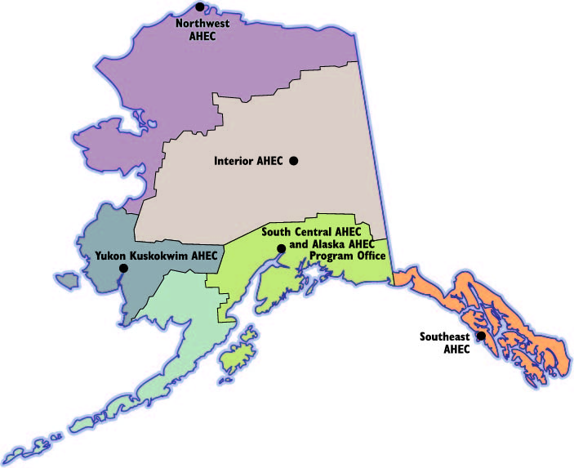
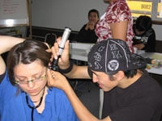
Alaska Area Health Education Center (AHEC) System
Goals
  Alaskans Into Health Careers
  Clinical Student Rotations to Underserved and Rural Areas
  Continuing Education for Professionals in Underserved Areas

Slide 12
AHWC Action Agenda 2012-2015
Occupational Priorities
  Primary Care Providers
  Direct Care Workers
  Behavioral Health Clinicians
  Physical Therapists
  Nurses (Specialists, Educators, RN-BS)
  Pharmacists
Systems Change and Capacity Building
Health profession loan repayment and incentive programs
Training and professional development
Aligning regulatory policies that impact the health workforce
Engage and prepare Alaskan youth for health careers
Health workforce recruiting
Health workforce data
Notes:
12 major initiatives that highlighted occupations that were poised to move forward through 2015.
Encompass both specific professions but also highlight areas across professions.
Goal was to highlight areas where the Coalition’s group approach could make a significant difference in achieving the objectives.

Slide 13
Important Program Needs
Funding
  Backlog of identified priorities across the MAUs
  Nutrition/Dietetics faculty position
  AHEC system funding
  College of Health establishment
  Mental Health Trust funding discontinuations in FY14
  Partner programs in pharmacy and physical therapy
Faculty
Space
Clinical rotations
  Working with industry partners to expand

Slide 14
Challenges
Limited clinical rotations
  Other Alaska and Lower 48 programs coming into state
  Coordination needed – AHEC has had initial meetings
Recruiting well-prepared faculty/aging faculty
Community/ethnicity preference requests
Need to strengthen health research core and health workforce data
Admissions issues/student preparation pressures
Changing nurse workforce picture and continued high interest - need for bachelor’s prepared and specialty nurses, especially in urban areas, with foundational distributed outreach program at associate level and need to provide opportunities for associate graduates to advance their education

Slide 15
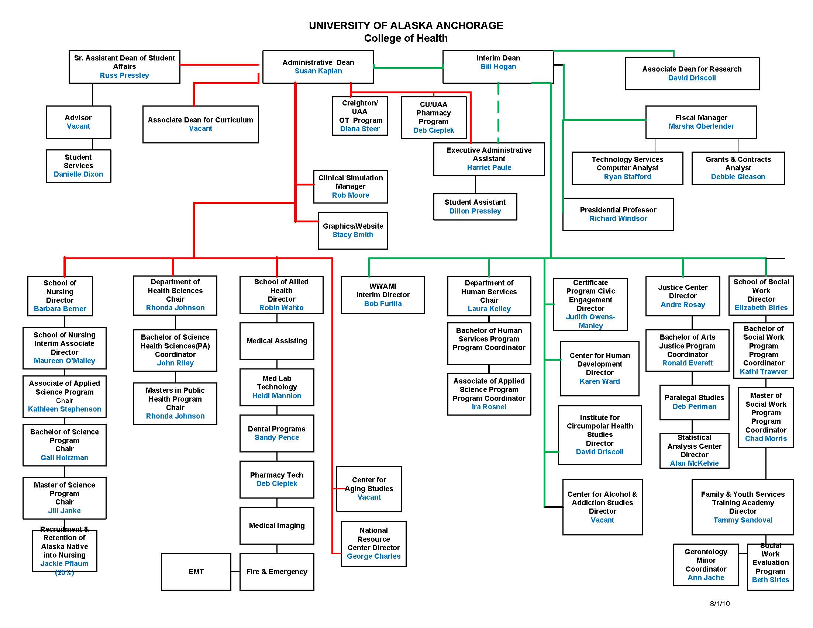

Slide 16
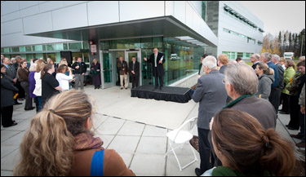
College of Health
Strategic Visioning – currently underway
Inter-professional/interdisciplinary opportunities
“One Stop Shop” for student success/advising
CoH Dean search
Foundational support for restructured and evolving organization
Programs
  Ultrasound
  Physical Therapy Assistant
  Nurse Practitioner/Educator expansion
  Wellness offerings
Facility projects
  HSB backfill
  HSB II planning

Slide 17
UAA Programs in Other Colleges
College of Arts and Sciences
  Joint PhD in Clinical/Community Psychology – the UAA Psychology faculty was thrilled to be able to offer a true joint degree to their two graduating PhD students at this year’s Commencement
Community and Technical College
  Nutrition – the number of admissions to this program were so overwhelming that admissions were temporarily suspended in order to serve the majors enrolled; funding for additional faculty is needed to support this and the Dietetics program in the future

Slide 18

UAF Health Program Updates
Programs
  Search for UAF CTC Dean
  Kuskokwim Campus allied health/medical assisting faculty position is a priority
  Also will need to find funds to replace Trust funding for the Human Services program in FY14
  Update on Bachelor’s in Social Work (BSW) distance program
Facility Projects
  Completion of Courthouse remodel

Slide 19
UAS Health Program Updates
Programs
  Development of the Health Information Management and Health Information Technology career pathways
  Evaluating outcomes of distance science pre/co-requisite offerings
Facility Projects
  Creation of a clinical simulation room in Juneau

Slide 20
Office of Health Programs Development
Health programs planning, coordination, advocacy, implementation
  Health Academic Plan
Facilitation statewide
  Alliances
    Allied Health Alliance (includes Nursing)
    Nursing Education Advisory Council (industry and university partners)
    Behavioral Health Alliance
  Work groups – faculty, others
Internal and external partnerships, collaborations
  Coalition Action Plan
Health workforce data, research and analysis
Management of major multi-MAU projects
Home of AHEC Program Office

Slide 21
