Slide 1
ANSEPTM: Alaska Native Science & Engineering ProgramTM
Notes:
1

Slide 2
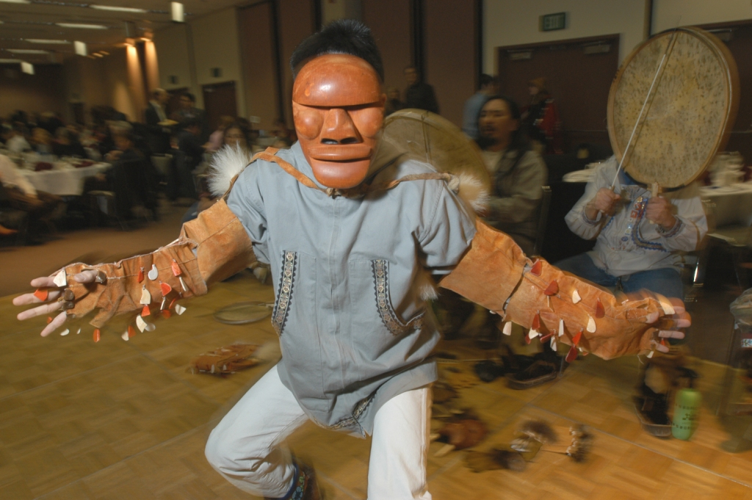
70+ Partner Organizations: $30+ million
ABR, Inc. - Environmental Research & Services
Alaska Department of Fish & Game (ADF&G)
Alaska Federation of Natives (AFN)
Alaska Interstate Construction LLC (AIC)
Alaska Native Tribal Health Consortium
Alfred P. Sloan Foundation
Alyeska Pipeline Service Company
Anchorage Water & Wastewater Utility
Anonymous
ANSEP Alumni Scholarship Association
ASRC Energy Services (AES)
Arctic-Yukon Kuskokwim Sustainable Salmon Initiative (AYK SSI)
AT&T
BP Exploration (Alaska), Inc.
Bristol Bay Native Association (BBNA)
Bristol Environmental & Engineering Services Corporation
Bureau of Land Management (BLM)
CH2M Hill
Chevron
Cook Inlet Region Incorporated (CIRI)
Cook Inlet Tribal Council (CITC)
ConocoPhillips
Denali Commission
Doyon Drilling, Inc.
ExxonMobil
First Alaskans Institute
Ford Foundation
Hawk Consultants LLC
HDR, Inc.
INBRE: Idea Networks of Biomedical National Institute of Health
JL Properties, Inc.
Jonathan Rubini & Suzanne La Pierre
Kapiolani Community College (KCC)
Kuskokwim Community College
Kuskokwim Native Association (KNA)
Leonard & Tannie Hyde
Microsoft
NANA Development
NANA /Dowl HKM
NANA Management Services (NMS)

Slide 3
70+ Partner Organizations: $30+ million
NANA Worley Parsons
NACME, Inc. National Fish & Wildlife Foundation
National Science Foundation (NSF)
National Institute of Health (CAHDRE)
NOAA
Northern Dynasty
NSEDC
OAK Foundation
Peak Oilfield Services Co.
The Pebble Partnership
PND Engineers, Inc.
Rasmuson Foundation
SAIC
Schlumberger
Shell
Siemens Building Technologies
SKW, Eskimos Inc.
South Dakota School of Mines
Summit Consulting Services, Inc.
Teck
The Nathan Cummings Foundation
Udelhoven Oilfield System Services
U.S. Army Corps of Engineers (ERDC-CRREL)
U.S. Bureau of Land Management
U.S. Department of Commerce -EDA
U.S. Department of Education
U.S. Fish & Wildlife Service
U.S. Forest Service
University of Alaska
University of Alaska Anchorage
University of Alaska Fairbanks
University of Arizona
University of Colorado Boulder
University of Hawai'i Manoa
University of Idaho
University of Montana
University of North Dakota
University of Washington
USKH
Wells Fargo
Yukon Kuskokwim Health Consortium

Slide 4
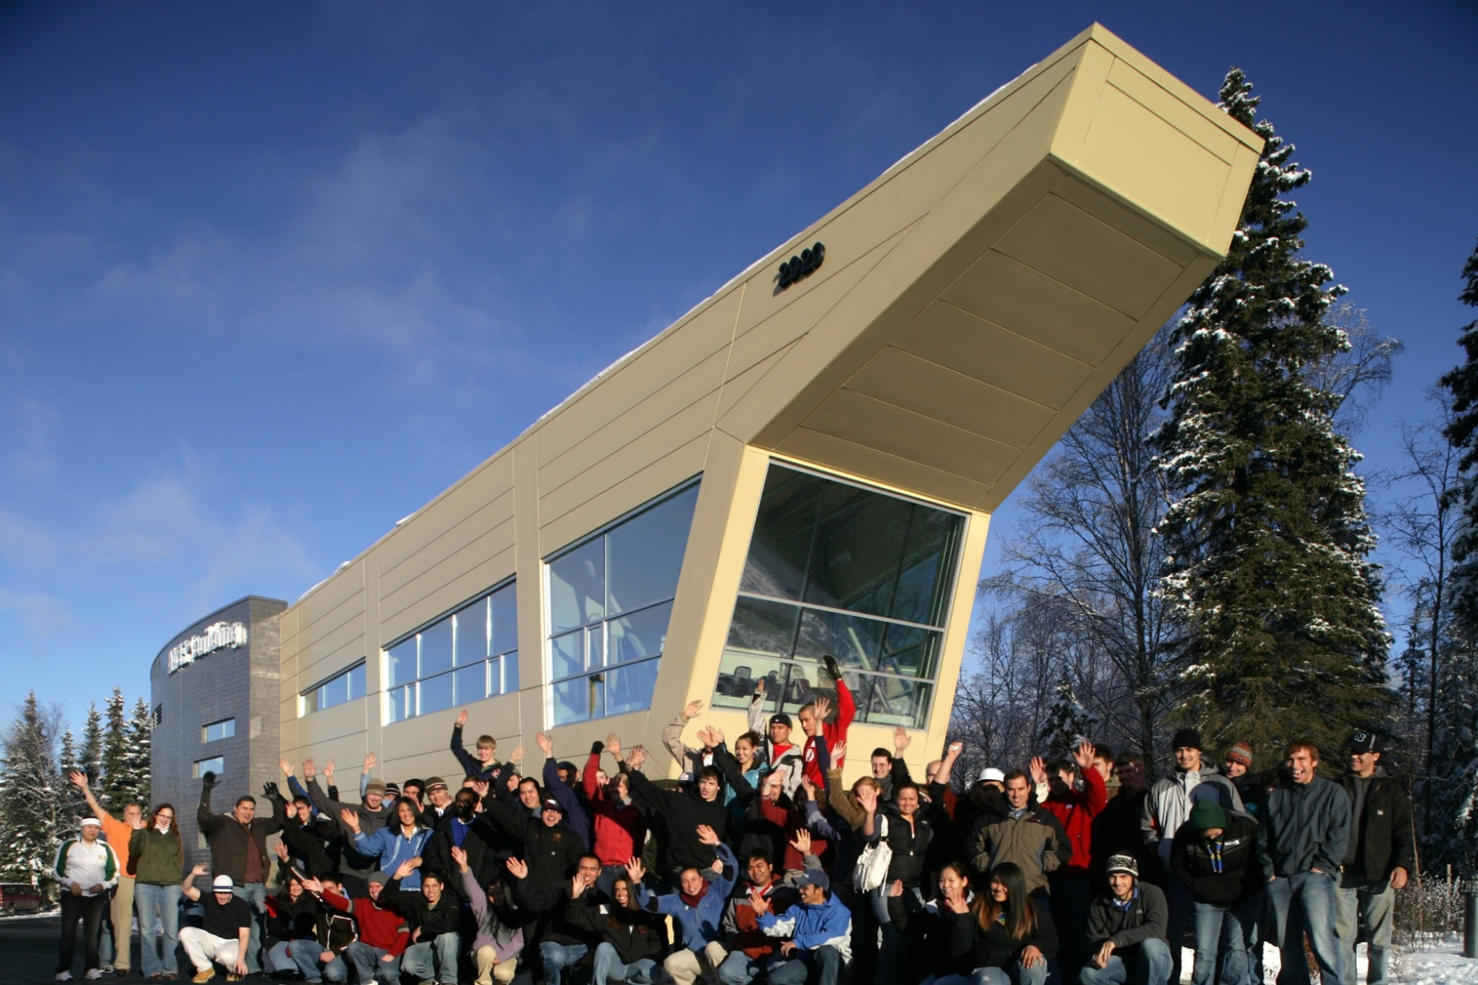
ANSEP Building A home for our students on campus

Slide 5
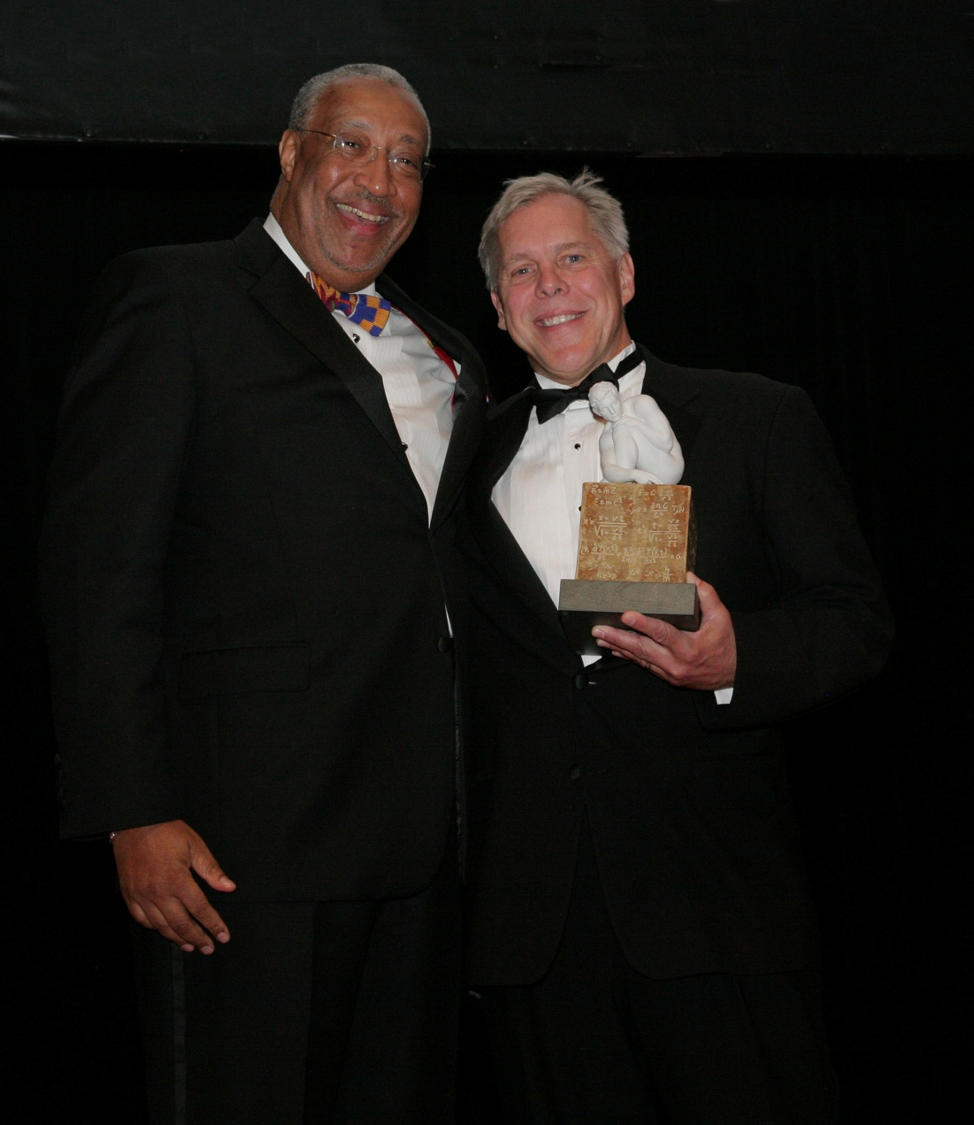
Denali Award
2005
Reginald Jones Founder’s Award 2009

Slide 6
Presidential Award for Excellence in Science, Mathematics, and Engineering Mentoring

Slide 7
ANSEP Programmatic Components 6th Grade through the PhD
Pre-College
Middle School Academy
Computer Assembly
Acceleration Academy
Academies of Engineering
Jump Start
Summer Bridging
University Success
Graduate Success

Slide 8
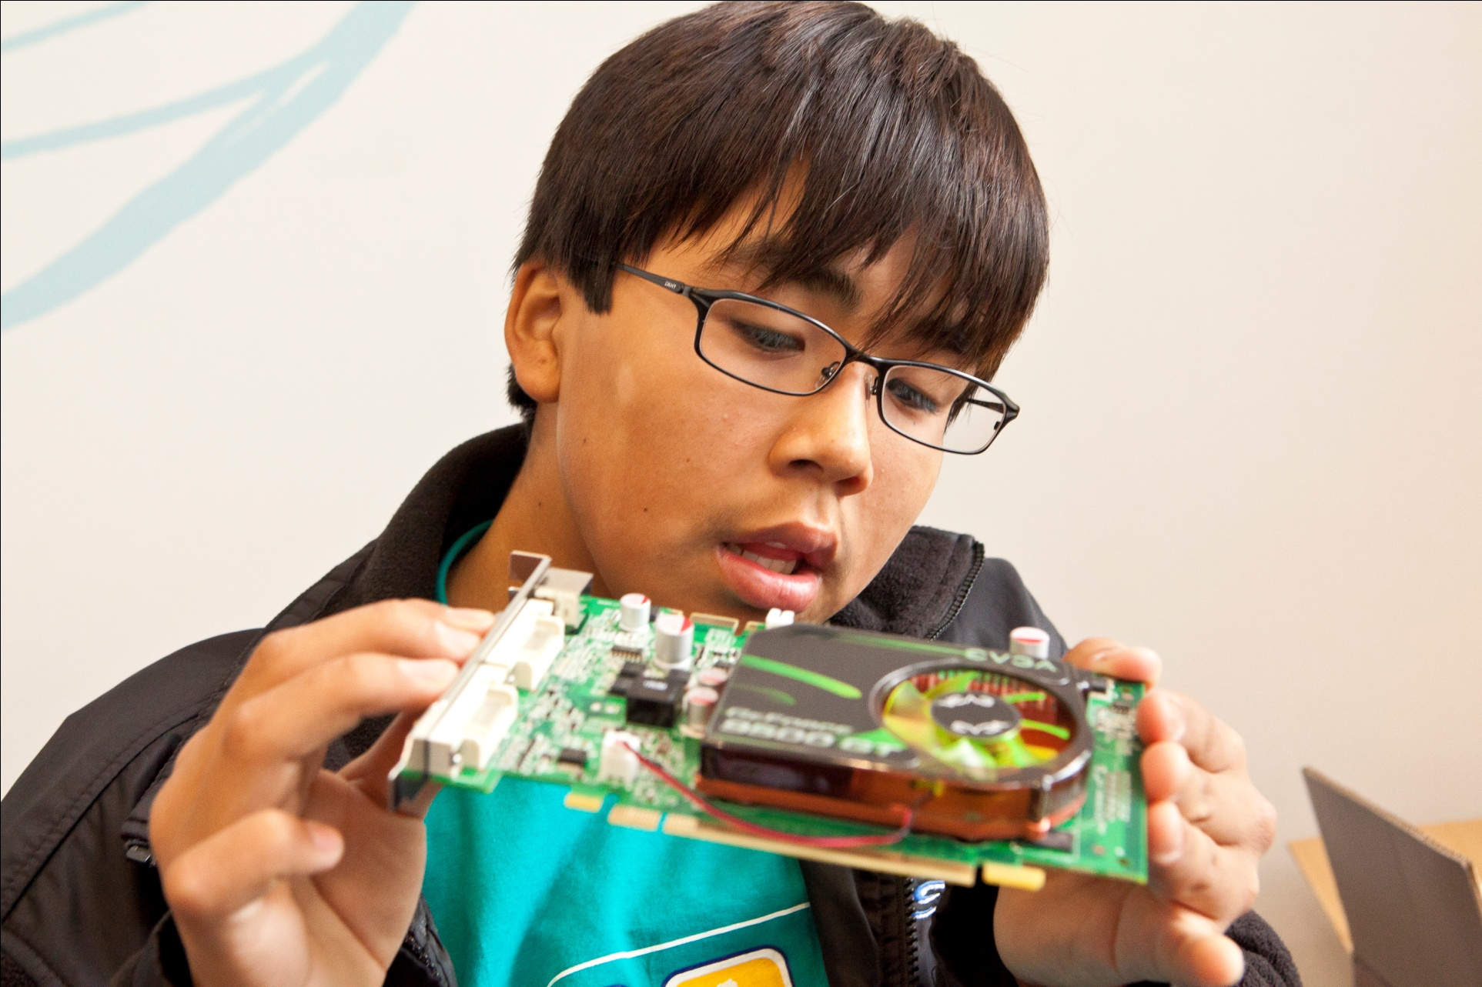
ANSEP Pre-College Middle School Academy Excitement and empowerment about careers in engineering & science

Slide 9
ANSEP Pre-College Middle School Academy Excitement and empowerment about careers in engineering & science

Slide 10
ANSEP Pre-College Middle School Academy Excitement and empowerment about careers in engineering & science

Slide 11
ANSEP Pre-College Computer Assembly Excitement and empowerment about careers in engineering & science
1000+ computers so far
50+% have completed trigonometry, physics, and chemistry prior to graduation
Some students complete calculus 2

Slide 13
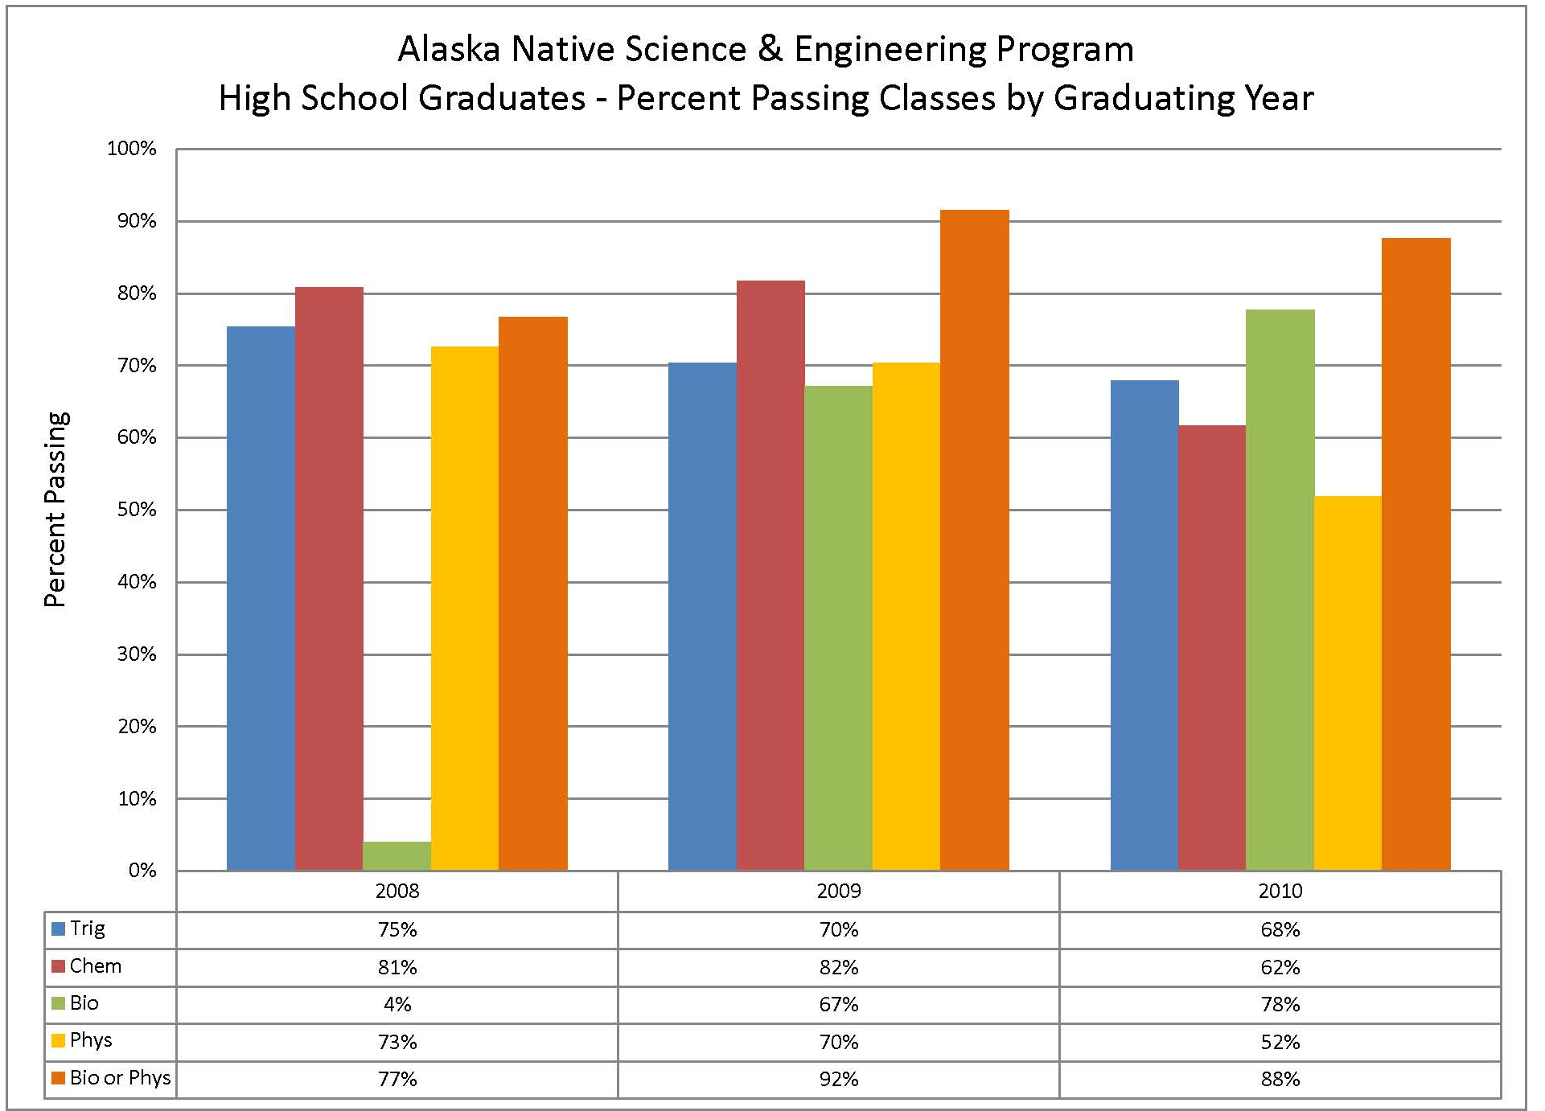

Slide 14
ANSEP Pre-College Acceleration Academy Excitement and empowerment about careers in engineering & science
Starting summer after sophomore year in high school
6 weeks on campus
2 full courses for university credit
chemistry, physics, trigonometry
calculus 1, calculus 2
Introduction to Engineering
Introduction to Biology
Introduction to Geology
Hands on enrichment activities

Slide 15
ANSEP Pre-College Acceleration Academy Excitement and empowerment about careers in engineering & science

Slide 16
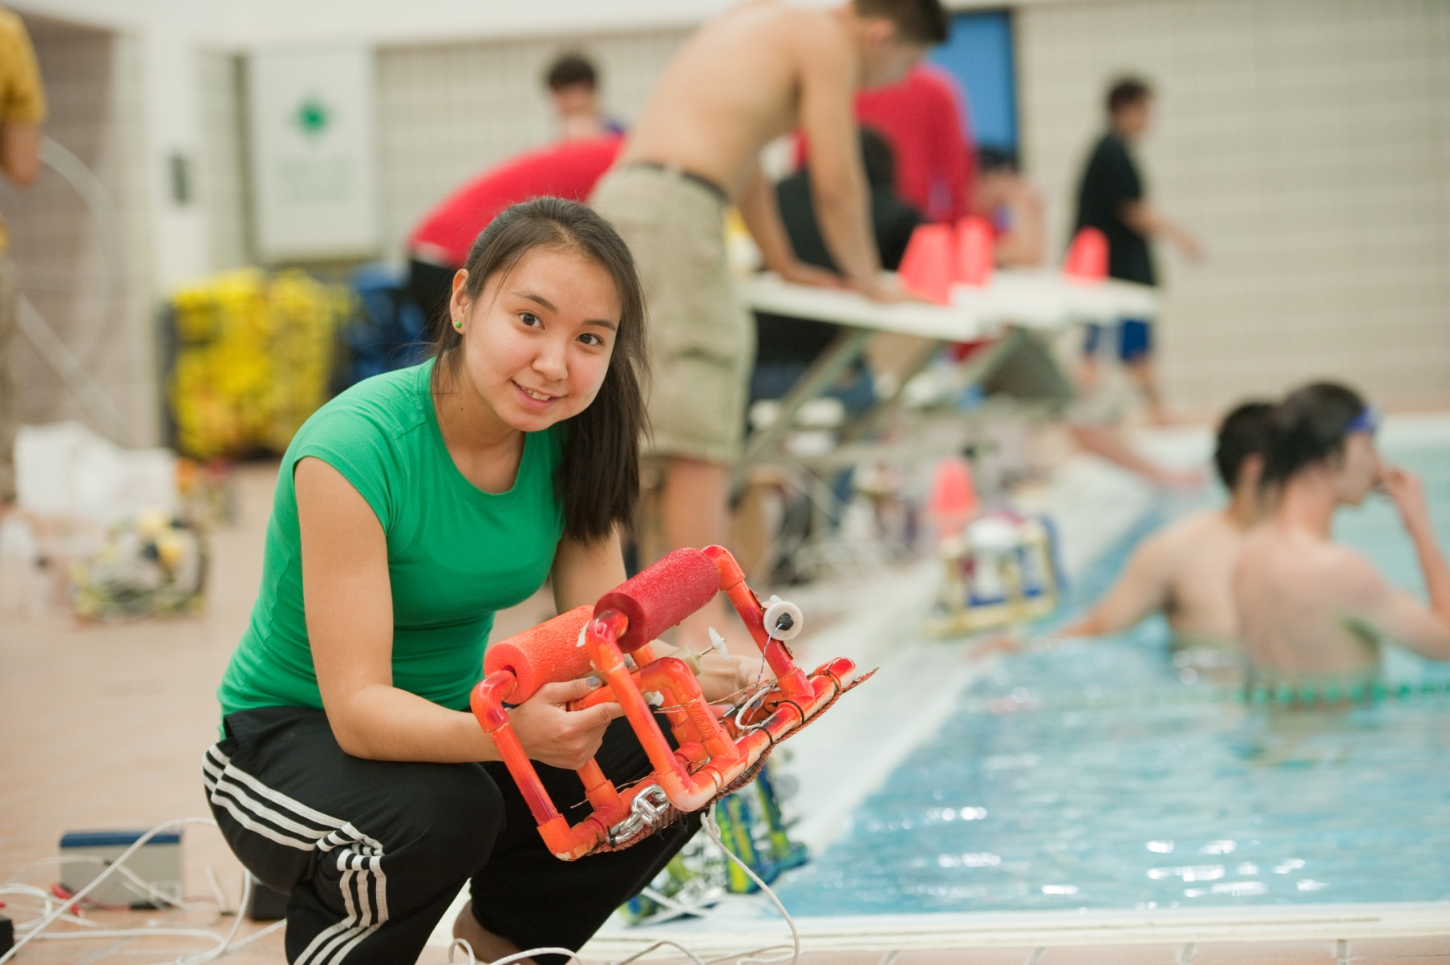
ANSEP Pre-College Acceleration Academy Excitement and empowerment about careers in engineering & science

Slide 17
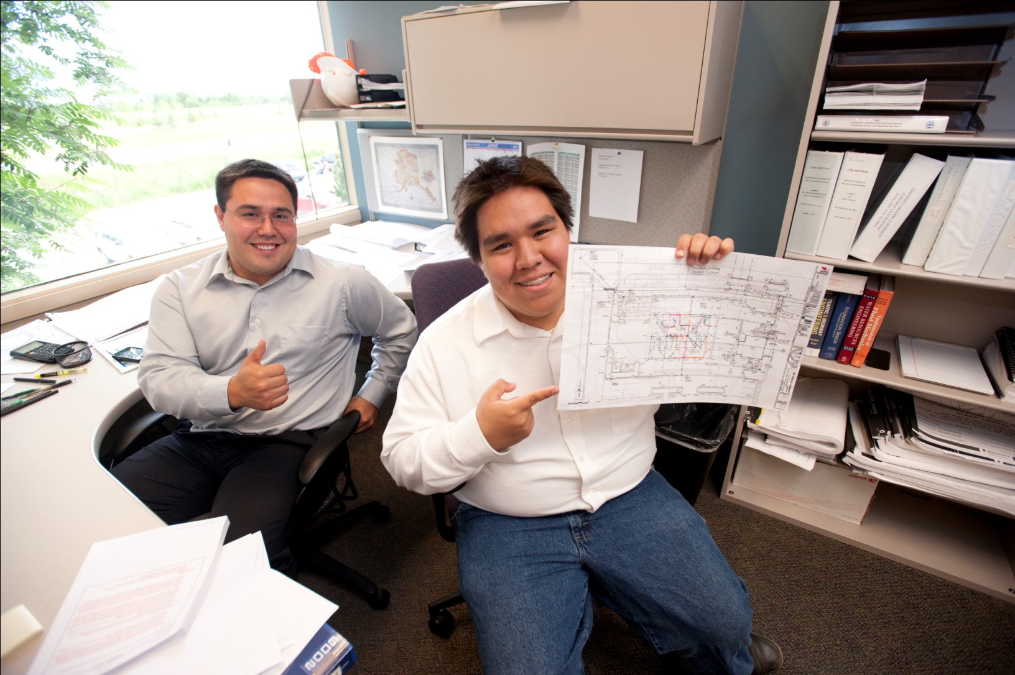
ANSEP Summer Bridge
Building a Strong Foundation for
University and Professional Achievement

Slide 18
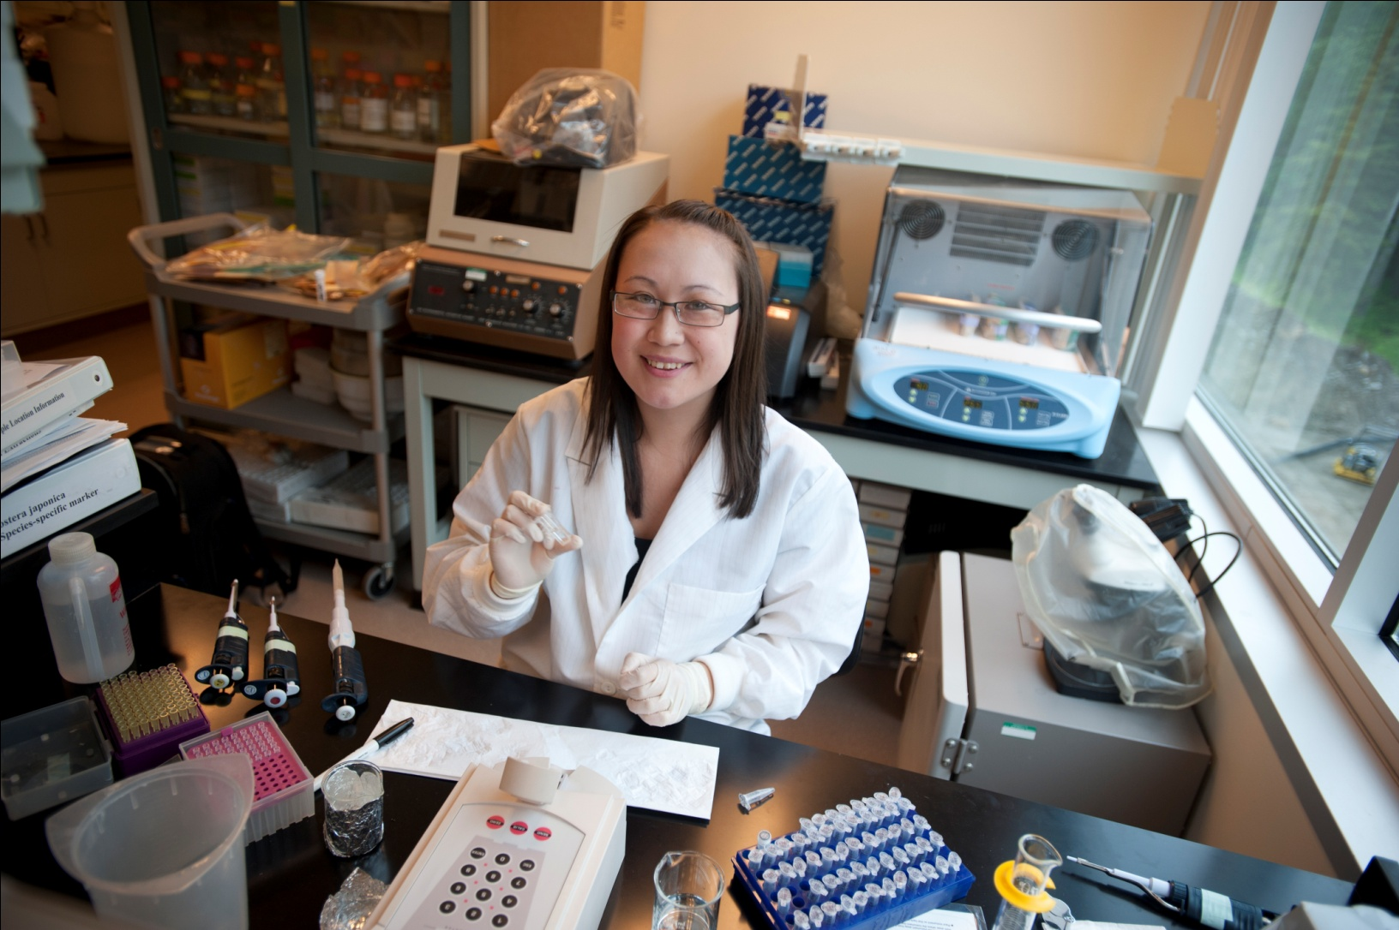
ANSEP Summer Bridge
Building a Strong Foundation for
University and Professional Achievement

Slide 19
ANSEP Summer Bridge Building a Strong Foundation for University and Professional Achievement

Slide 21
ANSEP University Success Study Groups

Slide 22
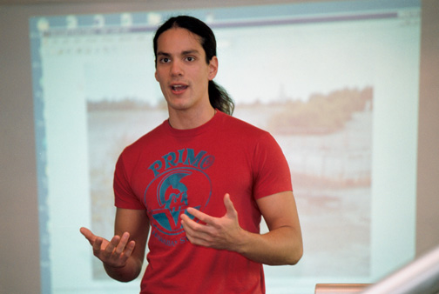
ANSEP University Success Weekly Meetings: Meaningful Connections with Each Other

Slide 23
ANSEP University Success Internships: Career Vision & Money for School

Slide 24
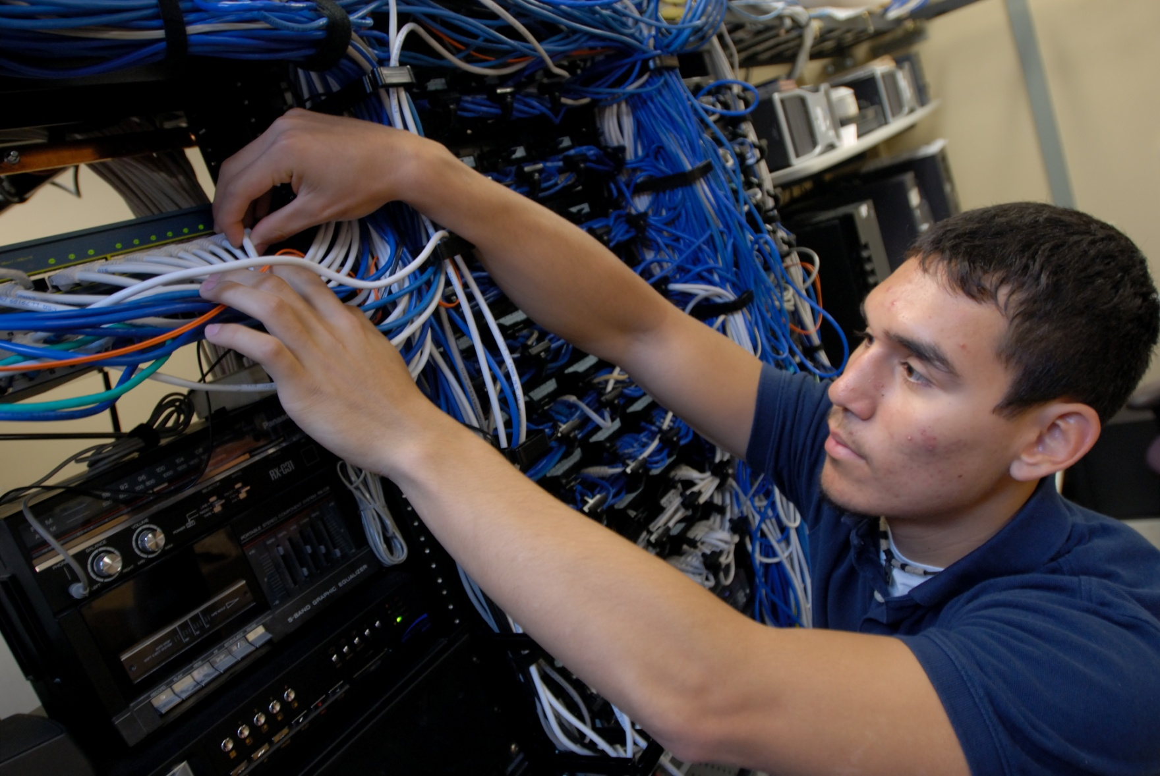
ANSEP University Success Internships: Career Vision & Money for School

Slide 25
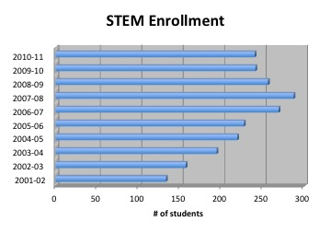
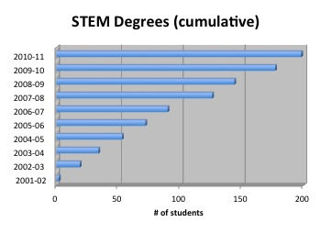
Native STEM Enrollments & BS Degrees

Slide 26
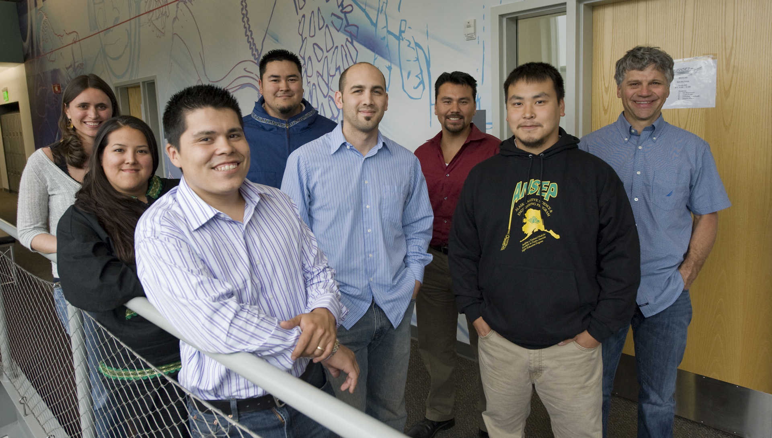
ANSEP Graduate Success Extending Community into Graduate School

Slide 27
2001: Indigenous Alliance for Engineering and Science Education
University of Alaska Anchorage
University of Alaska Fairbanks
University of Arizona
University of Colorado Boulder
University of Hawai'i Manoa
University of Idaho
University of Montana
University of North Dakota
South Dakota School of Mines
and Technology
University of Washington
Kapiolani Community College
Andy White and Mike Nabers (ASRC)
UAA Civil Engineering Graduates

Slide 28
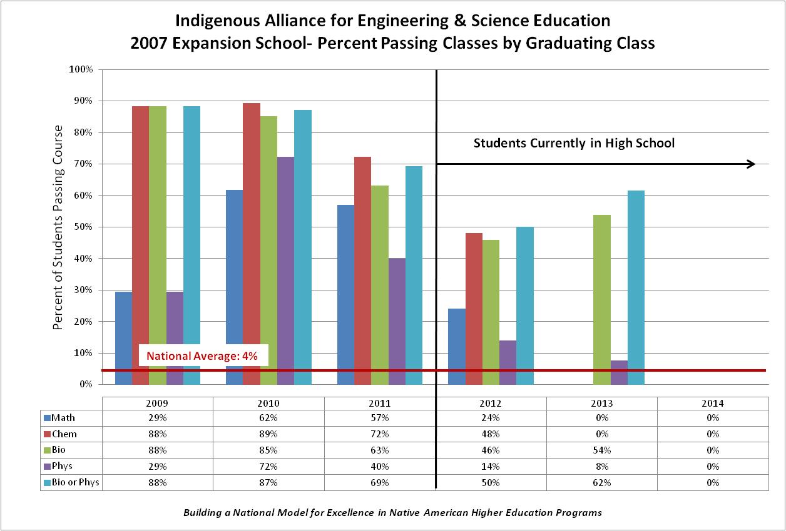

Slide 29
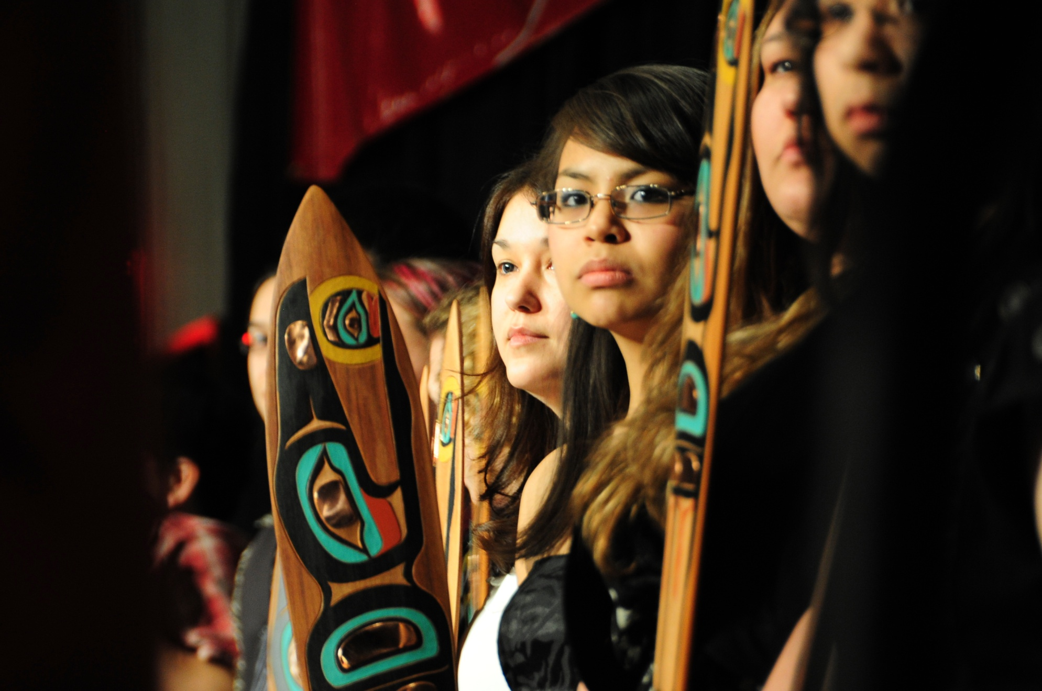
ANSEP
Alaska Native Professionals Managing Alaska’s Resources

