Slide 1
Health Programs Update
September 2011

Slide 2


Alaska health workforce coalition

Slide 3
Alaska Health Workforce Coalition
LEADERSHIP
A public-private partnership created to develop, implement, and support a statewide approach to ensure a robust workforce to address Alaska’s growing health care needs
Industry
Alaska State Hospital and Nursing Home Association
Alaska Primary Care Association
Alaska Native Tribal Health Consortium
Alaska Workforce Investment Board
State of Alaska
Alaska Mental Health Trust Authority
University of Alaska
Department of Health and Social Services
Department of Labor and Workforce Development
Department of Education and Early Development

Slide 4
Action Agenda 2012-2015
Occupational Priorities
Primary Care Providers
Direct Care Workers
Behavioral Health Clinicians
Physical Therapists/Assistants
Nurses (Specialists, Educators)
Pharmacists
System Change/Capacity Building
Health Profession Loan Repayment and Incentive Programs
Training and Professional Development
Aligning regulatory policies that impact the health workforce
Engage and prepare Alaska youth for health careers
Health workforce recruiting
Health workforce data

Slide 5
A blueprint
For us the Action Agenda serves as a blueprint
Along with 2007 UA Health Academic Plan (to be updated in FY2012)
And based on available evidence, to help us
  Set priorities/guide work
  Strengthen essential partnerships
  Develop coordinated advocacy approaches

Slide 6
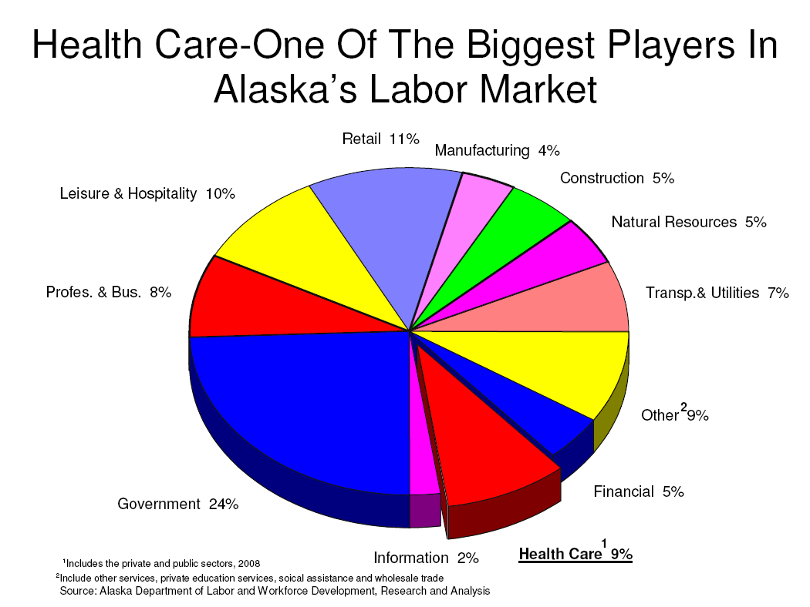
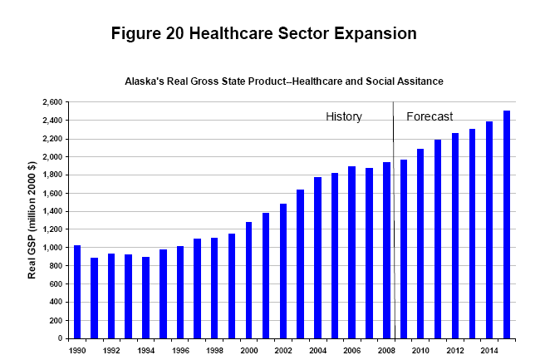
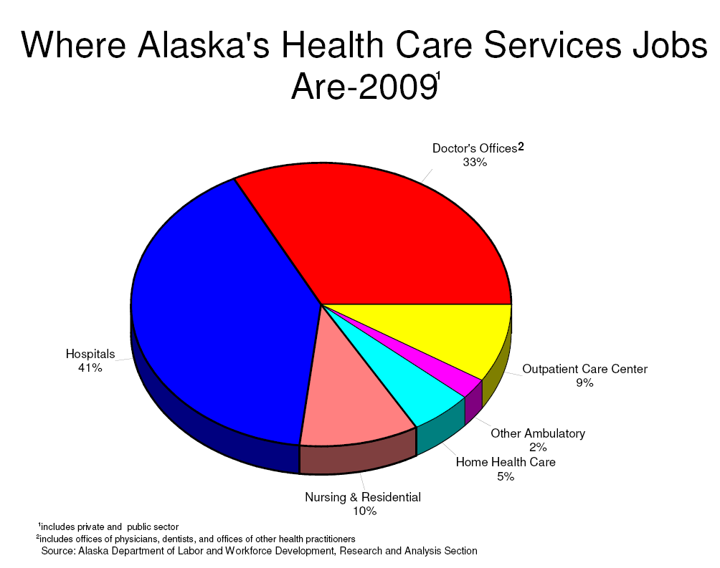
demand for our graduates – drivers and considerations

Slide 7

The picture of health workforce
Many types of data are available – occupations projections, vacancies, industry, student – but the picture is incomplete
Working on developing a more comprehensive and integrated set of data to allow for better prediction of critical needs

Slide 8

Program development direction
Criteria - balancing pressures while collaboratively determining which programs to consider for development/expansion/contraction
  Industry demand = JOBS (current and projected)
  Criticality of occupation
  Student demand/trends
  Clinical sites/opportunities
  Financial and other resources
  Opportunity costs
  Faculty availability
  Educational space
  Student preparation

Slide 9
Update on Initiatives related to action agenda priorities
Primary care
  Physicians
  Physician assistants
  Nurse practitioners – program capacity support
  Community health aides/practitioners
Direct care workers
  Training
  Continuing education
Behavioral health clinicians
  Distance career pathway, articulation among MAUs
  Children’s mental health
Physical therapy careers
  Physical therapists
  Physical therapy assistants
Nursing
  Focus on AAS > BS (distance) program
  Collaborate with industry on specialty education
  Nurse educators

Slide 10
Update, continued
Pharmacy
  Creighton partnership
Health information technology (HIT)
  Close collaboration across UA system and with Alaska e-Health Network, the Department of Health and Social Services, others
  UAS Sitka is lead campus for this effort
  One day seminar on Health Information Technology – 9/28 in Anchorage
Veterinary medicine
  UAF partnership initiative is progressing

Slide 11
Our health students
91% increase in UA health
majors in a decade

Slide 12


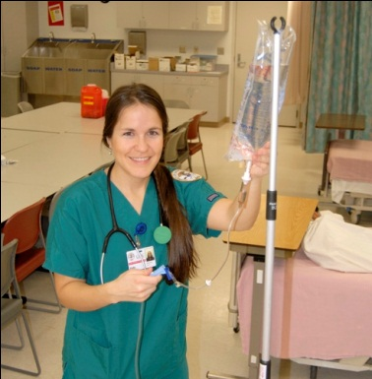

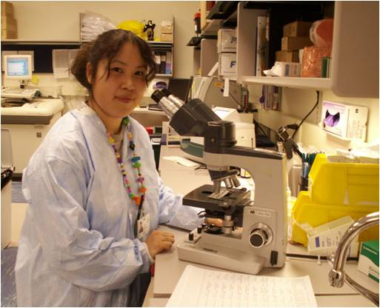
Synergies and collaboration
Interdisciplinary opportunities
  Academic programs
  Research
  Teamwork and communication
  Clinical simulation/other technologies
Student services
Ethics
Teamwork
Communication
Lifestyle Choices
Professional Role
Patient/Family Focus
Population Orientation
Human Development Over the Life Span
Approved by
UA BoR
June 2011
Research Methods/Practice Evaluation
Evidence/Science Based Practice
Quality and Safety Improvement
Information Management
Interviewing Techniques
Simulation Technology
Case Management

Slide 13
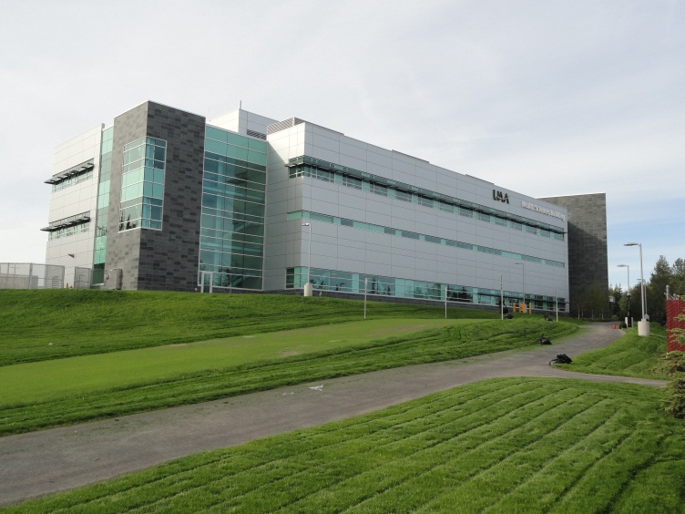
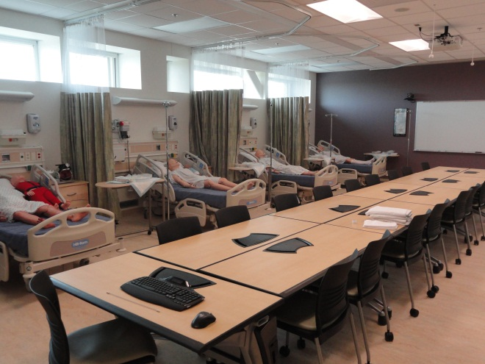
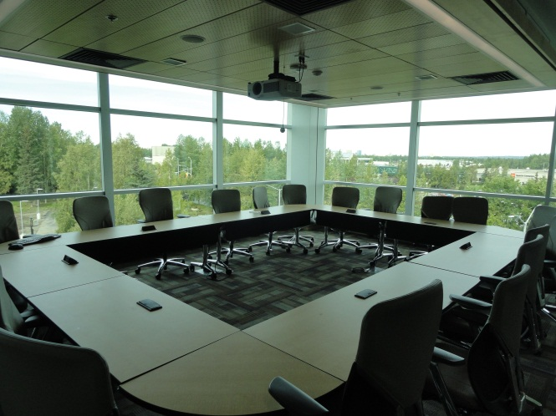
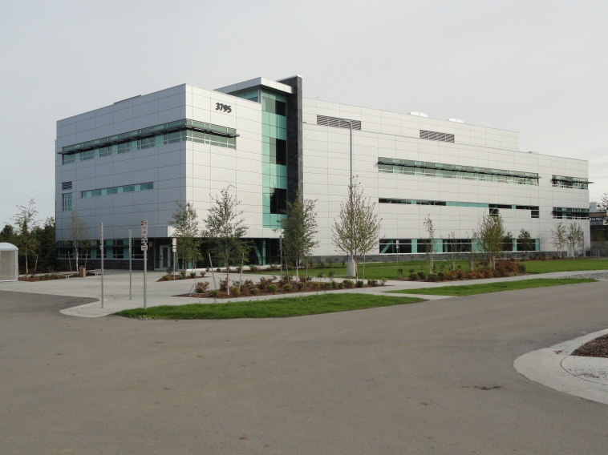
Health Sciences Building
Oct.7 Grand Opening
4 PM

Slide 14
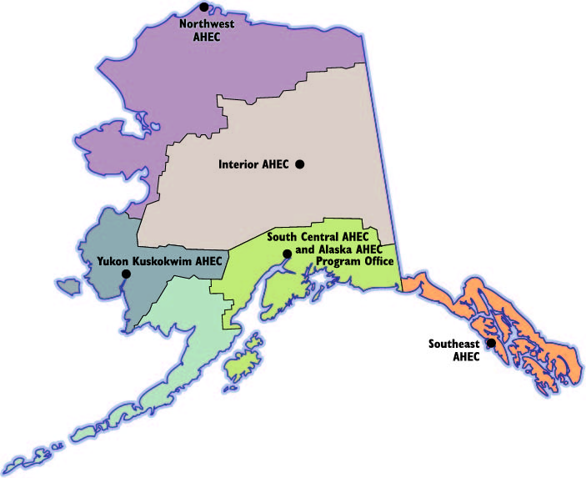
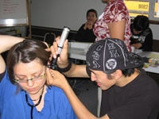
The Alaska area Health Education Center (ahec) System
Goals
  Alaskans Into Health Careers
  Clinical Student Rotations to Underserved and Rural Areas
  Continuing Education for Professionals in Underserved Areas

Slide 15
Office of Health Programs Development
Policy, planning, development and advocacy for health programs across the UA system
  Facilitate, coordinate and document
  Involve faculty, deans and directors from all MAUs, campuses
  Convene alliances, advisory councils, and work groups
  Maintain and update the UA Health Academic Plan
  Document program budget and other resource needs; seek resources
Provide an interactive bridge between external and internal stakeholders
Work with others, including the Alaska Health Workforce Coalition, to identify and address Alaska’s health workforce needs
Coordinate assessment and compilation of health workforce data and information
Manage multi-campus externally funded health projects

Slide 16
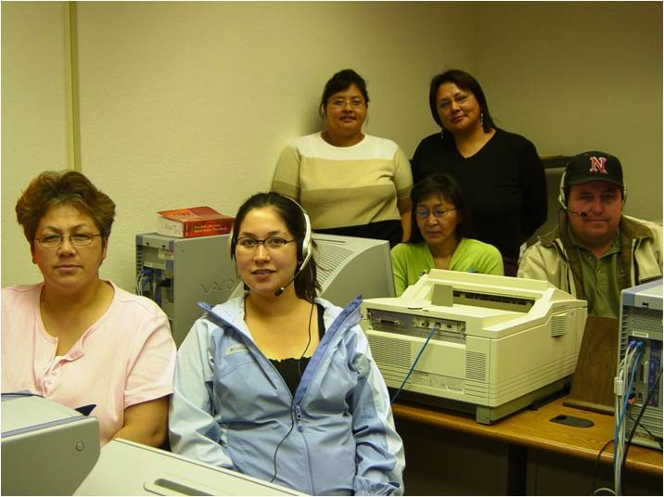
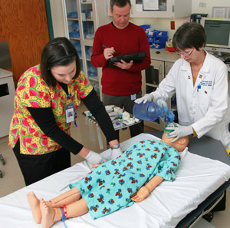
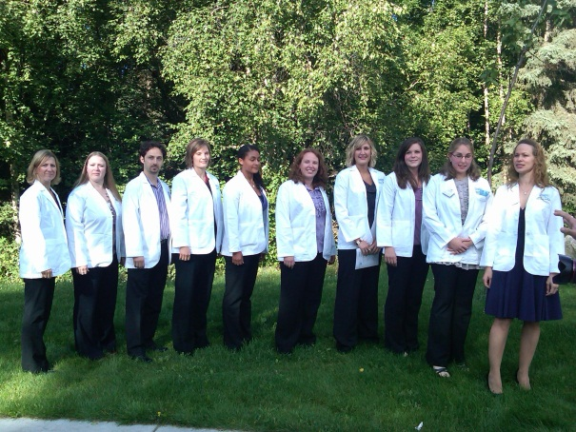
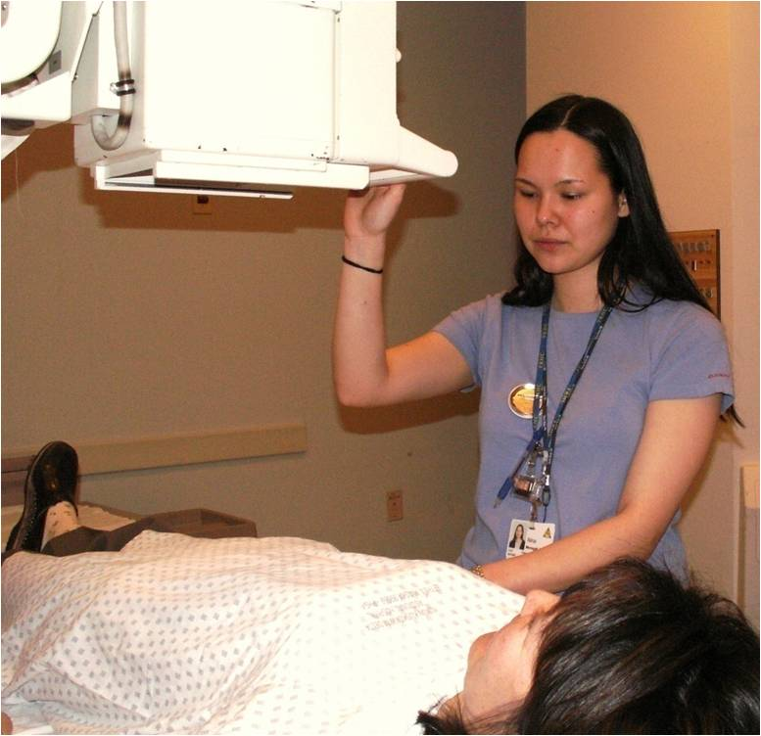

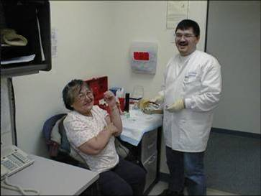
Questions/Comments?

