Slide 1
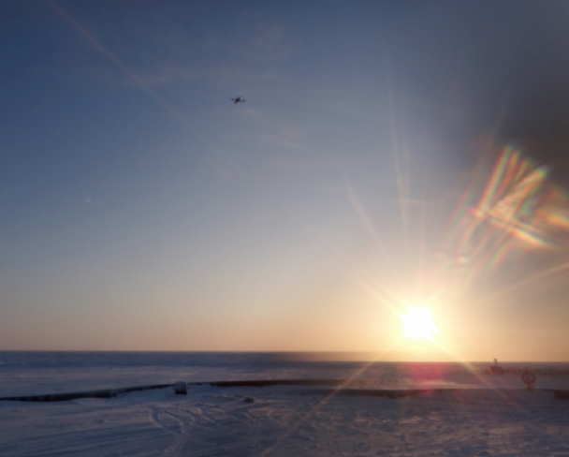
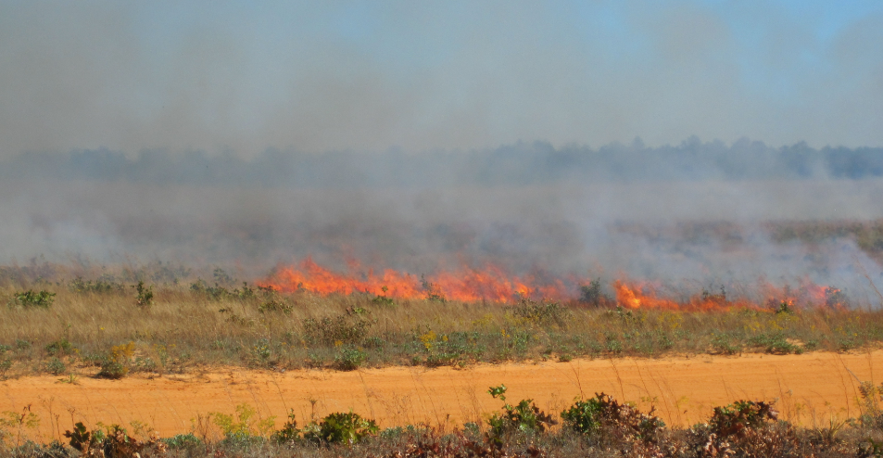
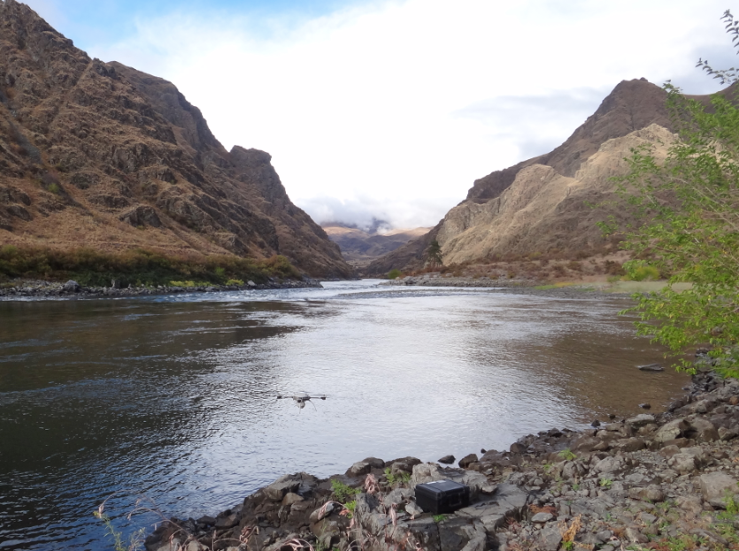
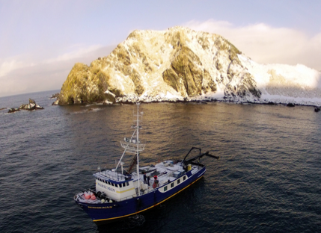
Recent Alaska’s Unmanned Aircraft Research
Gregory Walker
Gregory.Walker@gi.alaska.edu
(907) 455-2102

Slide 2
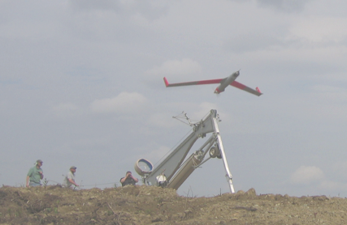
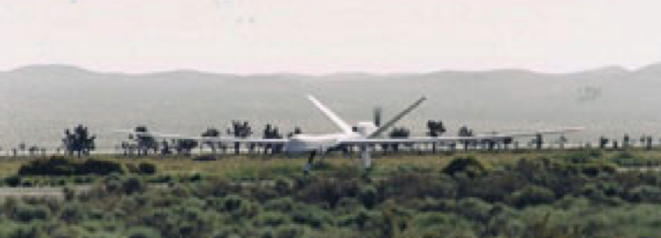
History of Unmanned Aircraft at UAF
June 2007
2001 - Partnership with New Mexico State University
Tasked to develop an application focus
2003/2004 - Funded to work with USAF and USCG
Maritime domain awareness
Wildfires in the Interior of Alaska
2006 - Acquired first ScanEagle with 50% loan from Foundation
2007 to present - Multiple missions for science, emergency response, humanitarian needs, and engineering development
Today the UAF unmanned aircraft fleet is diverse and growing
Existing fixed wing systems
Existing rotor systems
Developing our own systems
First UAF Launch
Altair “Mariner” Alaska July 2004

Slide 3
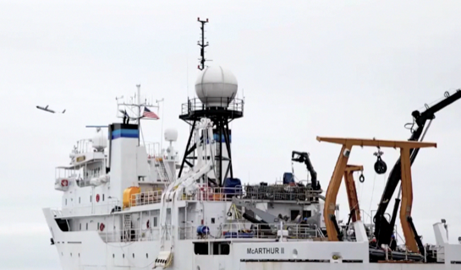
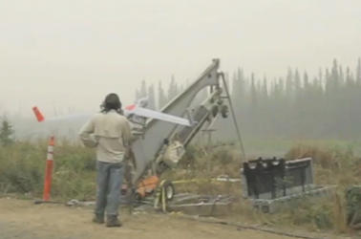
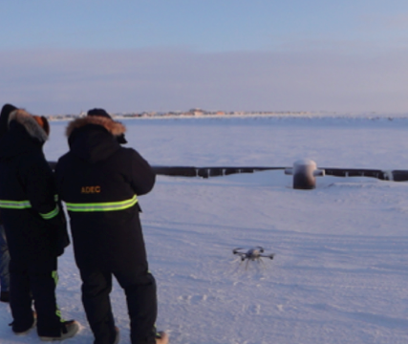
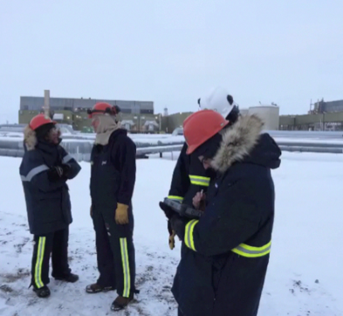
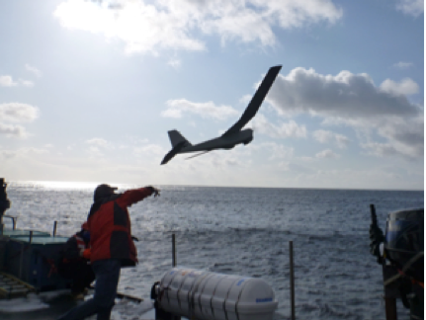
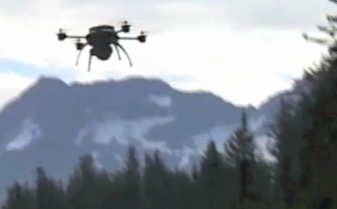
Alaskan Requirements
Bering Sea
Research
Science
Engineering
Public Safety / Emergency Response
Natural Resource Management
Circle
Nome
Prudhoe Bay
Aleutians
Valdez

Slide 4
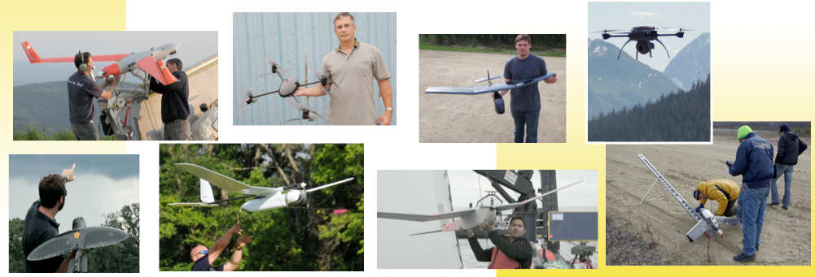
Mission Statement
A research center for small, unmanned aircraft systems providing integration of unique payloads and supporting pathfinder missions within government and science communities, with a special emphasis on the arctic region.
Conducted over 150 mission flight days worldwide in 2012

Slide 5
Successes

Slide 6
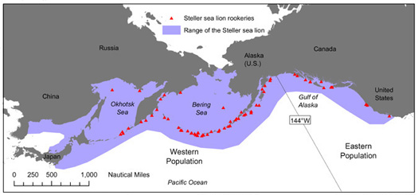
Augmenting Steller Sea Lion Surveys Western Aleutians
Problem: Biological opinion, based on few observations, eliminated a commercial fishery
Goal: Demonstrate a method to collect high quality imagery for population surveys in hard to observe areas
Possible Benefit: Improved understanding of animal use of and movement through their habitat
Problem Area

Slide 7
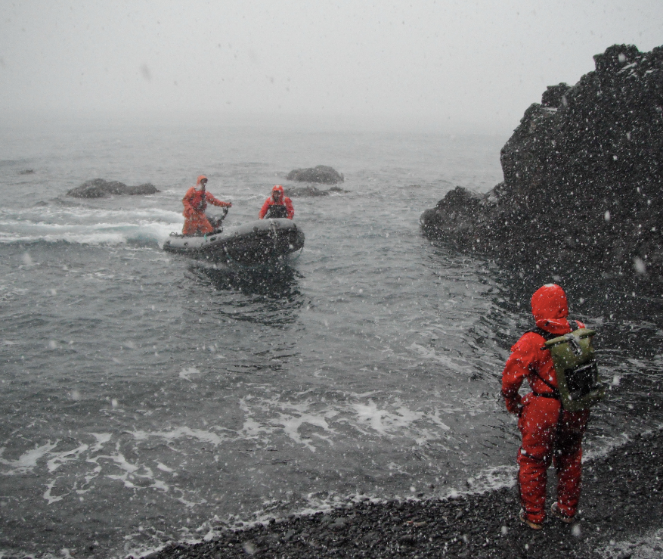
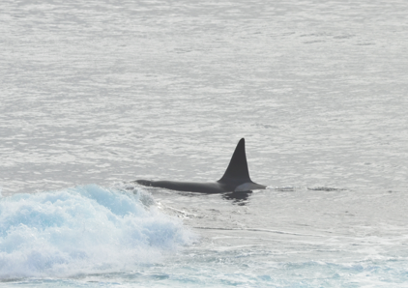
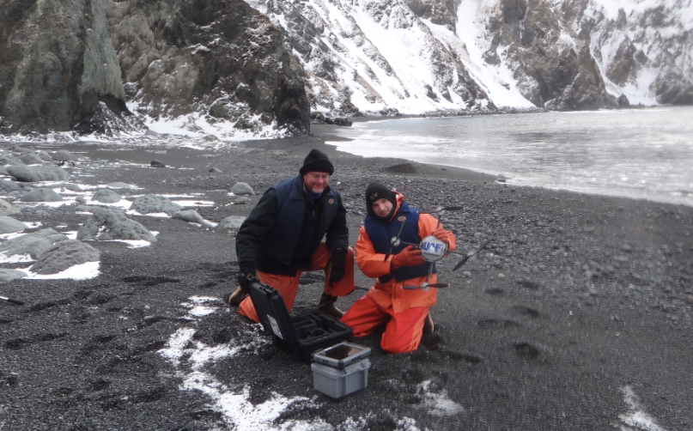
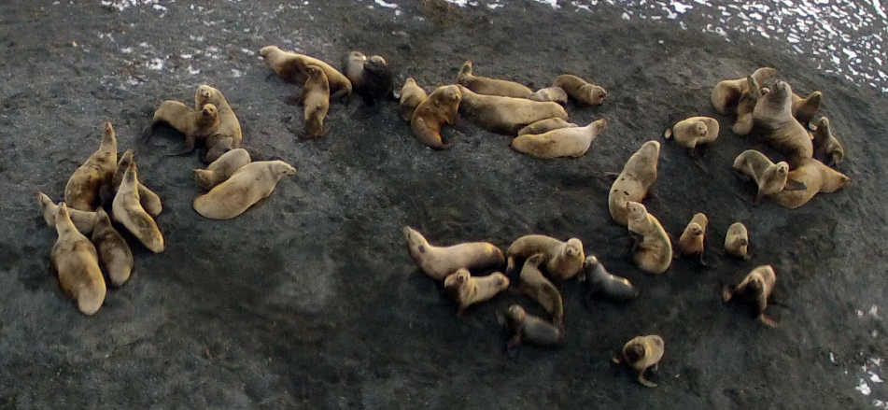
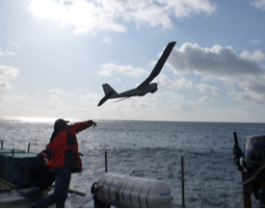
Steller Sea Lion Habitat Monitoring
Preliminary Findings
- Migration
- Transient Killer Whales

Slide 8
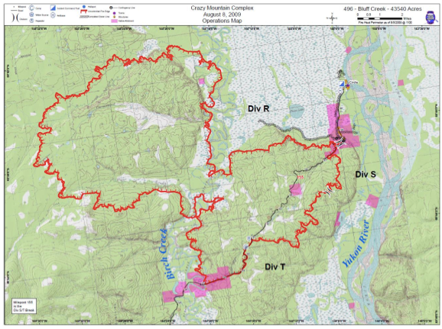
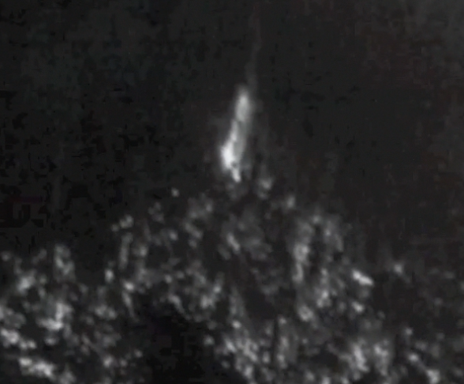
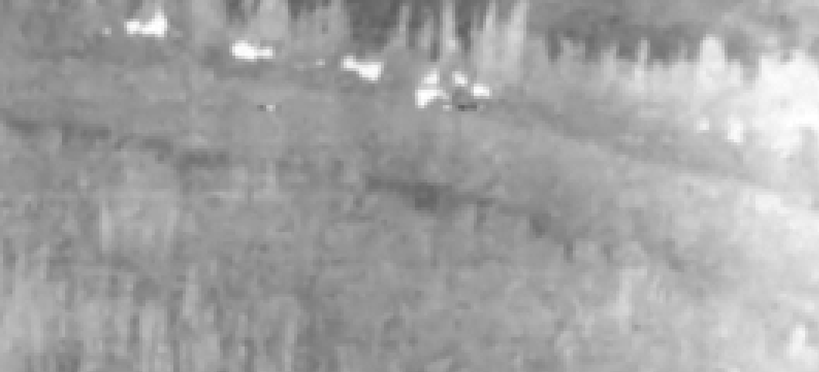
Crazy Mountain Wildfire Alaska Fire Service Incident Command Team Support
Tasked by Alaska Fire Service Incident
Command Team
Manned aviation not flown for (5) days
due to the smoke and limited visibility
Satellite imagery (MODUS) incapable
of showing critical activity

Slide 9
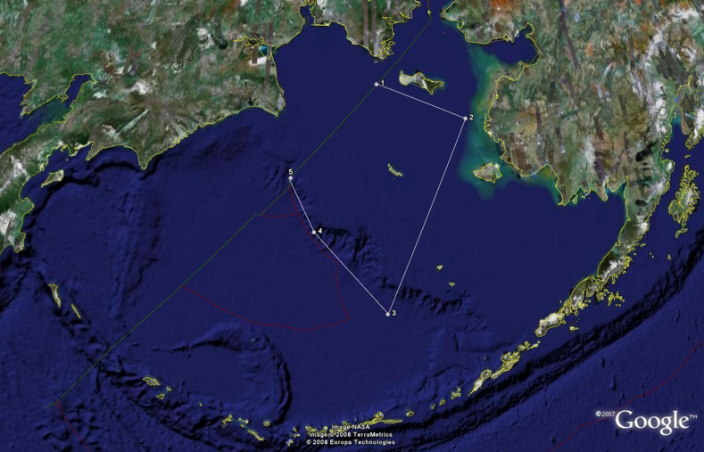
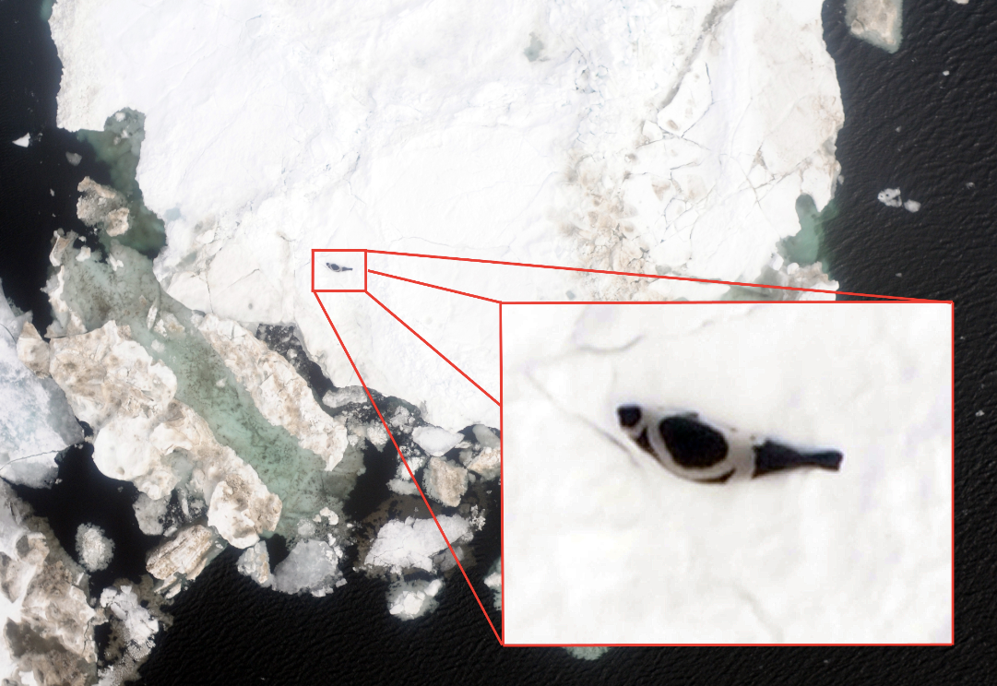
Ice Seal Population Study
Scientific Need
Marine Mammal Protection Act mandated
Relevance
Large-scale, systematic ship-based survey
Outcome
Safer (than manned aviation)
More effective (they do not startle seals)
vs. manned fixed wing or helicopters
2009 First Deployment
2014 Proposed Expanded Survey
Joint NOAA and US Navy Funded

Slide 10
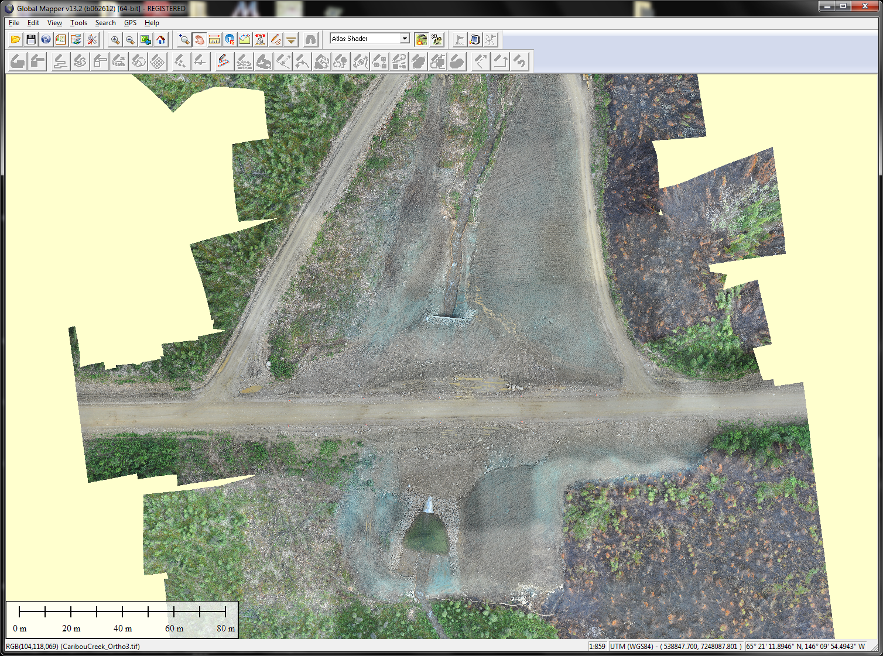
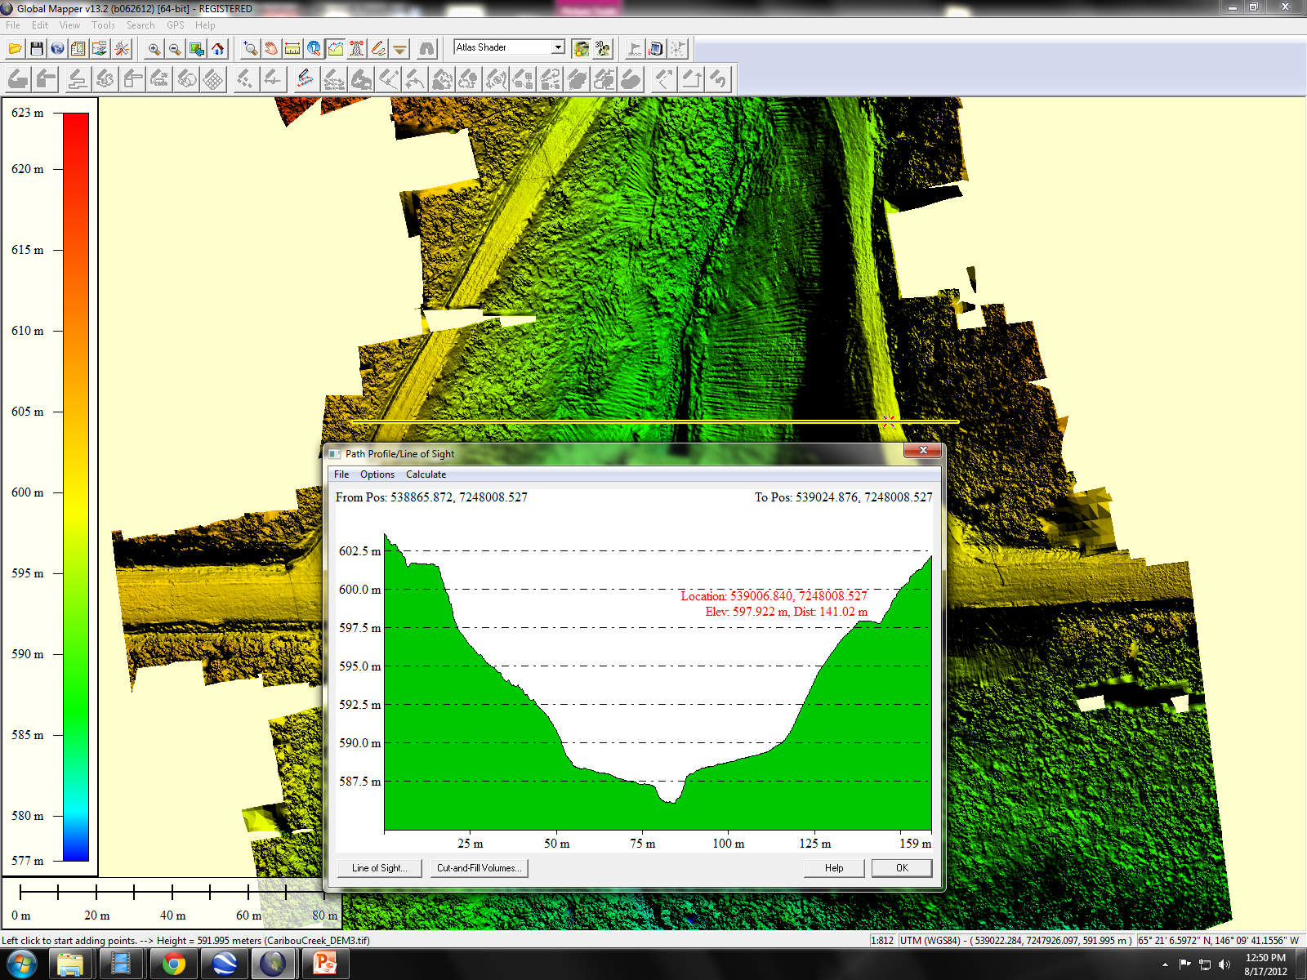
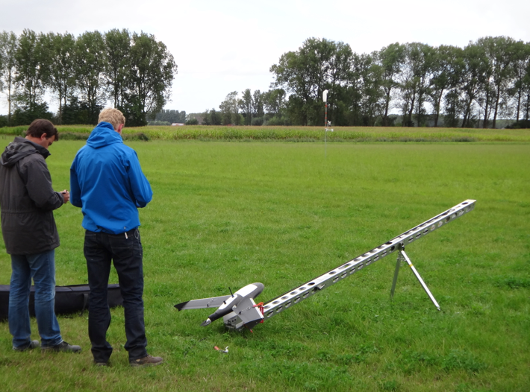
Ortho Image and Surface Models
Gatewing x100
Weight: 2 kg (4.4 lb)
Wingspan: 100 cm (39 inch)
Flight Duration: 45 minutes
Speed: 75 km/hr (47 mph)
Up to 1.5 km² mapped/flight

Slide 11
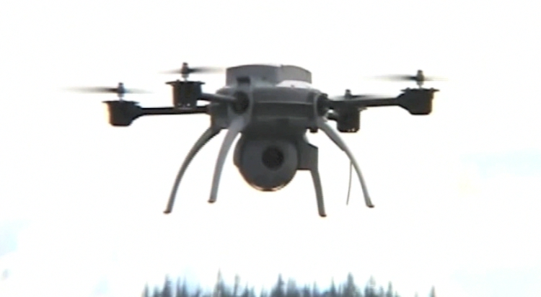
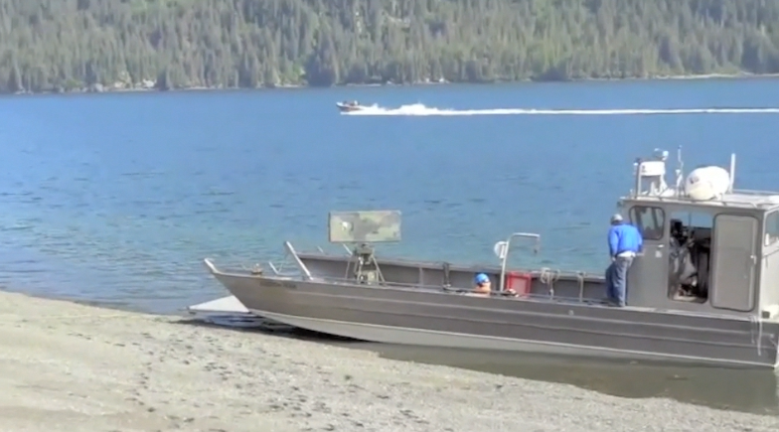
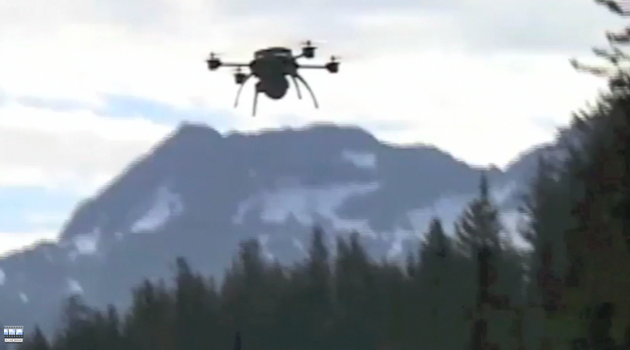
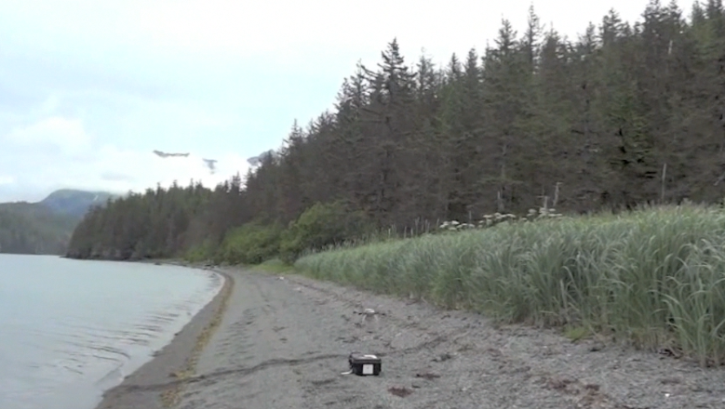
Shoreline Clean-up Assessment Technique (SCAT) Evaluation
BP Exploration (Alaska) Inc. Partnership

Slide 12
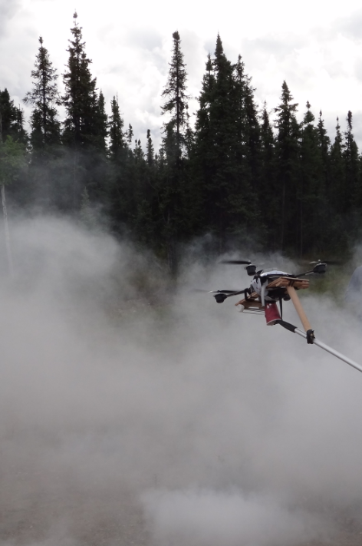
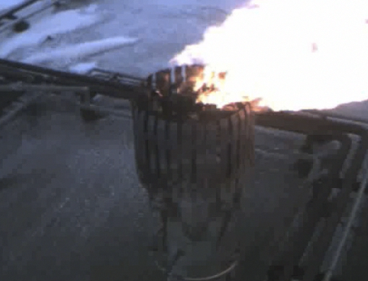
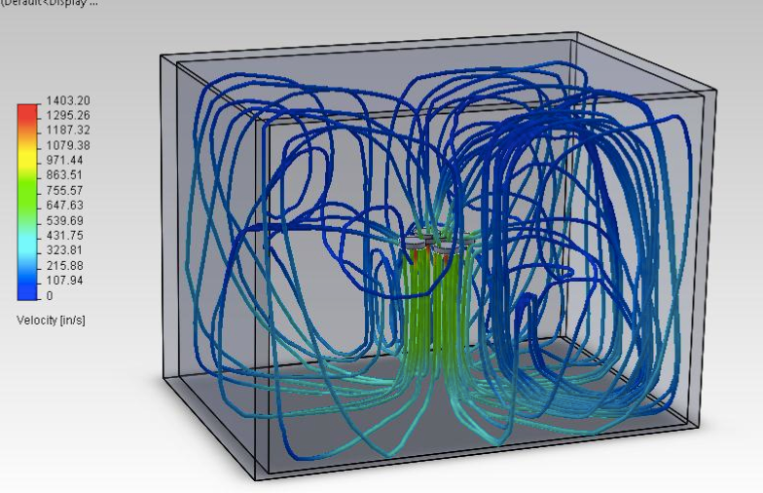
Oil Infrastructure Monitoring Research
Flare Stacks
Pipelines
- Processing Facilities
- Access Roads
BP Exploration (Alaska) Inc. Partnership
BP Exploration (Alaska) Inc. Partnership

Slide 13
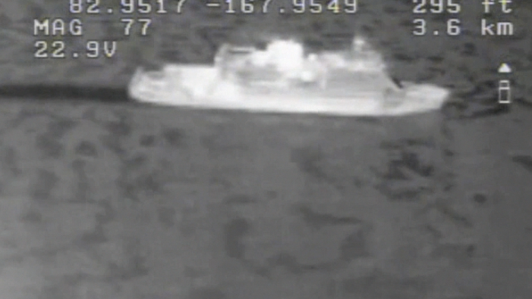
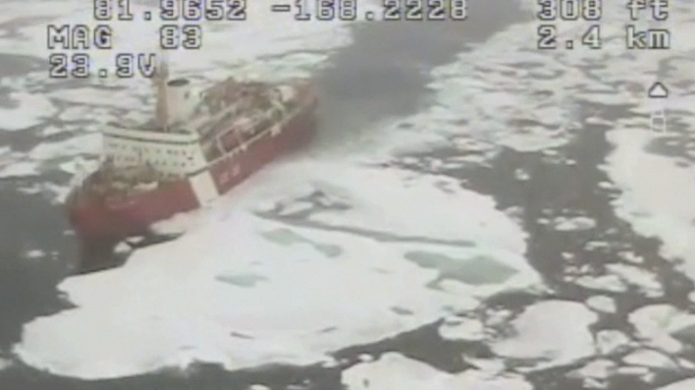
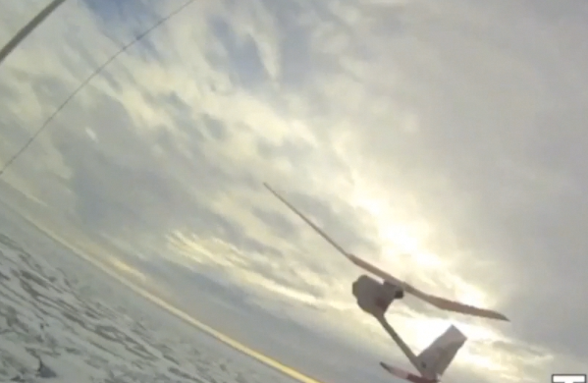
High Arctic Ship Piloting Experiments Aboard the Canadian CCGS LOUIS S. ST. LAURENT
Phase I Research conducted by Capt Stephen Wackowski (USAF)
Phase II Ongoing with UAF graduate students with recent Raven systems acquisition

Slide 14
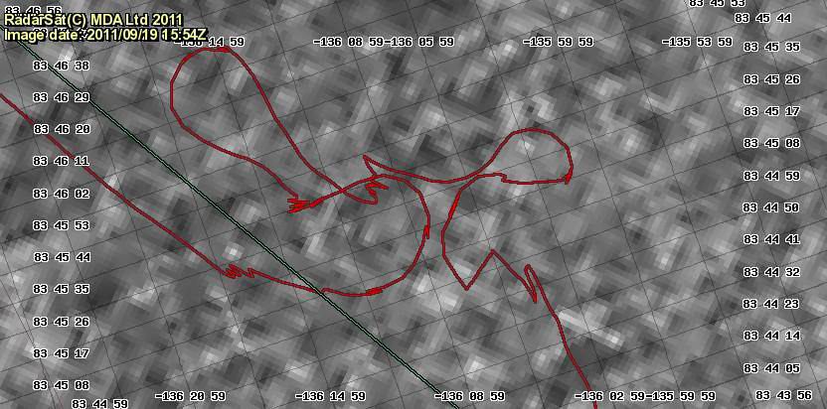
Imagery Used For Ship Piloting in Ice Ship tracks superimposed (Sept 2011)
Background Image: National Ice Center highest resolution RADARSAT
Desired icebreaker track (green)
Actual navigation track (red)

Slide 15
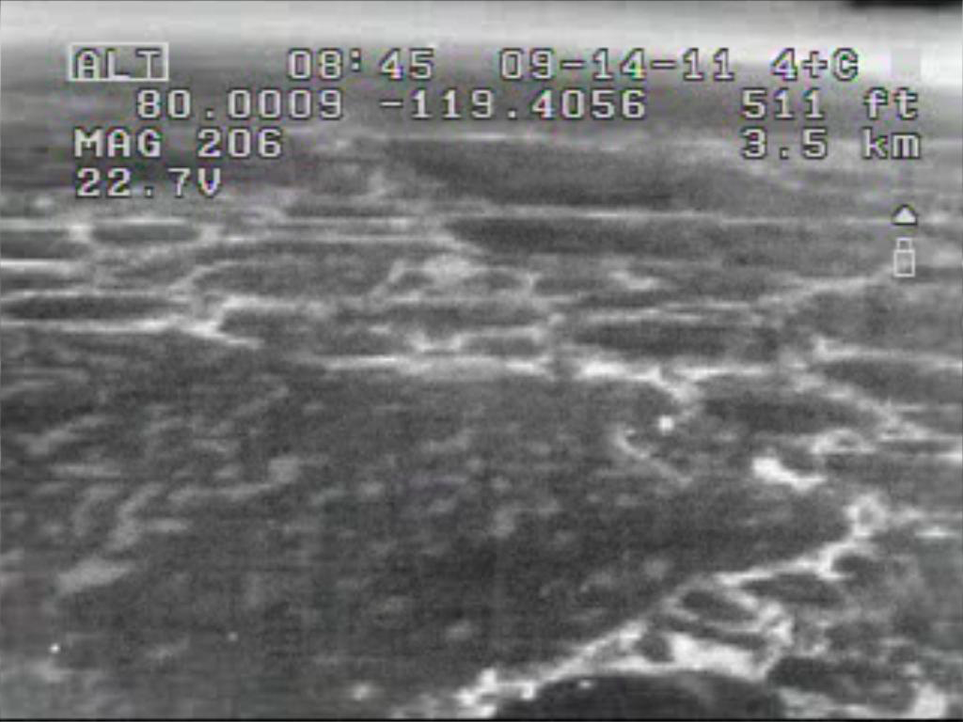
Small UAS Imagery of Ice Ridges IR image from RAVEN UAS (Sept 2011)

Slide 16
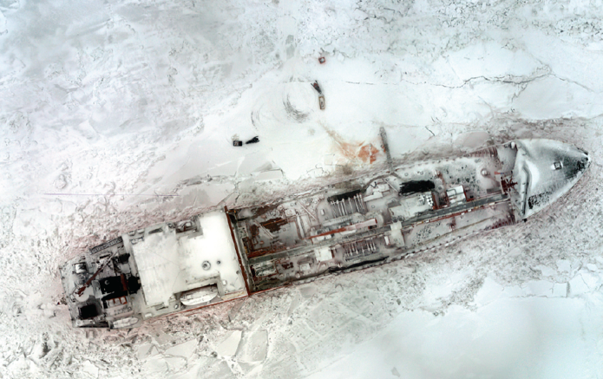
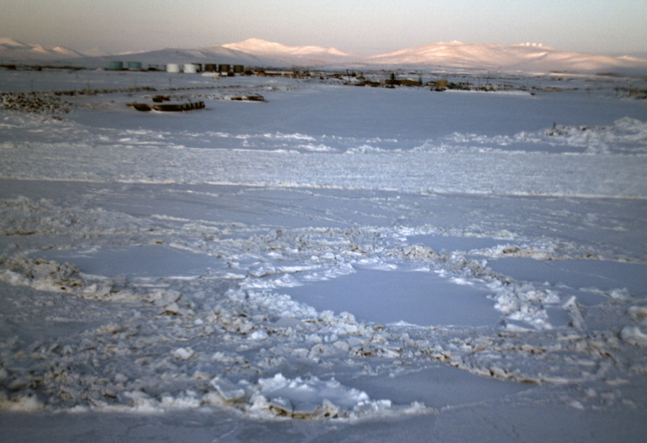
Navigating Sea Ice during the
Nome Fuel Delivery
University Engagement and Decision Support
Mission
Identify potential safety concerns for those working on the ice
Document the site for mission response activity
Collect imagery for the USCG Public Affairs Officer

Slide 17
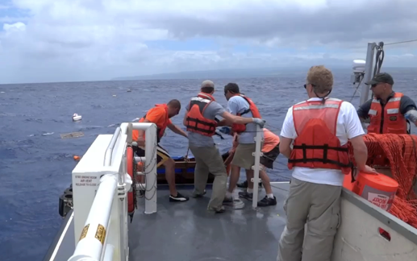
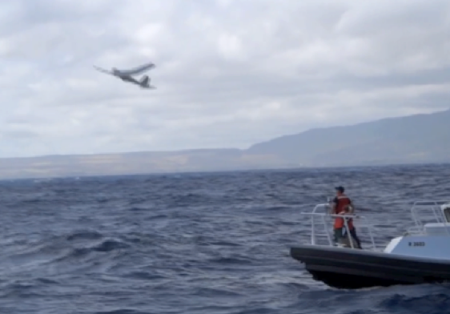
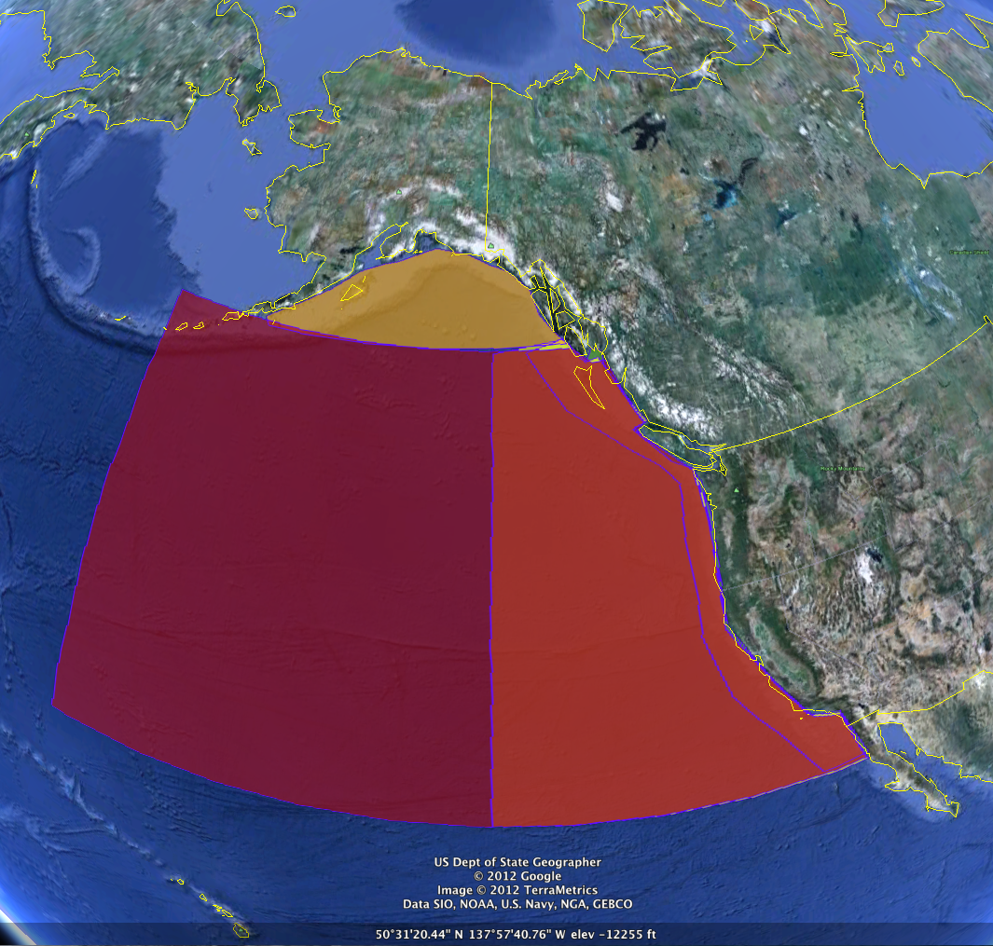
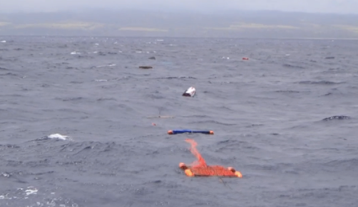
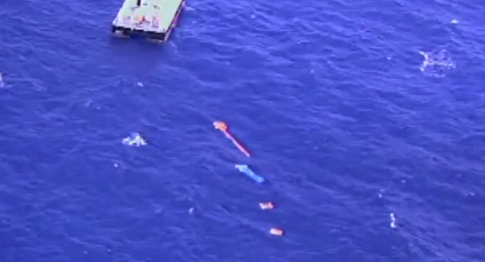
UAS Survey of Marine Debris Generated by 2011 Japanese Tsunami
NOAA Funded Effort
Partnering with a Wasilla Alaska based Company

Slide 18
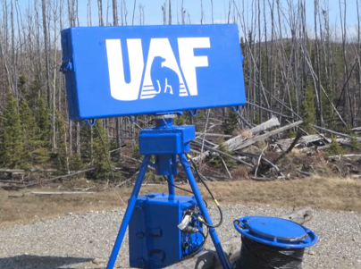
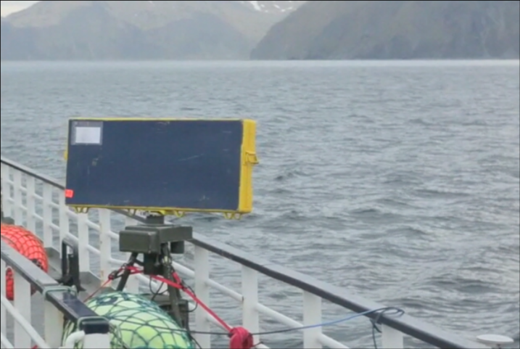
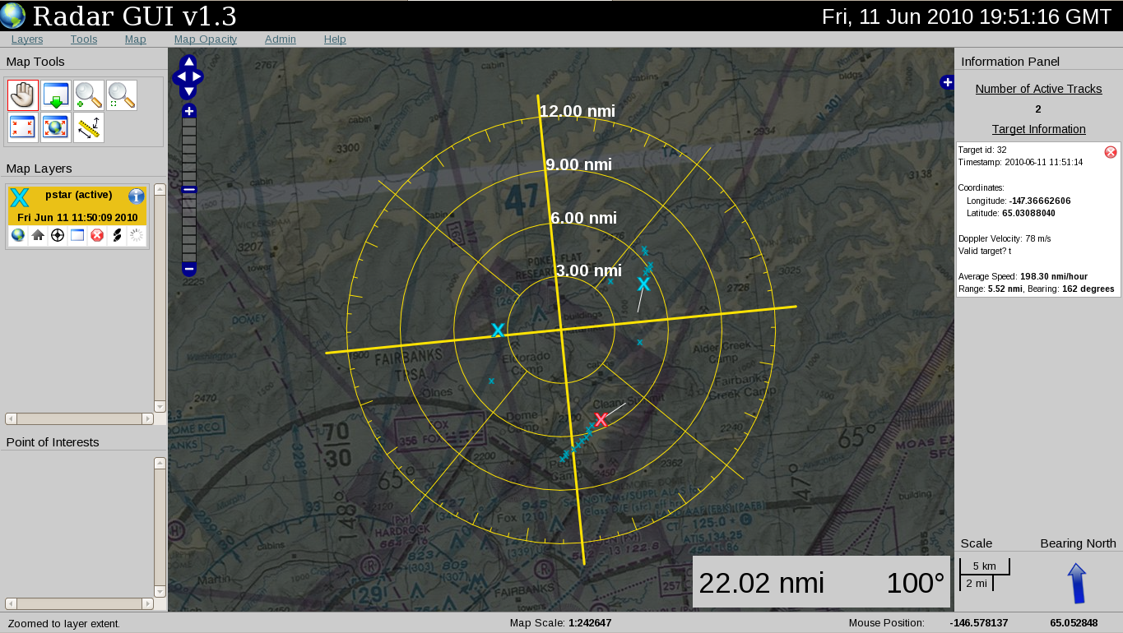
iPASS UAF’s Portable Airspace Surveillance System
Designed and built by UAF for Alaska’s airspace monitoring needs
Status
Operational, used in Canada and NASA Certified
Airspace activity monitoring
Monitors airspace use patterns and validates traffic pattern assumptions
Enhanced situational awareness during aircraft or spacecraft operations
Provides real-time position and track of local airspace activity to assist in traffic avoidance

Slide 19
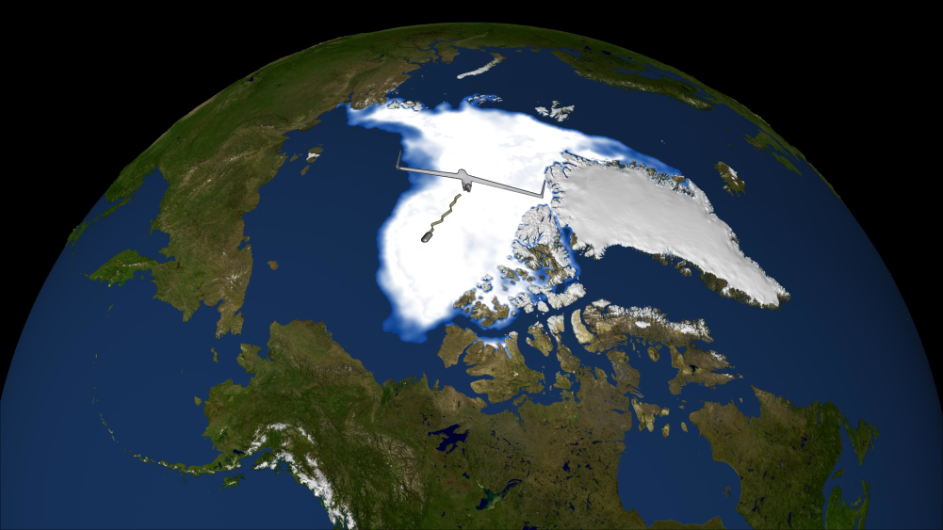
Low-altitude, over-the-pole capability Fuel-injected, Iridium-communication-enhanced, long-endurance, small unmanned aircraft
Climate modelers need repeated measurements at defined points
Presently there are few methods to collect this data in the Arctic
The capability combines a scientific payload, polar satellite communications, and 30+ hour endurance in a 20 kg aircraft that could fly from Alaska to Norway at altitudes below 300 m.
Custom designed by UAF – successfully executed flight test on September 29 and 30 2012. UAF is the only University in the world with this capability.

Slide 20
2012 FAA Modernization Reform Act Unmanned Aircraft Language – Permanent Arctic
“Permanent area in the Arctic where small unmanned aircraft may operate 24 hours per day for research and commercial purposes below 2,000 feet in altitude.”
Calls for a process to facilitate safe operations over water
The University is helping the FAA UAS
Integration Office develop this process
UAF will build products to meet this need
UAF will provide services for the users

Slide 21
2012 FAA Modernization Reform Act Unmanned Aircraft Language – Six Test Ranges
“… to integrate unmanned aircraft systems into the national airspace… to provide for verification of the safety of unmanned aircraft systems and related navigation procedures…In determining the location the Administrator shall (A) take into consideration geographic and climatic diversity; (B) take into consideration the location of ground infrastructure and research needs”.
Alaska will extend the University pilot program with the FAA
Alaska will compete for one of the six FAA test ranges
The University of Alaska will lead the Alaska team
Alaska is investigating partnering (leading) with Hawaii, Oregon, Washington and Idaho

Slide 22
Economic Impact in Alaska Not Waiting for the Expected Economic Impact of a Test Range
Northern Embedded Solutions
Polartronix
Not customers but Alaska-based development partners

Slide 23
Volcanic Ash Analysis and Detection USAF Small Business Innovative Research
Collaboration between UAF researchers and new industry
Conflict of Interest resolved
Provided opportunity and assisting in launching a business to capitalize on USAF funding with UAF IP
Validating A Better Volcanic Ash Transport & Dispersion Model

Slide 24
Vision
Develop, test, and ultimately exploit emerging unmanned aircraft technology and its uses to create a positive economic and social benefit within the State of Alaska.
When the cost of the hardware is no longer a factor what will people do with the capability?
Plan that way today to prepare for the future
Develop what is needed to expedite this concept

