Slide 1
UAS Campus Masterplan
December 2012
Draft

Slide 2
Prior Work - inputs
2002-2003 –UAS Masterplan
2009 – Accreditation Review
2010 – UAS Strategic & Assessment Planning

Slide 3
University of Alaska Board of Regents Requirements
Enrollment Projections & other Factors which:
Impact Facilities
Demolition
Renovation
New construction
Impact Infrastructure
Roads
Parking
Pedestrian circulation
Utilities
Proposed areas for Land Acquisition/ disposal
Landscaping / Signage Guidelines
Architectural Guidelines
Location and intent of open spaces
ADA access & energy conservation
Environmental & cultural issues
Relationship between campuses and surrounding communities
Location, size & purpose of new buildings and infrastrucure
Priorities for Capital Projects

Slide 5
The mission of the University of Alaska Southeast is student learning enhanced by faculty scholarship, undergraduate research and creative activities, community engagement, and the cultures and environment of Southeast Alaska.

Slide 6
CORE THEMES
Student Success
Teaching and Learning
Community Engagement
Research and Creative Expression

Slide 7
SDI THEMES
Student Achievement and Attainment
Productive Partnerships with Alaska’s schools
Productive Partnerships with Alaska’s Public and Private Industries
Research and Development to Sustain Alaska’s communities and Economic Growth
Accountability to the People of Alaska

Slide 8
UAS Values
EXCELLENCE—continuous improvement
DIVERSITY—respect & understanding
ACCESS—innovative & inviting
COLLABORATION—dynamic partnerships
SUSTAINABILITY—educating for the future
STEWARDSHIP—responsible & accountable

Slide 9
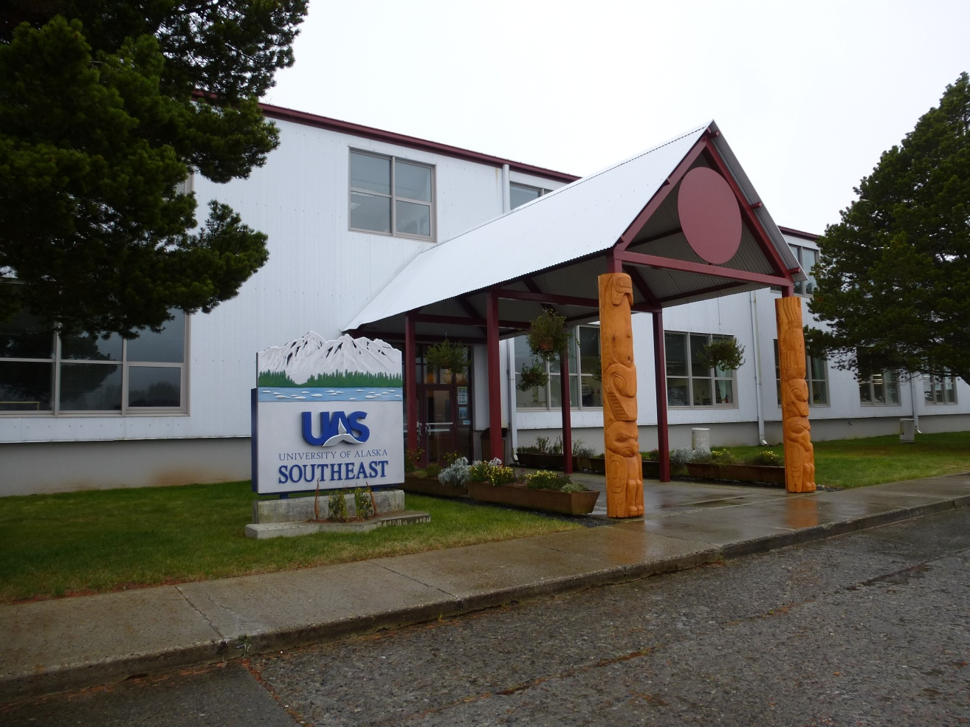
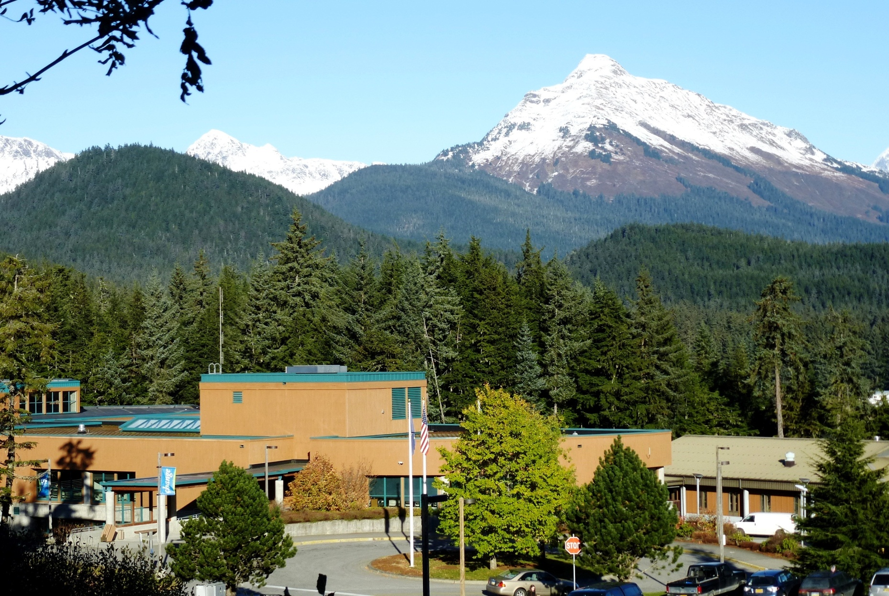
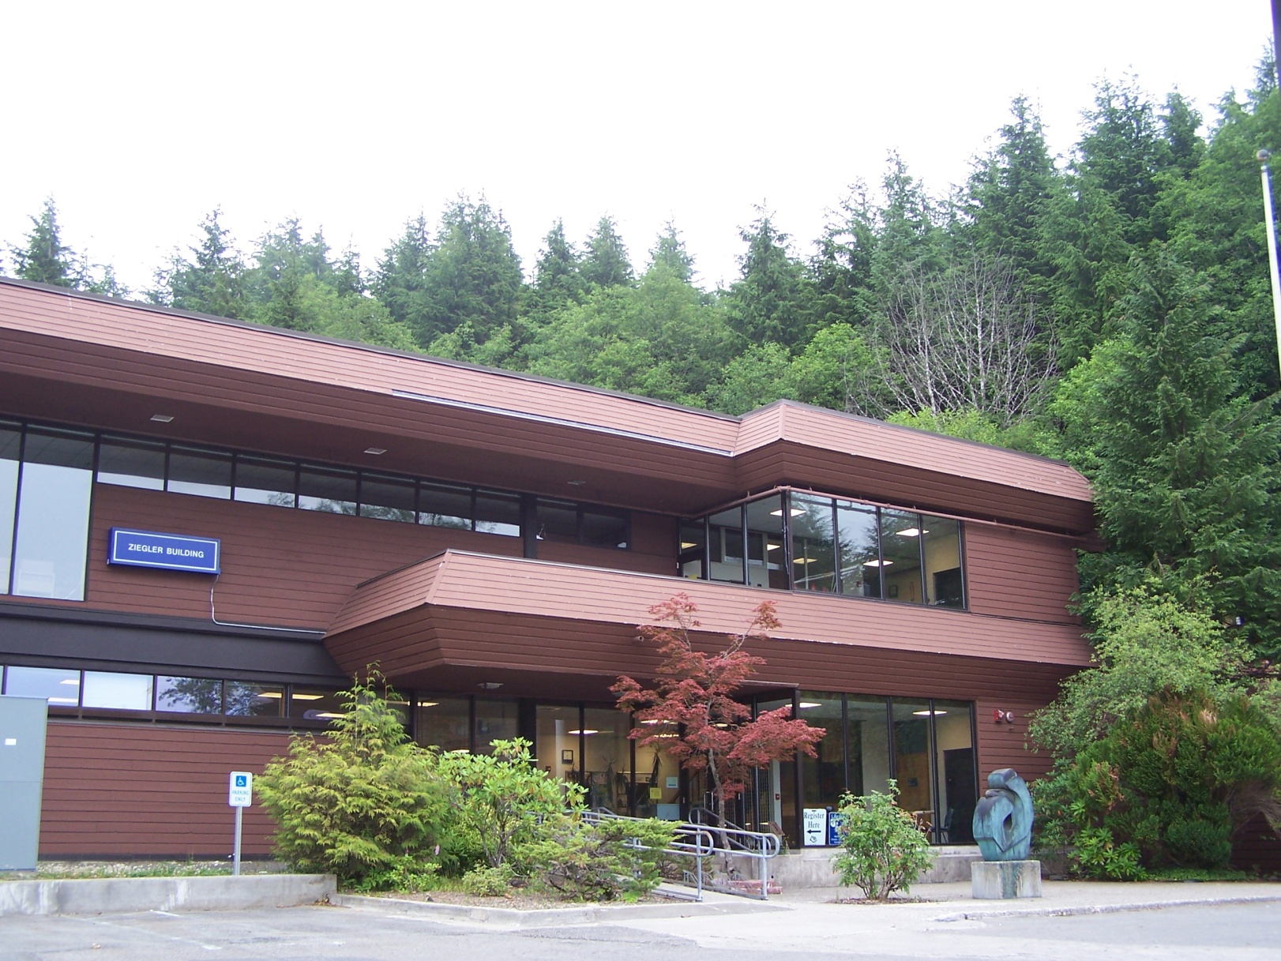
3 campus locations - 1 university

Slide 10
Fall 2021 Juneau Projected Enrollment
Fall 2021 Sitka Projected Enrollment
Fall 2021 Ketchikan Projected Enrollment
41%
59%
E-Learners vs. Face to Face
Total Projected FTE= 319
E-Learners vs. Face to Face
Total Projected FTE= 538
E-Learners vs. Face to Face
Total Projected FTE= 1617
Enrollment Assumptions - E-Learning vs. Face to Face

Slide 11
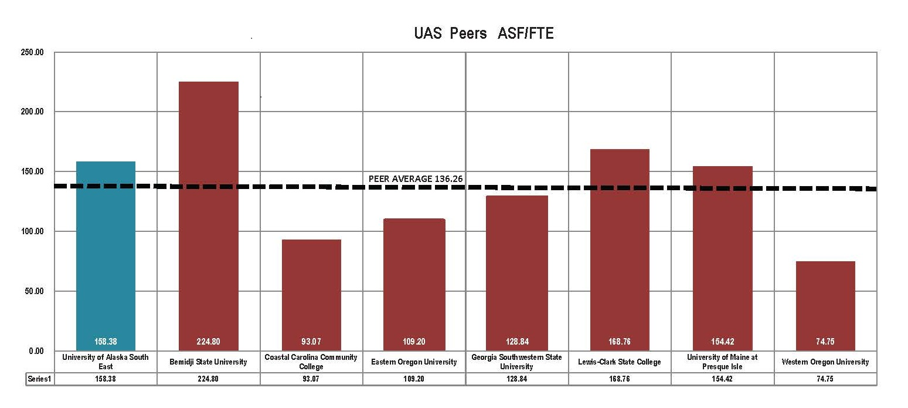

Slide 12
Juneau Student Housing Needs
Affordable student housing in Juneau is extremely difficult to find.
35% of total FTE at Auke Lake Campus will be housed on campus
50% of new incoming freshmen will be housed on campus by 2021

Slide 13
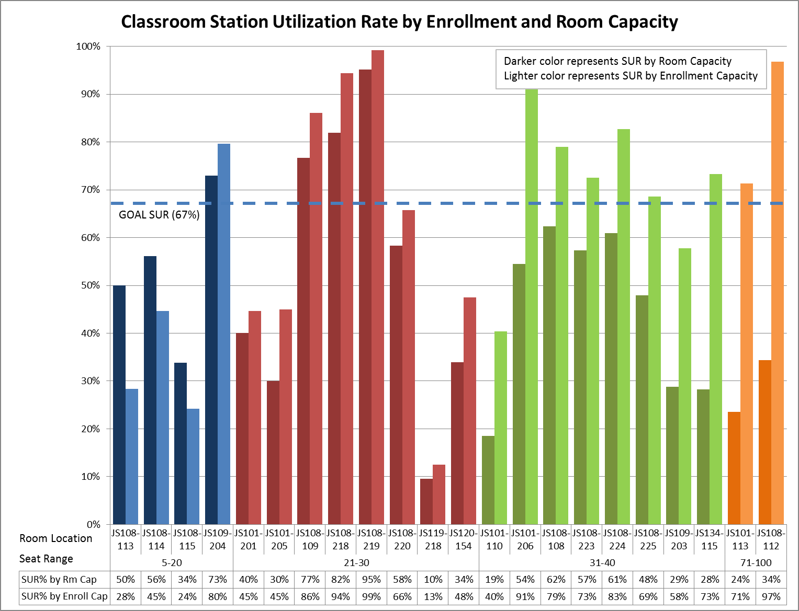
Juneau Campus
Classroom Station Utilization by Room and Enrollment Capacity

Slide 14
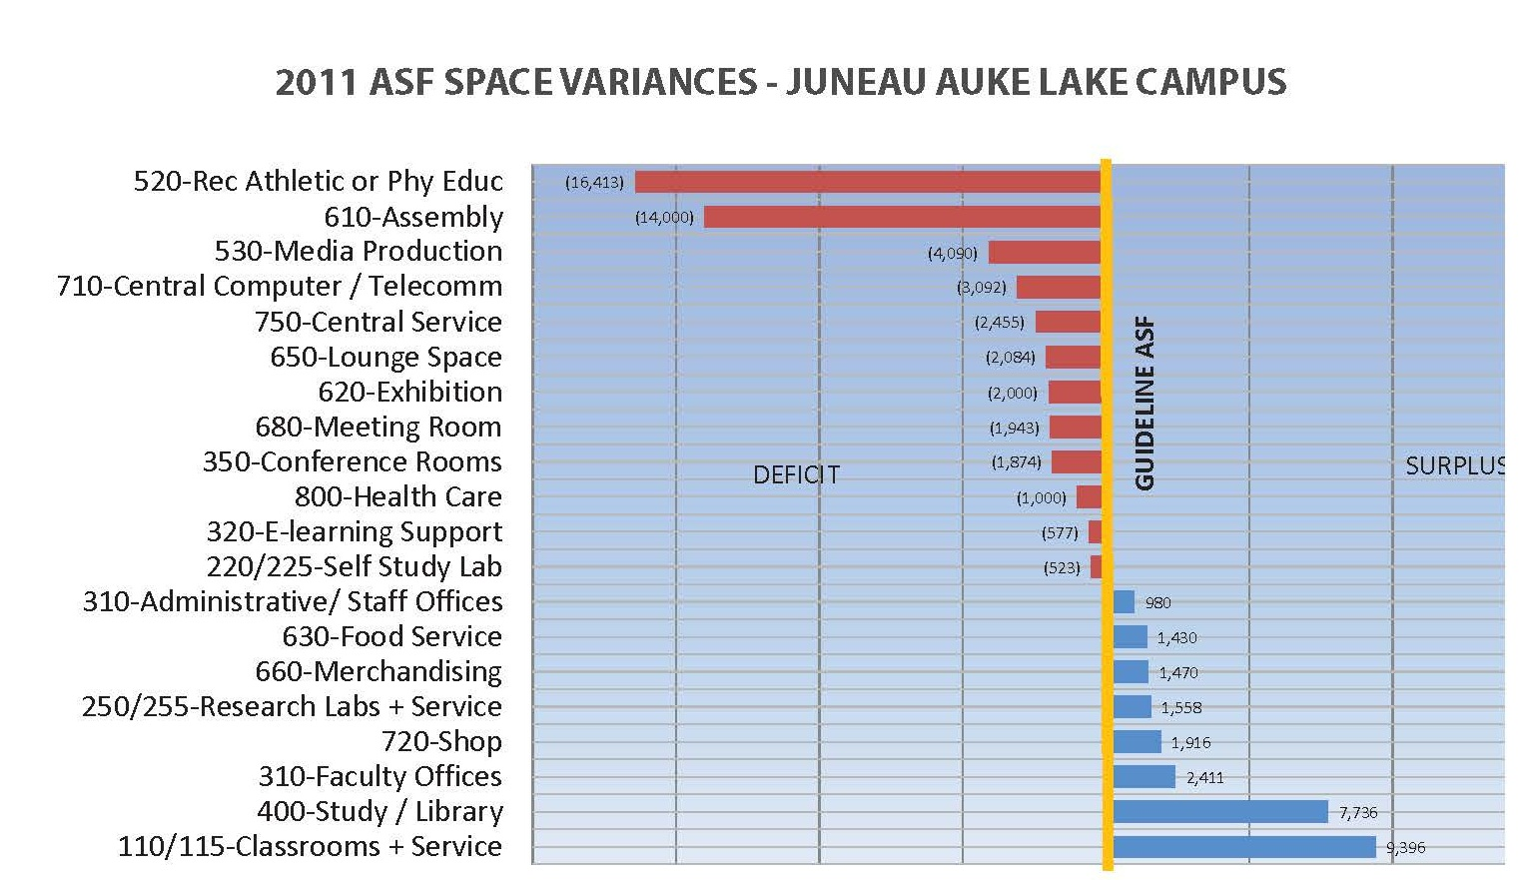
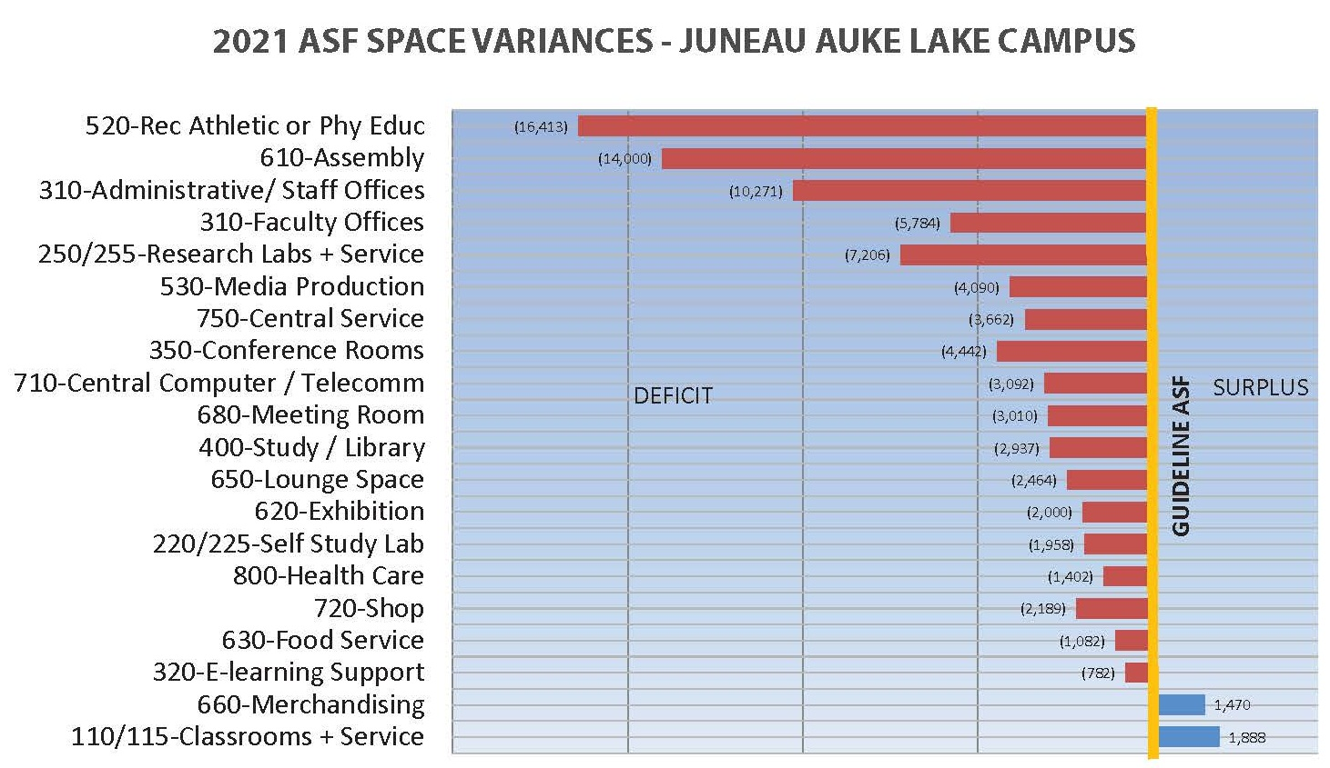
Space deficit / surplus

Slide 15
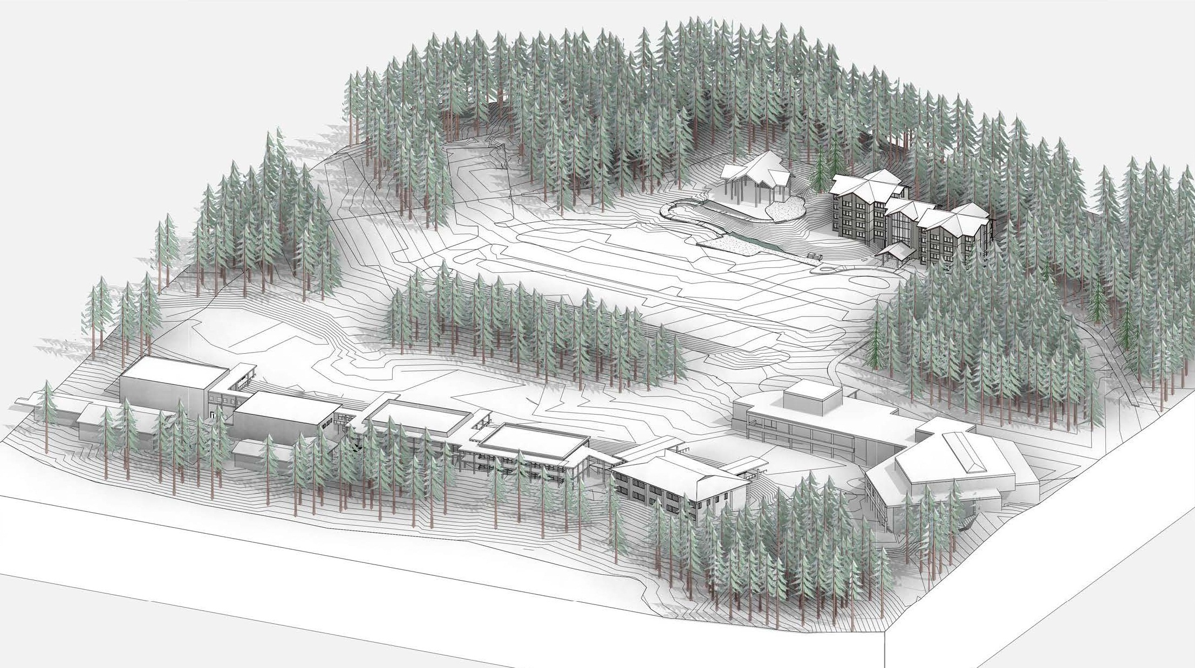
Juneau Auke Lake - Strategy
Orient new development around campus center
Locate freshman housing in center of campus
Locate Cultural Arts Center at the campus entry to create a signature campus gateway
Create field house/ soccer field on under utilized parking
Move Heath Sciences/ UAA Nursing programs to Auke Lake Campus
Lease or Sell Natural Sciences Research Lab (NSRL) building and move programs to new science space
Create a physical home for environmental sciences
Replace Facilities Services at a new site
Build a student center with cafeteria & bookstore
Phased demolition of annexes as additional academic buildings are built
15

Slide 16
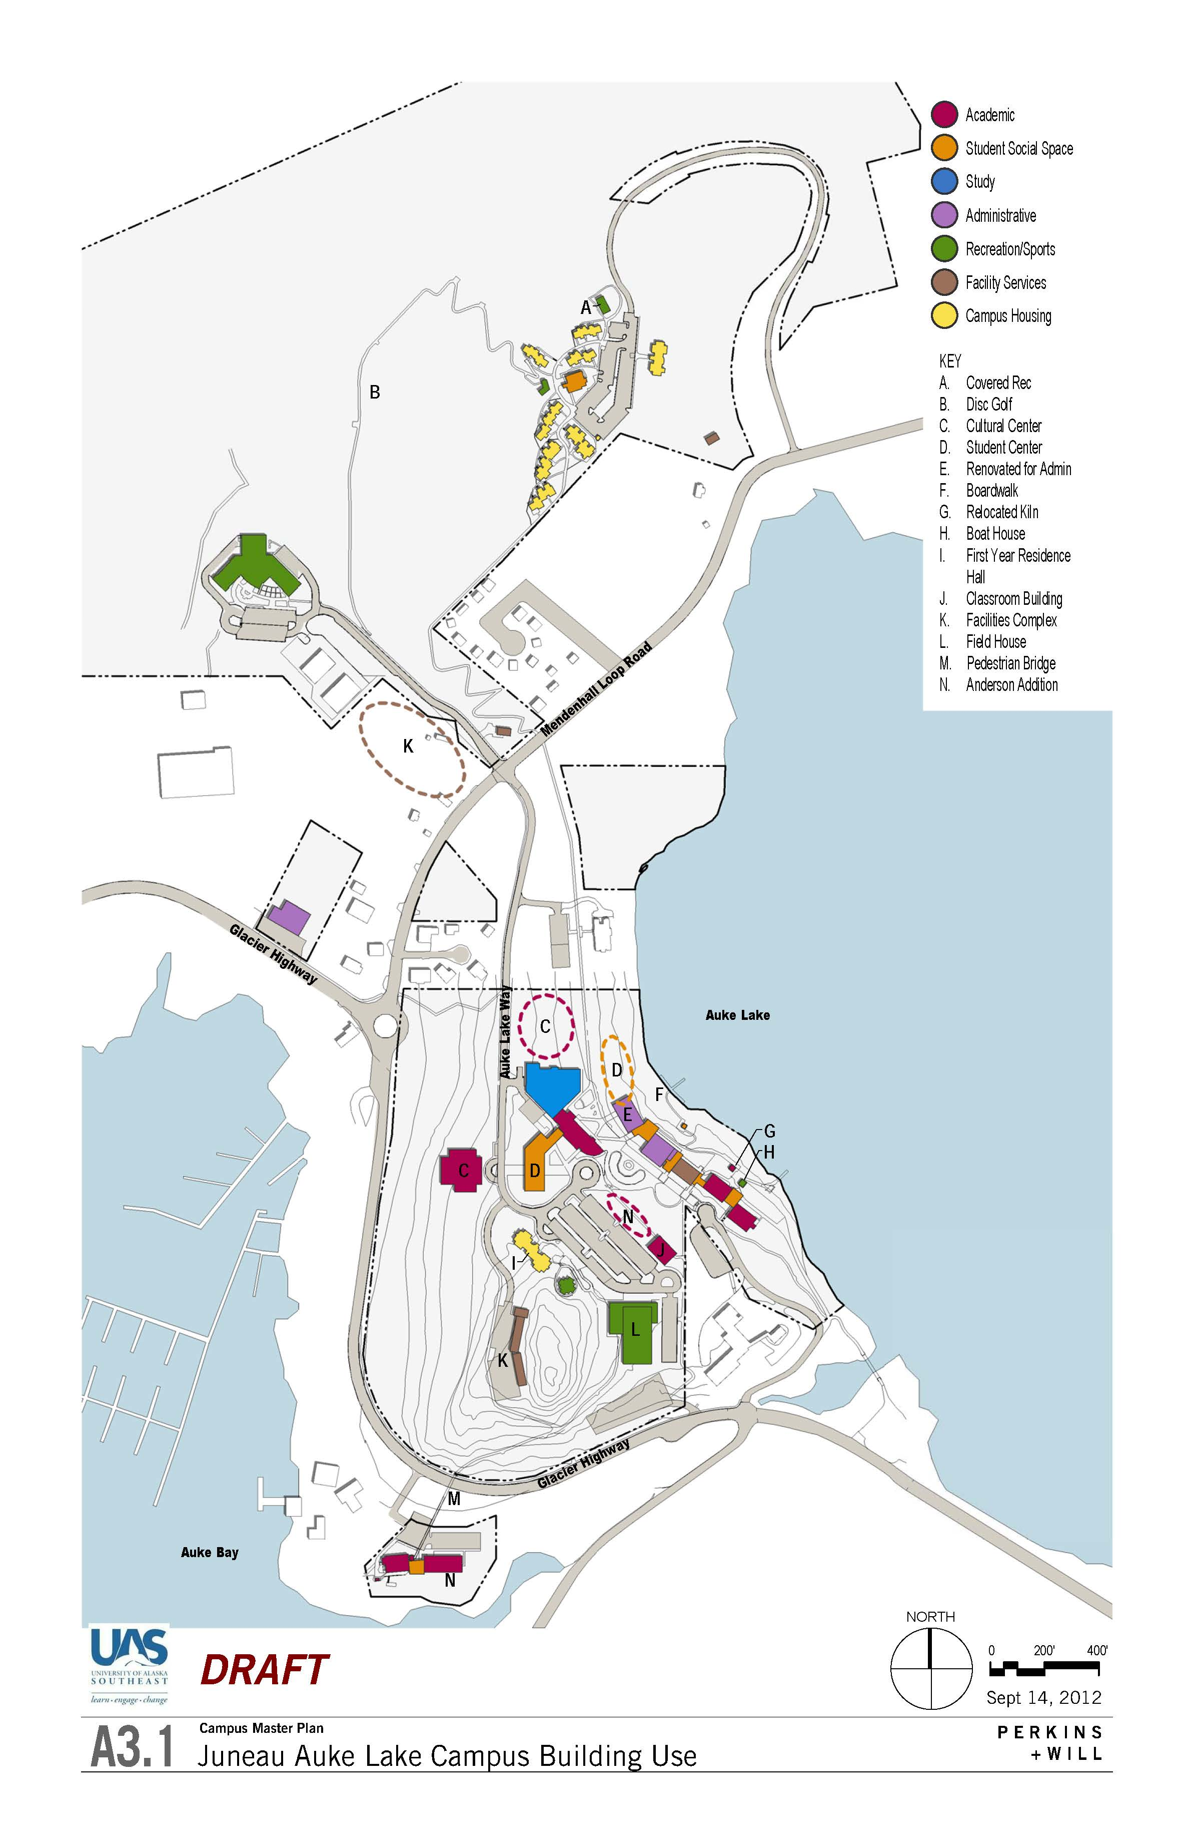
Student Center
Cultural Arts Center
Field House / soccer field
New Facilities Services

Slide 17
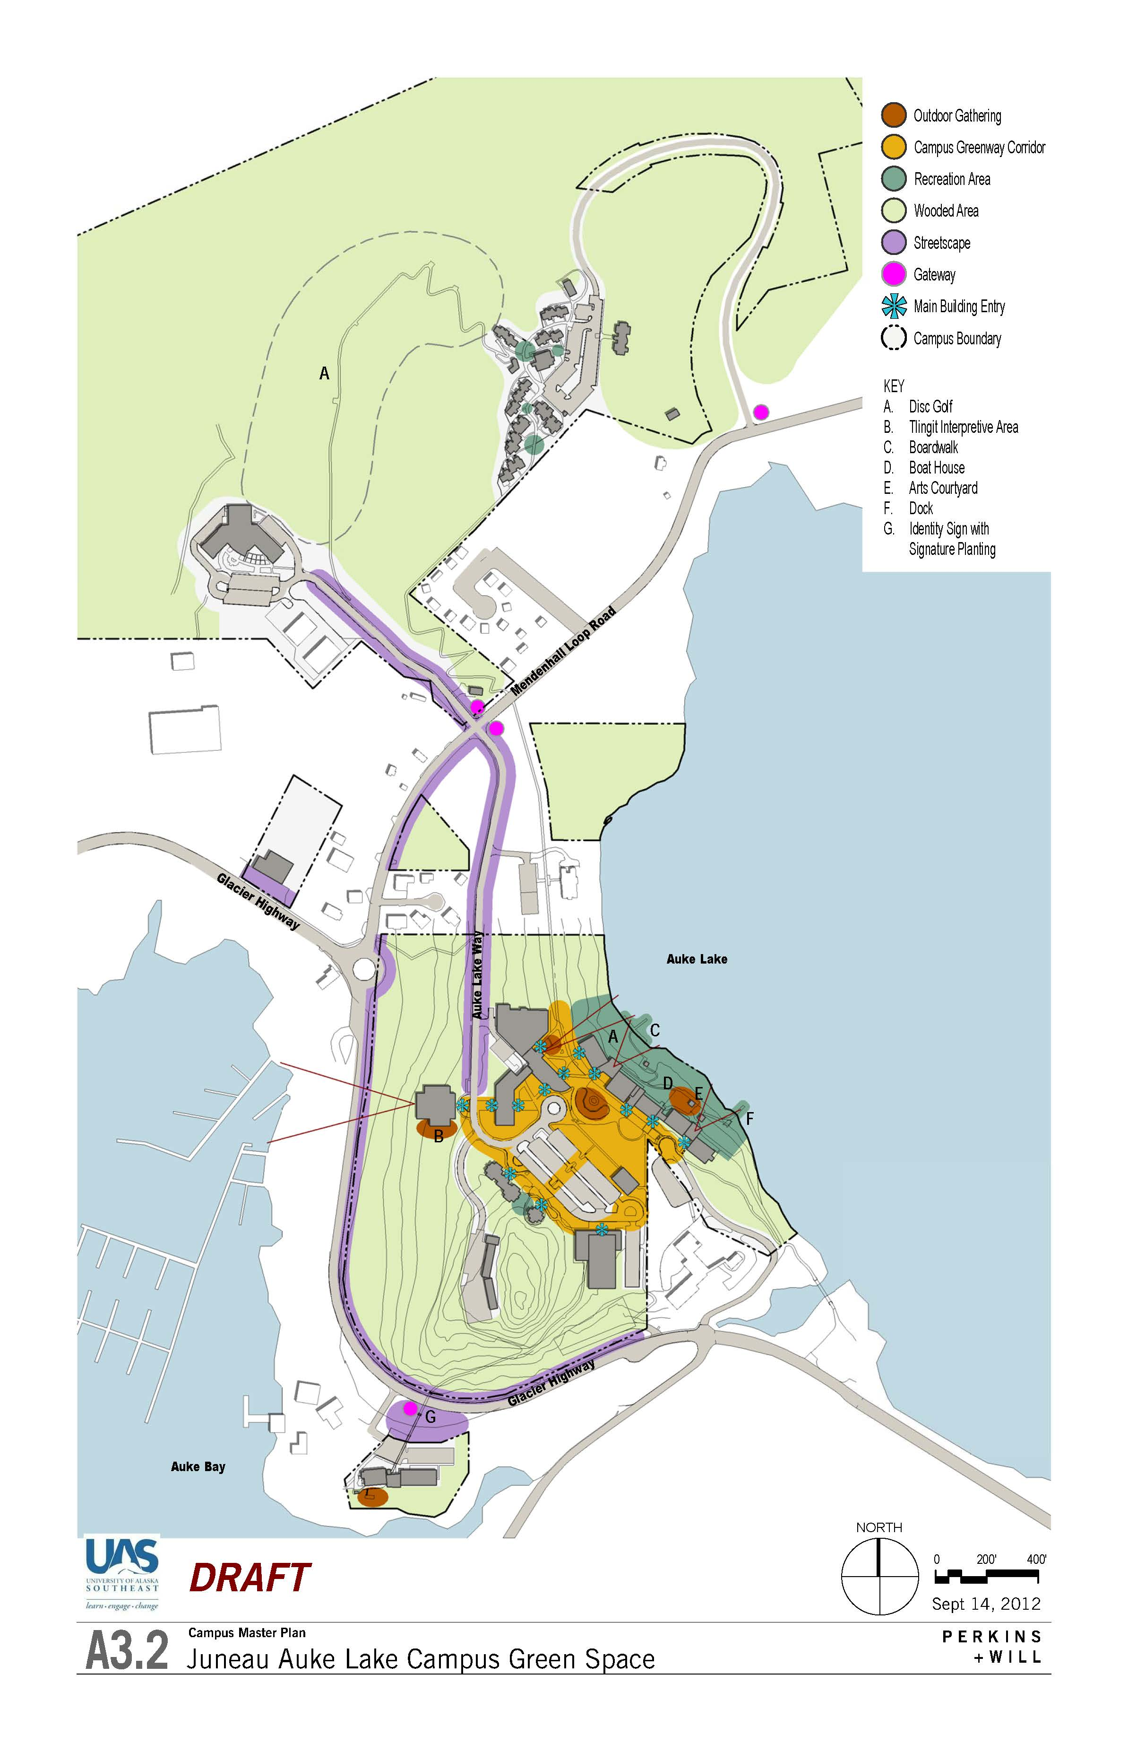
Juneau Auke Lake- Green Space
Orient new development around campus center
Design development to maximize access to Auke Lake and vistas of surrounding mountains and glaciers
Recognize and interpret Tlingit cultural heritage of Auke Lake area
Increase Auke Lake Campus visibility along Glacier Highway corridor through streetscape enhancements including signage and light-pole banner/ artwork
17

Slide 18
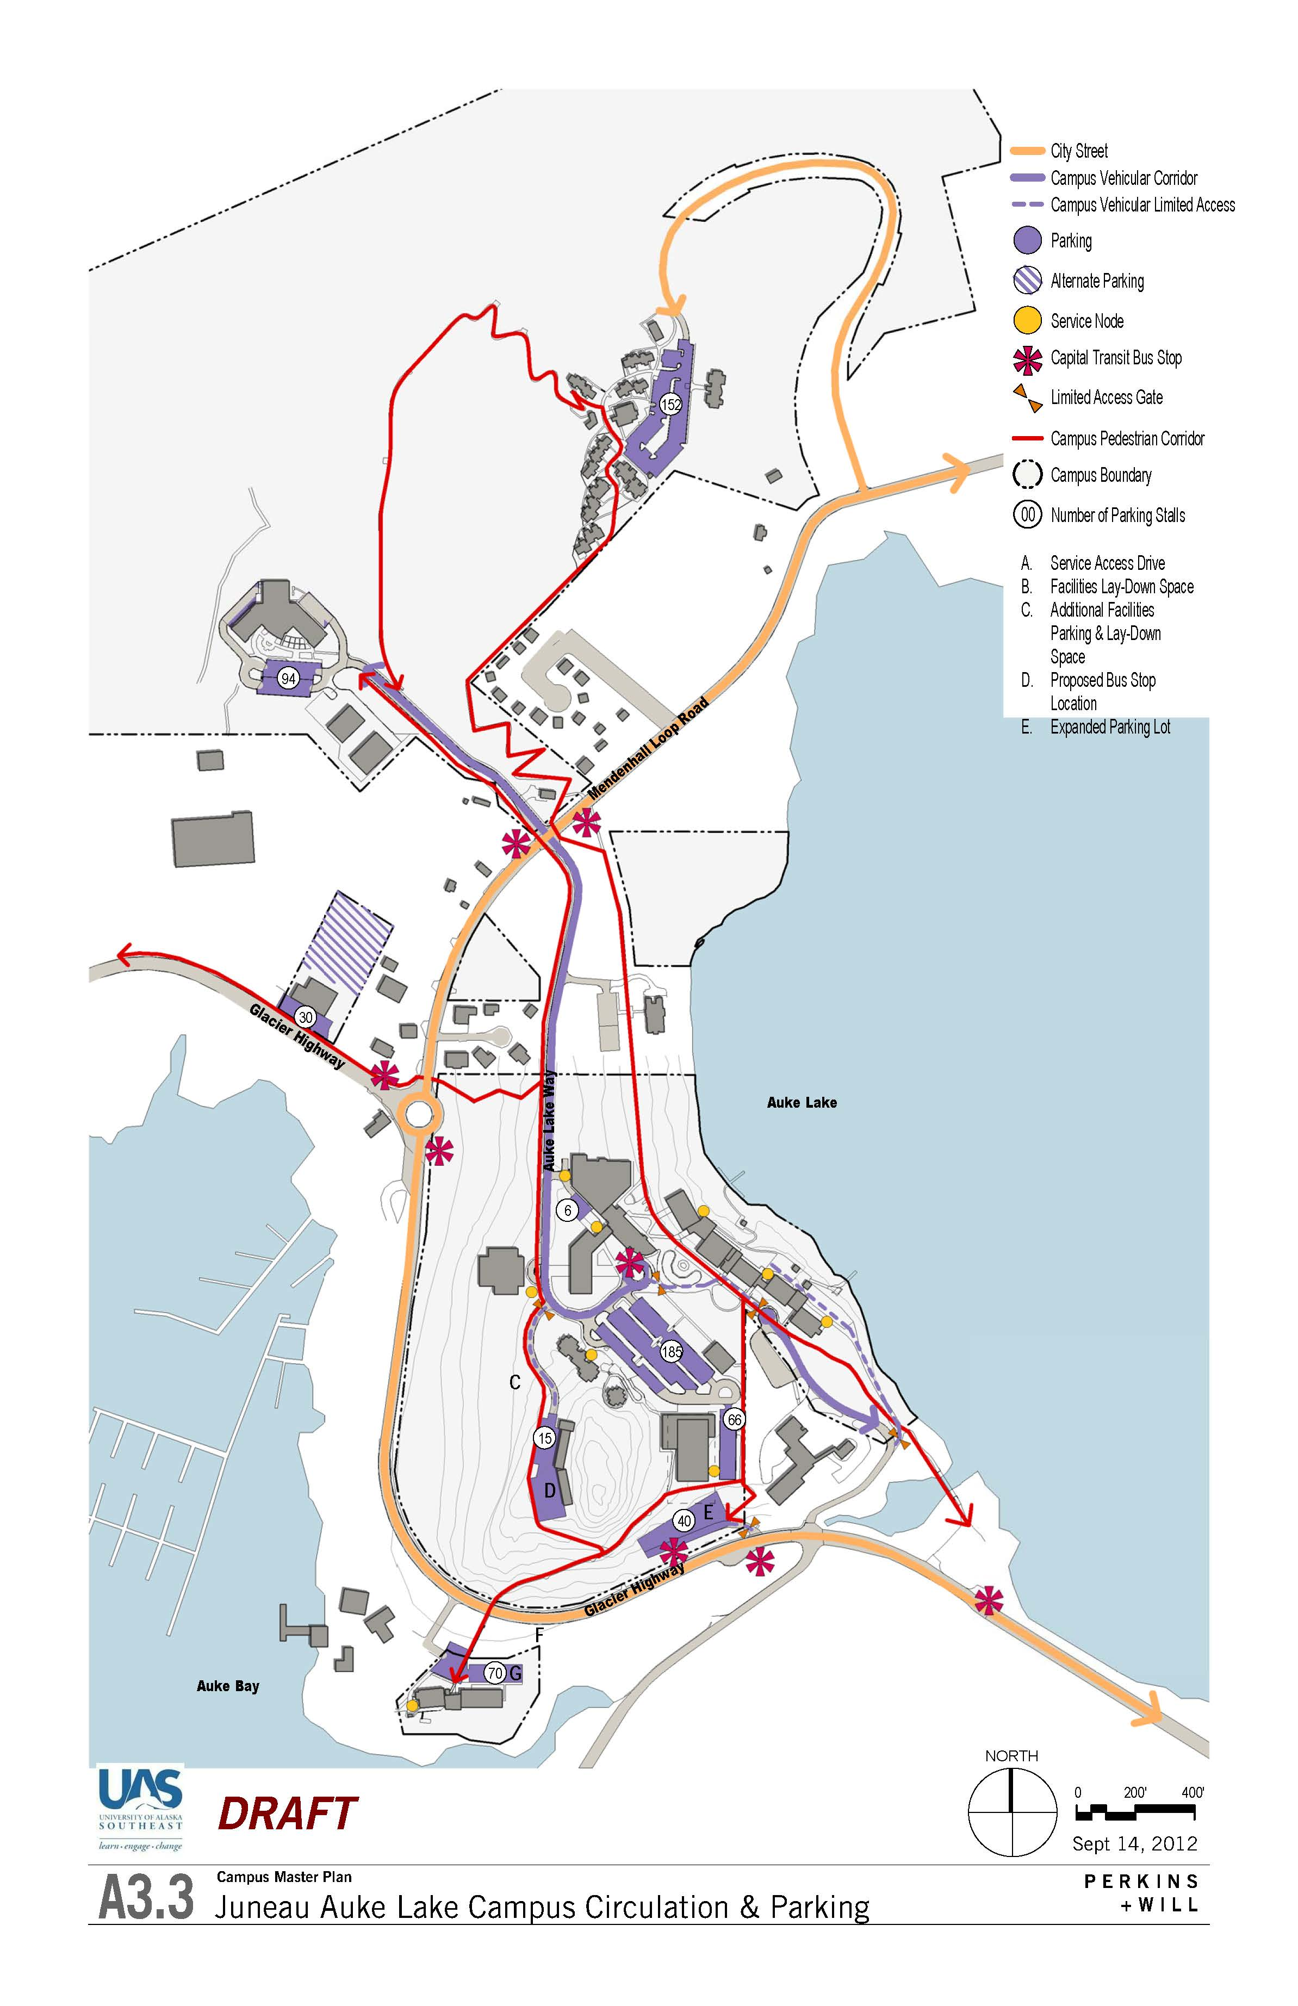
Juneau Auke Lake-
Circulation/ Parking
Connect Anderson Building and Main Campus with new pedestrian path and Bridge
Limit vehicular circulation through campus center
Connect facilities services to main campus via limited access road.
Coordinate Bus Stop locations and schedules with Capital Transit.
18

Slide 19
Juneau Auke Lake
Enlarged Circulation/ Parking
19

Slide 20
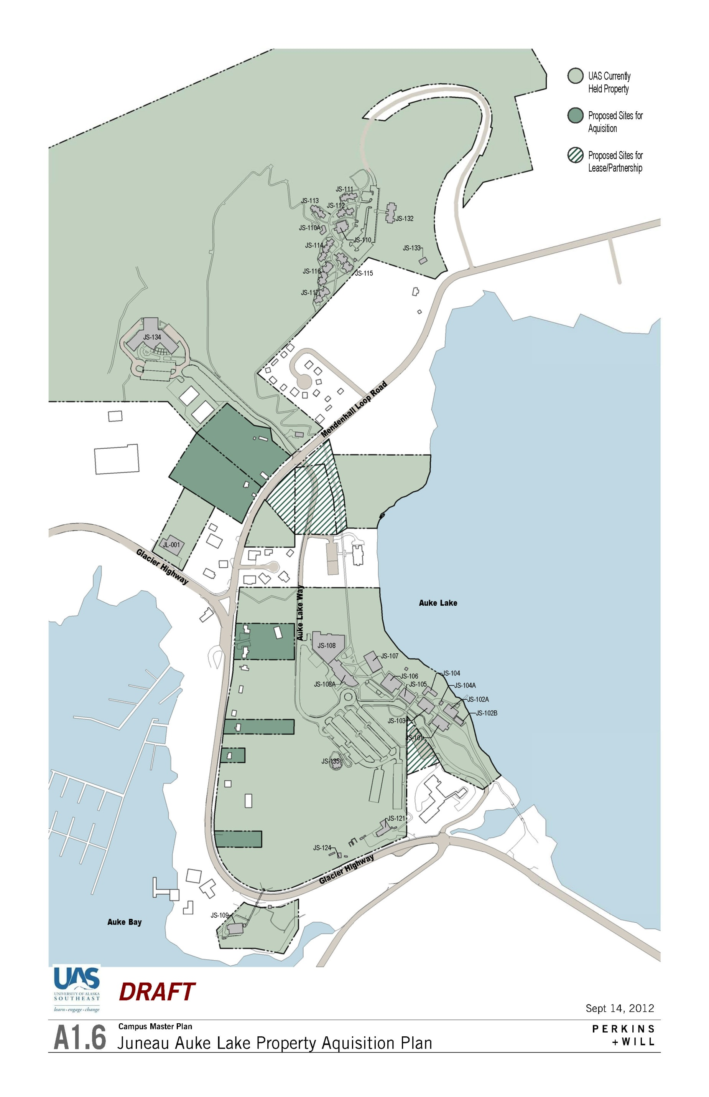
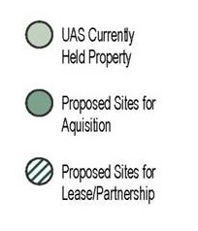
Property Acquisition Plan

Slide 21
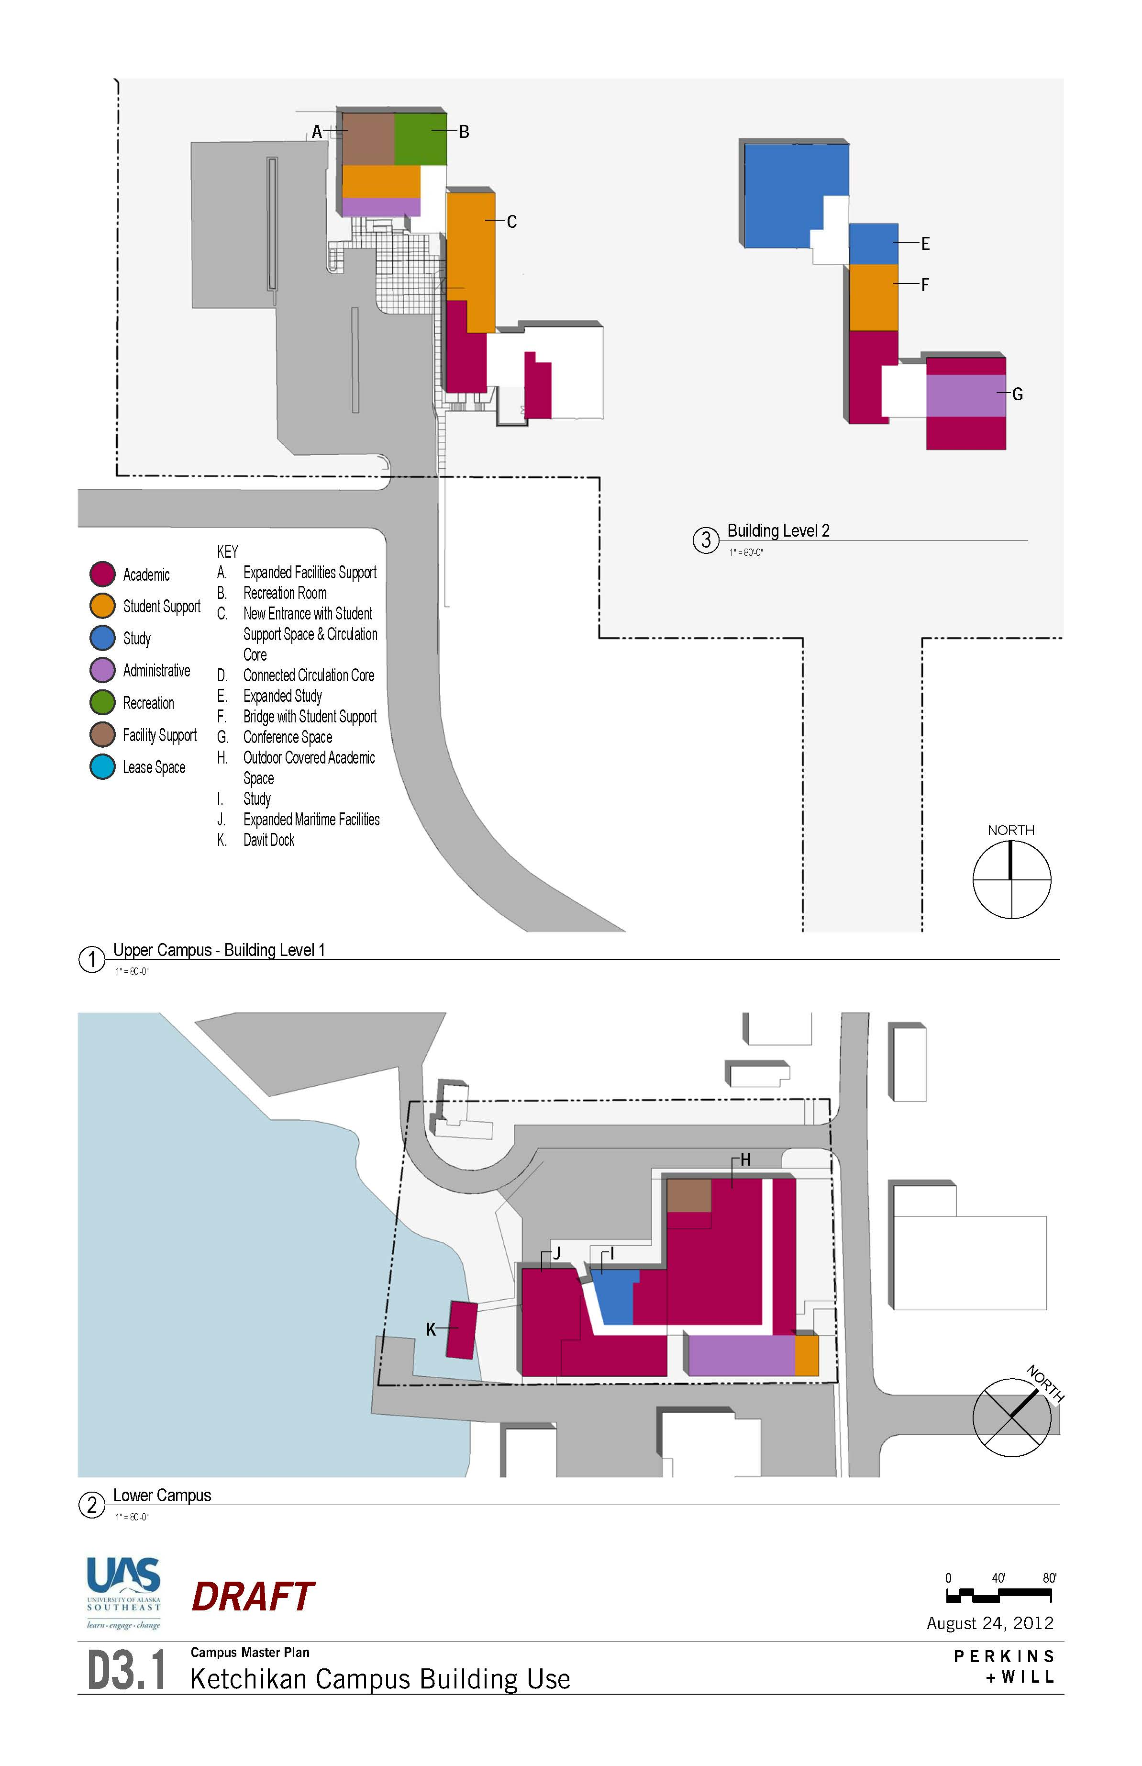
Ketchikan Campus- Building Strategies
Create a central entrance and hub for student services at the Ziegler and Paul buildings
Adapt existing and future classrooms for hybrid learning
Cluster future development for ‘upper campus’ between Ziegler and Paul buildings
Improve integration of services in Ziegler/ Paul and Robertson buildings through display kiosks and smart signs
21

Slide 22
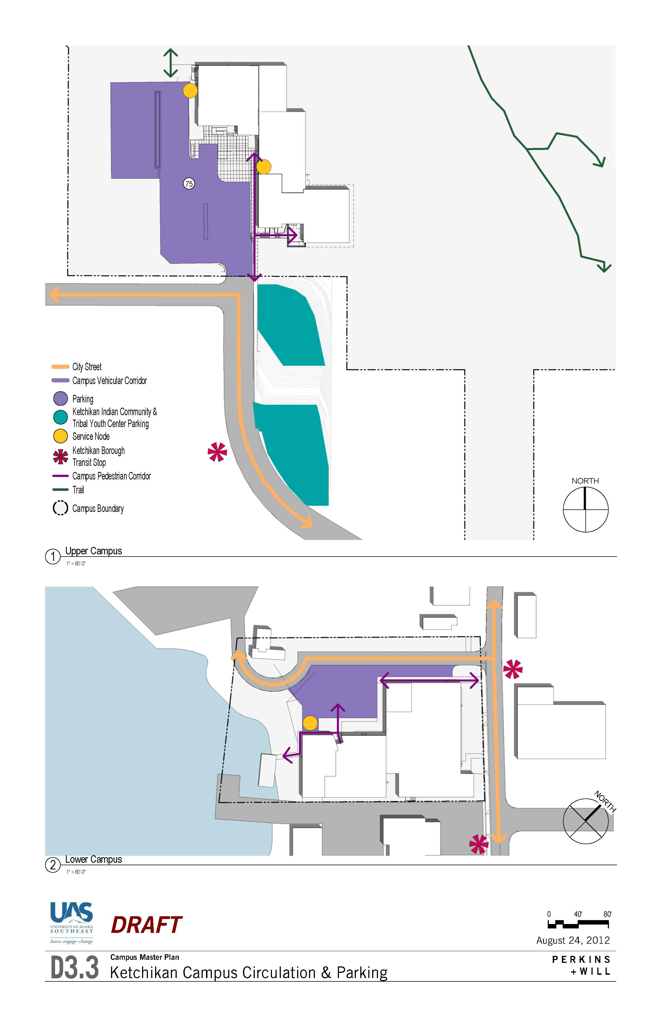
Ketchikan Campus- Site Strategies
Create clear pedestrian circulation from parking to building entries
Enhance campus visibility through signage and light-pole banner/ artwork program
22

Slide 23
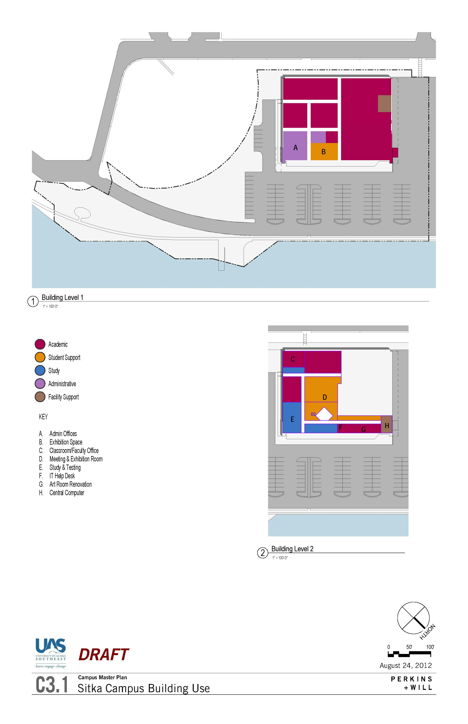
Sitka Campus- Building Strategies
Consolidate uses within Sitka Campus main building (hangar)
Adapt existing and future classrooms for hybrid learning
Create clear circulation zones within the building
Bring public functions to the forefront in support of student success
Improve public displays of student learning and creativity
23

Slide 24
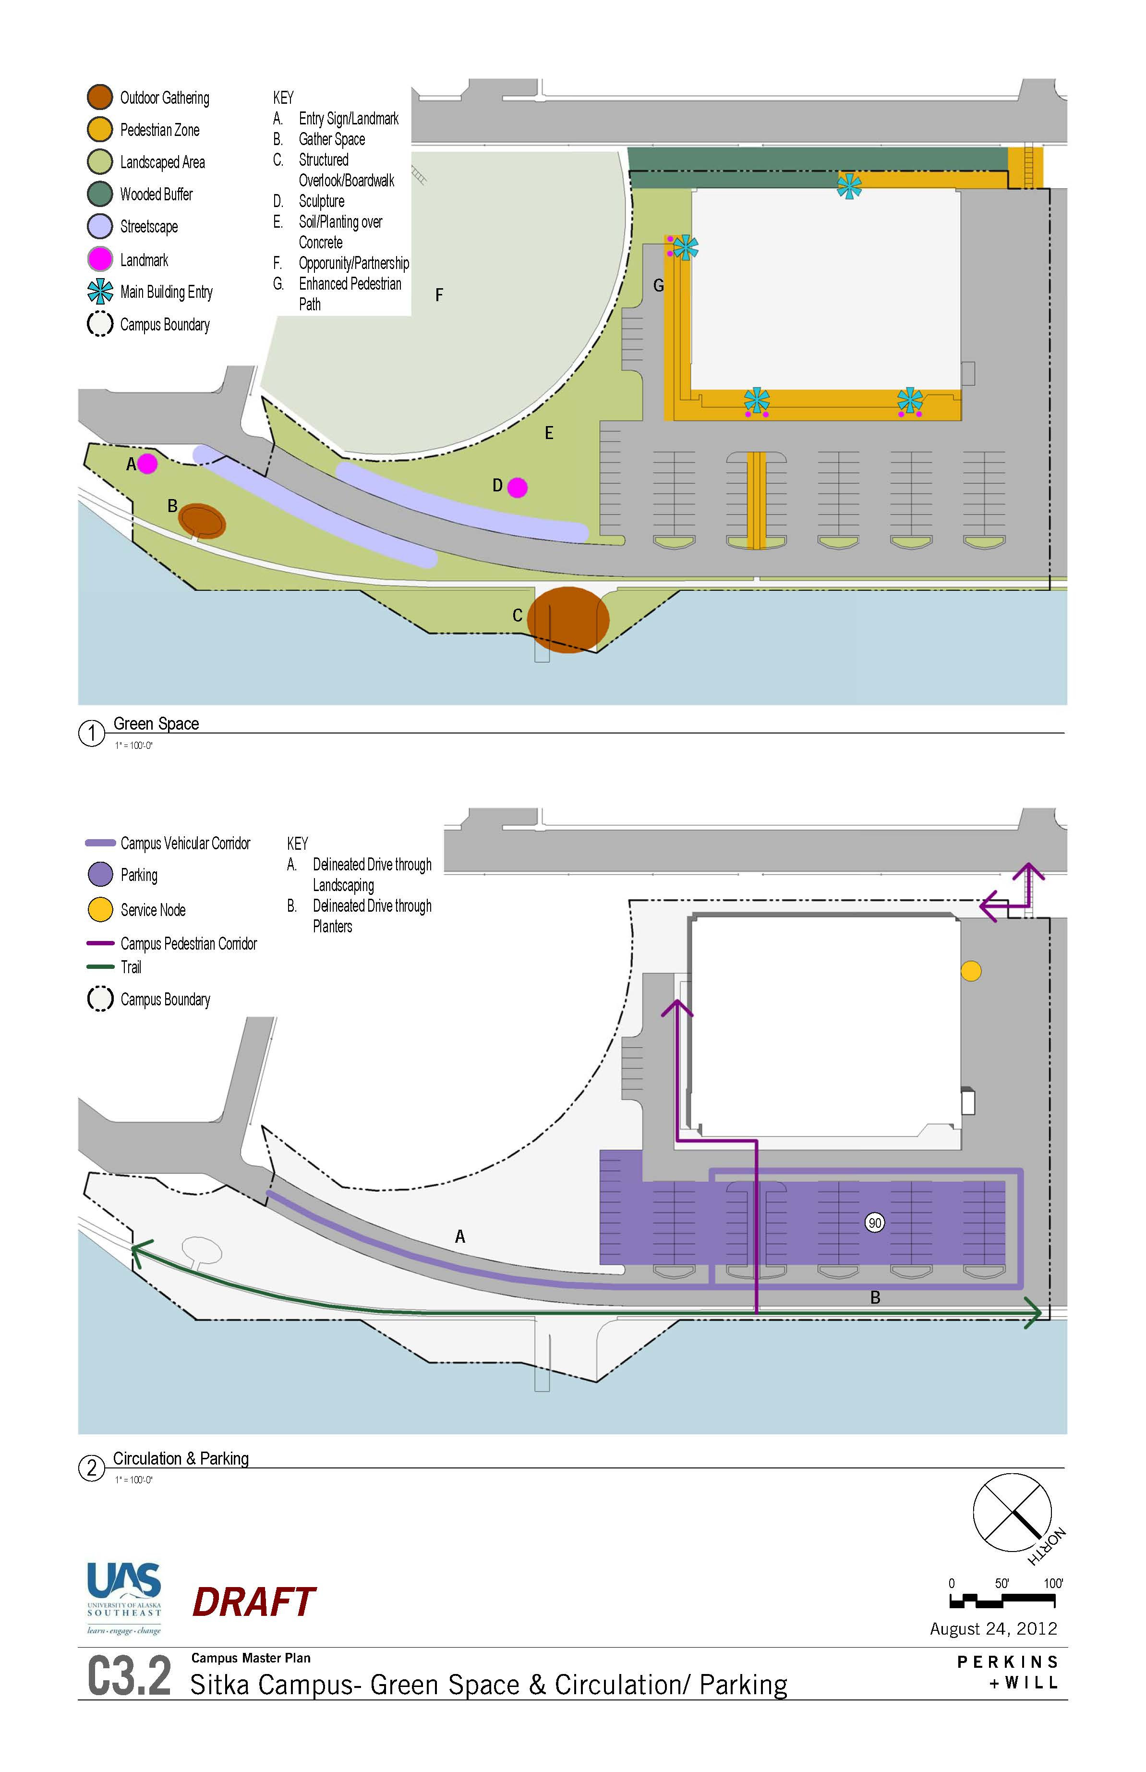
Sitka Campus- Site Strategies
Enhance quality of green space and pedestrian circulation adjacent to Sitka Campus building
Use green space improvements to clarify drive lanes
Maximize benefits from proximity to Mt. Edgecumbe High School in support of collaboration and secondary-postsecondary links
Make use of community facilities supporting UAS programs (e.g. Sitka Sound Science Center, Public Safety Training Academy, Sitka Fine Arts facilities.)
Increase Campus visibility through streetscape enhancements including signage and light-pole banner/ artwork
Connect with future trail system to create outdoor gathering spaces and connection to the water
24

Slide 25
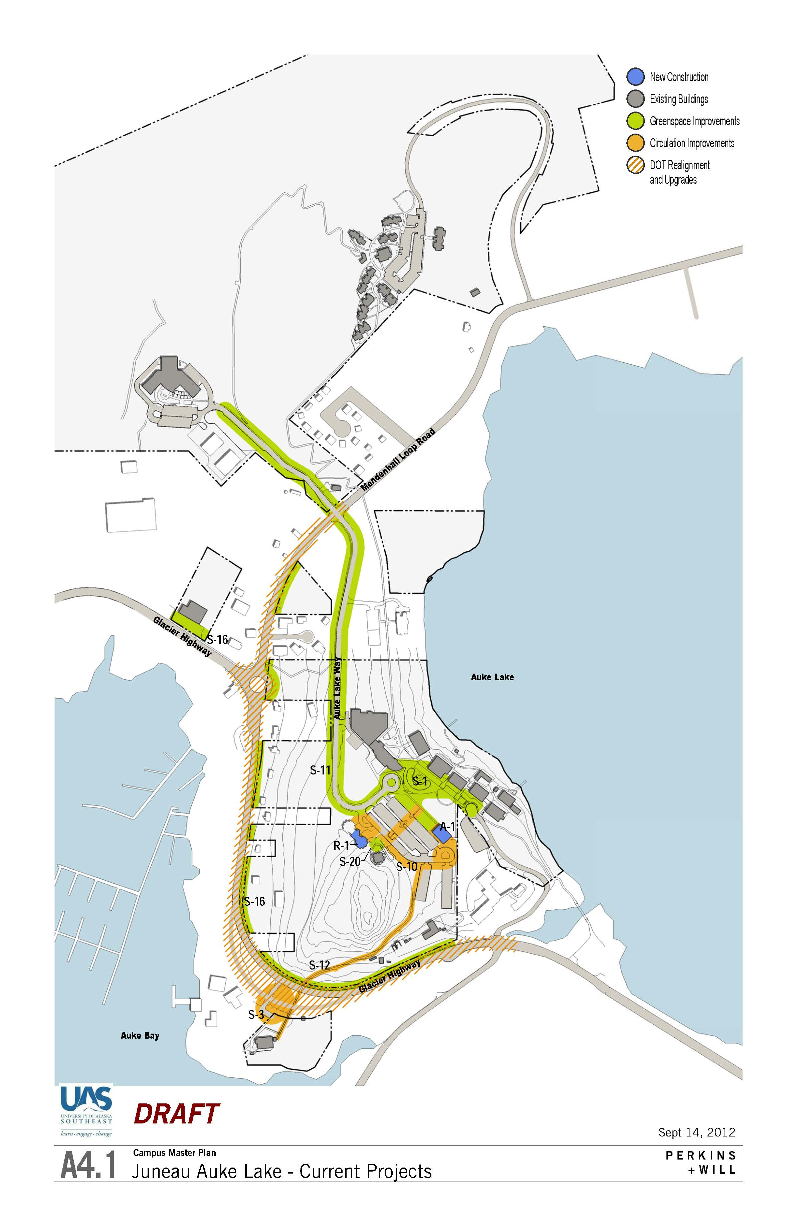
Juneau Auke Lake
Short Term

Slide 26
Juneau Auke Lake
Mid Term 2012-2019

Slide 27
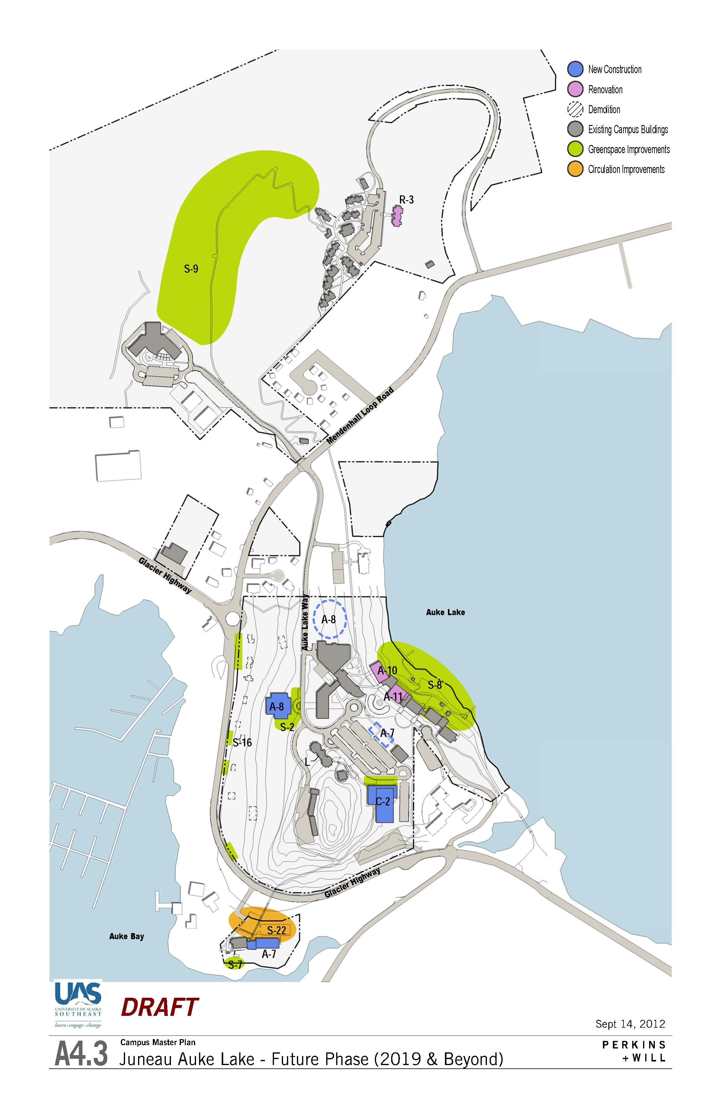
Juneau Auke Lake
Long Term - 2019 & beyond

Slide 28
Next Steps
February 2013 – comments on draft
April 2013 – presentation of final report – request for approval

