Slide 1
Research in the UA System
December 2012

Slide 2
Strategic Directions in Research
Economic Impact on Communities: Research as an Economic Enterprise
Research to Meet State Needs
Intellectual Property and Commercialization
Research and Creative Opportunities for Students: Improving Educational Outcomes
Fostering Creativity in Communities

Slide 3
Information provided by UA Information Systems, Banner Extracts 2012.

Slide 8
Table 1. Research Expenditure Sources for UAF and UAA Peers
 | Federal % | State % | Institutional % | Business %
UAF Peer Average | 60% | 13% | 21% | 3%
UAA Peer Average | 63% | 8% | 20% | 3%
Leading Research Universities in the West Average | 62% | 7% | 16% | 6%
Data are from the NSF Higher Education Research and Development Survey results (http://www.nsf.gov/statistics/nsf12330/). Foundation and other funding sources are not shown.

Slide 12
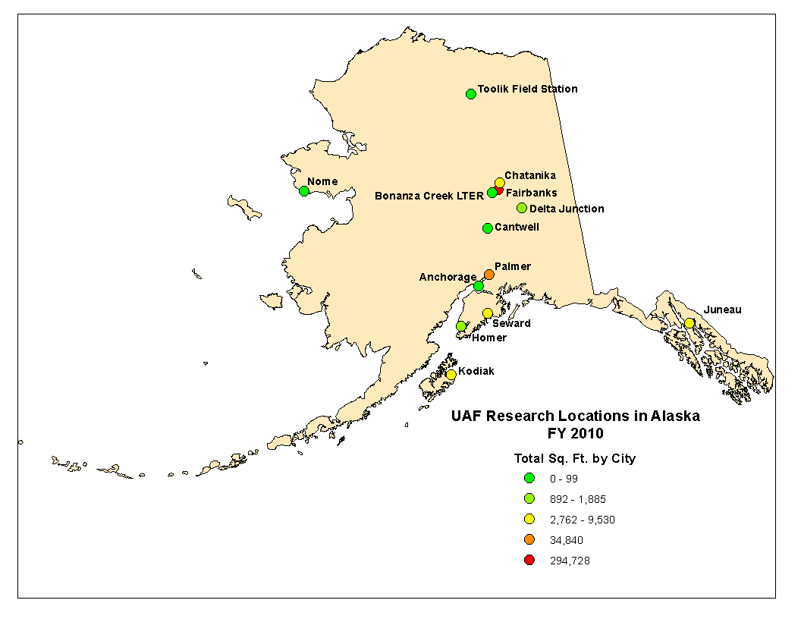
Sikuliaq
Bethel

Slide 13
Graduate students are integral to research at UA.
Four of the Ph.D.s were advised by UAA faculty of the joint Psychology Ph.D. program.

Slide 15
UA Undergraduate Research
The UAA Office of Undergraduate Research and Scholarship fosters involvement of UAA undergraduates in research and creative activities. During FY12 59 students were awarded support.
The number of participants in the UAA Undergraduate Research and Discovery Symposium has increased from 15 in FY05 to 84 in FY12.
UAF undergraduate research is facilitated through the Undergraduate Research and Scholarly Activity office. For FY 12 URSA funded 33 undergraduates and matched 66 with projects.
The total number UAF students participating in undergraduate research in FY12 was 303.
URECA is the Undergraduate Research and Creative Activity program at UAS. The annual URECA awards have provided opportunities to students to apply competitively for up to $2500
In its first two years, URECA supported 21 students. Of seven graduates, three are enrolled in graduate school.

Slide 16
UAA, UAF, and UAS Creative Activities and Communities
All three universities contribute to the arts and creative writing in their communities, including the cities and villages associated with community campuses.
UAA and UAF offer degrees in Art, Music, Theatre (UAA has dance option), and a MFA in Creative Writing. UAS offers a BA in Art.
Some examples:
UAA arts faculty total more than 170 performances or exhibits annually.
UAA has three art galleries exhibiting works by students, faculty, and guests.
Each season UAA theatre produces four plays on its mainstage, and many one act or full-length plays directed by students.
During FY12 the UAA music department hosted or performed at a dozen events.
UAF President’s Professor Eduard Zilberkant conducts the Fairbanks Symphony.
The UAF Art Department houses the University Art Gallery.
The UAF Theatre program usually offers one public mainstage production per semester, as well as “Winter Shorts” each fall.
UAF arts programs offer summer programs of children’s creative activities.
Tidal Echoes, a literary journal, is produced by UAS faculty and students.
Perseverance Theater teaches classes and produces plays on UAS campus.
UAS co-sponsors the Juneau Symphony.

Slide 17
Table 6. Research Performance of UA Peer Groups
Peer Group | Citations/Publication (2006-2011) | Publications (2006-2011)/Faculty* | Research Expenditures**, Thousand $/Faculty*
UAA Peers | 6.0 ± 1.4 | 3.4 ± 1.3 | $48 ± 35
UAF Peers | 8.8 ± 1.4 | 8.0 ± 2.2 | $167 ± 61
UAS Peers | 3.6 ± 2.5 | 0.7 ± 0.5 | $4.2 ± 7.4
Table 7. Research Performance of UAA, UAF, and UAS
Institution | Citations/Publication (2006-2011) | Publications (2006-2011)/Faculty* | Research Expenditures**, Thousand $/Faculty*
UAA | 7.4 | 1.8 | $29
UAF | 9.8 | 8.6 | $283
UAS | 7.2 | 1.7 | $20
*Tenured and tenure-track faculty.
**From external sources only, FY10.

Slide 18
UAF Research Peers
Institution Type** | U Alaska Fairbanks Peers | FY10 Sponsored Research in Million $
LG, RUH | U Alaska Fairbanks | $118
LG, RUH | Kansas State U | $122
LG, RUVH | Montana State | $105
LG, RUH | New Mexico State Las Cruces | $133
LG, RUVH | North Dakota State | $71
LG, RUVH | Oregon State | $193
LG, RUVH | U Delaware | $122
LG, RUH | U Idaho | $71
LG, RUH | U Maine | $77
RUH | U Montana | $47
LG, RUH* | U Nevada Reno | $66
LG, RUH | U Wyoming | $52
LG, RUH | Utah State | $130
*Has medical school; **Carnegie Basic Classification.

Slide 19
UAF’s performance is shown as a yellow symbol. The research peers used in this chart are listed in Table 2., above. This chart is based on publications from a six-year period, January 1, 2006 to December 31, 2011.

Slide 20
UAA Research Peers
Institution Type* | U Alaska Anchorage Peers | FY10 Sponsored Research in Million $
Master’s L | U Alaska Anchorage | $12
Master’s L | Boise State U | $16
RUH | Cleveland State U | $32
DRU | Lamar U | $4.9
RUH | U Massachusetts Boston | $34
Master’s L | U Michigan Dearborn | $4.7
RUH | U Missouri St Louis | $8.2
DRU | U Nebraska Omaha | $7.4
RUH | U North Carolina Greensboro | $21
Master’s L | U Southern Maine | $14
DRU | U West Florida | $16
*Carnegie Classification

Slide 21
UAA’s performance is shown as a yellow symbol. The research peers used in this chart are listed in Table 3., above. This chart is based on publications from a six-year period, January 1, 2006 to December 31, 2011.

Slide 22
Leading Western Research Universities
Institution Type** | University | FY10 Sponsored Research in Million $
LG, RUVH | Oregon State | $193
RUVH* | Stanford U | $760
LG, RUVH* | U Arizona | $410
RUVH | UC Berkeley | $832
RUVH* | UC San Diego | $832
RUVH | U Oregon | $83
RUVH* | U Washington | $979
LG, RUVH | Washington State | $192
*Has medical school; ** Carnegie Classification

Slide 23
UAF’s performance is shown as a yellow symbol. The research universities used in this chart are listed in Table 4., above. This chart is based on publications from just one year, January 1, 2011 to December 31, 2011.

Slide 24
Research Multiplier
The Research Multiplier is the NGF:GF (non General Fund to General Fund) ratio for research expenditures.
Nationally the multiplier is between 5 and 6 (Goldsmith 2007).
For UA the multiplier is:
5.5 for UAF
2.4 for UAA
13.1 for UAS
MAU Research Multipliers as reported in UA in Review 2012 (Fig. 49, based on FY 11 figures).

Slide 25
Favorable Characteristics of Research as an Economic Enterprise (based on Goldsmith, 2007)
• Labor Intensive
• High Wages and Good Benefits
• Year-Round Employment
• Diverse Job Mix
• High Resident Job Share
• Stable
• Environmentally Benign
• Non-Competitive with Other Industry
• Fosters economic activity in support industries

Slide 26
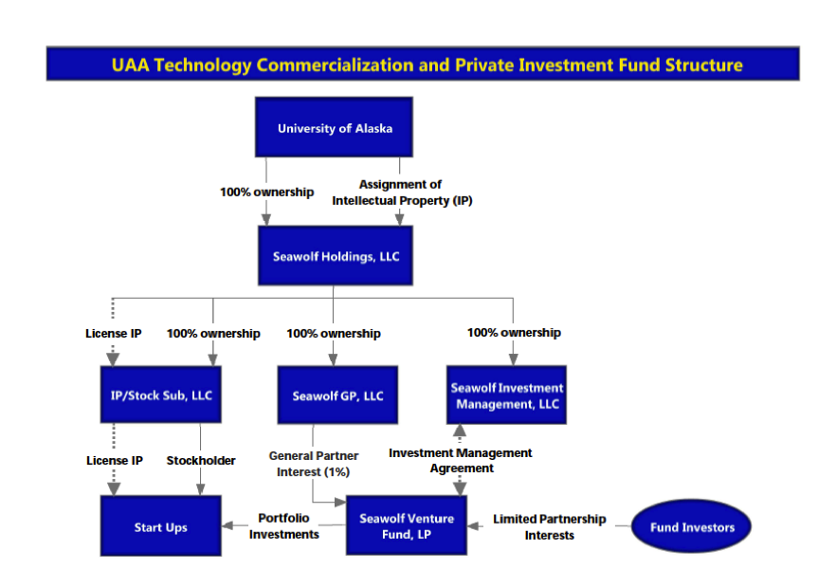
Since January 2012, the number of Invention Disclosures from faculty and students increased to 16, in contrast to 3 the previous year. Many of these invention disclosures have evolved into patents pending. The disclosures and patents pending are in biomedical devices, remote monitoring and surveillance, large distributed wireless sensor networks, potential therapeutic pharmaceuticals, and biometrics.

Slide 27
The UAF Office of Intellectual Property and Commercialization (OIPC)
In FY12 OIPC reviewed 48 contracts and proposals for intellectual property language. Further, OIPC executed 19 non-disclosure agreements, one collaborative research agreement, and one material transfer agreement. OIPC filed three provisional patents and prepared three provisional patents in that year.

Slide 28
The Future of UA Research
Monitor funding changes to agencies and specific programs within agencies.
Provide advice to researchers on where the best opportunities may exist.
Foster interdisciplinary research, as that is a focus of major federal programs.
Submit the best proposals possible.
Partner with other universities for large grants.
Submit funding requests to international and non-traditional funding agencies.
Strive to hire and retain the best possible faculty researchers.
Increase the focus on applied and translational research, to the extent that new funding streams (or increasing funding streams) for such research can be developed.
Continue to work with the State to identify areas where UA can meet state needs, with State support.
Continue to build our portfolio of commercially viable research.
Focus on partnerships and grants from industry.

Slide 30
Extra slides not intended for presentation unless questions arise.

Slide 37
Includes only courses numbered 498 and 499. There are other research courses whose numbers vary among the MAUs.

Slide 38
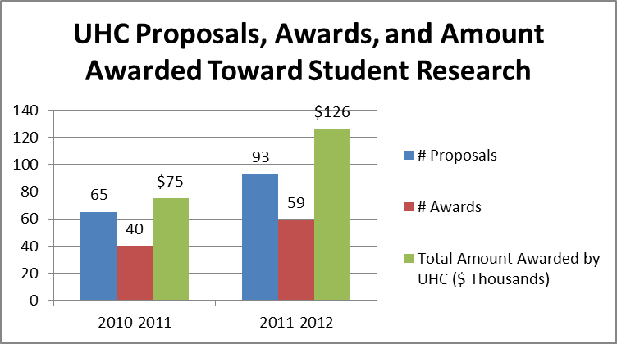
UAA Undergraduate Research

Slide 39
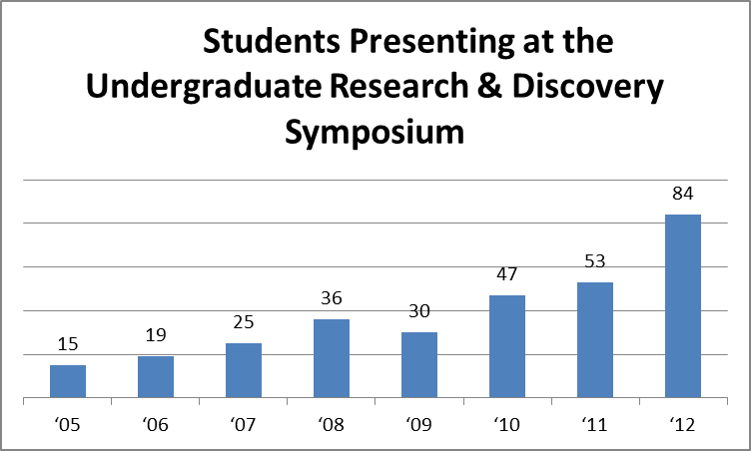
UAA Undergraduate Research

Slide 40
UAF Undergraduate Research
The number of undergraduate students that URSA funded in FY12 was 33.
The number of undergraduate students that URSA matched with projects in FY12 was 66.
The total number UAF students participating in undergraduate research in FY12 was 303.
UAF Research Day 2012 included presentation of 87 posters, 57 by undergraduate and 30 by graduate students.
Six undergraduates participated in national and international conferences and competitions in FY12.

Slide 41
UAS Undergraduate Research
URECA, the Undergraduate Research and Creative Activity program
The annual URECA awards have provided opportunities to students to apply competitively for up to $2500
In its first two years, URECA supported 21 students
Each spring at the URECA symposium, students present their work to the public. Students have conducted studies on topics as diverse as:
the best bait for catching crabs of legal market weight
the construction of a biofuel-fired pottery kiln
an examination of the metabolic rates of starry founder
the impacts of temperature and precipitation changes on harvesting red and yellow cedar for Haida basketry
the use of iPads to enhance the life of senior citizens
the genetic makeup of coast range sculpin
Of the seven URECA awardees who have graduated, three are in graduate programs.

Slide 42
Table 8. UAA Publications and Creative Arts 2007-2012
Year | Articles in Refereed Journals* | Articles in Conference Proceedings | Books | Book Chapters | Creative Arts
2007 | 100 | 121 | 8 | 91 | 105
2008 | 239 | 151 | 9 | 60 | 166
2009 | 209 | 214 | 13 | 61 | 164
2010 | 181 | 134 | 11 | 68 | 177
2011 | 181 | 220 | 14 | 57 | 175
2012 | 311 | 163 | 22 | 88 | 179
*Many of these are included in the Web of Science analysis above. Publications from all schools and colleges are included, as reported by faculty in their annual activity reports.

Slide 43
Table 9. UAF Creative Performances and Exhibitions per FTE Faculty 2007-2009
 |  | 2007 | 2008 | 2009
Total Performances and Exhibitions |  | 103 | 85 | 85
FTE Faculty |  | 36 | 36 | 36
Categorization of Performances and Exhibitions
International | Solo | 10 | 11 | 8
 | Group | 4 | 3 | 6
National | Solo | 27 | 21 | 22
 | Group | 18 | 16 | 10
State | Solo | 32 | 22 | 32
 | Group | 12 | 11 | 7

Slide 44
Table 10. UAF College of Liberal Arts Reviewed Publications 2009-2010
Field | Year | Journal Article* | Conference Proceeding Article | Book Chapter | Book | Film
Social Science** | 2009 | 32 | - | 18 | 4 | -
 | 2010 | 34 | 3 | 14 | 11 | -
Humanities | 2009 | 5 | - | 5 | - | -
 | 2010 | 15 | - | 4 | 2 | -
Arts** * | 2009 | 3 | - | - | - | -
 | 2010 | 2 | - | 1 | - | 1
*Some of the social science journal publications were also counted in the Web of Science analysis.
**Linguistics publications were classified as social science, but this field straddles the social sciences and humanities.
***UAF’s arts faculty focus on performance rather than publication.

Slide 45
UAS Creative Activities
Faculty productivity:
All three art faculty participated in local, statewide, and national exhibitions and workshops.
One faculty member published book of poetry.
One faculty member published the first children’s book in both Tlingit and English.
One faculty member produced a play in both Ketchikan and Juneau as part of the UAS Humanities Forum.
Student successes:
Bonnilyn Parker won national awards for ceramics in both her junior and senior years.
Ishmael Hope produced a play, Naatsilanei, in the Tlingit language at Perseverance Theater .
Joel Mundy was selected for, and produced, a solo exhibition of his photography.
Students produce weekly UAS radio show on public radio.
Students organize community poetry slams regularly.
Alaskapella, a student-organized and student-lead a capella vocal group, performs widely.

Slide 46
UAF Creative Activities and Communities
UAF Professor Eduard Zilberkant conducts the Fairbanks Symphony
UAF ensembles that offer public performances include the Arctic Chamber Orchestra, the Alaska Camerata, Alaska Trio, the Borealis Brass, the Choir of the North, Ensemble 64.8 (percussion), the Northern Lights String Orchestra, the University Chorus, and the Wind Symphony.
The Art Department houses the University Art Gallery.
The UAF Theatre program usually offers one public mainstage production per semester, as well as “Winter Shorts” each fall.
The Messenger (UAF professor Kade Mendelowitz) premiered as first film created under the new Film program.
UAF arts programs are also notable for offering summer opportunities for creative activities by children, including the Summer Visual Art Academy and the UAF Summer Music Academy.

Slide 47
UAS Creative Activities
Community engagement:
Tidal Echoes, a regional literary journal, is produced by UAS faculty and students.
The Art of Place, a series of demonstrations and discussions focusing on arts and culture of the Tlingit people, was developed by faculty member Ernestine Hayes.
Perseverance Theater teaches theater classes and produces plays on campus.
UAS hosts Perseverance Theater’s STAR theater performance camp for youth each summer.
Artist in residence, Dr. Alexander Tutunov of Southern Oregon University, taught master classes in classical piano.
UAS co-sponsors the Juneau Symphony.
UAS partners with the Juneau Arts and Humanities Council to produce Community Arts Day on campus.

