Slide 1
UA Metrics University of Alaska Board of Regents Meeting December 6-7, 2012
1

Slide 2
Topics Addressed
Starting point.
What others are doing?
How can UA approach this?
Outcome areas to track.

Slide 3
Starting Point
University of Alaska mission statement
State’s results-based budgeting
MAU institutional accreditation “Indicators of Achievement”
Strategic Direction Initiative themes
External guidance (AGB, NCAN, APLU, others)
Notes:
Always start with UA mission: Instruction, Research, and Service
History
1. Missions and Measures
Senate Bill 281, a performance measures reporting bill entitled Missions and Measures, passed in 2000, required the University of Alaska to annually measure and report on its success – UA first reported on 17 distinct performance measures in 2001. These measures were assimilated into the later versions of performance evaluation.
2. Performance Based Budgeting in 2004
UA’s primary creation of a robust tool to help communicate, drive, and measure progress toward strategic priorities.
Reduced the number of performance measures used to influence budget distributions from 17 to 7 by 2007.
utility eventually reduced by internal politics and loss of single appropriation
3. Performance framework (State OMB, 2008)
Requirement for long range fiscal and performance plan in support of annual operating and capital budget request;
possible expansion to include ratio and efficiency measures,
state level performance funding, etc. for context on each Agency’s request in support of achieving mission
4. Results Based Budgeting - Expansion of Performance framework to include efficiency and effectiveness measures for each mission area.
MAU Accreditation – later slide
SDI Themes – later slide
External Guidance
AGB = Association of Governing Boards
NCAN = National College Access Network
APLU = Association of Public and Land Grant Universities
http://agb.org/trusteeship/2011/1/making-metrics-matter-how-use-indicators-govern-effectively (note, added ATTAINMENT, RESEARCH)
2. http://www.collegeaccess.org/Common_Measures
3. http://www.nwccu.org/Standards%20and%20Policies/Accreditation%20Standards/Accreditation%20Standards.htm

Slide 4
What are others doing?
Outcomes and efficiencies (ratios)
Trends over time
More than one set of metrics for different needs (dashboard monitoring vs. detail topic reports)
Performance-driven funding
External and peer comparisons
4
Notes:
Focus on outcomes and efficiency ratios; ability to manage efficiency ratios and key outcome metrics. Aligns with 2012 State effort.
Strong cultural expectation for data to be cornerstone of timely operational decision-making
ANNUAL metrics versus dashboard? Distinguish these.
More than one set of metrics for different needs – Dashboard for monitoring versus periodic topic detail reports
Relevance to mission, direction
Best UA metrics may differ
Utility to make, evaluate policy decisions
Major areas for metrics and aligning those with SDI themes
Performance-Driven Funding – this is difficult with current single appropriation structure
Best used for Specific Desired Outcomes, i.e. a system of higher education distributes revenue uses formula funding
… Good Idea? Probably, if new annual funding source available. PBB most successful in rewarding change when consistently sourced via non-reallocation method.
but only as part of systematic, comprehensive program!
External comparison – Thompson-Reuters for research assessment, etc

Slide 5
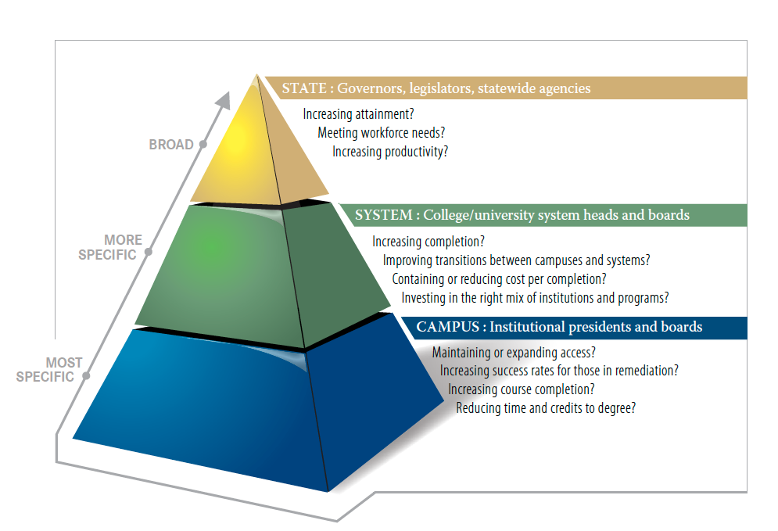
How other states are approaching this
Source: From Information to Action: Revamping Higher Education Accountability Systems, National Governors Association, available at http://www.nga.org/
5
Notes:
This graphic taken from a resource cited by the National Governor’s Association Complete to Compete initiative:
Additionally, the revamping process should take into account the question of
which measures are most relevant at the state, system, and campus levels.
What is an appropriate division of labor for monitoring performance within an accountability system?
The figure below presents a general framework that states can use as a starting point for their own efforts.
depicts a system in which institutions are charged with the most granular level of reporting and analysis (e.g., student movement through and performance in certificate and degree programs),
systems take a broader view of performance (e.g. cross-institutional measures of performance and efficiency), and
states focus on macro-level questions (e.g., system performance in meeting states’ economic needs, return on investment).
Because states vary considerably in how they organize and govern their public colleges and universities, there is no
single model that fits all circumstances and needs.

Slide 6
The Strategic Direction Initiative
Student Achievement & Attainment
Productive Partnerships With Alaska’s Schools
Productive Partnerships With Alaska’s Public and Private Industries
Research & Development to Sustain Alaska’s Economic Growth and Enhance Communities
Accountability to the People of Alaska
→ Each SDI Theme crosses every UA Mission area: instruction, research, and service

Slide 7
Institutional Accreditation “Indicators of Achievement”
More than 140 different measures in use among UAA, UAF, UAS and PWSCC, with these commonalities:
Learning outcomes
Persistence
Graduation
Continuing education and employment
Common to three:
Faculty and student creative output (publications, etc.)
High demand job area graduates
Partnerships with local entities and private partners
Public lectures, presentations and performances
Degree to which student demographics reflect the population
Notes:
75 (+/-) distinct metrics used by MAUs
148 (+/-) distinct metrics used by MAUs and PWSCC (including many that only PWSCC uses)
Four used by all 4 (5.3% of 75, or 2.7% of 148)
Students achieve intended learning outcomes within their programs.
Student persistence
Student graduation.
Graduates secure jobs or continue their education.
Six used by 3 in some form (8.0% or 4.05%).
Faculty publish peer-reviewed journal articles, book chapters, and books, or give presentations or performances.
Students produce independently reviewed research and creative products.
High-Demand-Job-Area graduates.
Partnerships with local entities and private partners
Public lectures, presentations and performances
Degree to which student demographics reflect those of the population
Eleven were used by 2 in some form (14.7% or 7.4%)
Student satisfaction with degree
Student transfers and/or continuing education
Students produce research or creative products
Students participating in international study
Non-credit course and workshop completion/participation
Community use of cultural and athletic resources
Proposal submissions (and awards)
Degree to which faculty and staff demographics reflect state demographics
Student and/or staff satisfaction.
Percentage of students receiving financial aid
Student participation in academic advising
–Subsequent degrees
–e-Learning
–Graduates
–Student survey, graduate survey
•Including co-curricular activities (NSSE, CCSSE, Noel-Levitz, Survey of UA Graduates)
–Quality
•Specialized accreditation status
•Proportion of General Education Coursework taught by Adjuncts/Grad Students
•Proportion of General Education Course Sections Larger than 10

Slide 8
Other University Systems
University of California Berkeley Diversity Dashboard http://diversity.berkeley.edu/data-dashboard
Minnesota State Colleges & Universities Accountability Dashboard http://www.mnscu.edu/board/accountability/index.html
Center for Law and Social Policy (CLASP) The Return on Investment to Increasing Postsecondary Credential Attainment Dashboard http://www.clasp.org/postsecondary/pages?type=postsecondary_and_economic_success&id=0025
Also see handout example
Notes:
Berkeley dashboard should open/deploy without any special actions.
Minnesota dashboard: >>MAKE SURE POPUP BLOCKER IS OFF<<
Click on “Open Accountability Dashboard.”
Click OK button. (Can take 10-20 seconds to open.)
Click on second button from left below Net Tuition and Fees as % of Median Income. This opens the detail dashboard in a new window, which allows you to select other states, national average, etc., in the pull-down menus at the top.
CLASP dashboard: >>MAKE SURE POPUP BLOCKER IS OFF<<
Scroll to map at bottom of page. Click Alaska map.
Click “Visit the Alaska Return on Investment dashboard tool >>” (Can take 10-20 seconds to load.)
Red and green buttons are drag-able. You can also change numbers in the boxes on right side. Changes you make to the first tab, “Increase College Attainment,” change the lower right chart on that page, as well as the charts on the second tab, “View Returns on Investment.”
NOTE/CAVEAT: Clicking these links from within Powerpoint will bring up your browser, showing whatever you have up in the browser. Open application windows on the desktop tend to flash past, too. They show long enough for the audience to read parts of emails, for example.
Use embedded links for each of these to dashboard samples; take lists of these – what are common
FROM OTHER DASHBOARDS:
(UT)
Gross Revenue from Intellectual Property
New Invention Disclosures
U.S. Patents Issued
Licenses and Options Executed
Start-Up Companies
FTE students per FTE faculty
(SUNY)
Permanent residence of undergrad/grad students
Undergraduate admissions profile – transfers
(CAL-LB)
Cohort tracking by admissions criteria
Community college transfer retention by demographics and admissions characteristics

Slide 9
Metric Development Process: Early Considerations
Straw SDI-based metric set currently under review:
President’s Cabinet
Faculty, Staff and Student Governance
Statewide Academic Council (SAC)
Student Services Council (SSC)
Statewide Administrative Leadership Team (SALT)
SDI priorities are still unfolding. Information provided by MAUs by November 30 deadline being compiled now.
Notes:
How does Strategic Direction Initiative themes play in to overall mission-related metrics? For example, SDI themes and questions are very Alaska focused, while UA research is much broader than just Alaska. How do these two areas dovetail? What about when SDI changes are achieved?
Chancellors suggested 9 metrics common among all MAUs, then let each MAU pick no more than 3 additional metrics that relate to each institution's distinct mission.
Note question on using a metric summary for each MAU (including SW as appropriate) & UA; or just one comprehensive metric summary for UA?

Slide 10
Separate Metrics to Address Different Missions
Should there be a common set of metrics for all MAUs but also allow each MAU to select a few metrics that are specific to their unique mission?
Generally recommended to separate metrics for certificate/associate and baccalaureate programs, e.g., retention and graduation rates.

Slide 11
Access and Audience
How public should each dashboard be?
Highly visible information needs written analysis to help communicate context and avoid misinterpretation.
Some information may be for internal business use only.

Slide 12
Timing
How frequently does the committee want to receive updates on topics? Frequent reporting useful for highly variable measures.
Near Real Time - applications, admissions and enrollment by student category (non-degree, traditional/non-traditional adult learner) and in programs of interest such as health, engineering, teacher education, transfers, graduate programs, APS students, others?
Semester by Semester – tuition and fees revenue, enrollment, others?
Annual - research expenditures, retention, graduates, affordability, including financial aid and debt, program review, others?
Biennial, Triennial - e-Learning, teacher education programs, health programs, and research. For example, should a comprehensive e-learning report be provided every two or every three years?
Notes:
NOTE WE IMMEDIATELY MOVE TO TALKING ABOUT A DASHBOARD WITHOUT DISCUSSING WHAT A DASHBOARD IS AND HOW THIS IS A SPECIAL MONITORING TOOL FOR METRICS THAT FLUCTUATE TERM TO TERM OR MORE FREQUENTLY (ADMISSIONS, ENROLLMENT, DONATIONS?, AVG. SAT/ACT, APS enrollment, what

Slide 13
Proposed ASA Topic Report Schedule
Which metrics should have dashboards for more frequent strategy and process progress updates? UPDATE TO TABLE BELOW PENDING
Notes:
Mention the Teacher Education (SB241) & K-12 Alignment detail report might be a good candidate for presentation at a joint meeting of BOR and AK Board of Education?

Slide 14
How might UA approach this?
Note the relationship between dashboard and detail topic reports:
Metric: Research & Creative Activity
Annual Detail Report on Research & Creative
Activity includes:
Strategic Direction & the Future
Funding & Productivity
Undergraduate & Graduate Student Research
Facilities
Quality
Creative & Scholarly Activity
Intellectual Property
Notes:
Dashboard monitoring versus detail topic reports
Distinguishing and relating periodic detail reports versus metrics for monitoring institutions as a whole

Slide 15
UA Performance Evaluation Measures Related to Theme 1: Student Achievement & Attainment
Degrees, certificates & endorsements awarded
High demand job area degrees awarded
Baccalaureate engineering degrees
Health-related degrees
Baccalaureate graduation rate, 6-Year
Notes:
Measures listed in slides 13 – 17 are all from the UA level performance evaluation report – there are many others that align from MAU performance evaluation reports that are not listed here.
These measures are used to demonstrate the return on investment for university revenue and expenditures in support of meeting our mission.
The measures used at the MAU and UA system levels are evolving from prior years to reflect UA’s evolving Strategic Direction Initiative.
***
Additional areas in development for measures related to Student Instruction include job placement, workforce alignment, and advising.

Slide 16
UA Performance Evaluation Measures Related to Theme 2: Productive Partnerships With Alaska’s Schools
Recent Alaska high school graduates at UA (include APS and UA Scholars info)
First-time freshmen taking prep classes in the first semester of enrollment (include UA Scholars and APS)
Teacher graduates and their placement

Slide 17
UA Performance Evaluation Measures Related to Theme 3: Productive Partnerships With Alaska’s Public and Private Industries
Non-credit instructional units delivered
Publications distributed by cooperative extension service
Notes:
This mission area includes activities that make available to the public the unique resources and capabilities of the university in response to specific community needs or issues. There are very few metrics in place to assess and strategically manage university service activity at this time. A few examples of available information are shown here, however a number of additional performance measures are being considered for this important mission area. Standardized data collection for this area needs attention.

Slide 18
UA Performance Evaluation Measures Related to Theme 4: Research & Development to Build and Sustain Alaska’s Economic Growth and Enhance Communities
Grant funded research expenditures
Proportion of proposals funded
Percentage of graduate students supported by grants
Undergraduates completing an honors thesis or research or creative activity project
Notes:
Beyond those listed here, additional metric areas in development for the research mission include publications, citations and other measures of quality.

Slide 19
UA Performance Evaluation Measures Related to Theme 5: Accountability to the People of Alaska
Baccalaureate graduates – average time to degree
Ratio of NGF to GF research revenue
What is missing? Further student service assessment (transfers? affordability including financial aid and debt?)
Notes:
These are all effectiveness/efficiency measures
For theme 1:
Baccalaureate Graduates - Average Time to Degree
Theme 4:
Ratio of NGF to GF Research Revenue
This is an effectiveness/efficiency measure. We don't want it too high (no self-investment in research) or too low (small return on self-investment) over the long haul. It would be good to discuss this internally to decide what a good range is to target for each MAU.

