Slide 1
Da-ka-xeen Mehner
Assistant Professor of Native Arts
College of Liberal Arts, Native Art Center
Founded in 1965
Notes:
At this point in time it is a cliché for Native Americas to talk about living in two worlds, but I quite literally grew up in two separate houses, in two separate worlds. As long as I can remember my mother lived in Anchorage and my father in Fairbanks.

Slide 2
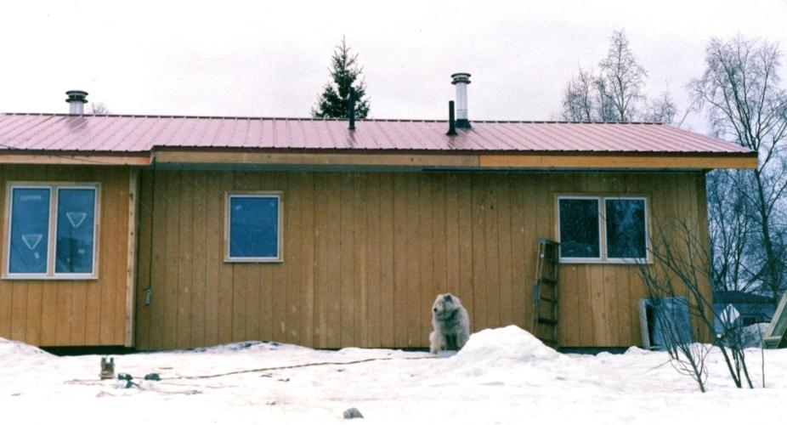
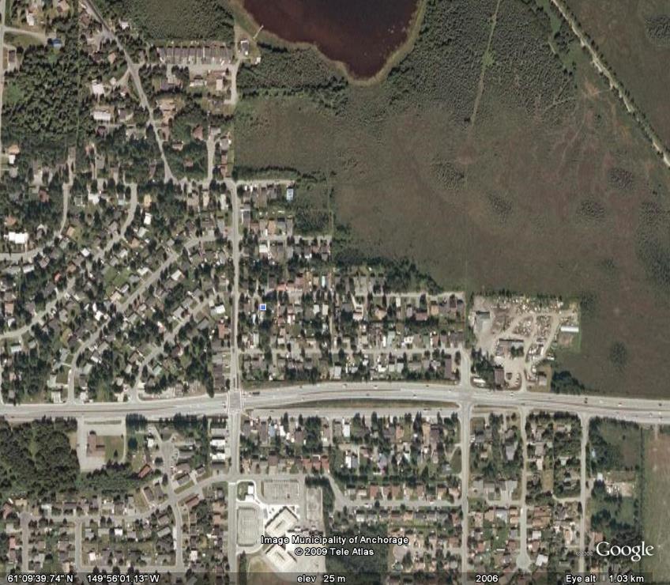
Notes:
As a child I would move back and forth year to year or season to season. This structure of living in two places set a pattern I followed for most of my adult life. In Anchorage my existence was that of an urban Native. In that world I experienced all the trappings of that world; poverty, addictions, violence. We were a multi-generational family living in one bedroom apartment in Spenard, but it was rich with a strong cultural base and lots of family that have carried me through today.

Slide 3
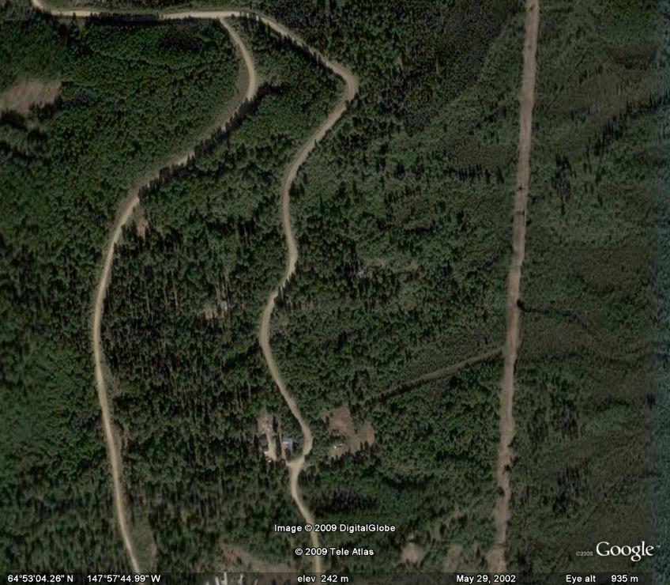
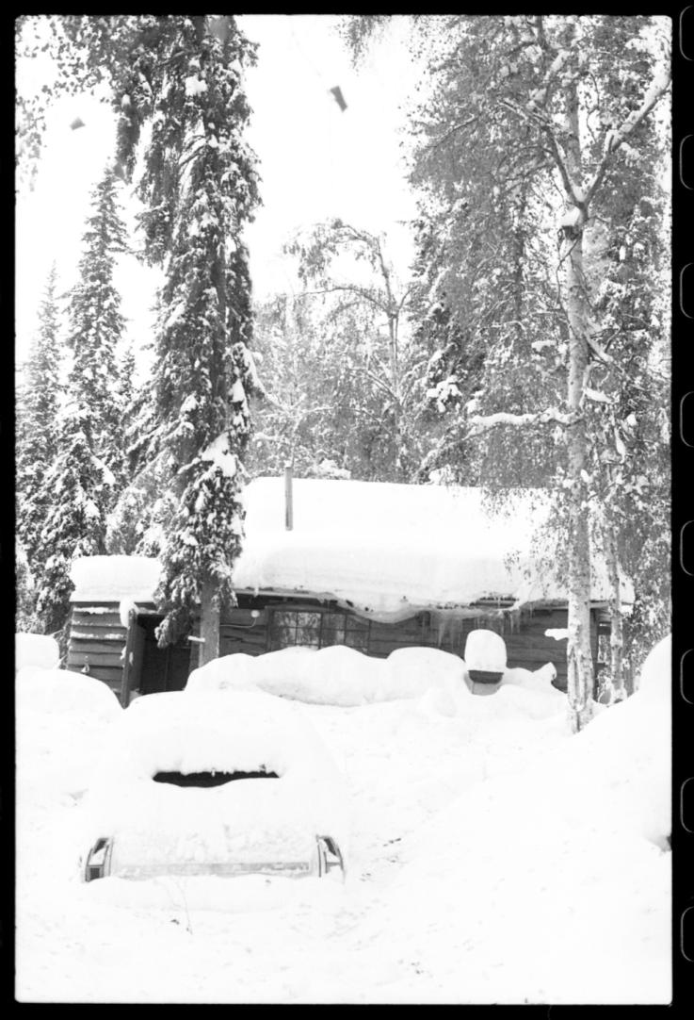
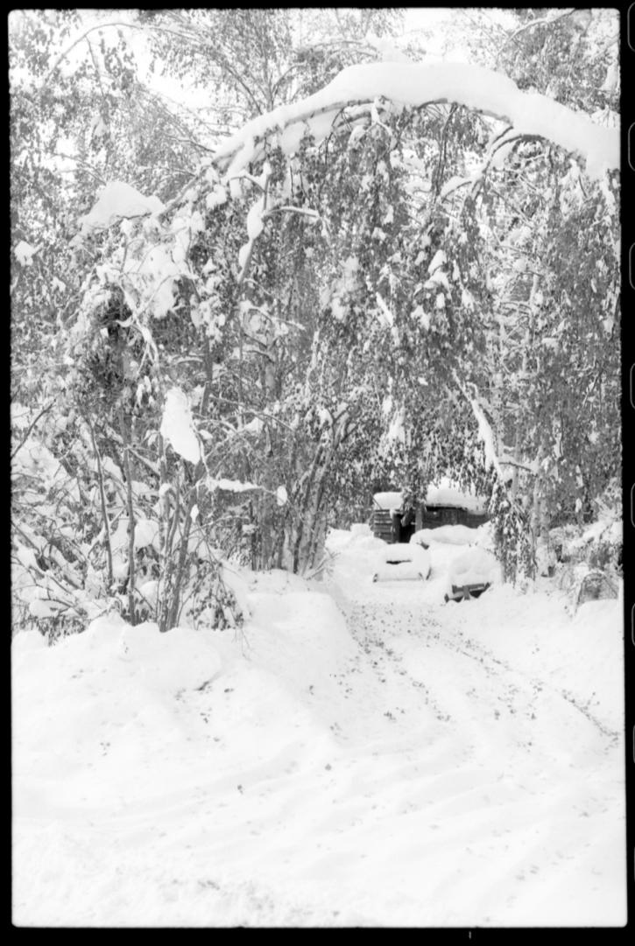
Notes:
Here in Fairbanks I lived with my father as a rural back to nature hippy , casting off the confines of mainstream society like electricity, plumbing, and phones. We lived in a 16’x20’ cabin, the only heat source a small wood stove that was used for both heat and cooking.

Slide 4
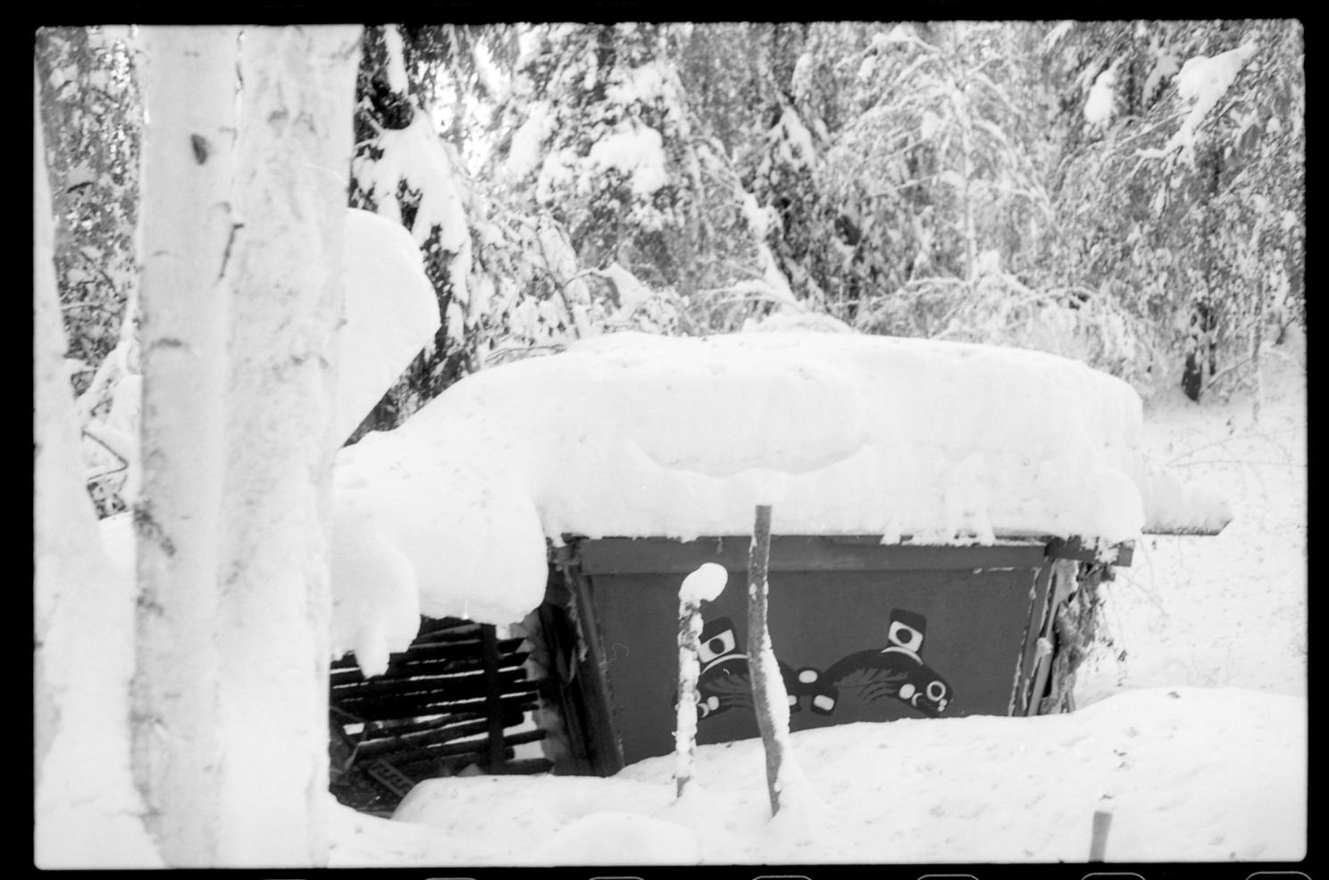
Notes:
We used the sauna for bathing and oil lamps for light at night. Having these two lives created a schism in defining my identity. As an adult, my work life has also been split in two, half the time trying to run a gallery and make art, and the other half building houses, bridges, roads, airports, and laying utility; two completely different worlds. Most of my artwork has been about searching for my own place in the world.

Slide 5
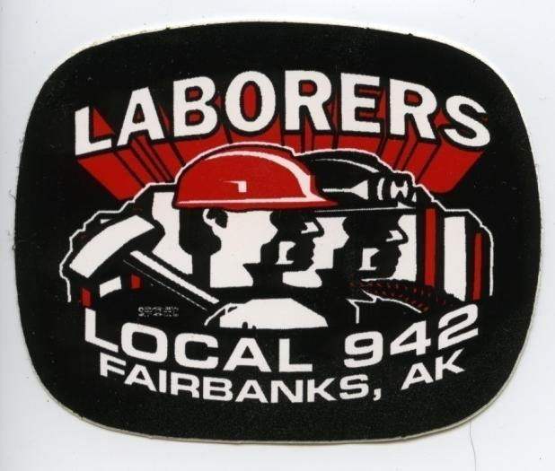
Notes:
. I no longer called myself an artist; I became a construction worker, a proud member of local 942. I helped build the roads, bridges, airports, sidewalks and utilities that provide valuable services to countless people in Fairbanks. After getting my finances in order, and working for a number of years non-stop, I found something lacking in my life, and decided to finish the degree that I had abandoned so long ago.

Slide 6
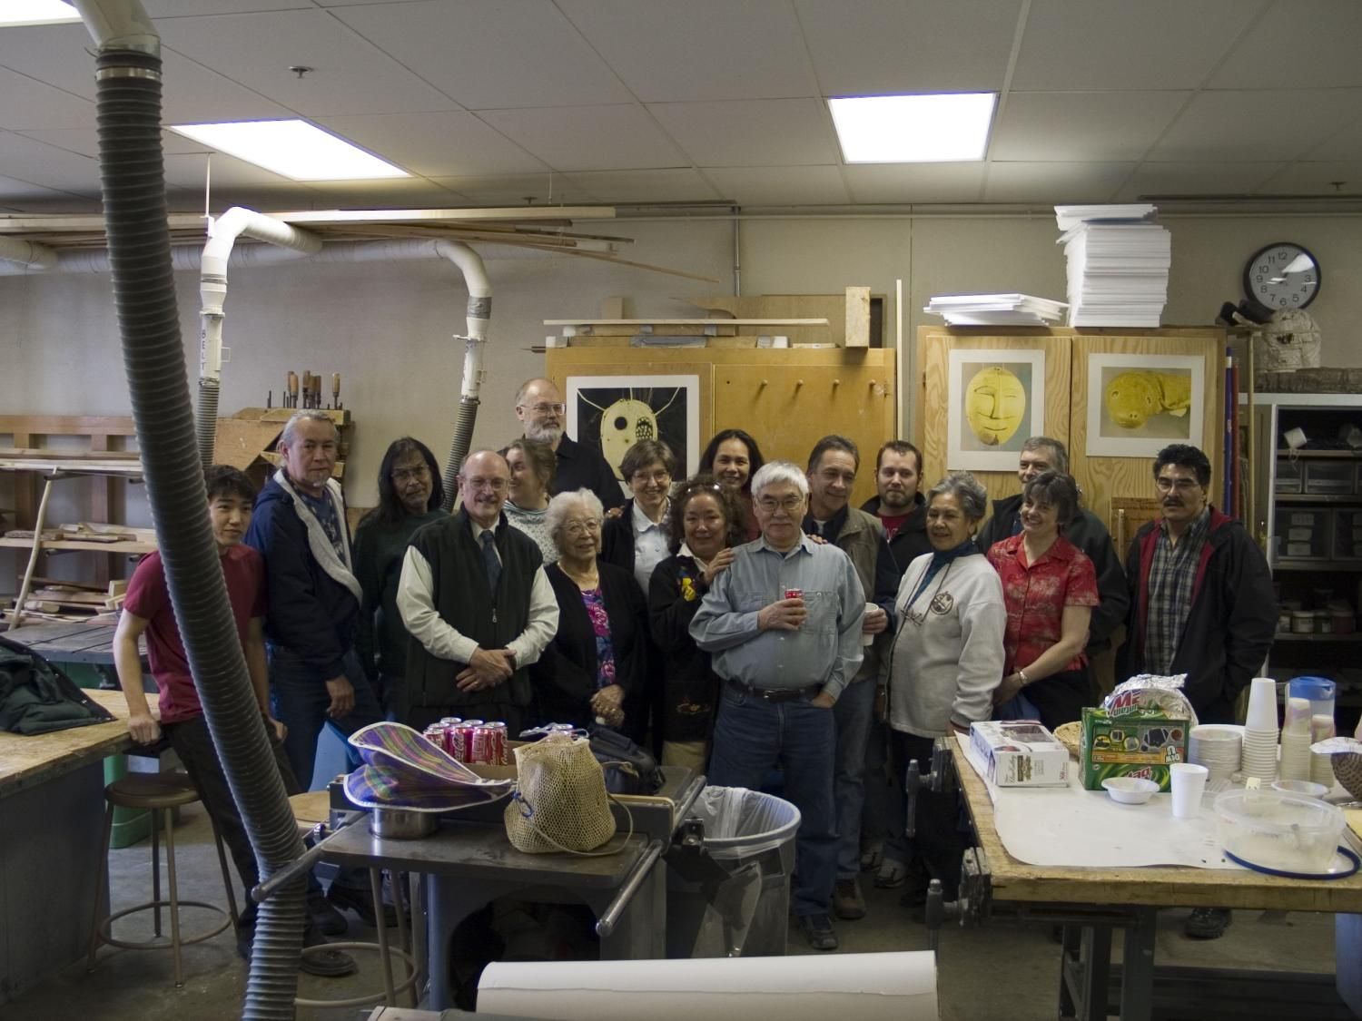
Notes:
While finishing up the last few credits I needed for my BFA degree, I found the Native Arts Center here in Fairbanks at UAF. I began carving for the first time in my life and was wooed back to the arts through the Native Arts department, where I found place, purpose, community and acceptance.
Rico Worl, James Grant, Bert Ryan, Terri Dicky, Jean Carlo, Glen simpson, Turrid Sunugutuk, Kathleen Carlo, Beckie Etuceiuk, Ron Sunugatuk, Alvin Amuson, Speriee, ?,?,? Bobbie Nusupetuk.

Slide 7
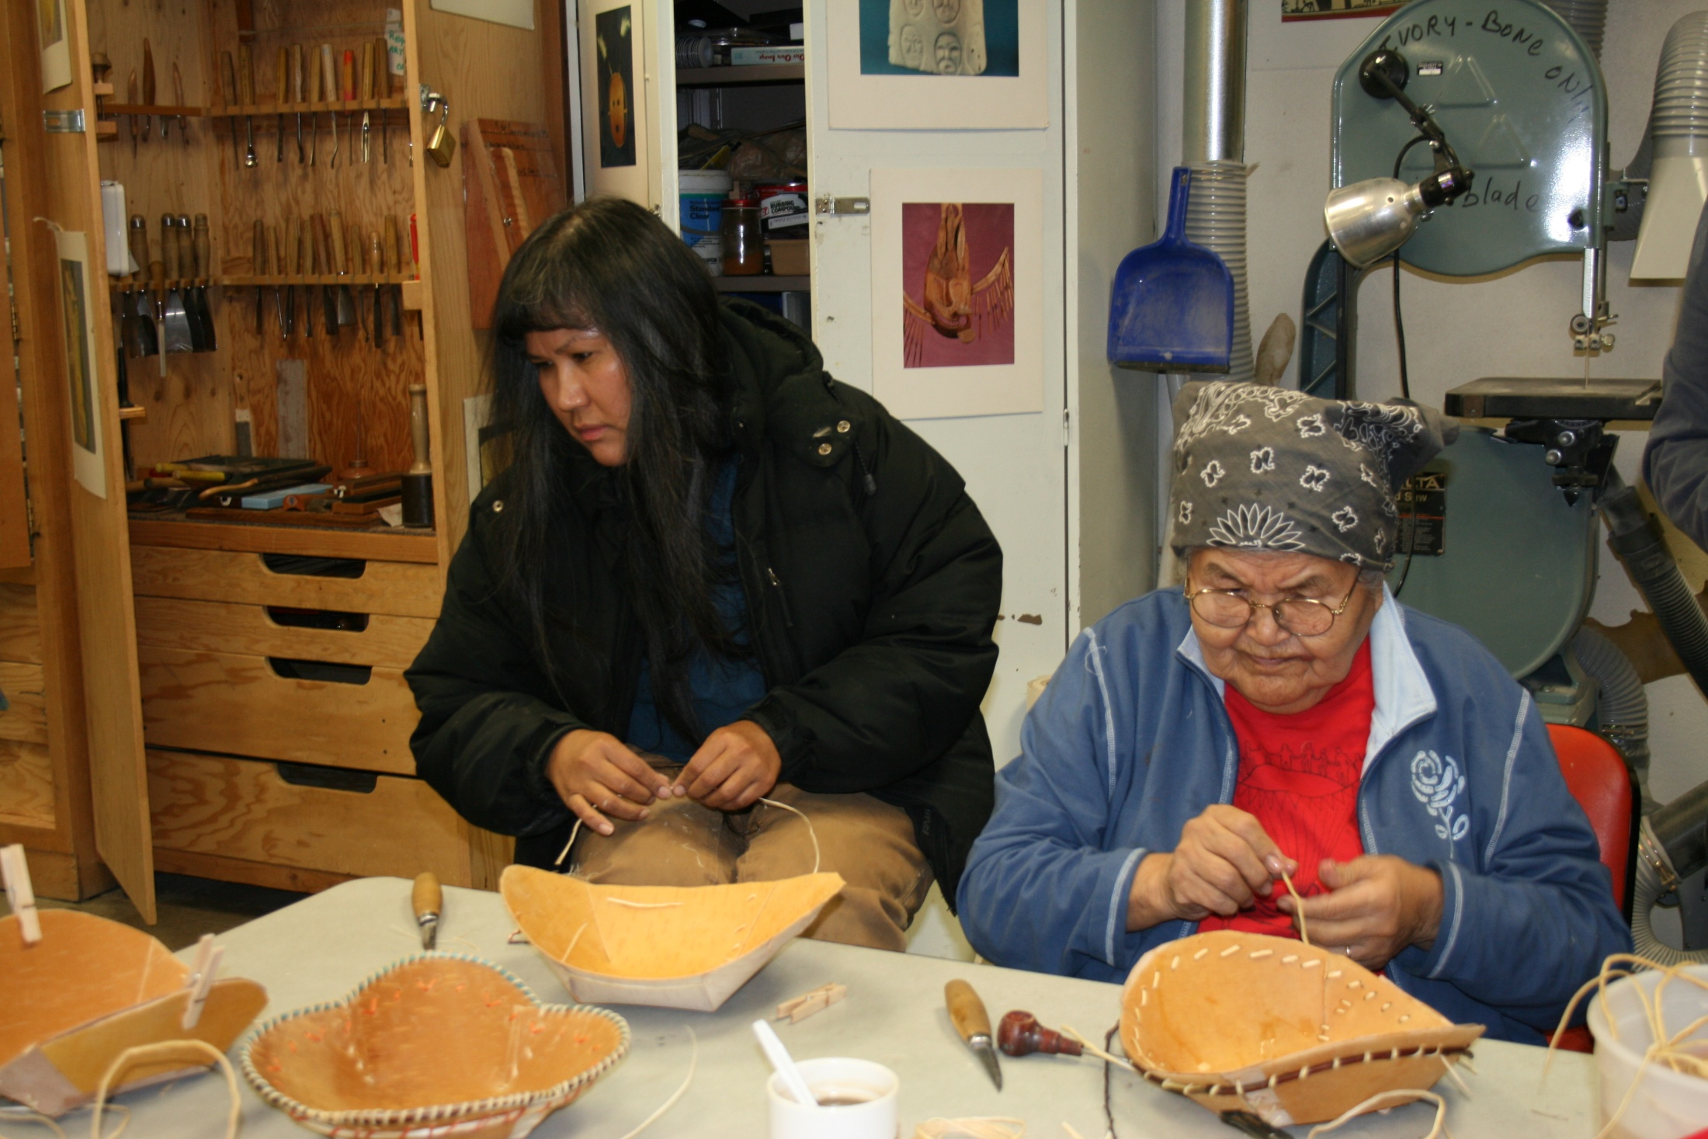

Slide 8
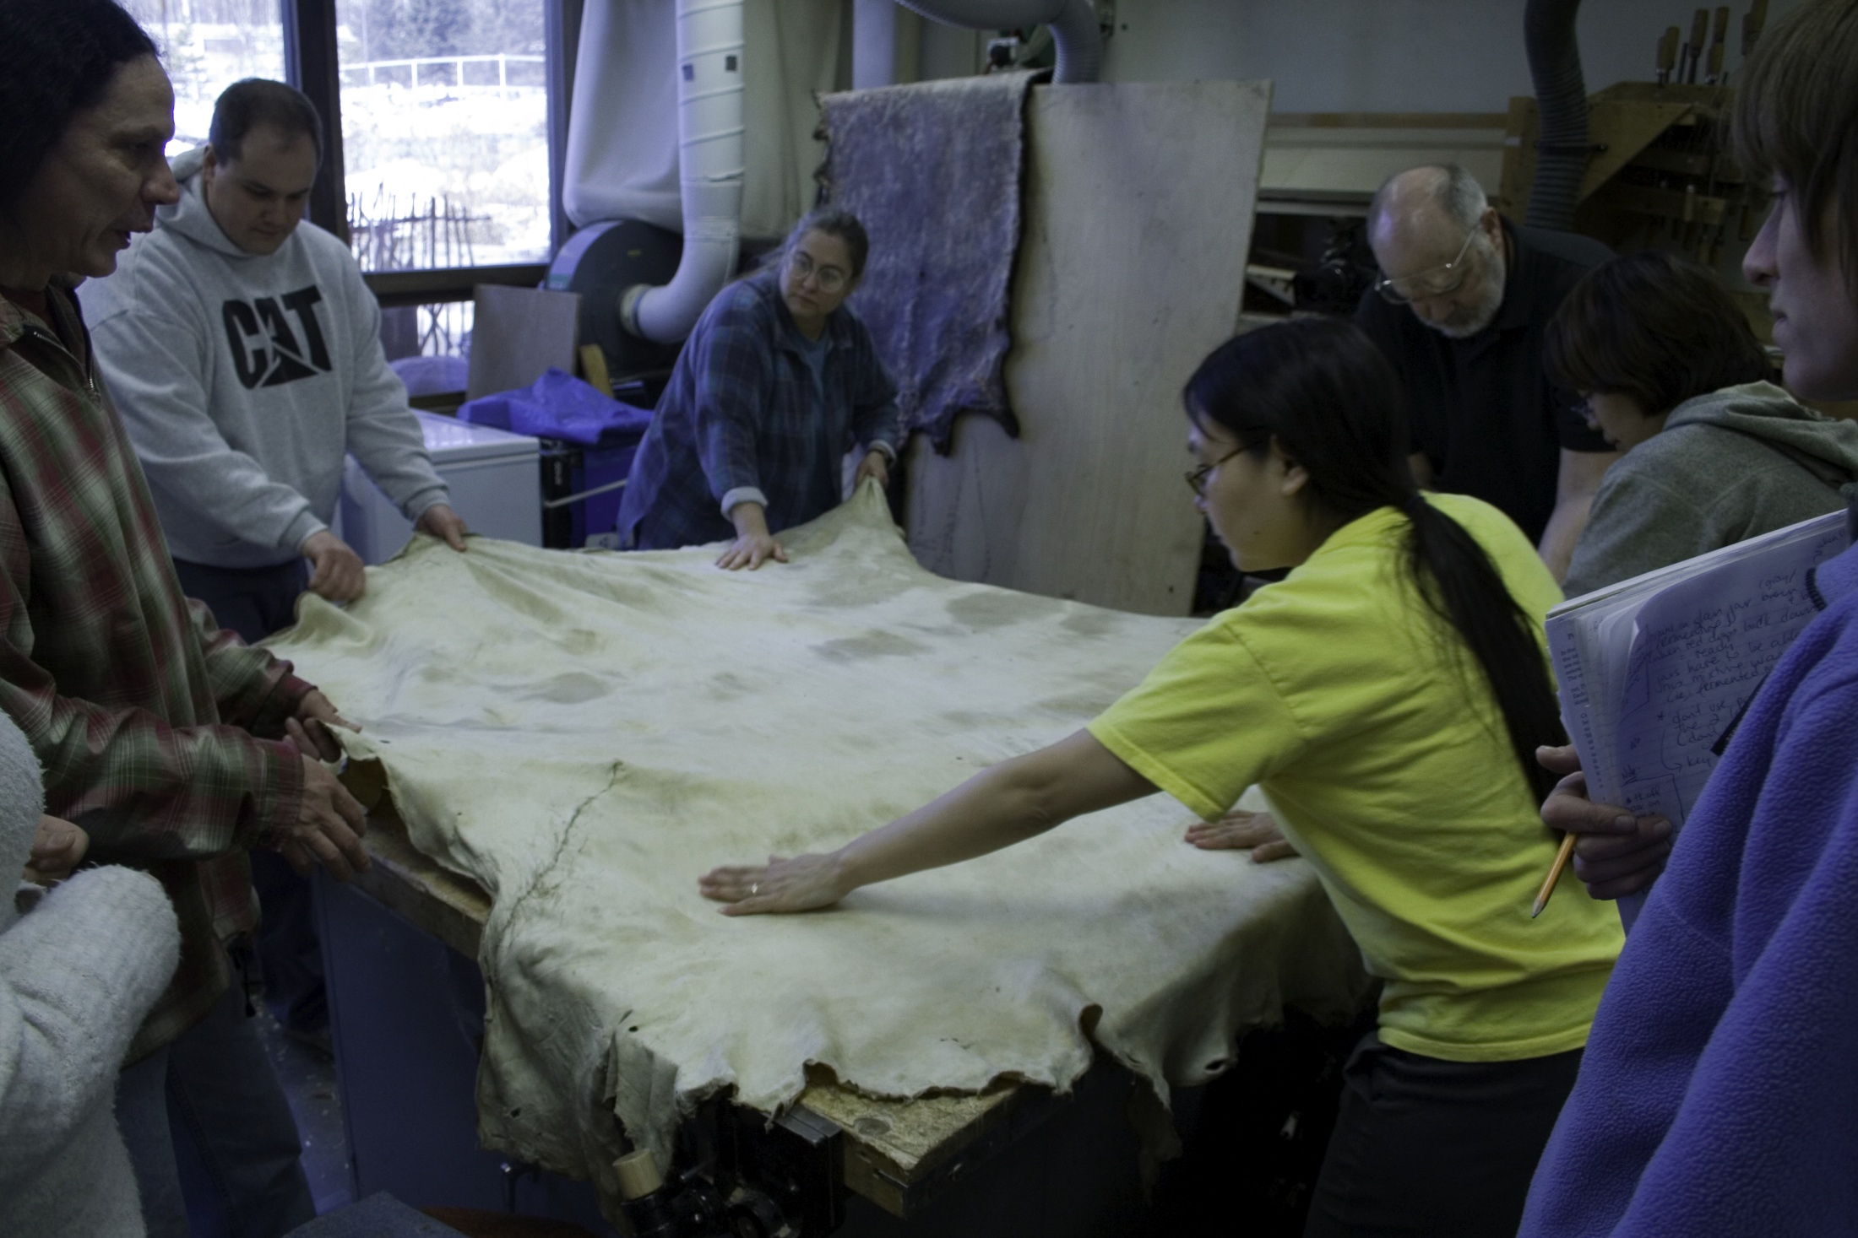

Slide 9
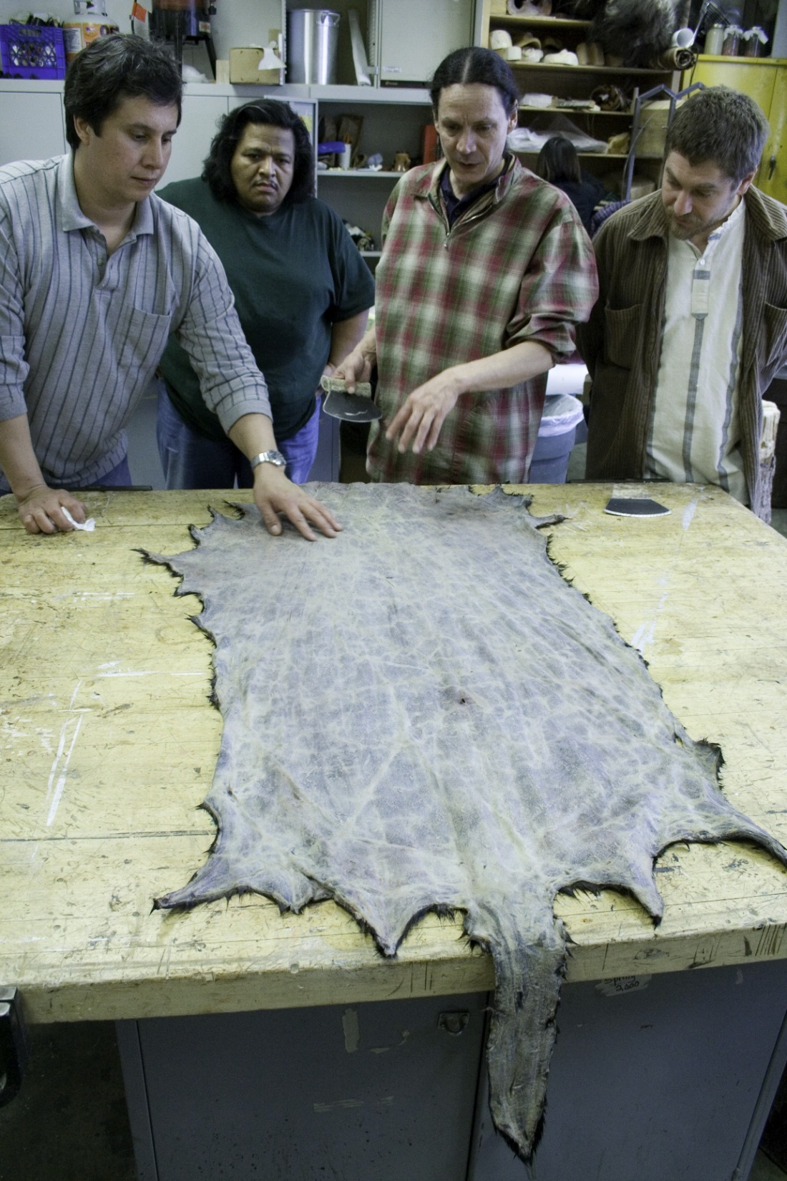

Slide 10
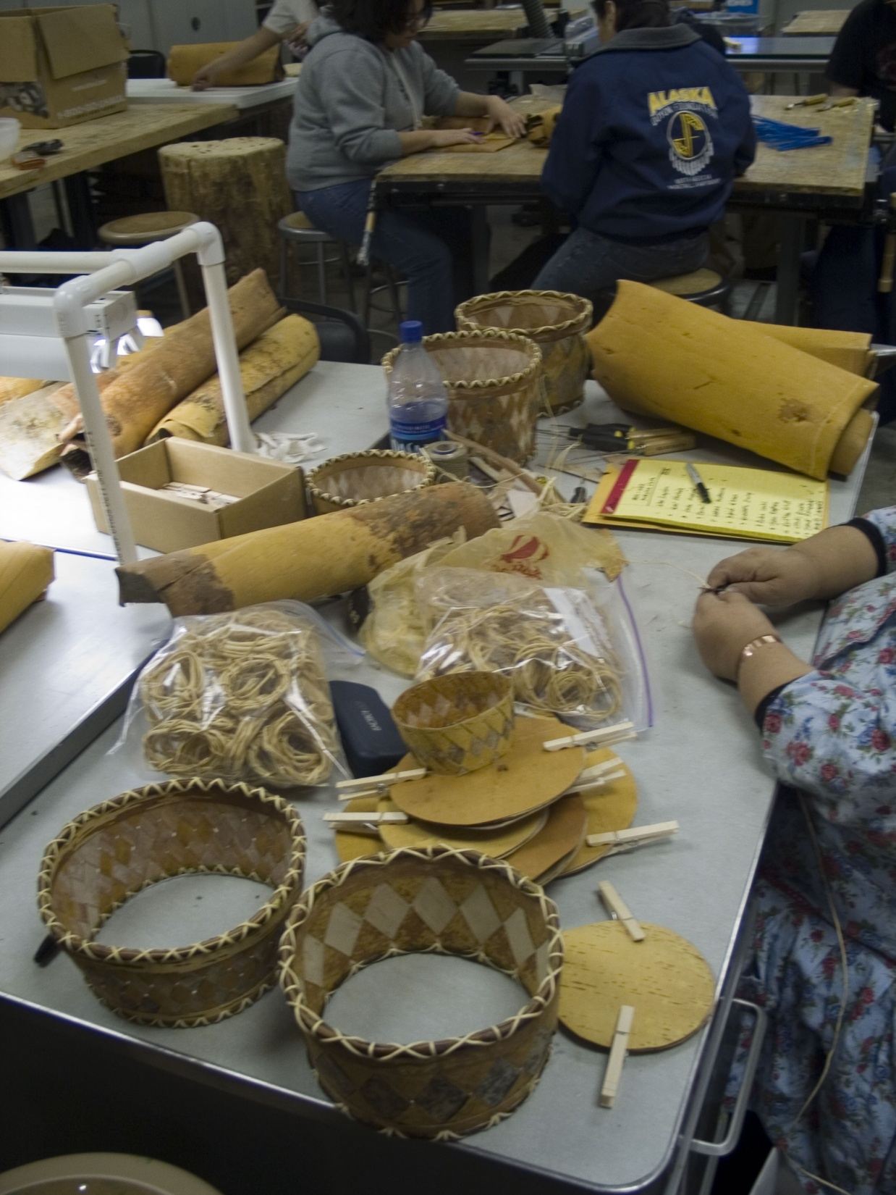

Slide 11
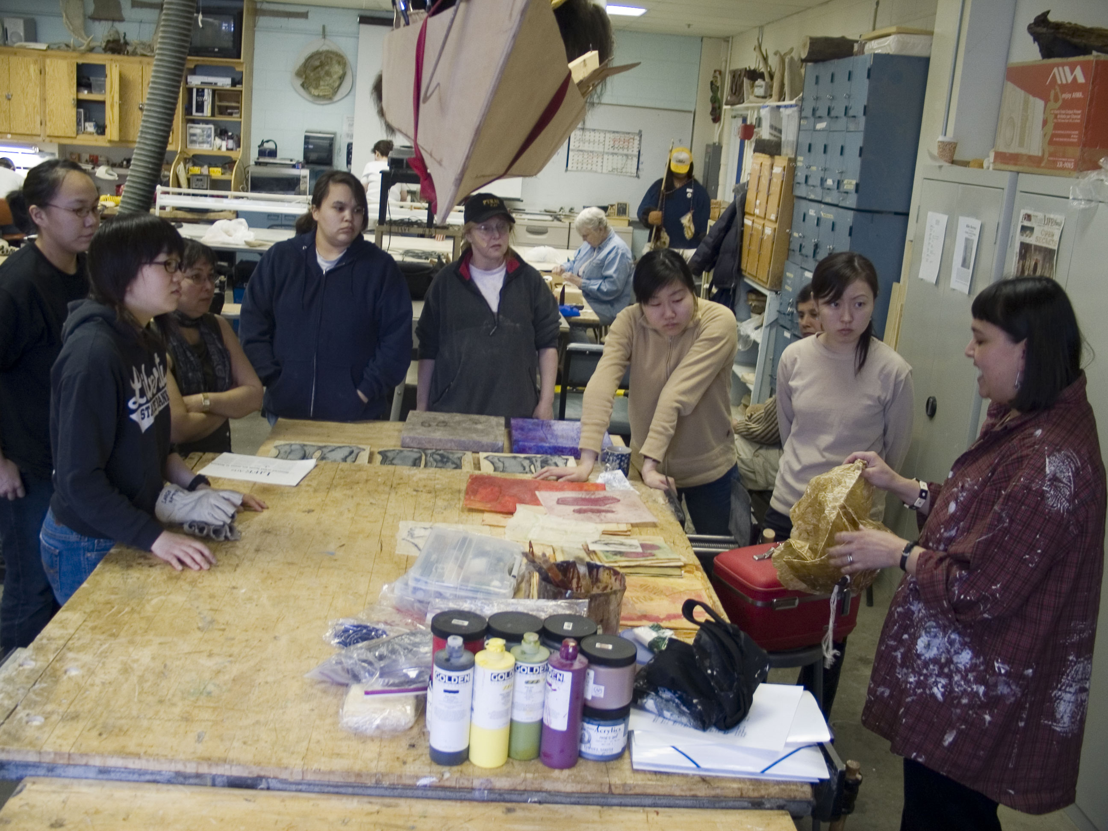

Slide 12
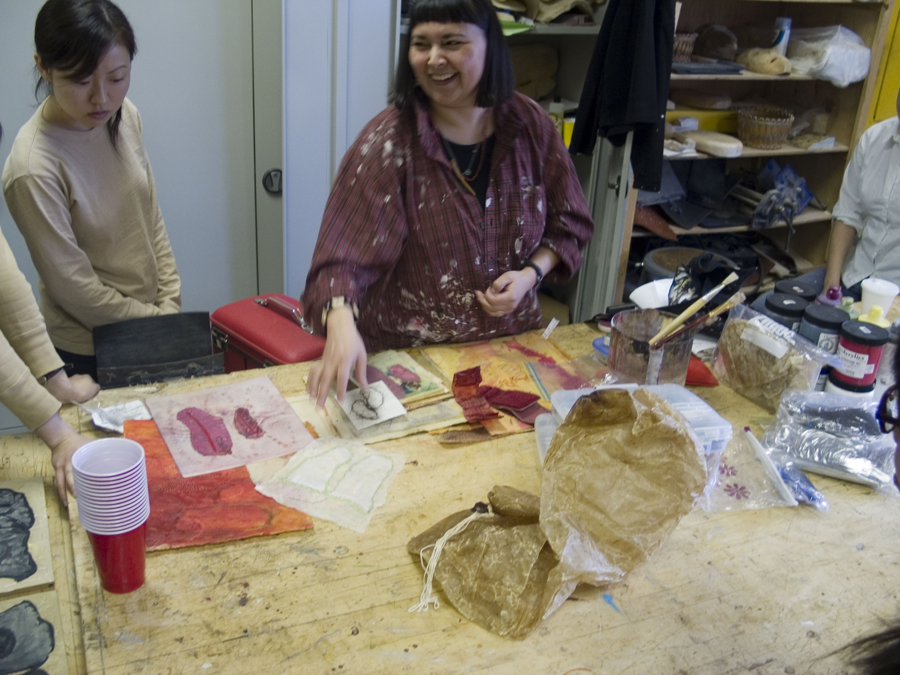

Slide 13
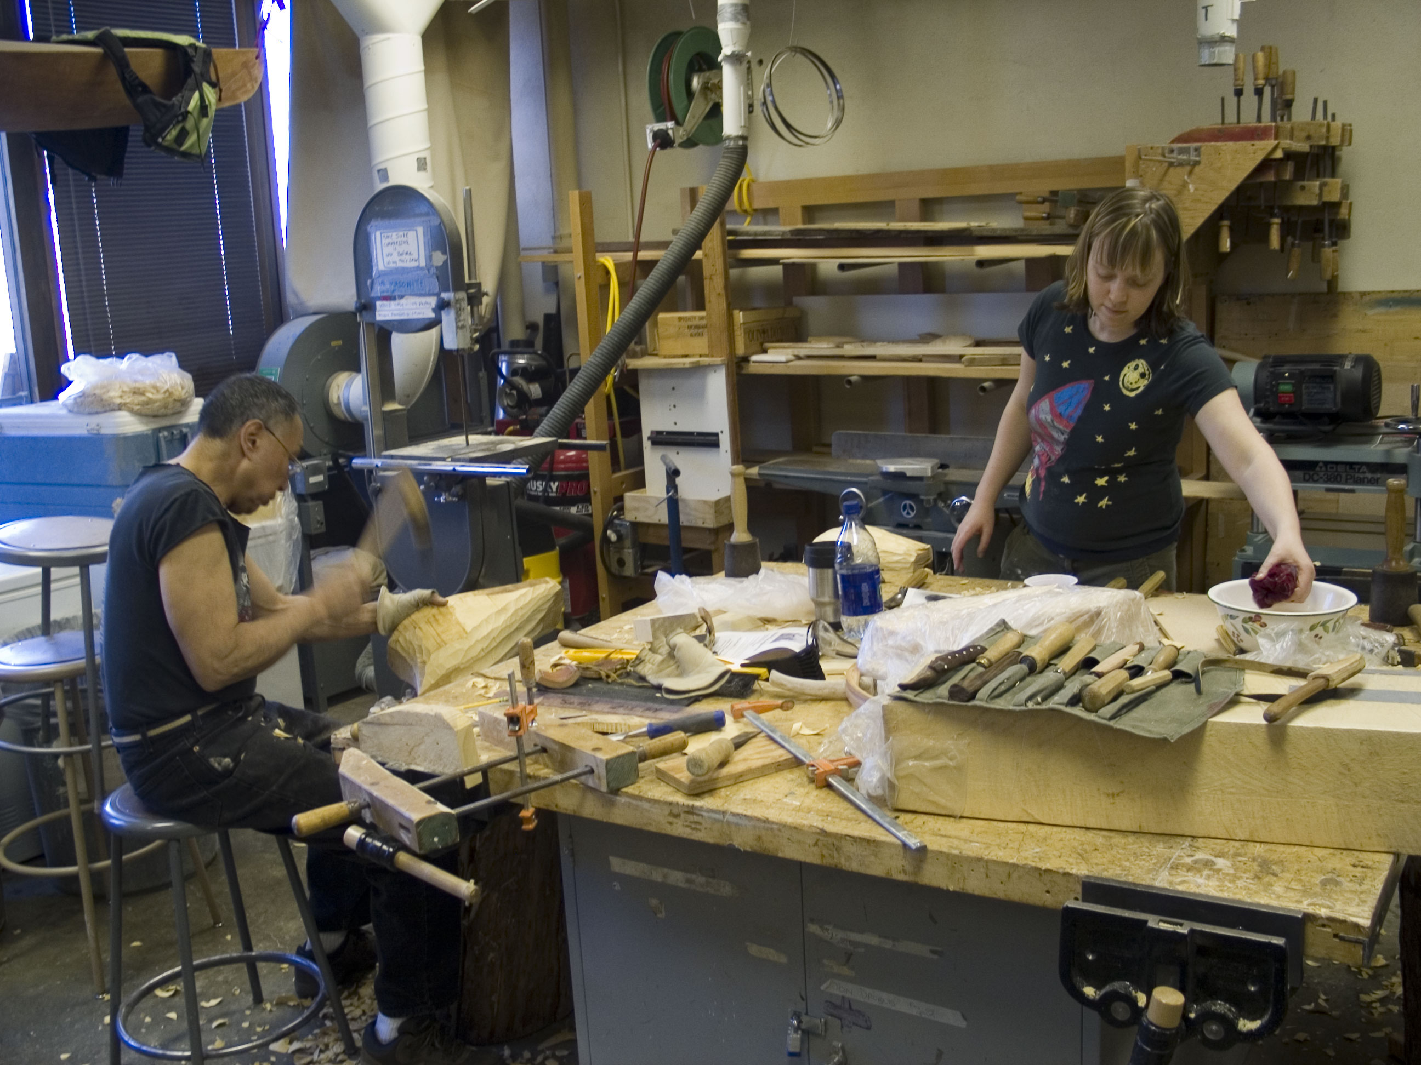

Slide 14
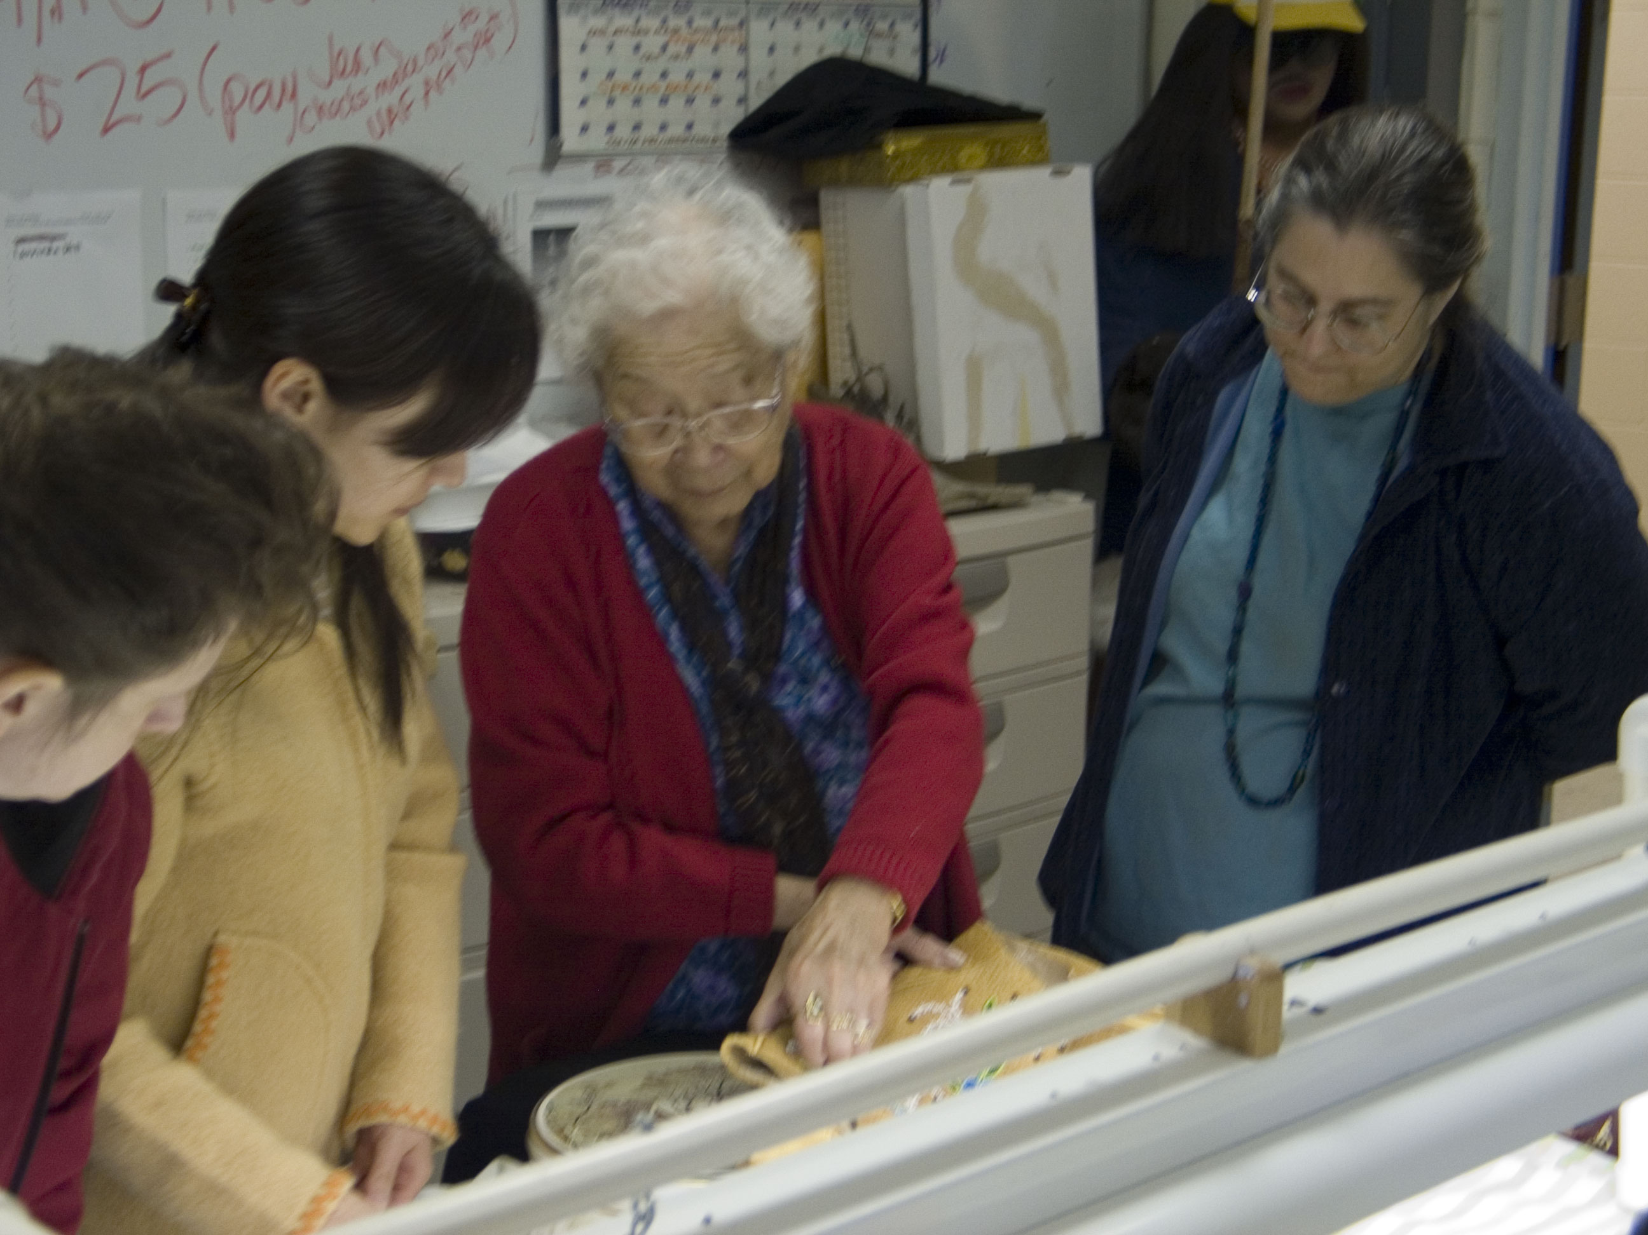

Slide 15
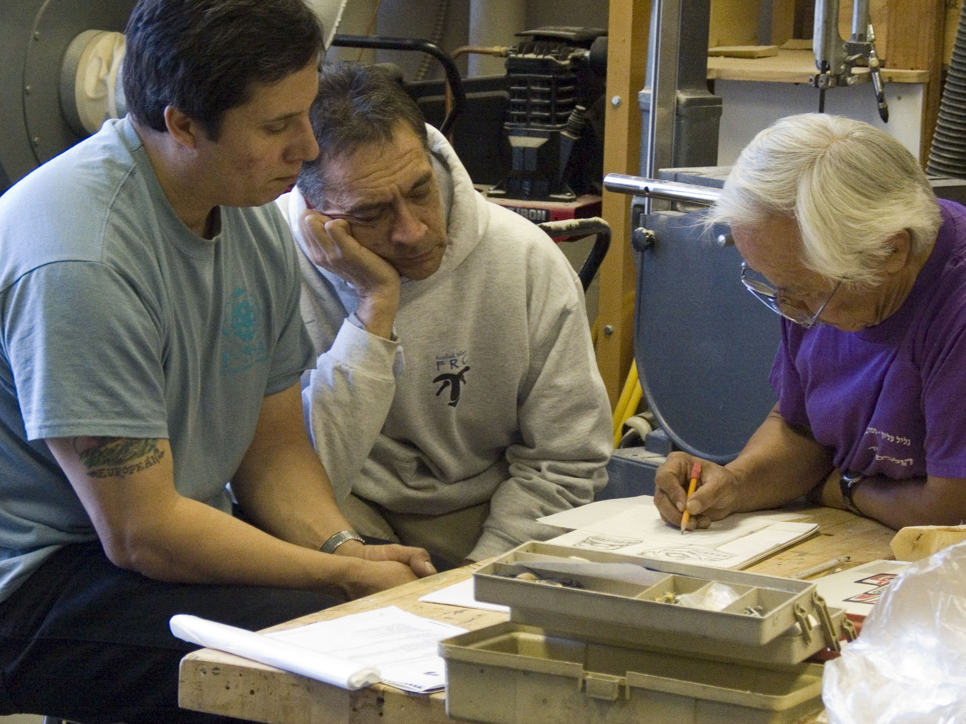

Slide 16
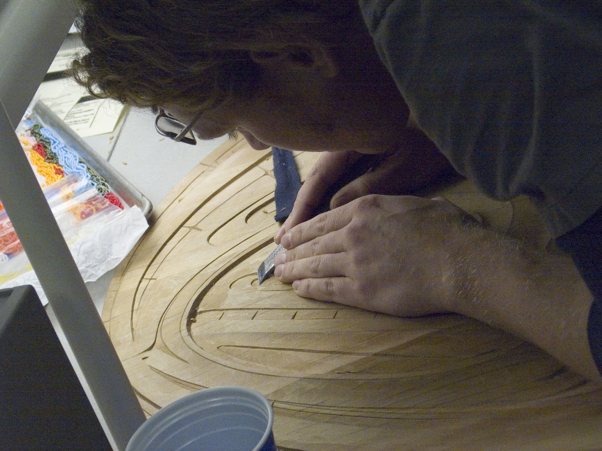

Slide 17
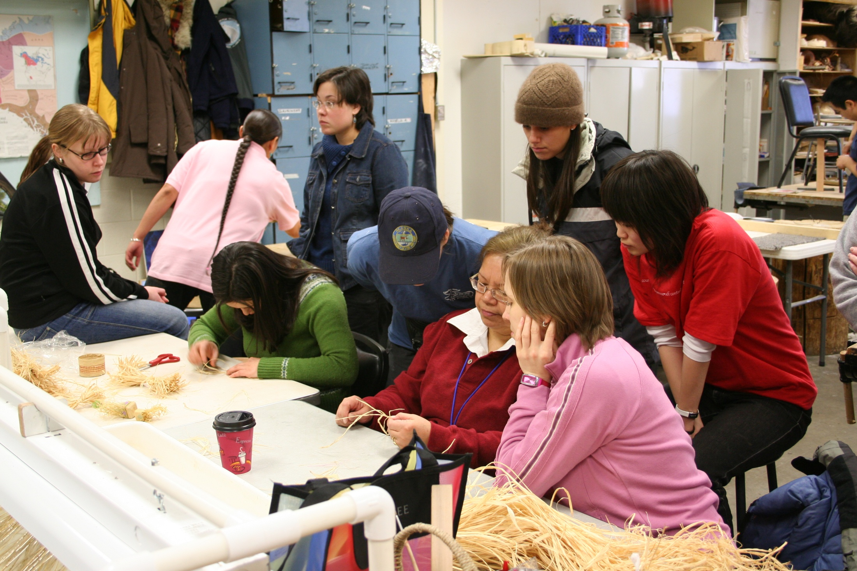

Slide 18
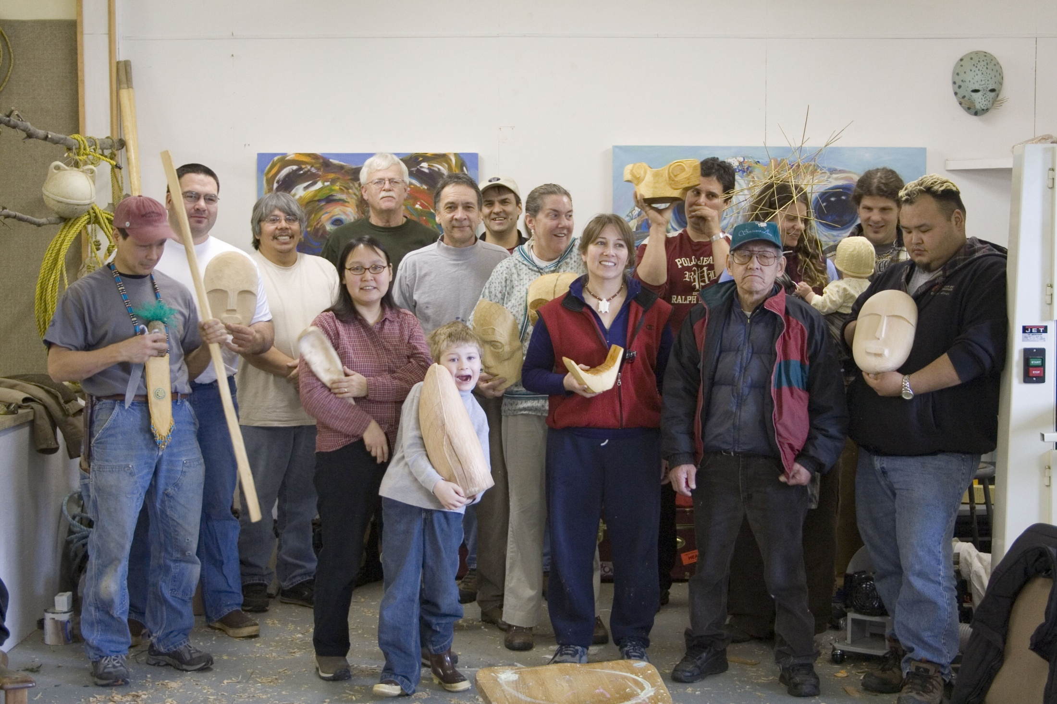

Slide 19
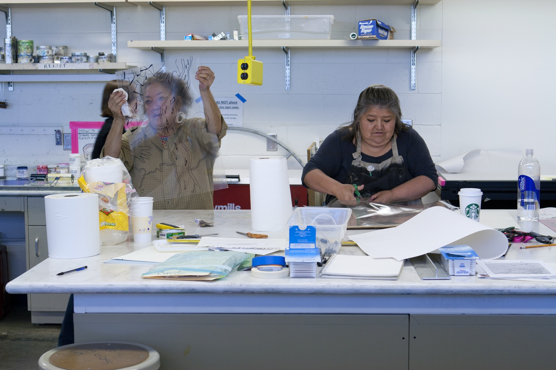

Slide 20
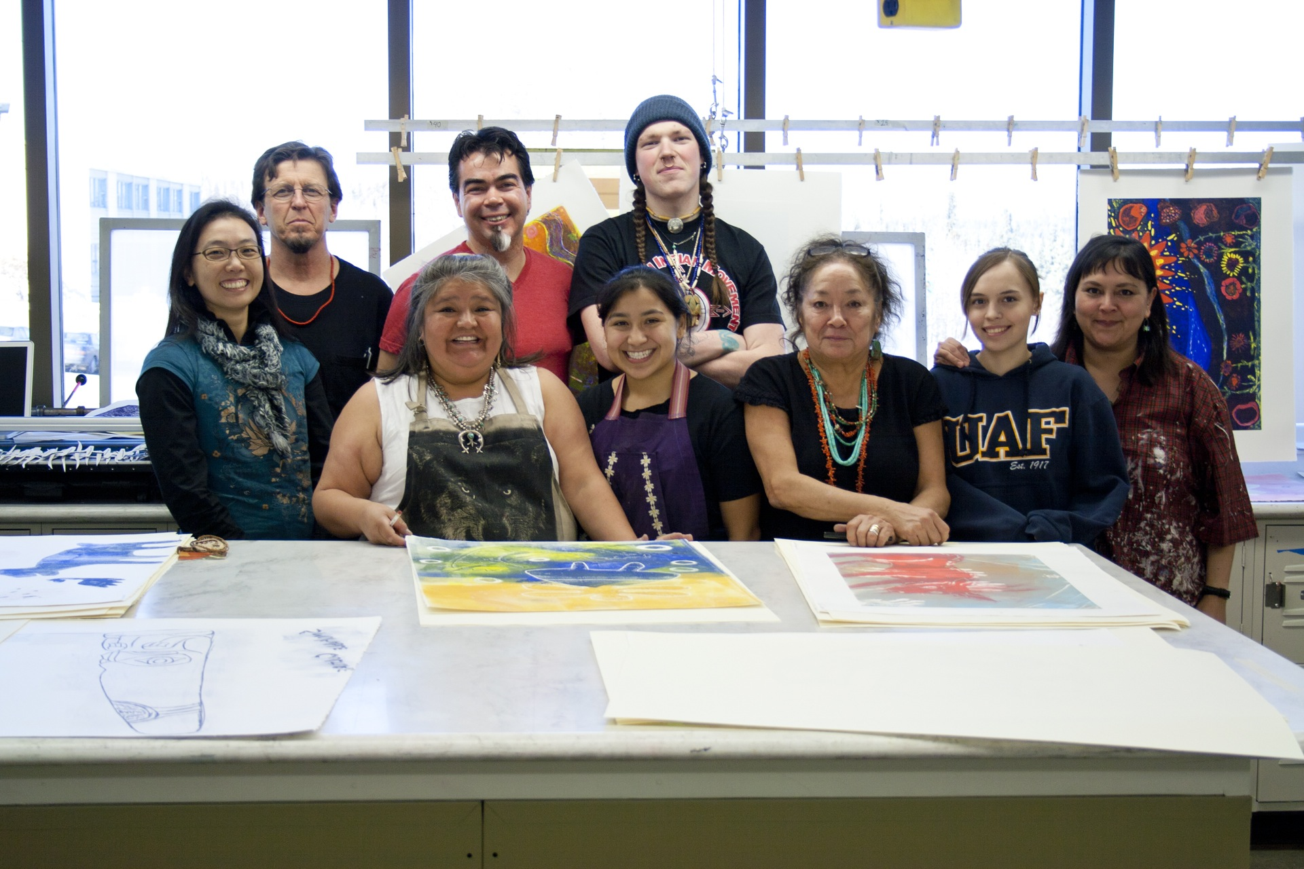

Slide 21
The College of Liberal Arts Native Art Center & College of Rural and Community Development "To Continue or Be Remembered" Project

Slide 22
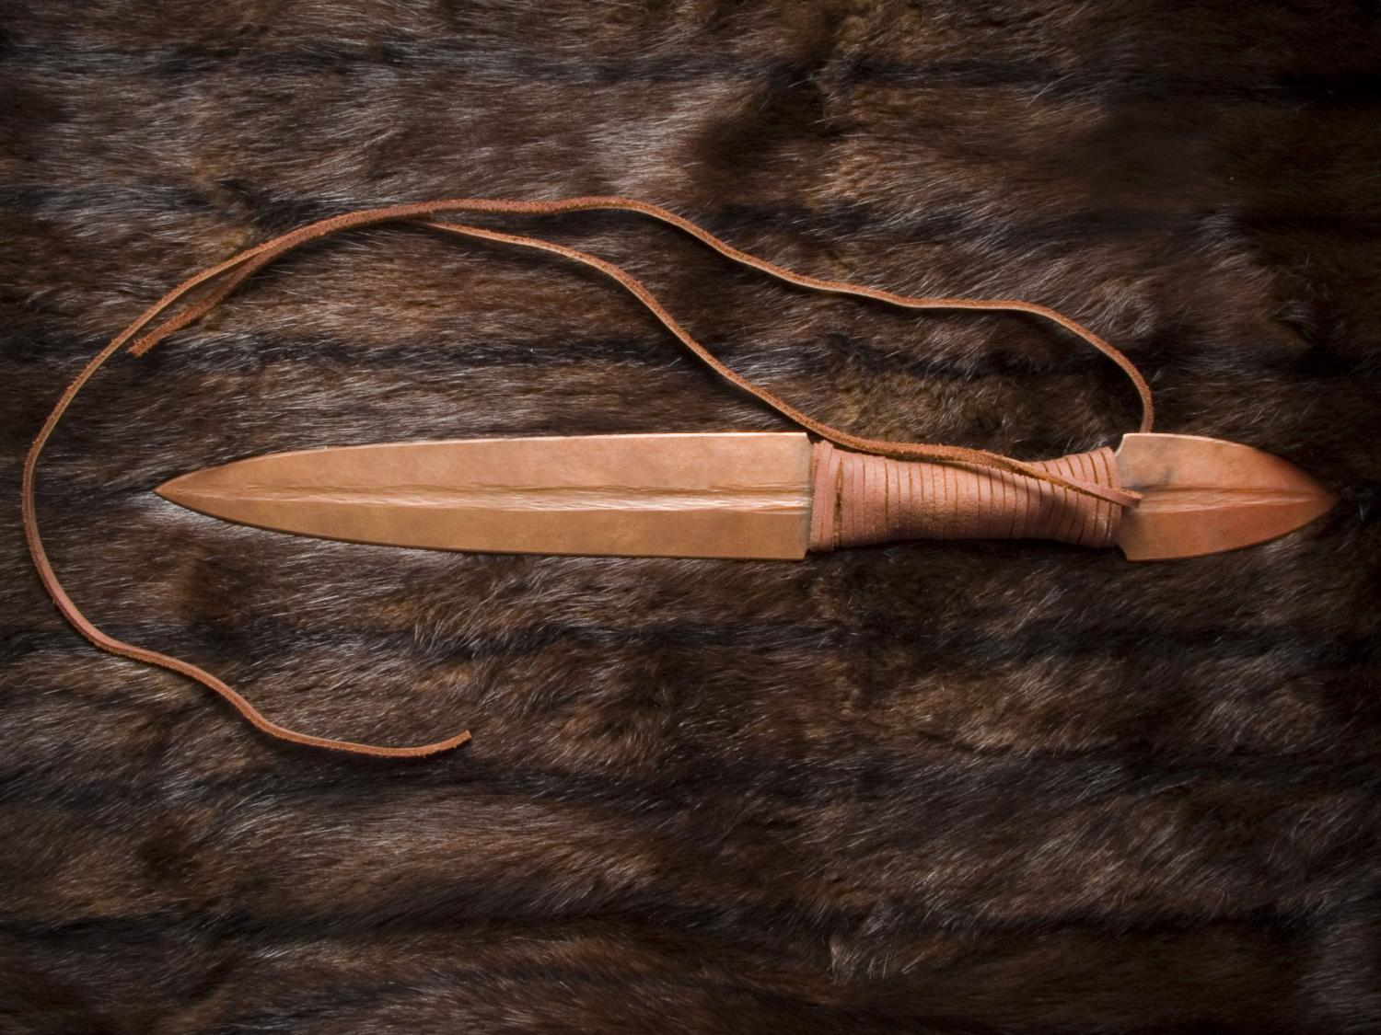
Notes:
In following my examination of Tlingit material culture I began to look at warrior culture. With the US nation at war in Iraq, I began to look at the objects of war from my Tlingit heritage. I started on a series of copper knives specifically thinking of my brothers, and how much Native American men have to battle against. Statistically the odds are not in our favor, and these pieces are a symbol to stand up and fight the good fight, to battle against racism and stereotypes.

Slide 23
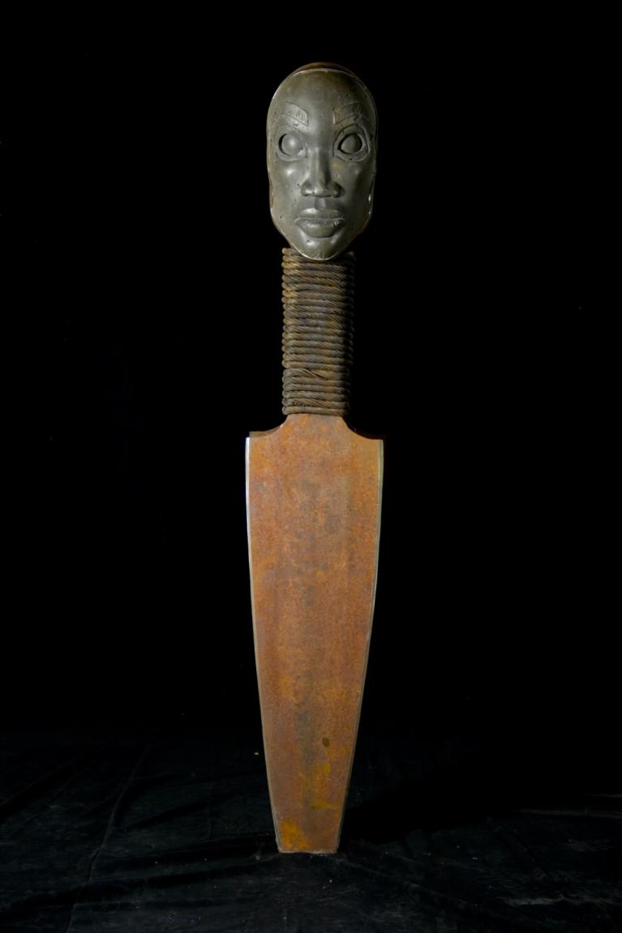
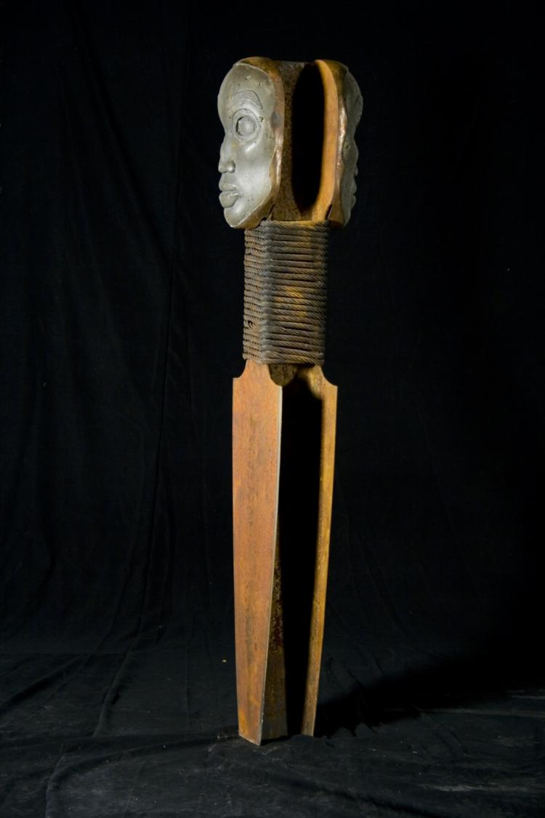
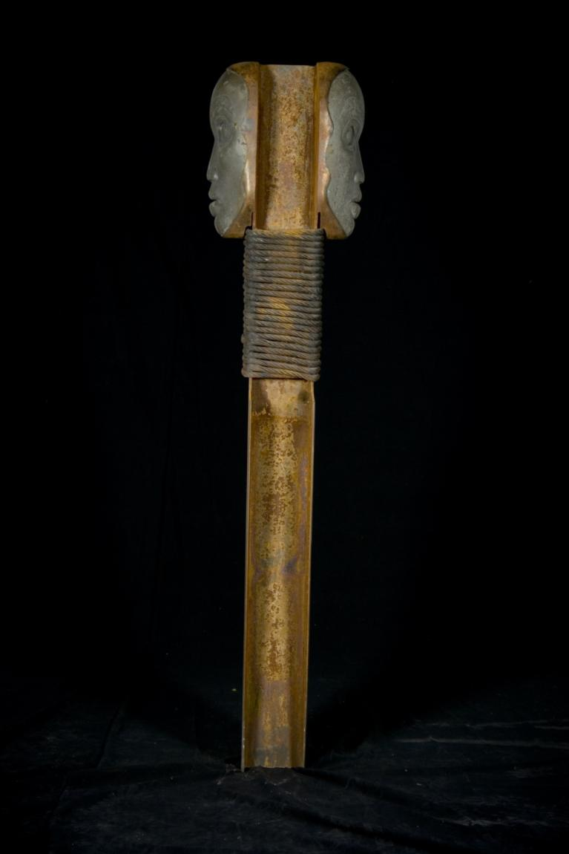
Notes:
The “Double-Headed Dagger” is a piece that again is a play on words. Tlingit fighting knives are often identified as double-headed daggers, the double-head of this dagger is a reflection of the parallel lives that I have lived up to this point, worker-artist, urban-rural, white-Native.

Slide 25
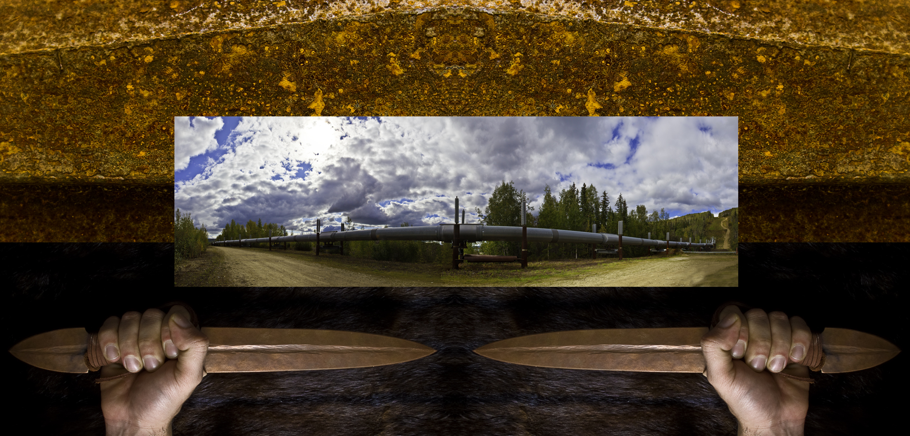

Slide 26
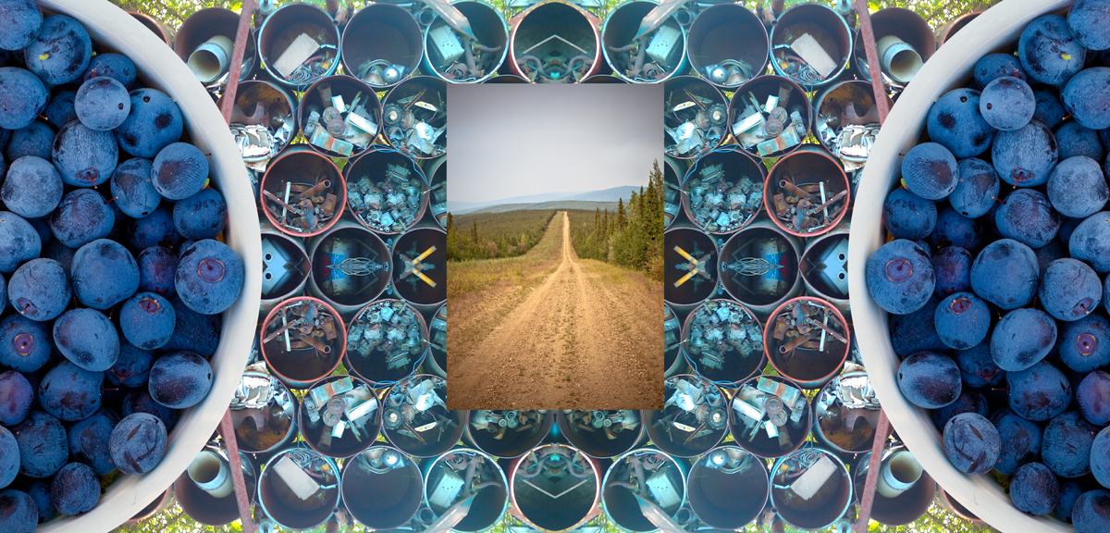

Slide 27
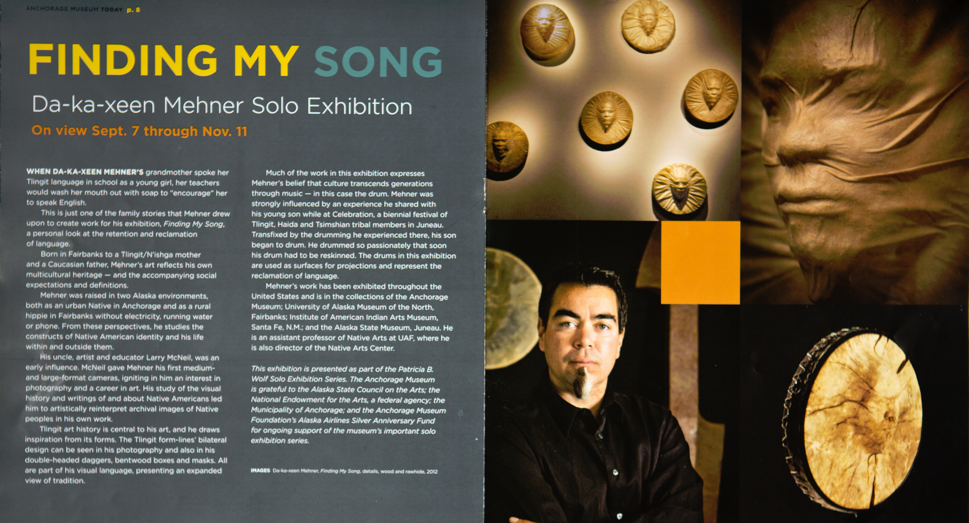

Slide 28
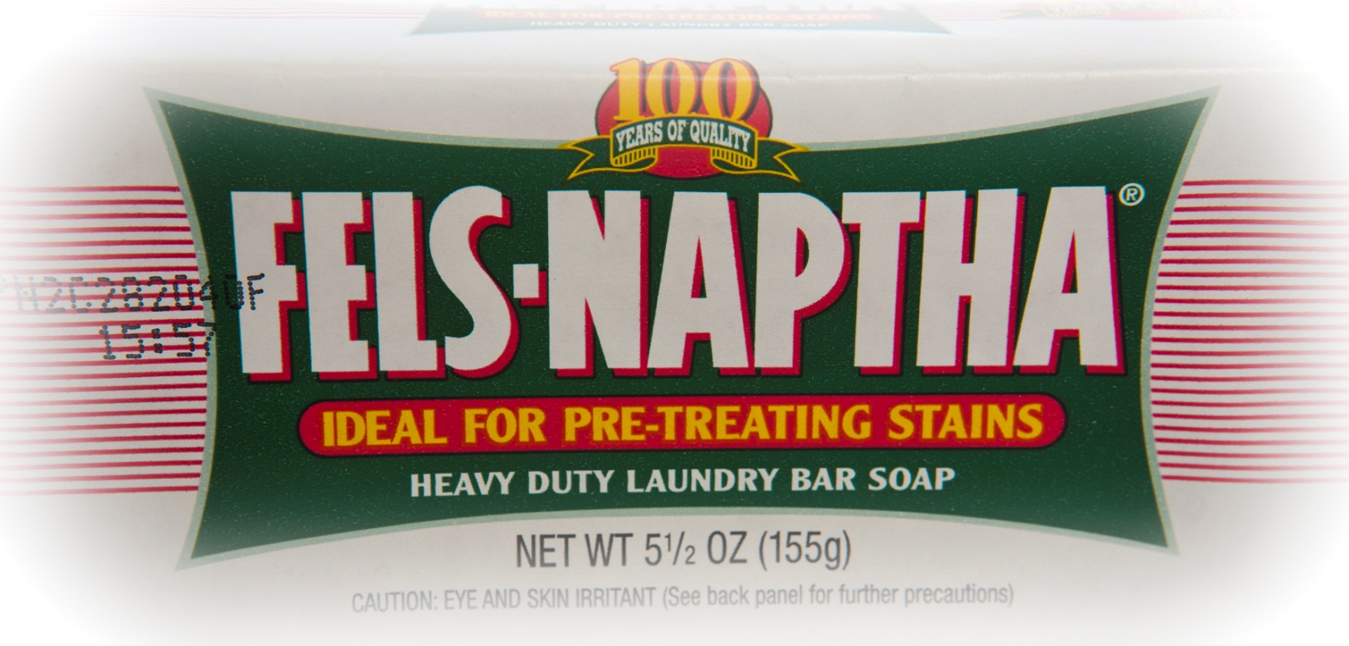

Slide 29
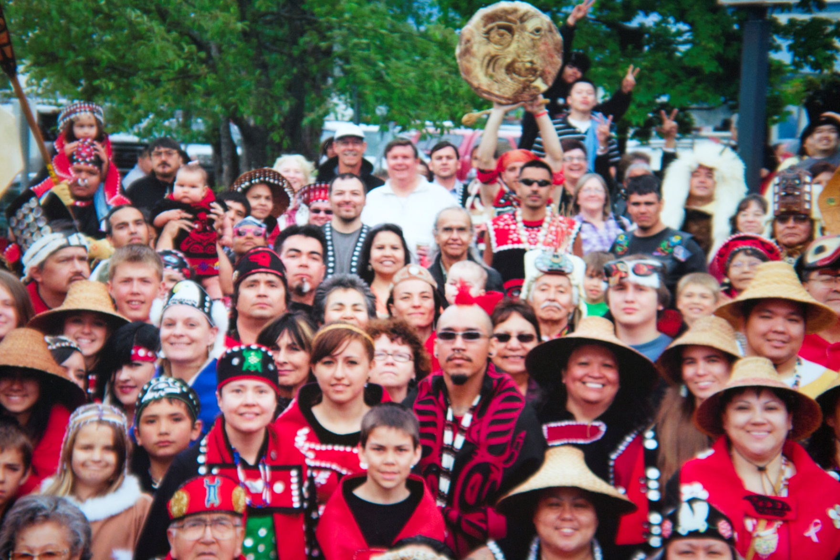

Slide 30
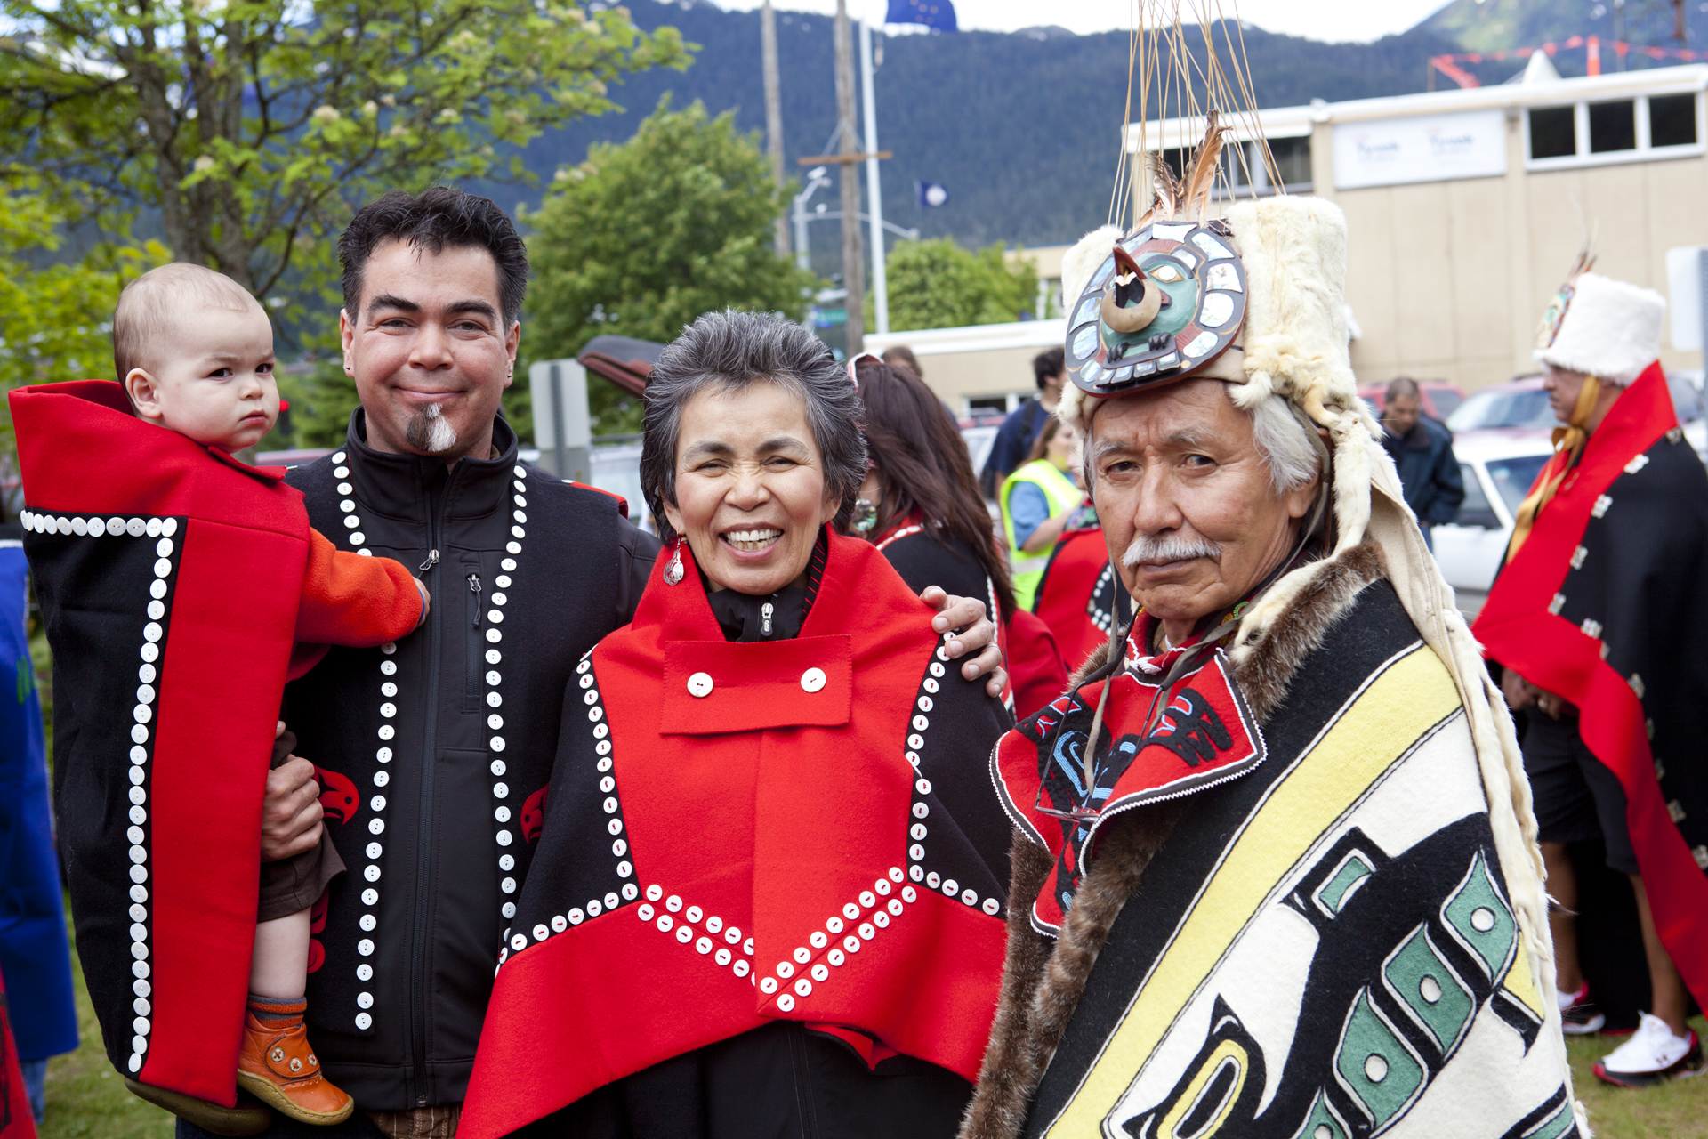

Slide 31
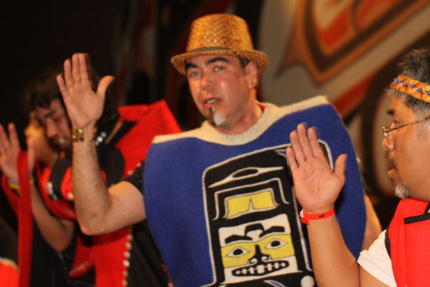
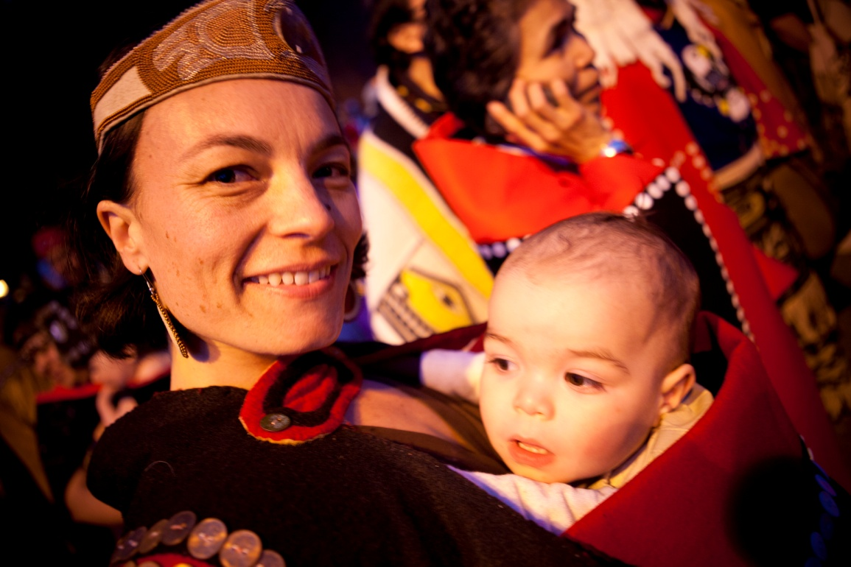
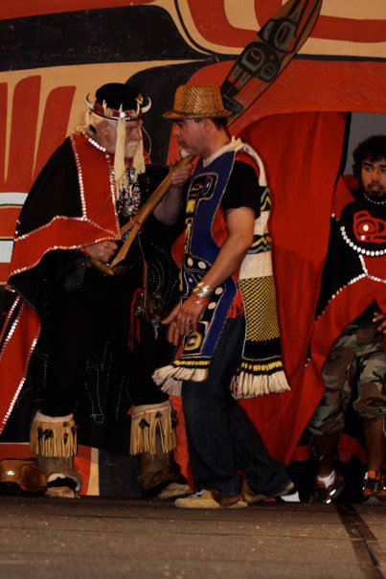
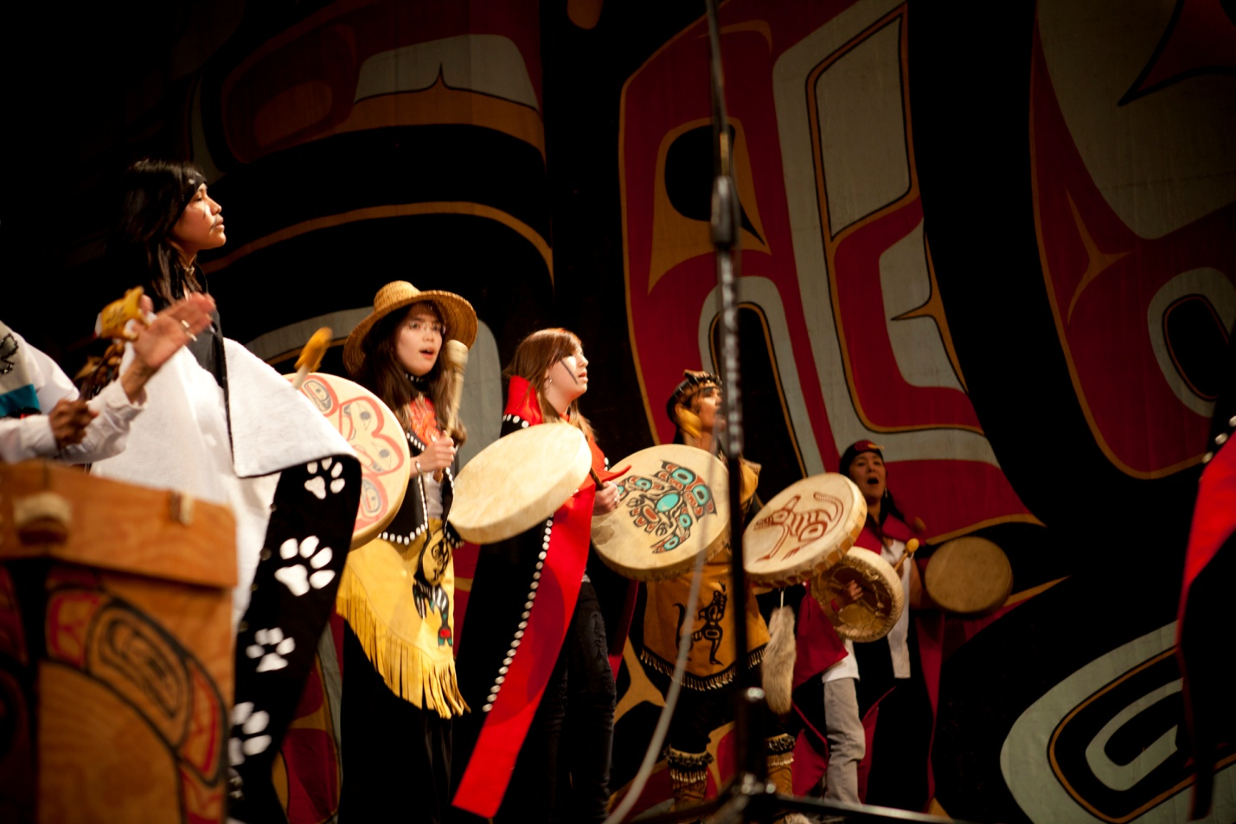

Slide 33
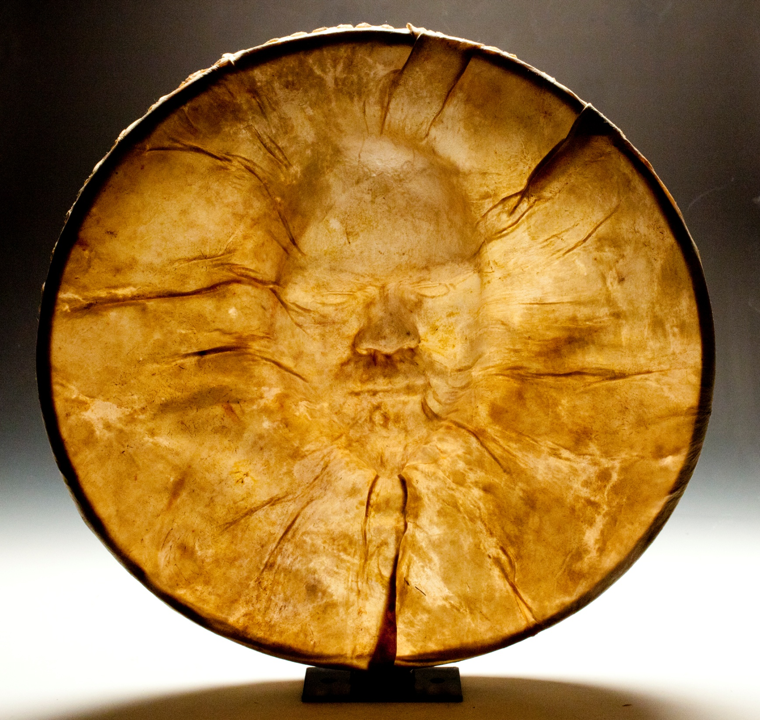

Slide 34
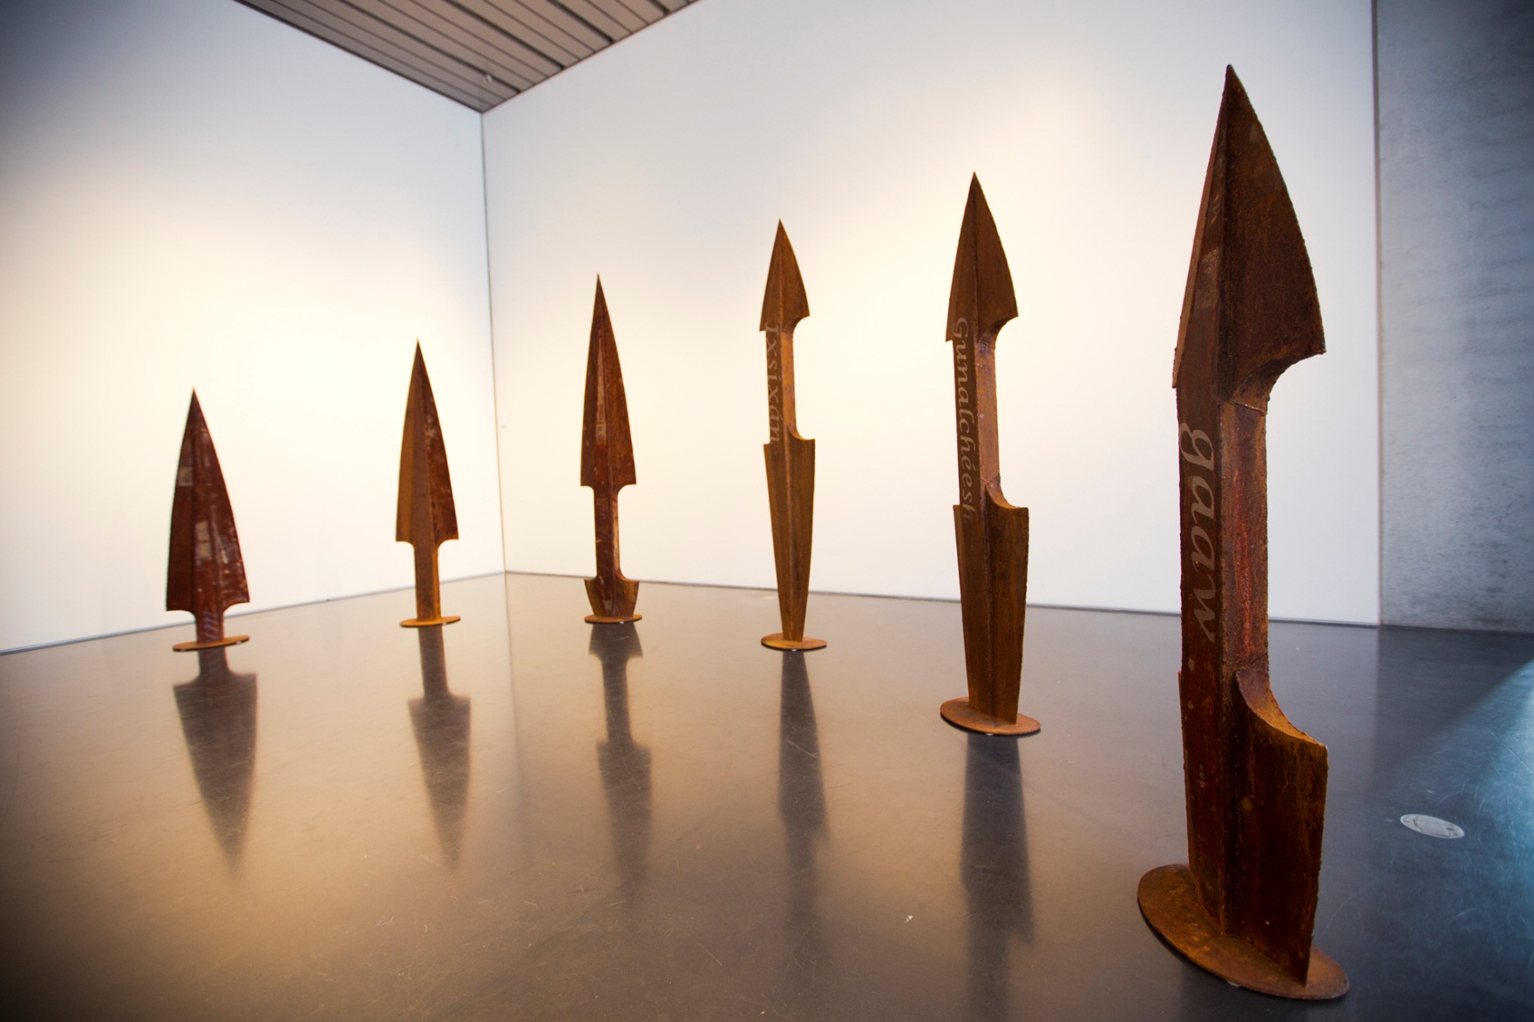

Slide 35
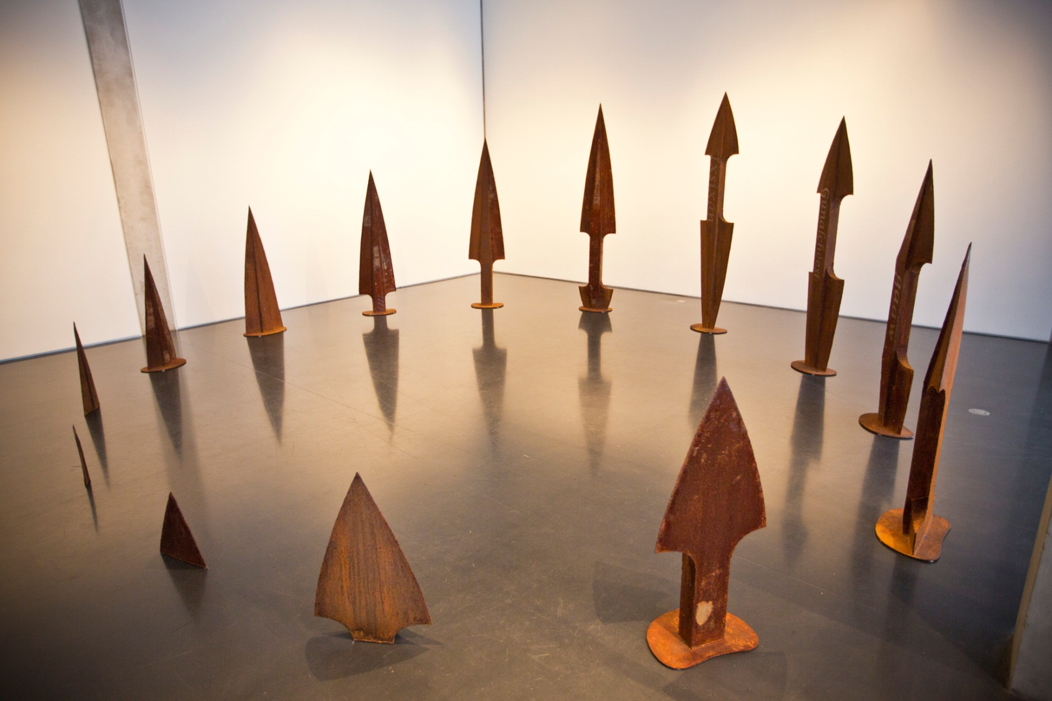

Slide 36
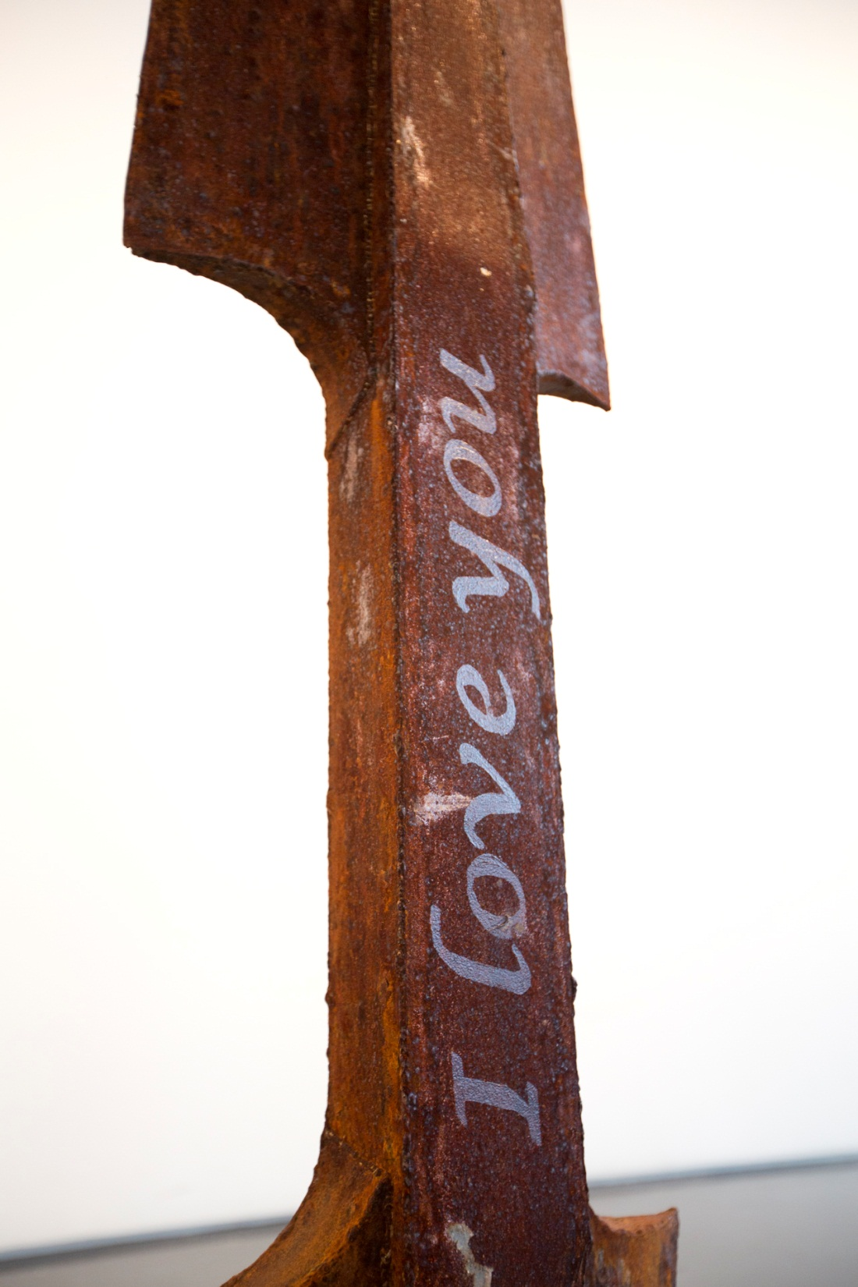
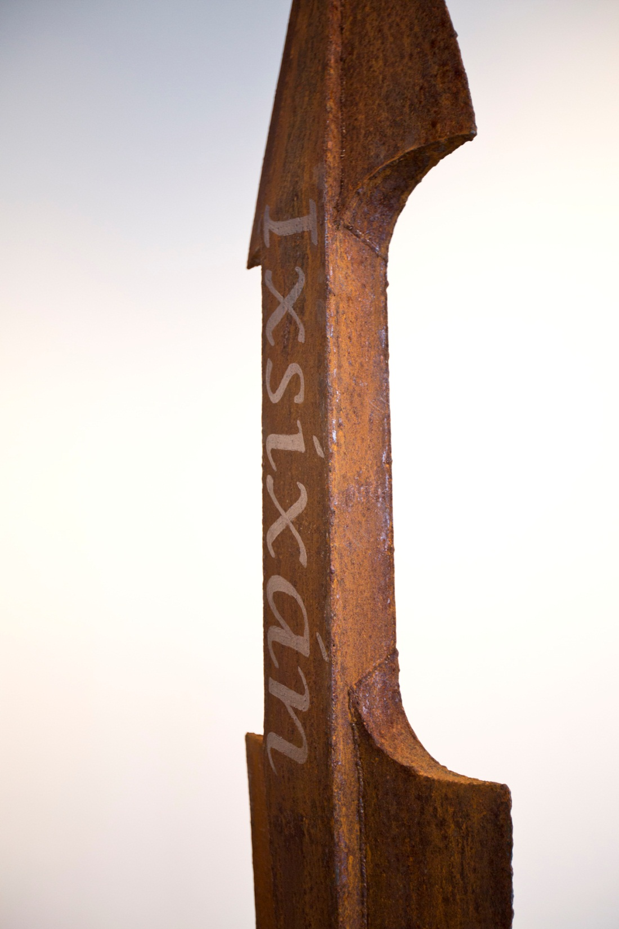

Slide 37
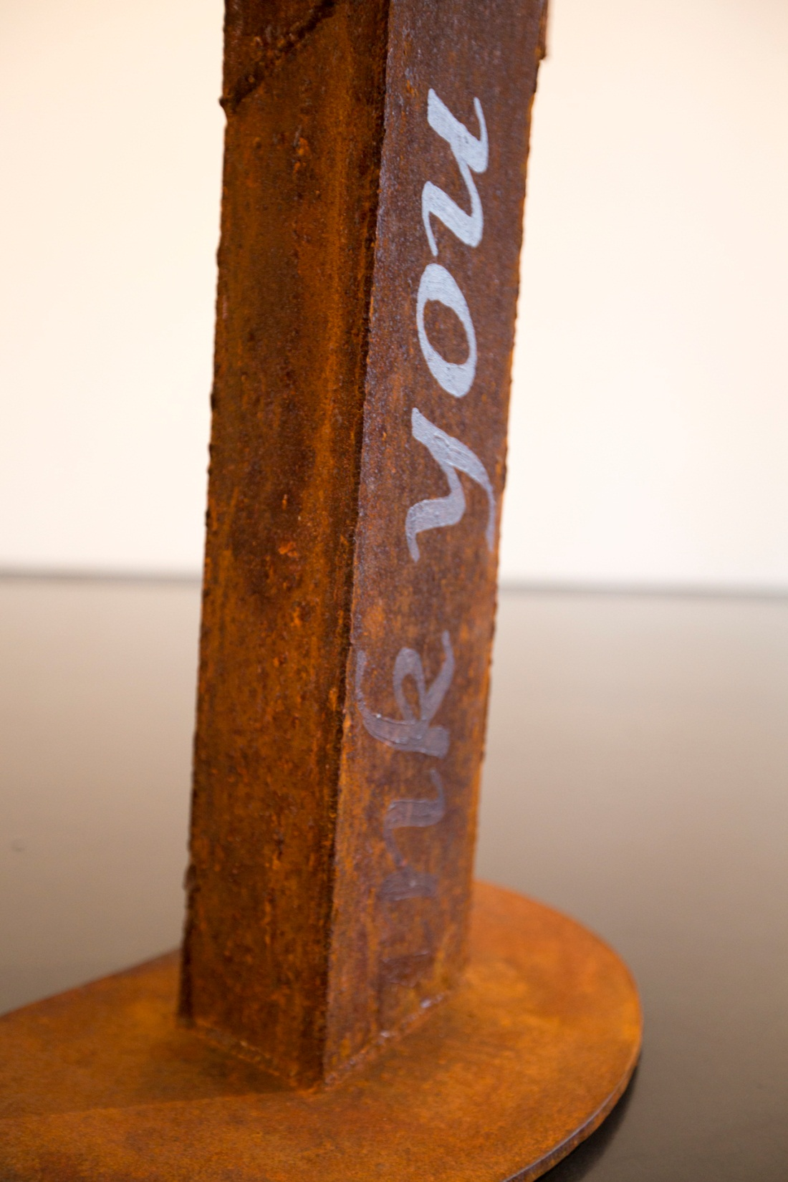
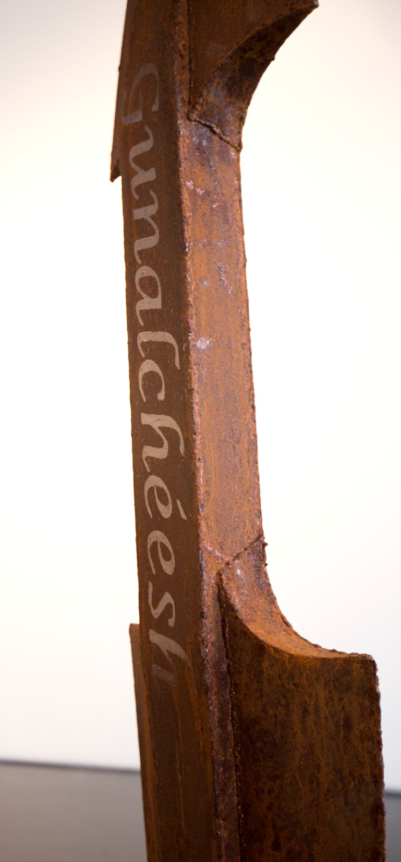

Slide 38
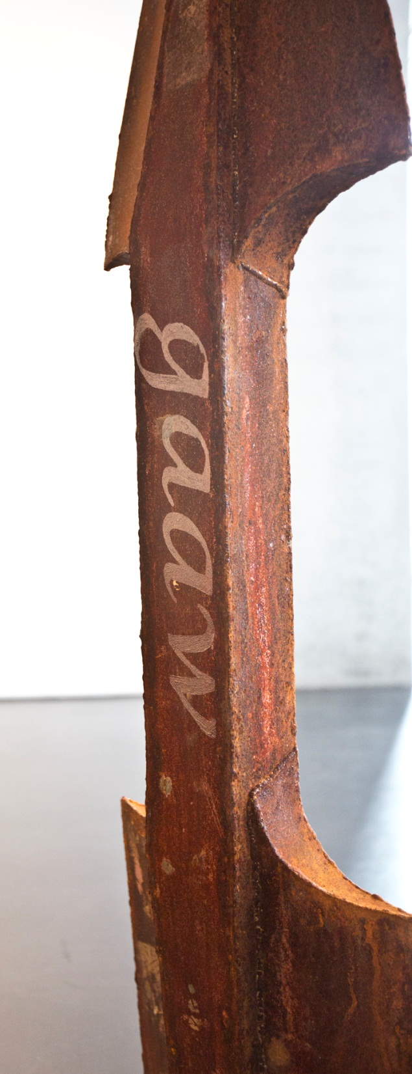
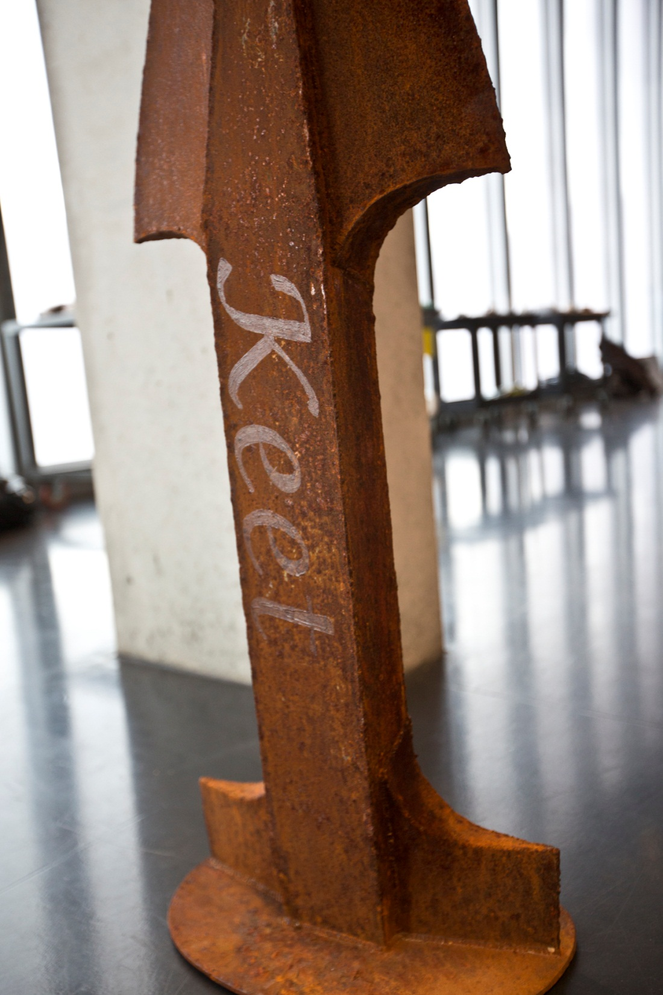

Slide 39
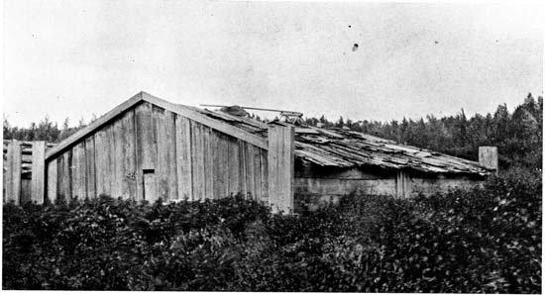
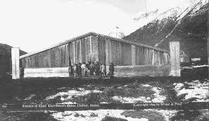

Slide 40
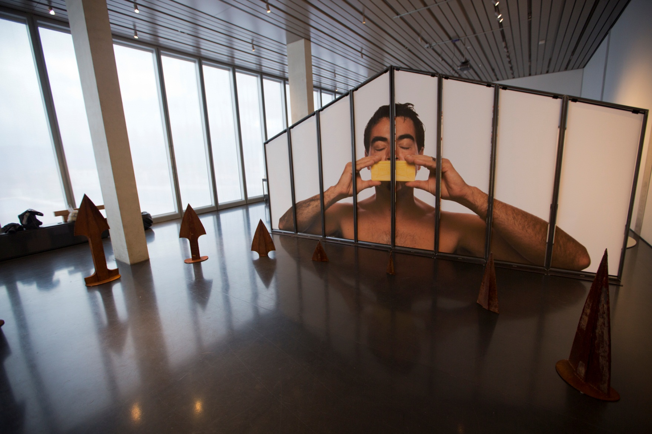

Slide 41
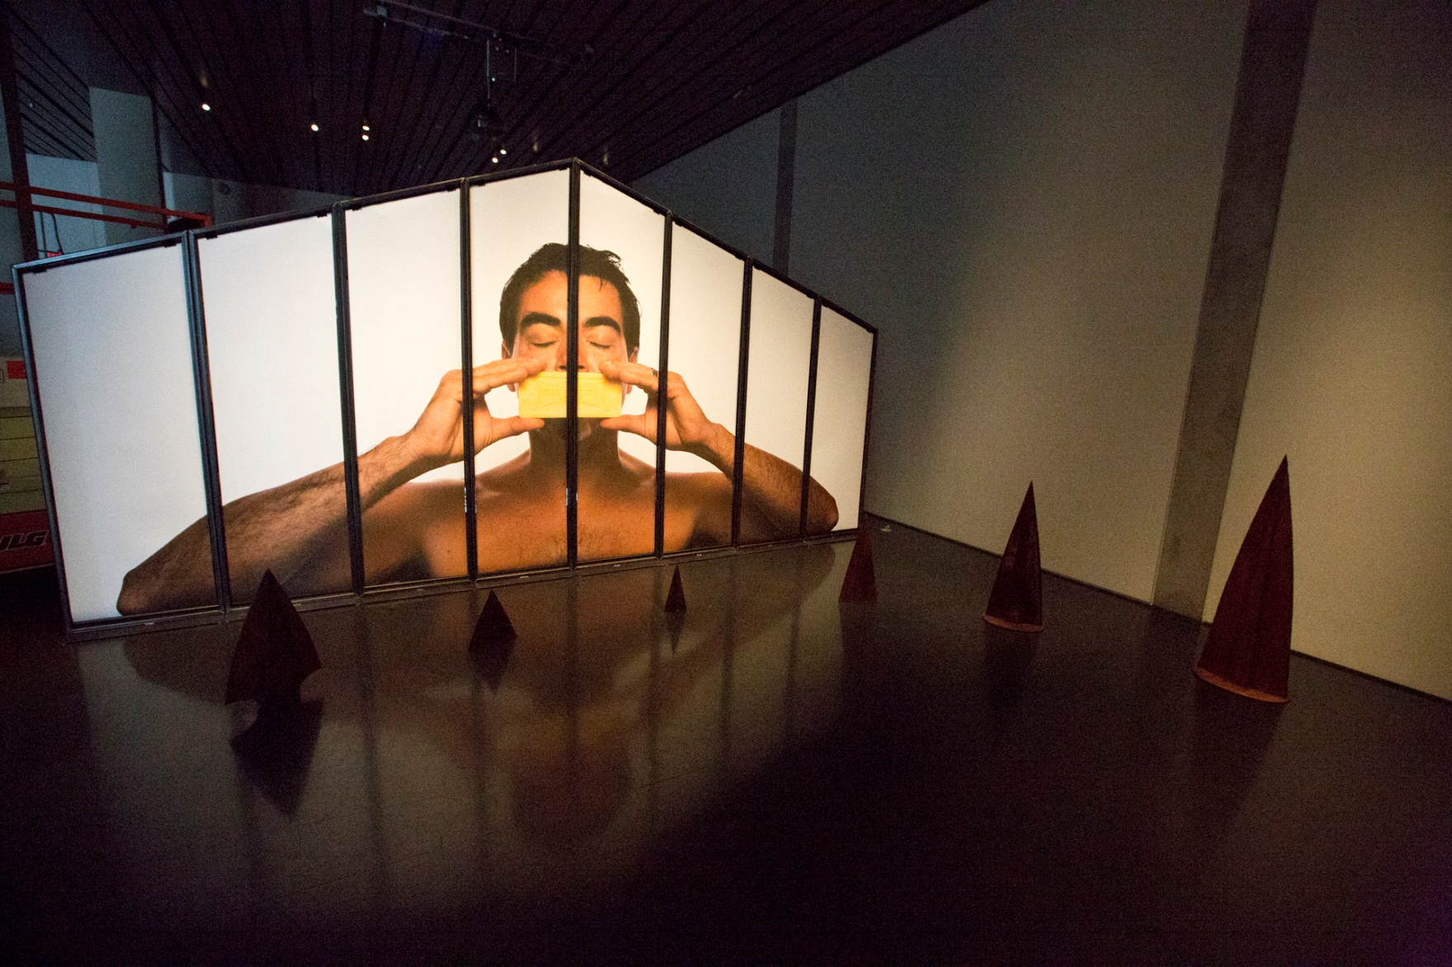

Slide 42
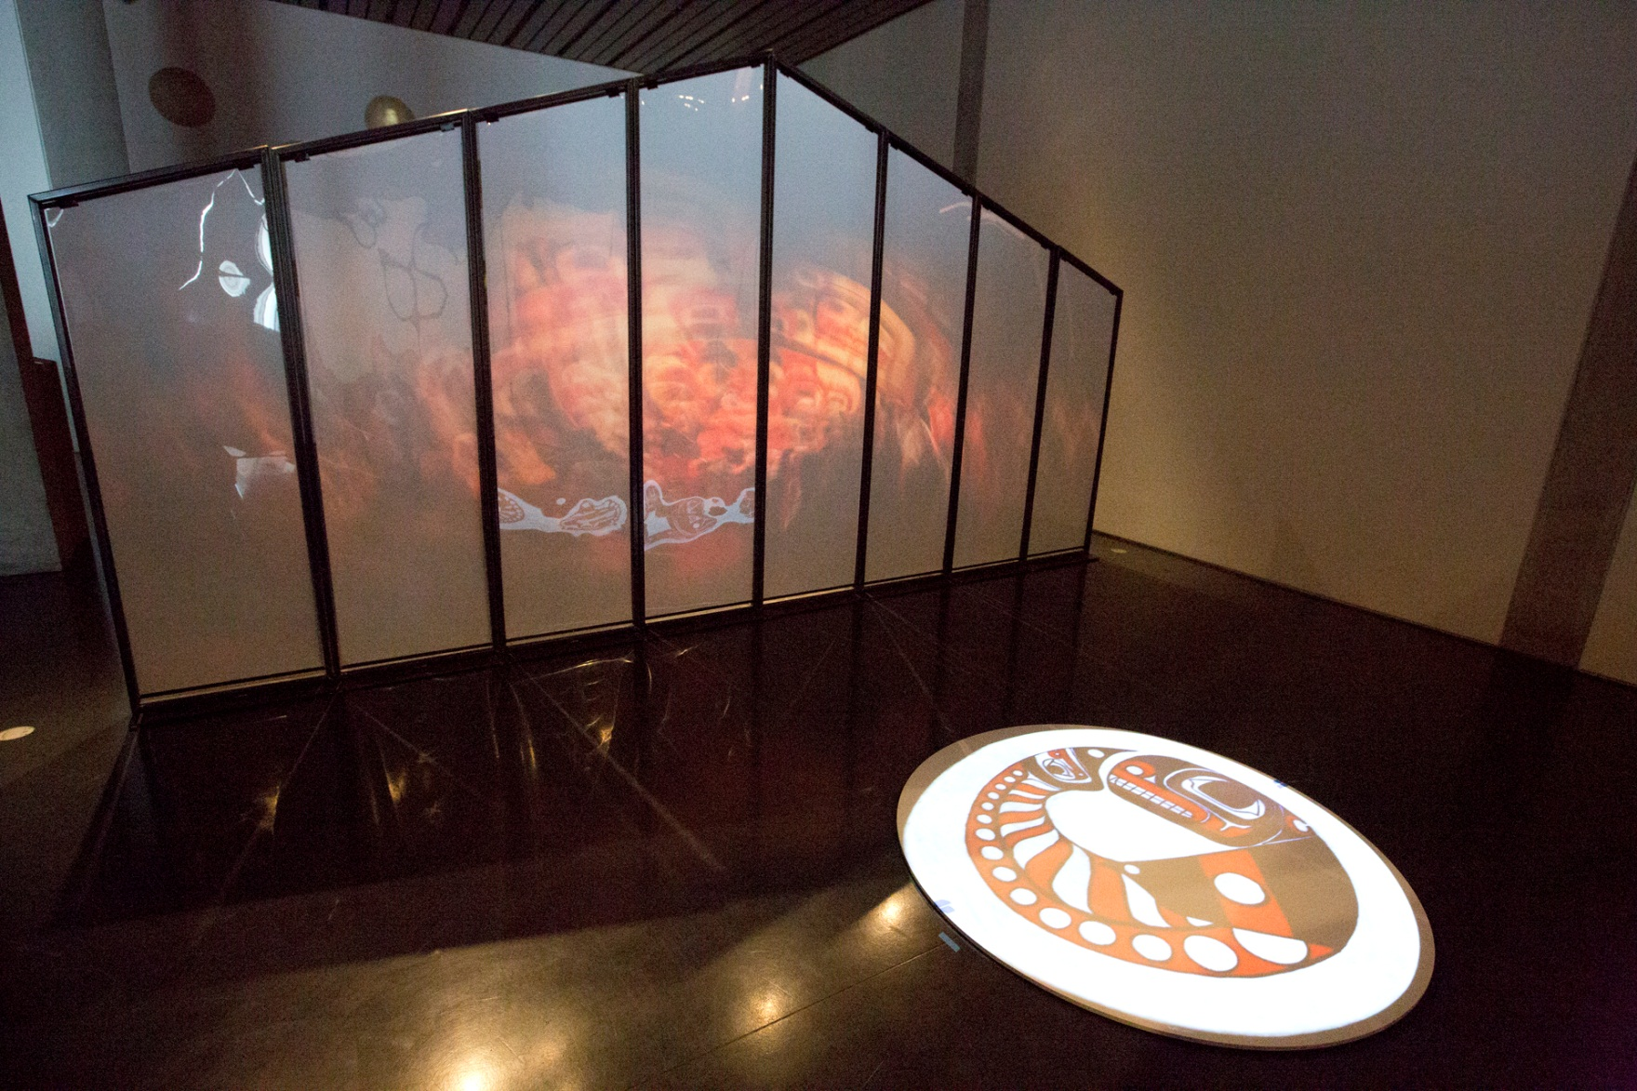

Slide 54
L.A. Craft and Folk Art Museum
May 2013
The Museum of Contemporary Native Arts
August 2014

Slide 55
Thank you

