Slide 1
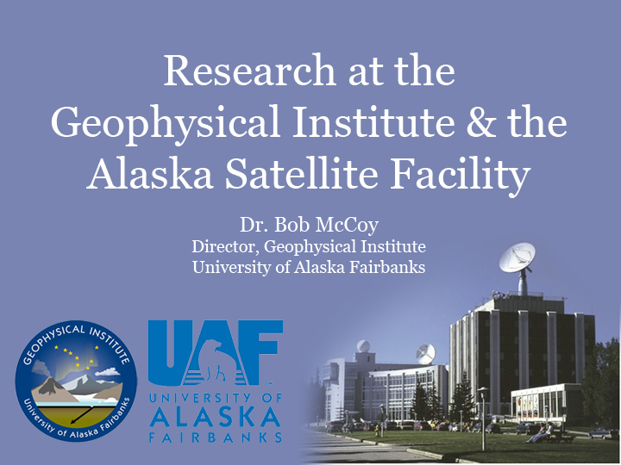

Slide 2
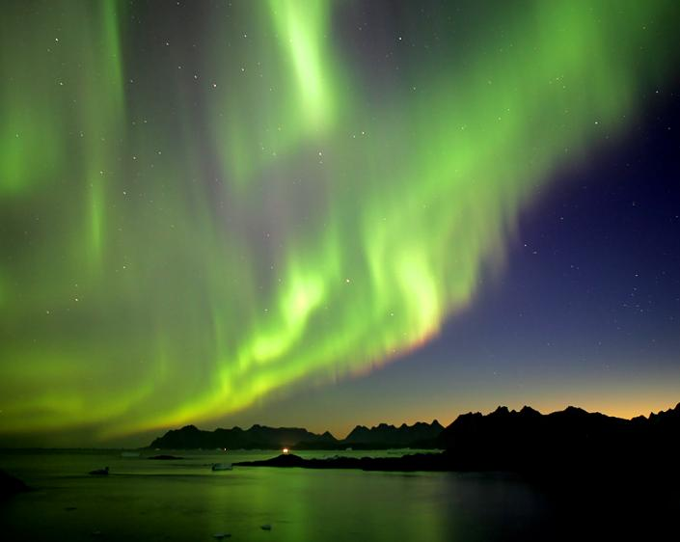
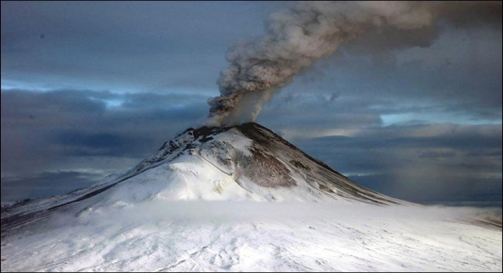
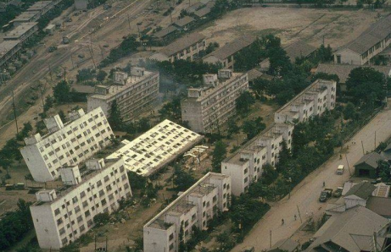
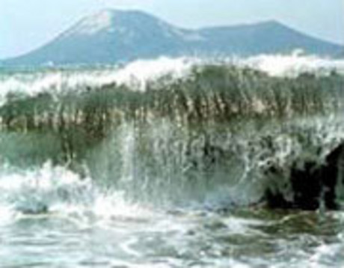
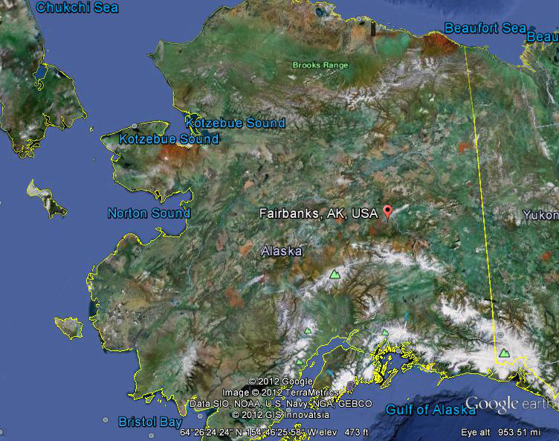
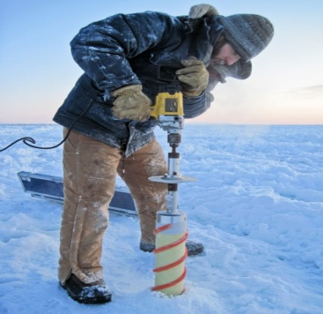
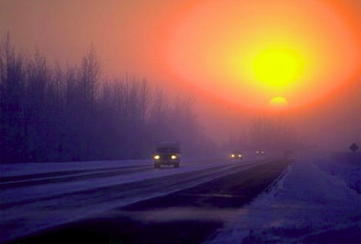
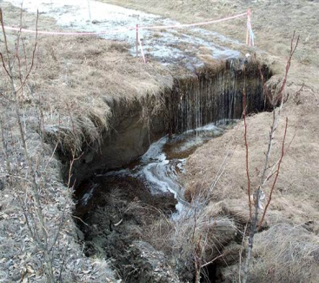
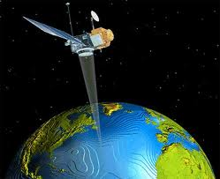
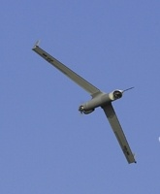
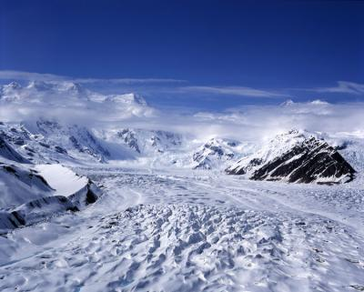
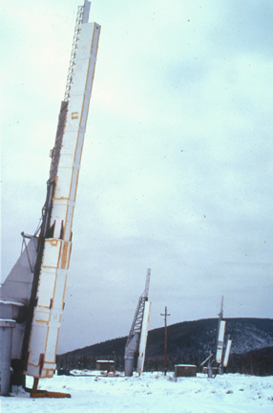
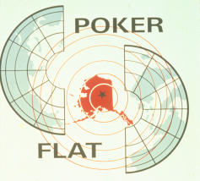
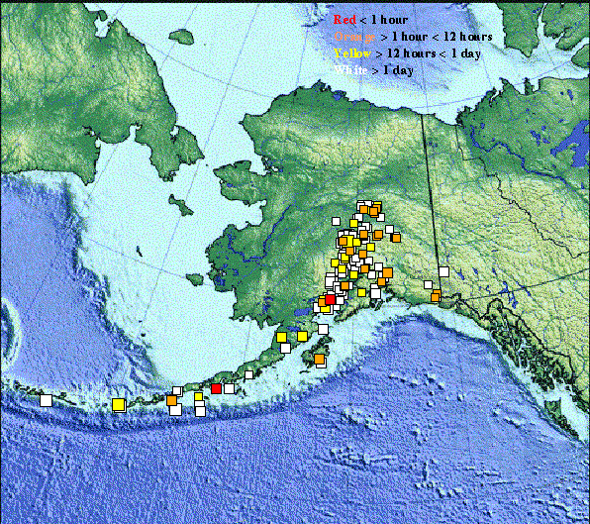
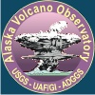
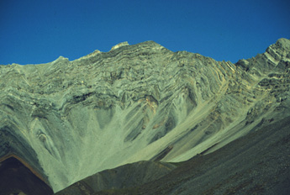
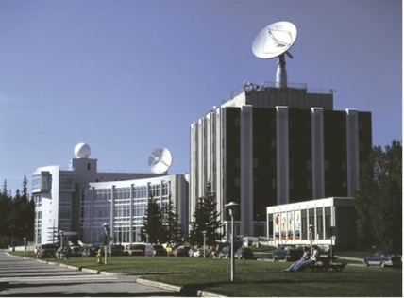
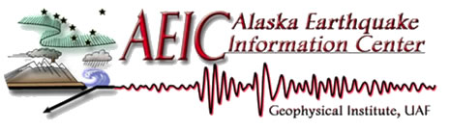

Volcanoes
Earthquakes
2 per year
25,000
Tsunamis
Naturally Inspiring
Space Physics
Study where science happens
Ice
&
Snow
Atmospheric
Science
Permafrost
Proposed:
ACUASI-RDE
Remote
Sensing
Alaska: An Exciting Natural Laboratory
Glaciers
100,000
Tectonics &
Sedimentation

Slide 3
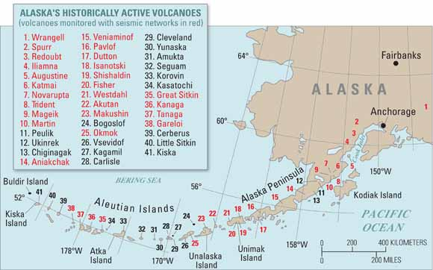
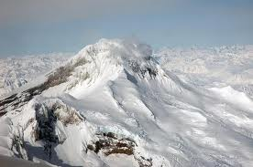
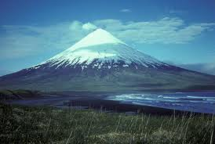
Iliamna
Cleveland

Slide 4
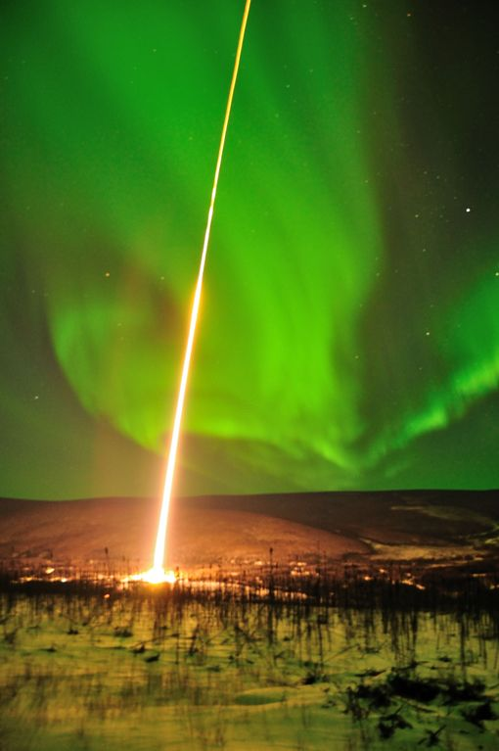
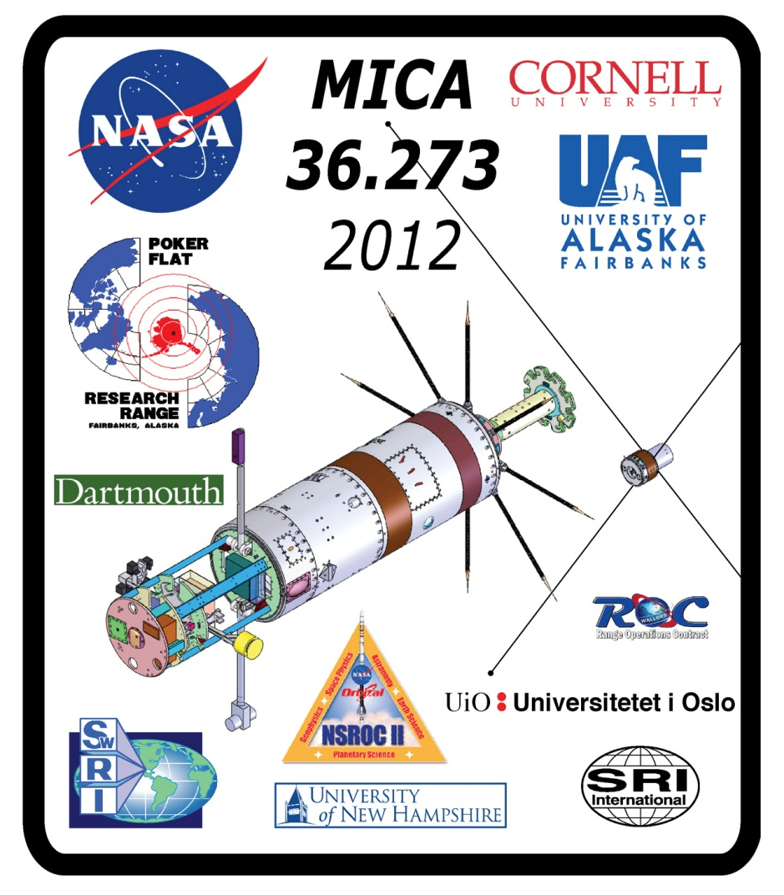
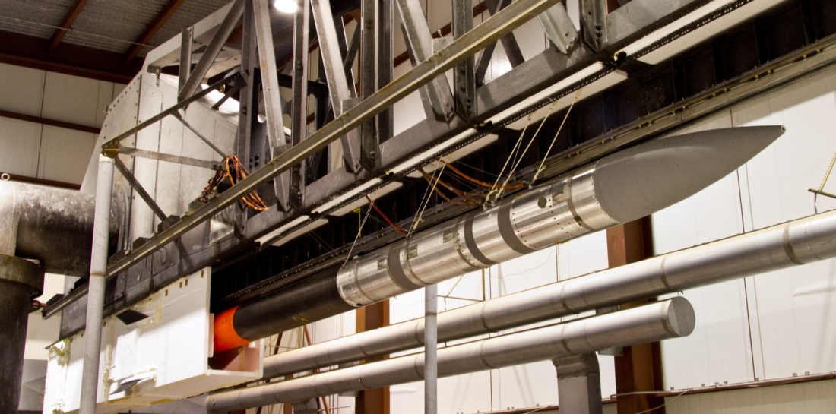

Slide 5
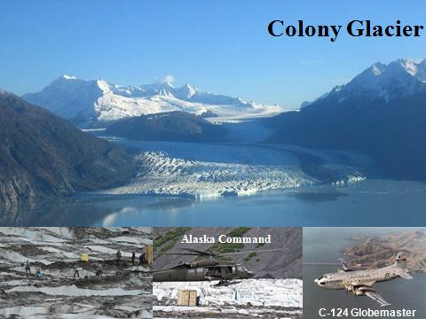
2011 - 2012 Impacts
Nome Fuel Crisis:
GI Sea Ice Researchers Support USCG with Sea Ice Samples & UAV Remote Sensing
Andy Mahoney
Greg Walker
GI Glacier Researchers Provide Actionable Information to Alaska Command on Speed of Glacier to Initiate Recovery of C-124
Dave Podrasky
Martin Truffer

Slide 6
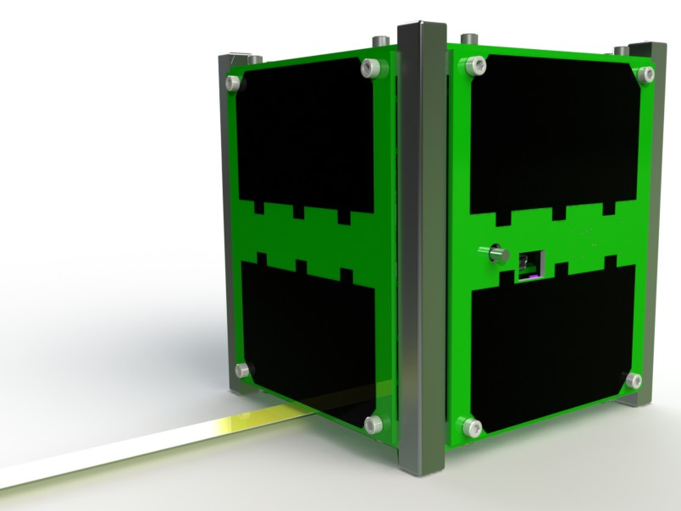

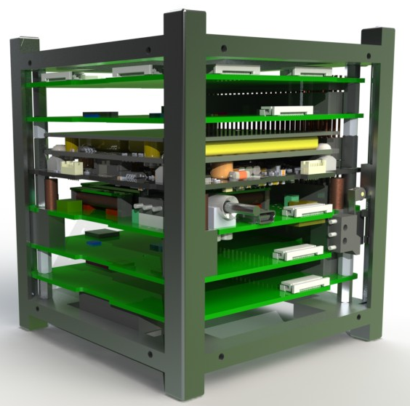
Alaska Space Grant Program
The Alaska Research Cubesat (ARC) satellite:
Imager (Changing snow/ice coverage in arctic)
Communications (High bandwidth image transfer)
Attitude Control & Determination Sys. (ACDS) (thermal/vibration from ignition to orbit)
Electronic Power System (EPS)
Command and Data Handling (CDH)
Launch Environment Data Logger (LEDL)
4” x 4” x 4”
Dr. Denise Thorsen
Additional Sponsors: Alaska Aerospace Corporation, NOAA Fox Facility & Arctic Armature Radio Club

Slide 7
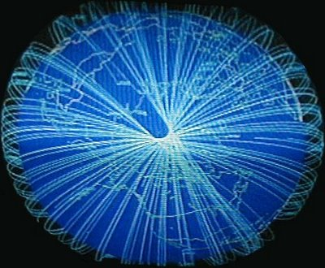
Alaska Satellite Facility –
Strategic Location for Polar Orbit Satellite Contact
Viewing Horizon
Polar Orbits
11/14 Orbits/day

Slide 8
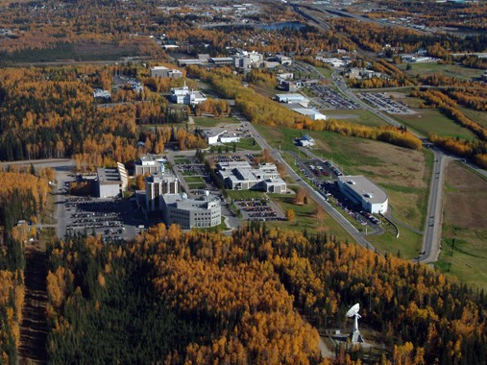

Alaska Satellite Facility
ALOS (Advanced Land Observing Satellite)
AIM (Aeronomy of Ice in the Mesosphere)
COSMIC (Constellation Observing System for Meteorology, Ionosphere & Climate)
ERS-1 & ERS-2 [decommissioned] (European Remote-Sensing Satellite-1/Satellite-2)
FAST
JERS-1 (Japanese Earth Resources Satellite-1)
NPP (NPOESS Preparatory Project)
QuikSCAT
RADARSAT-1
SAC-D
SAMPEX (Solar Anomalous and Magnetospheric Particle Explorer)
SCISAT-1
Dr. Nettie Labelle-Hamer, Scott Arko; Dr. Don Atwood

Slide 9
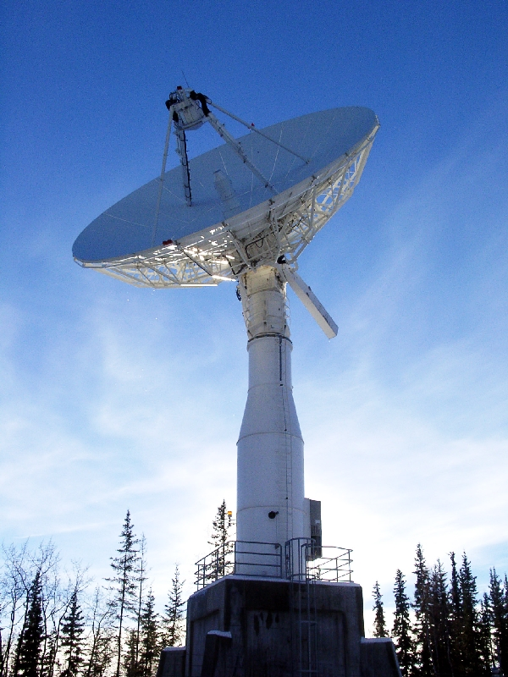
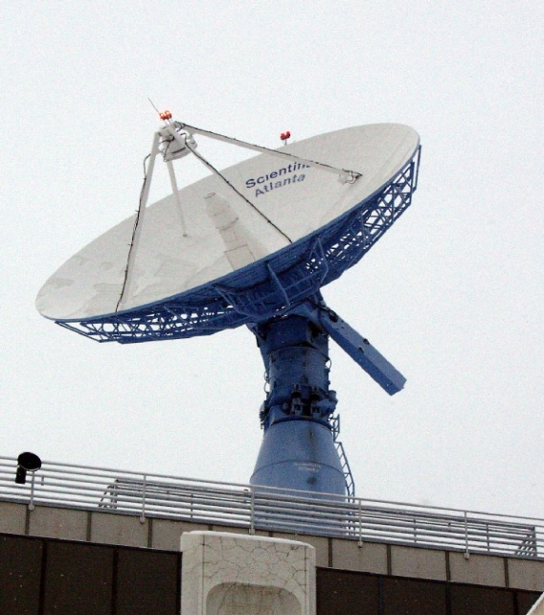
ASF Receiving Ground Station
11m Antenna
10-meter antenna
  operating since 1991
  X- band and S-band
  Receive only
11-meter antenna
  operating since 1995
  X- band and S-band
  Receive and command
10m Antenna
Operated by the Geophysical Institute at the University of Alaska Fairbanks since 1991

Slide 10

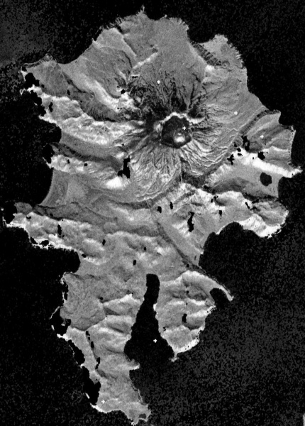
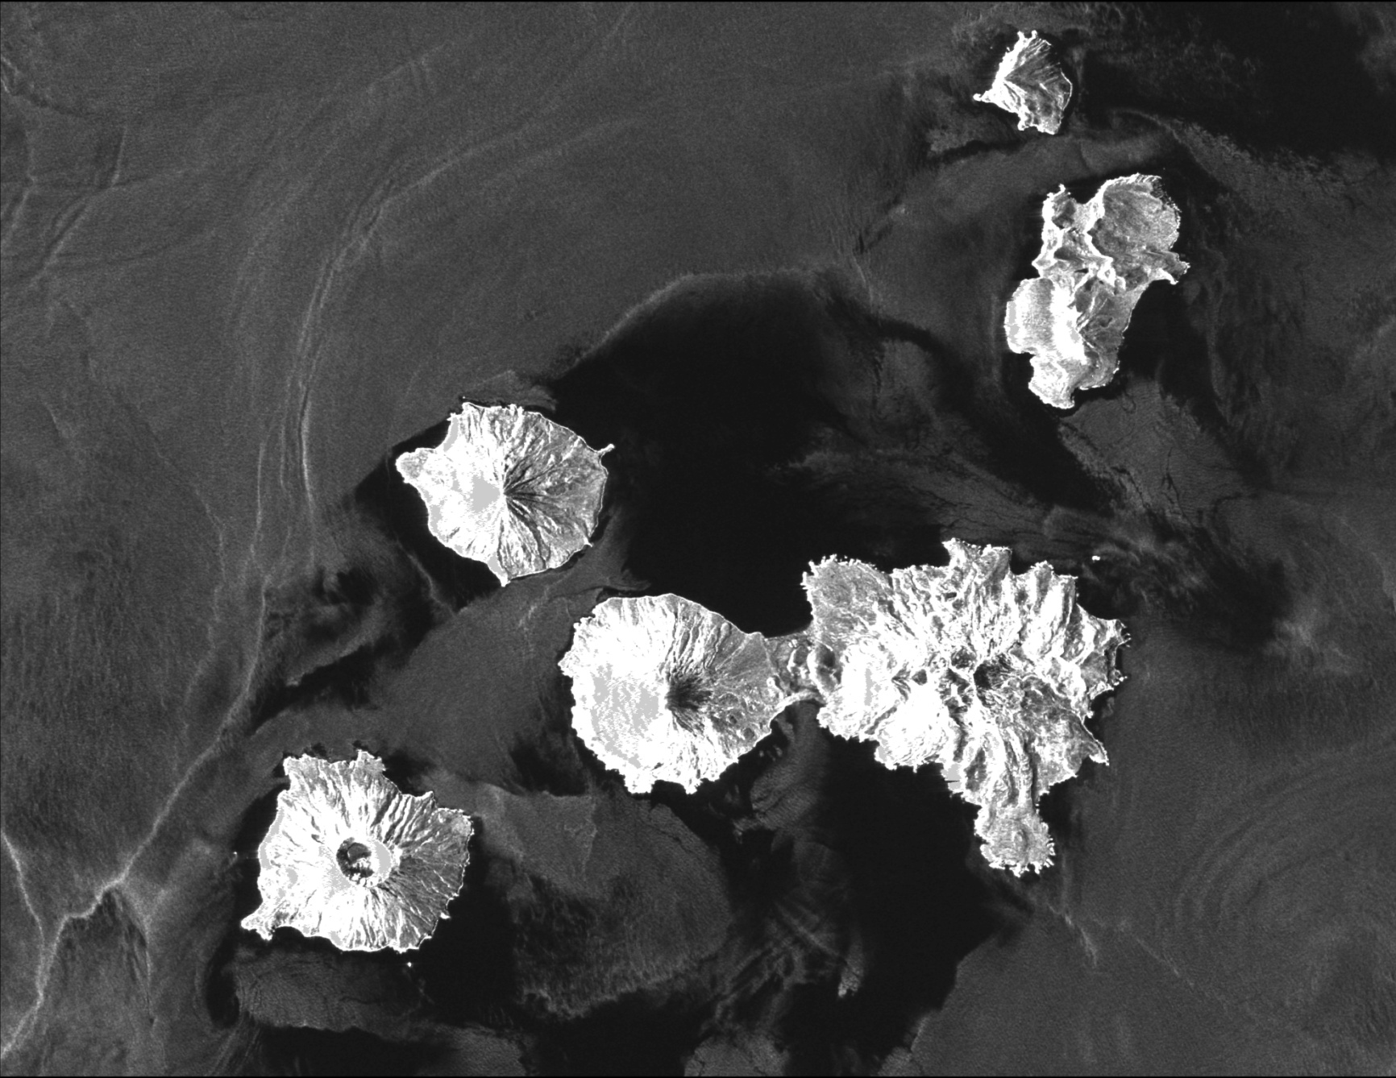
ASF Imagery
Akutan
Seeing through clouds
Synthetic Aperture Radar (SAR)
Cleveland Volcano

Slide 11
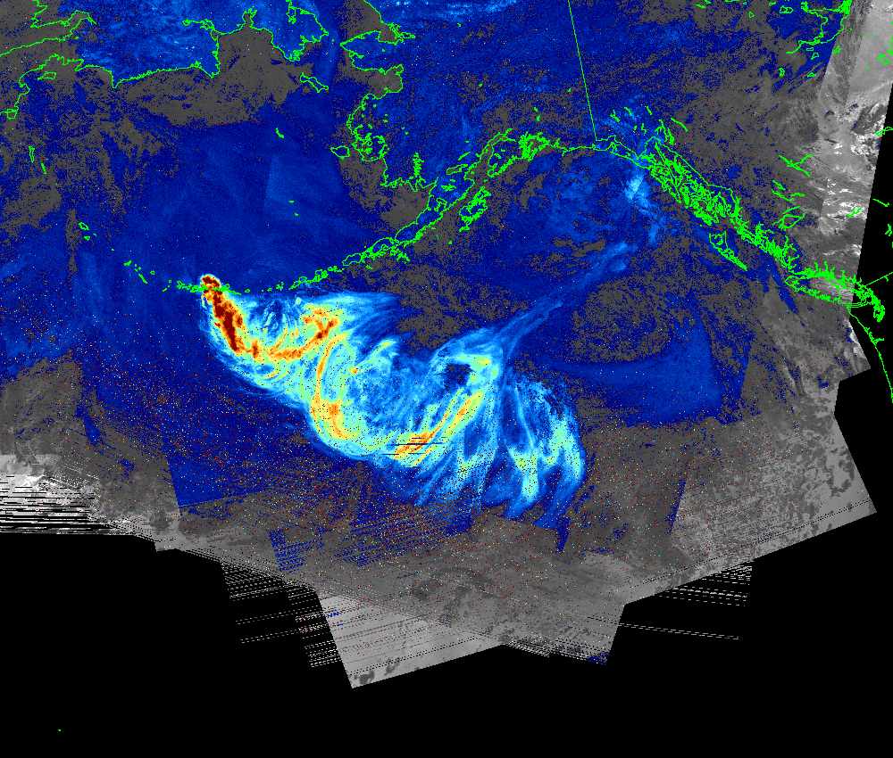
Ash Composites for Kasatochi Volcano

Slide 12
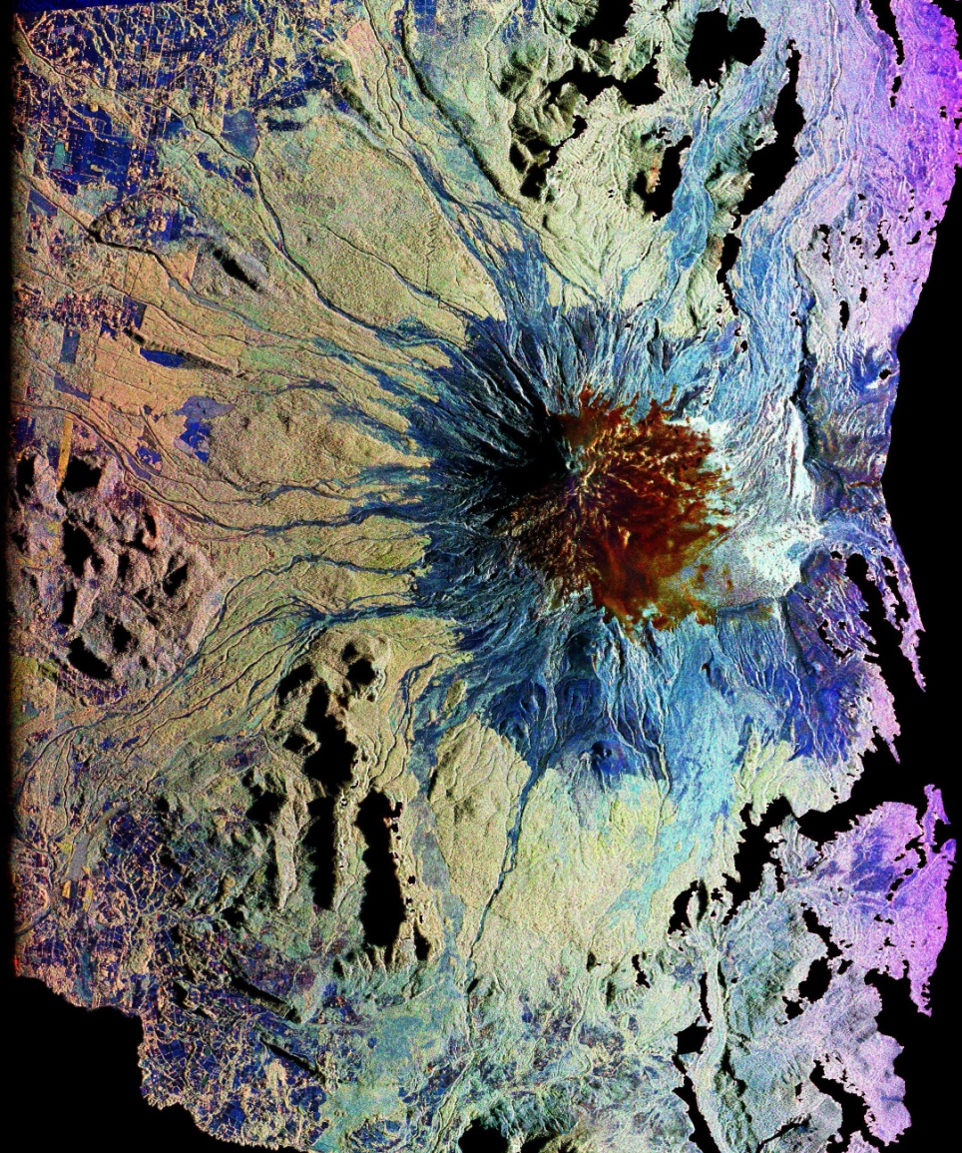
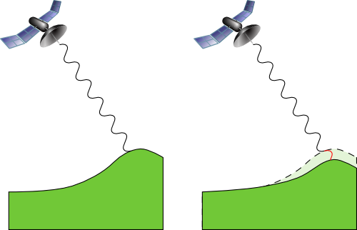
Interferometric Synthetic Aperture Radar (InSar)
ASF Imagery – AS_ts1862

Slide 13
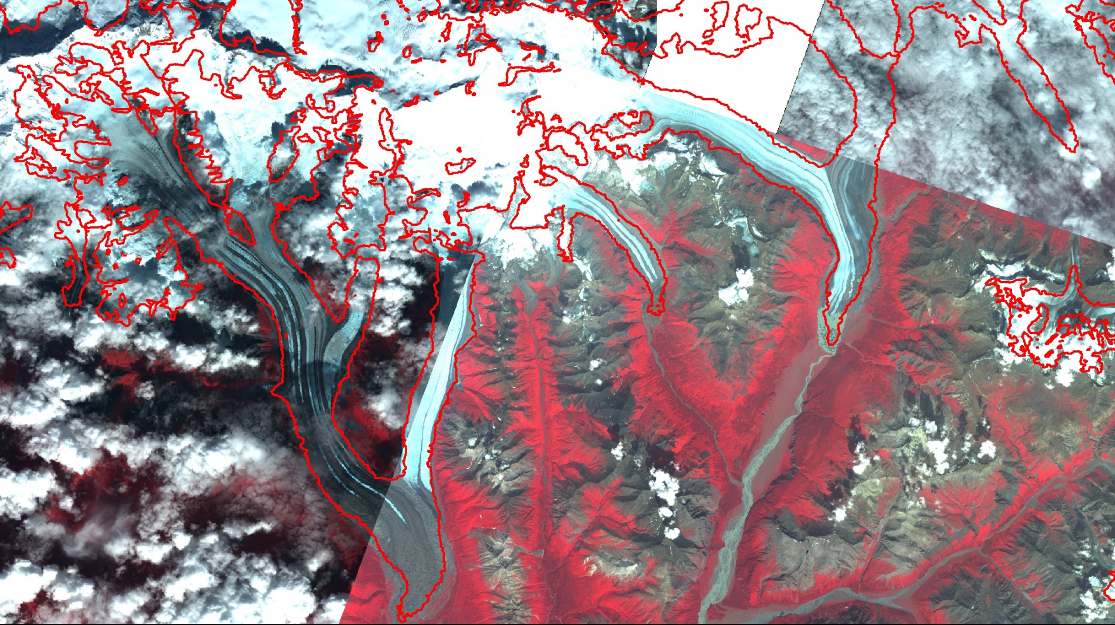
SAR Glacier Studies
InSAR used to delineate glaciers
Notes:
13

Slide 14
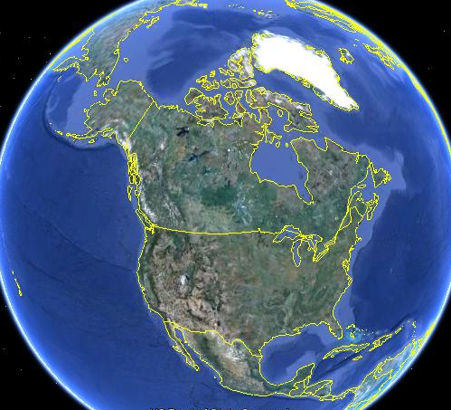

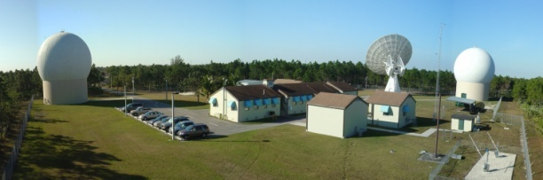
ASF
CSTARS

Slide 15
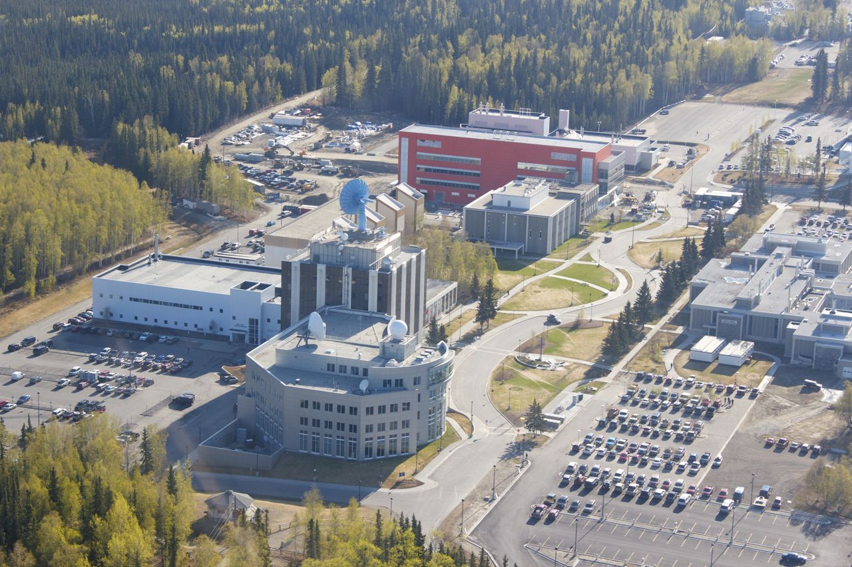
Thank you, Questions?
Steve Estes 5/16/2012

